Slide 1
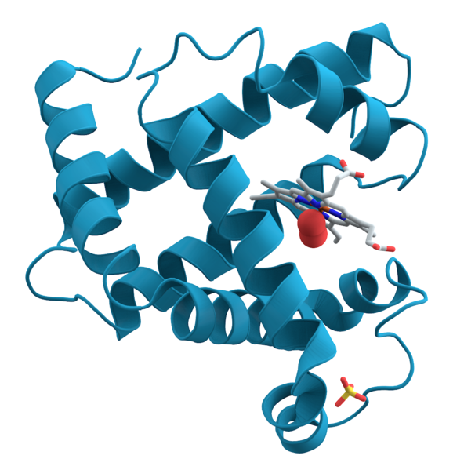
Genetics: RNA and Protein Synthesis

Slide 2
Review
Protein synthesis or creation is important for cellular function.
Proteins are made of amino acids and our DNA provides the instructions for assembling amino acids in the proper order
The nucleus holds the key for protein synthesis.

Slide 3
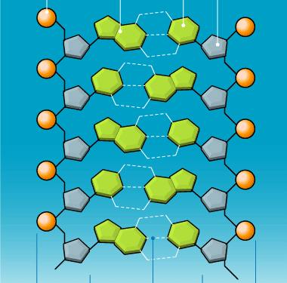
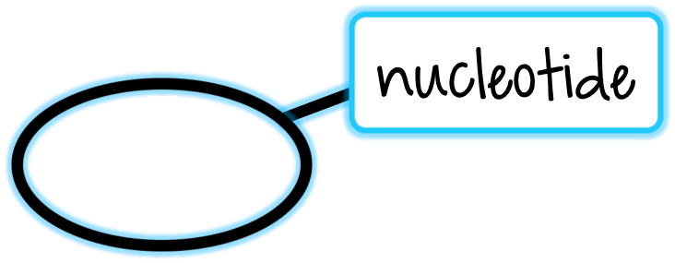
Ribonucleic Acid (RNA)
Like DNA, RNA is a long molecule made up of smaller units called nucleotides
Notes:
Pictured: DNA molecule showing nucleotide monomers

Slide 4
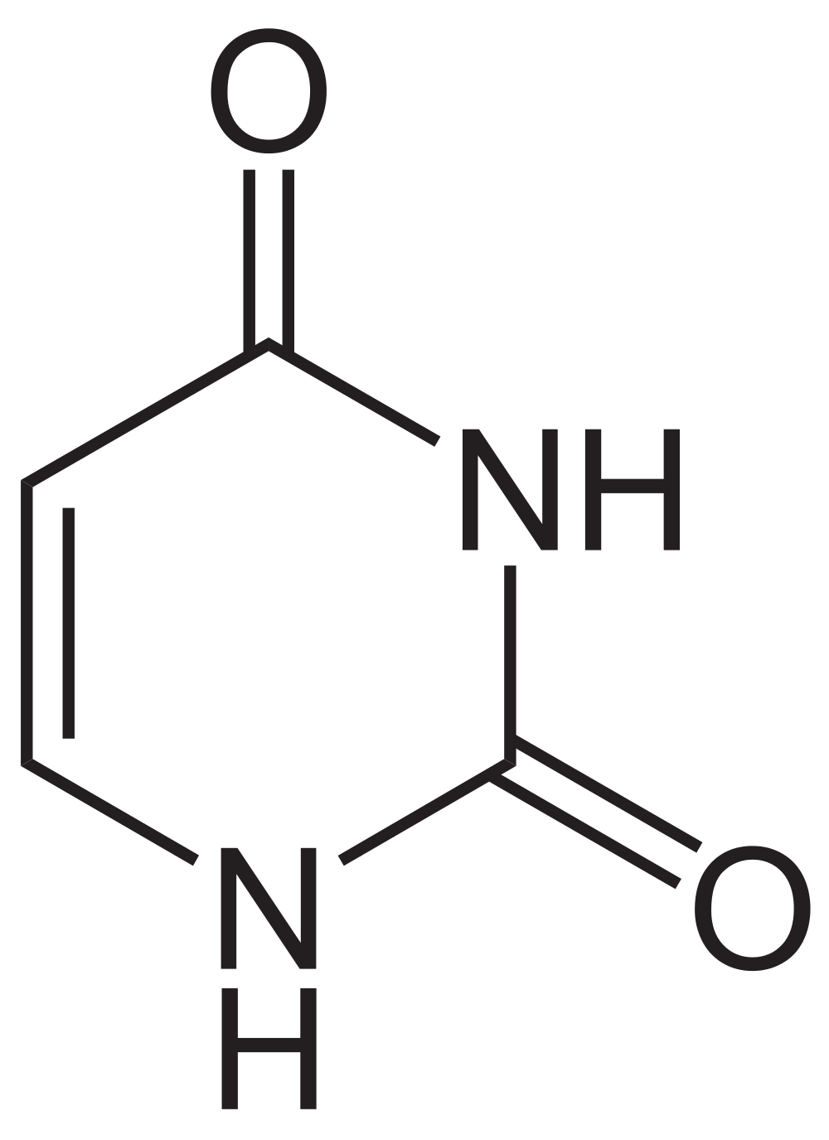
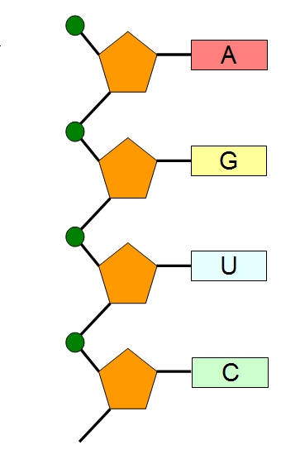
Ribonucleic Acid (RNA)
There are three main differences between RNA and DNA:
The 5-carbon sugar in RNA is ribose
RNA is generally single-stranded
RNA contains uracil in place of thymine
Notes:
Pictured: uracil nitrogenous base, single-strand RNA, ribose sugar

Slide 5
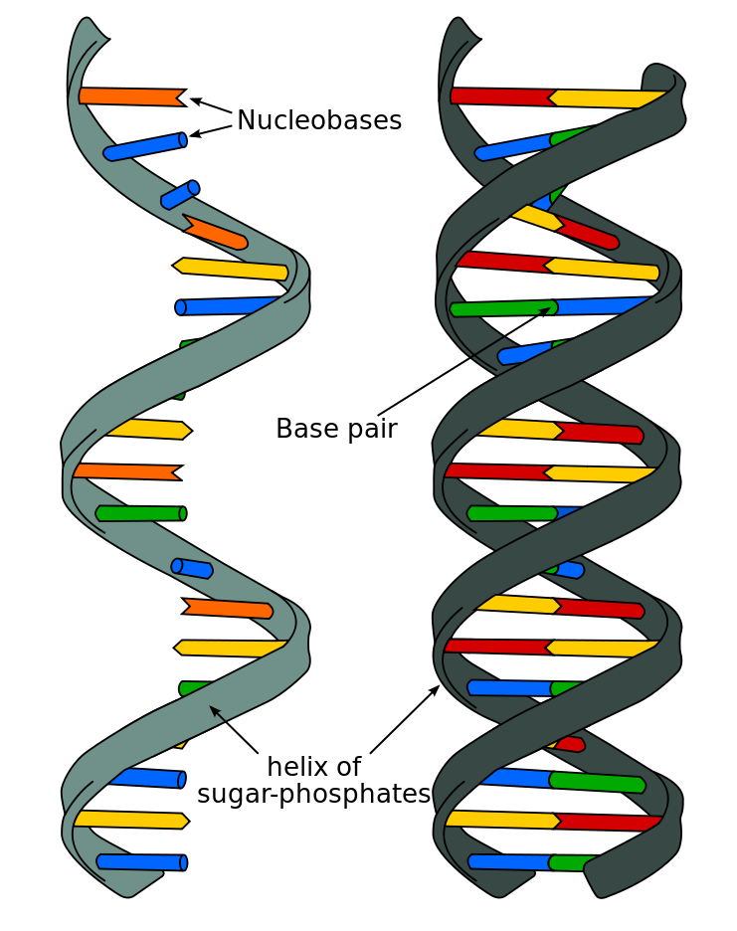
Ribonucleic Acid (RNA)
Notes:
Pictured: comparison of DNA and RNA molecules

Slide 6
mRNA
In the cell’s nucleus, DNA is used as a template and copied to create messenger RNA (mRNA) during a process called transcription
mRNA is made of ribose instead of deoxyribose, is a single strand, and the nucleotide base Thymine is replaced with Uracil.

Slide 7
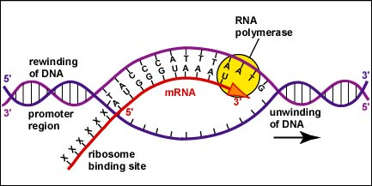
Types of RNA
Messenger RNA (mRNA)- RNA molecules that carry copies of instructions for assembling amino acids into proteins
Notes:
Pictured: mRNA strand (in red) being made from a DNA template strand

Slide 8
rRNA
Ribosomal RNA or rRNA is made up of a group of proteins which form ribosomes.
During translation, the ribosome reads three mRNA nucleotides at a time with each nucleotide triplet (codon) calling for a specific amino acid.

Slide 9
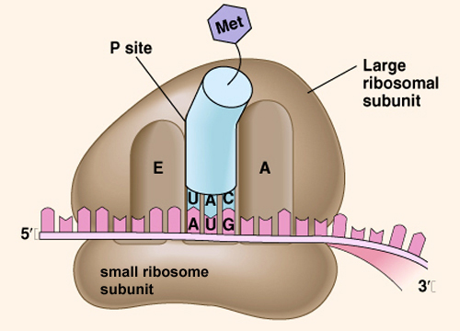
Types of RNA
Ribosomal RNA (rRNA)- RNA on ribosomes where amino acids are assembled into proteins
Notes:
Pictured: ribosome with small and large subunits

Slide 10
tRNA
That’s where Transfer RNA or tRNA comes in. As the ribosome reads the nucleotide triplet (codon) of mRNA, a specific tRNA molecule matches up with the sequence and carries with it a specific amino acid.
The amino acid then binds to the growing amino acid (polypeptide) chain until the mRNA message comes to a stop and a protein is created.

Slide 11
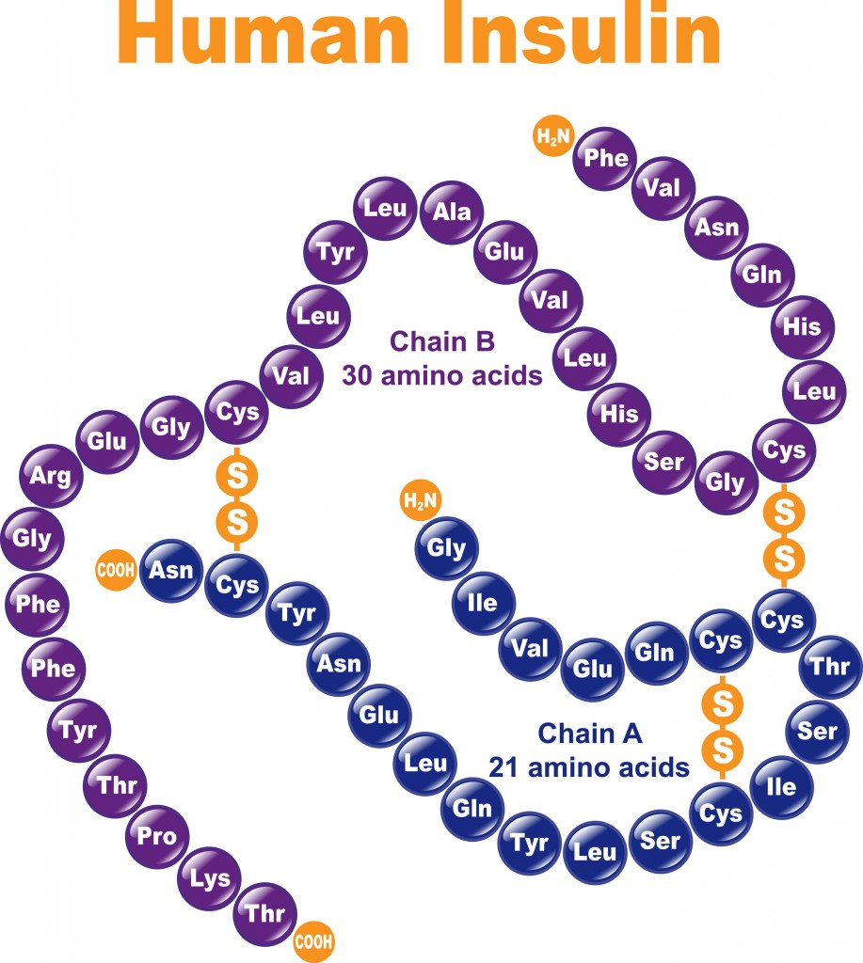
Amino Acids, Polypeptides, and Proteins
A polypeptide is a chain of amino acids
One or more polypeptides make up a protein

Slide 12
Types of RNA
Transfer RNA (tRNA)- RNA molecules that transfer each amino acid to the ribosome for protein assembly
Notes:
Pictured: a two-dimensional and three-dimensional diagram of tRNA structure

Slide 13
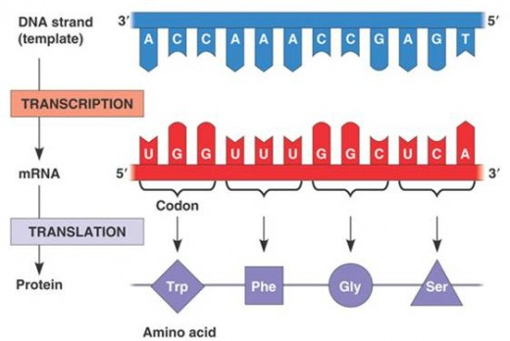
From DNA to Protein
Proteins are synthesized (made) through a two-step process:
Transcription → DNA is transcribed into
mRNA
DNA
mRNA

Slide 14
From DNA to Protein
Translation → mRNA is decoded to make
proteins
mRNA
amino acids

Slide 15
Protein Synthesis Summary
DNA → RNA → Protein
Transcription Translation
(nucleus) (cytoplasm)
Notes:
Transcription takes place in the nucleus. Translation takes place in the cytoplasm at ribosomes.

Slide 16
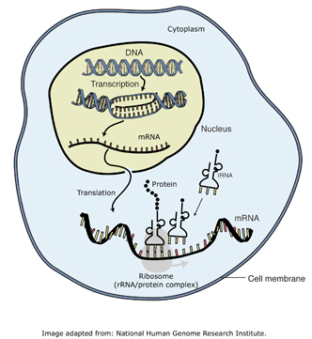
Protein Synthesis Summary
1
2
3
DNA → RNA → Protein
1
2
3
Notes:
Diagram labeling DNA, RNA, and Protein. DNA is transcribed into mRNA in the nucleus. mRNA is decoded and amino acids are assembled in the cytoplasm at the ribosomes.

Slide 17
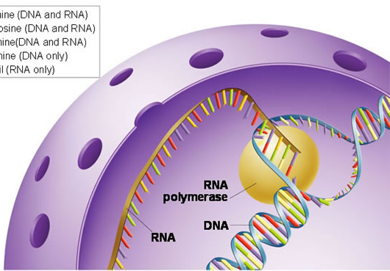
Transcription
DNA → RNA
DNA is transcribed into mRNA
Transcription occurs in the nucleus
Notes:
Pictured: mRNA strand being made from a DNA template strand in the nucleus.

Slide 18
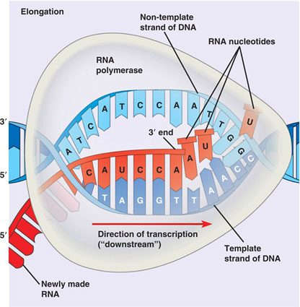
Transcription
DNA → RNA
Process is similar to DNA replication
Uracil replaces thymine:
adenine-uracil base pairing
Notes:
Pictured: mRNA strand being made from a DNA template strand.

Slide 19
Transcription
Transcribe the following DNA sequence into mRNA:
T A G

Slide 20
Transcription
Transcribe the following DNA sequence into mRNA:
T A G
A U C
Remember: uracil replaces thymine in mRNA

Slide 21
Transcription
DNA strands are separated by RNA polymerase
RNA polymerase uses one strand of DNA as a template to assemble nucleotides into a strand of mRNA

Slide 22
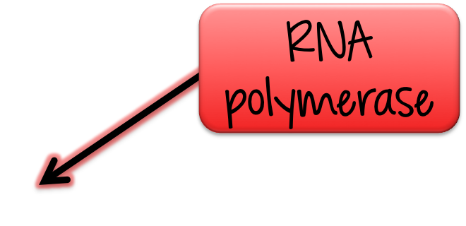
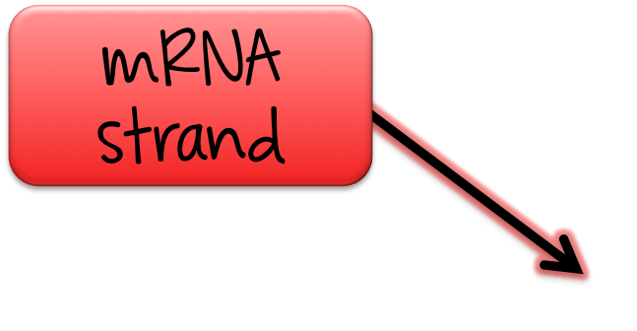
Transcription

Slide 23
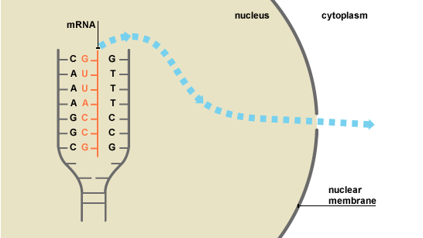
Transcription
RNA edits the molecule
The mRNA strand is released into the cytoplasm
Notes:
Pictured: mRNA being released into the cytoplasm

Slide 24
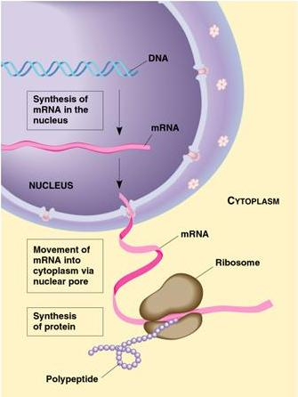
Translation
RNA → Protein
mRNA is decoded to produce proteins
Translation occurs in the cytoplasm
Notes:
After transcription, mRNA leaves the nucleus and goes to a ribosome in the cytoplasm for translation (to be decoded).

Slide 25
Translation
mRNA strand attaches to a ribosome in the cytoplasm

Slide 26
Translation
mRNA is read three base letters at a time- called a codon

Slide 27
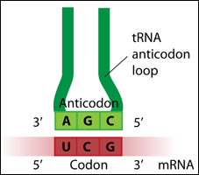
Translation
tRNA brings a complementary amino acid and pairs its anticodon with the mRNA codon

Slide 28
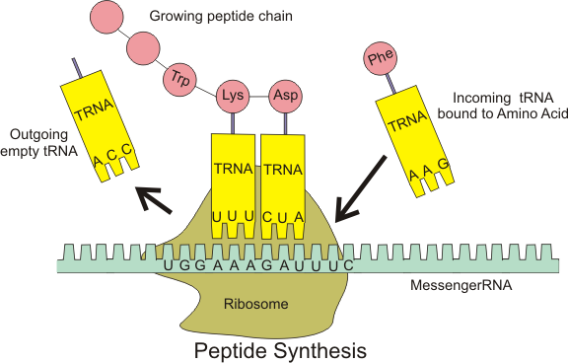
Translation
The ribosome forms a peptide bond between amino acids and releases the tRNA molecule
1
2
1
2

Slide 29
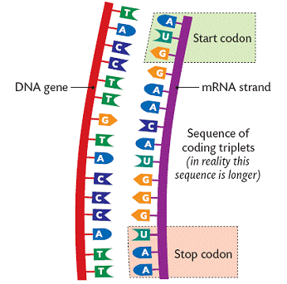
Translation
The polypeptide chain continues to grow until the ribosome reaches a “stop” codon in which the chain and mRNA are released

Slide 30
The Genetic Code
The “language” that cells use to make proteins from a DNA sequence

Slide 31
The Genetic Code
DNA is transcribed into mRNA
mRNA is read 3 base letters at a time
One mRNA codon codes for one specific amino acid
There are 20 different amino acids
Use an mRNA codon table to find the amino acid coded for by the codon

Slide 32
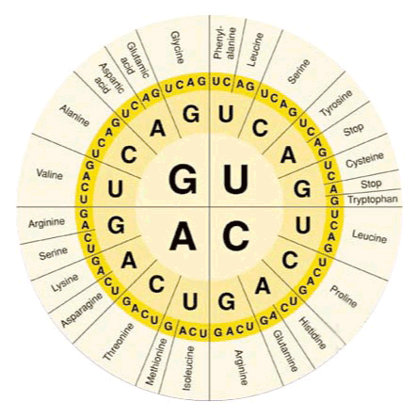
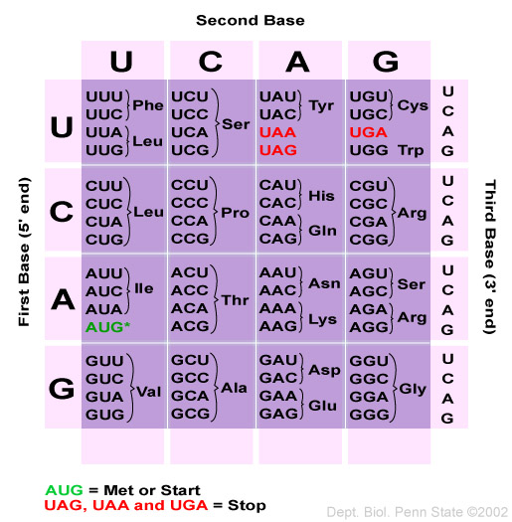
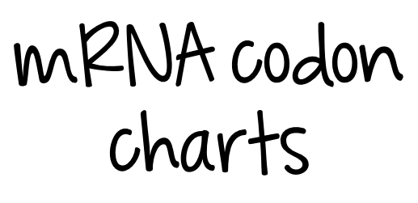
The Genetic Code
Notes:
Pictured: mRNA codon charts

Slide 33
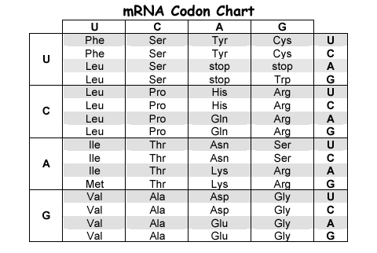
The Genetic Code
Find the amino acid coded for by the codon GCA
Notes:
Pictured: mRNA codon charts

Slide 34
Codon: GCA
C (second base)
G
(first
base)
A
(third
base)
Find the bases on the 1st, 2nd, and 3rd columns
Notes:
Pictured: mRNA codon charts

Slide 35
Codon: GCA
C (second base)
G
(first
base)
A
(third
base)
Find where the three points meet
Notes:
Pictured: mRNA codon charts

Slide 36
Codon: GCA
C (second base)
G
(first
base)
A
(third
base)
GCA codes for the amino acid Alanine
Notes:
Pictured: mRNA codon charts

Slide 37
From DNA to Protein
Transcribe and translate mRNA from a DNA sequence to an amino acid
From DNA to Protein
DNA | TAC | AAG | TTT
mRNA
tRNA
Amino Acid

Slide 38
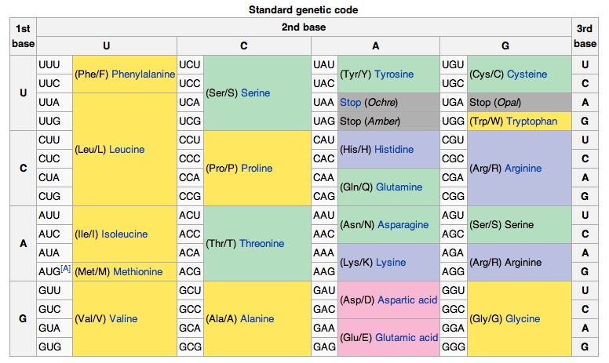
mRNA Codon Table
Notes:
Pictured: mRNA codon chart

Slide 39
From DNA to Protein
Transcribe and translate mRNA from a DNA sequence to an amino acid
From DNA to Protein
DNA | TAC | AAG | TTT
mRNA | AUG | UUC | AAA
tRNA | UAC | AAG | UUU
Amino Acid | Methionine (start) | Phenylalanine | Lysine

