Slide 1
Warming Waters: Impact of Global Temperature Rise on Exotic Species Distribution
Natalie Bentley, Christina Li, Madori Spiker and Christopher Peterson
Cluster 3: Living Oceans and Global Climate Change
Notes:
Abstract/Overview before starting presentation
Cite any pictures

Slide 2
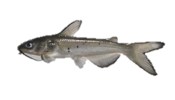
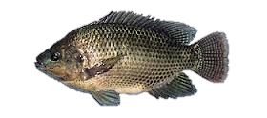
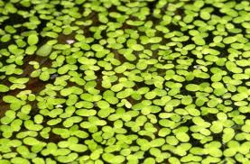
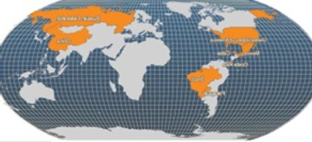
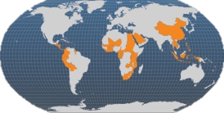
Introduction: What are the impacts of rising global temperatures?
Hypothesis: Water temperature increase will not have an effect on catfish and tilapia respiration rates or on duckweed mortality rates.
Catfish
Tilapia
Duckweed
http://gardenpool.org/gardening-tips/growing-duckweed
http://lemur.amu.edu.pl/share/php/mirnest/browse.php?databases_selected=mirnest&species=Oreochromis_niloticus

Slide 3
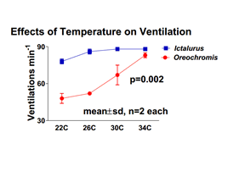
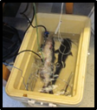
Catfish and Tilapia
Catfish and Tilapia Procedures: Respiration Rate
21-35°C Catfish
22-34°C Tilapia
Notes:
Chris

Slide 4
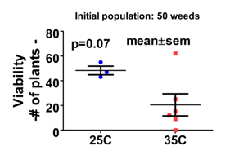
Duckweed
Duckweed Procedure
Control Group
25°C and 3 dishes
Experimental Group
35°C and 6 dishes
Notes:
Madori

Slide 5
Discussion/Conclusion
Temperature Fluctuations
Metabolism rate and consumption will increase, of tropical tilapia rather than of catfish
Native vs. exotic species competition
Global climate change conducive to extending range of exotic fish.
Marine tropical lionfish, Asian carps, Snakeheads in the United States
Notes:
.ddm

Slide 6
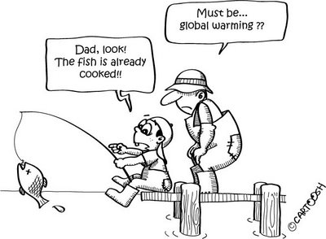
Works Cited
http://tolweb.org/Ictalurus_punctatus
http://aquafind.com/info/TilapiaLinks.php
http://www.fao.org/fishery/culturedspecies/Ictalurus_punctatus/en
http://efotg.sc.egov.usda.gov/references/public/WY/Bio_No_303.pdf
http://www.microponics.net.au/?p=181
http://www.news.com.au/features/environment/queensland-fish-species-migrating-south-due-to-climate-change/story-e6frflp0-1225907524941
http://aqua.ucdavis.edu/DatabaseRoot/pdf/282FS.PDF
http://www.fao.org/fishery/culturedspecies/Oreochromis_niloticus/enhttp://www.dpi.nsw.gov.au/fisheries/pests-diseases/freshwater-pests/species/tilapia
http://4.bp.blogspot.com/_rPDimn5dnfE/SW2PgvvCwxI/AAAAAAAAEHQ/SrysSWr3MrM/s400/fishing.jpg

