Slide 1
Free Water Surface Wetlands
Patrick Brice
12/04/2012

Slide 2
Types of Free Water Surface (FWS) Wetlands
Surface Flow
Open Water Zone
Floating Aquatic Plant System

Slide 3
FWS: Surface Flow
Free Water Surface Wetlands for Wastewater Treatment- A Technology Assessment, EPA 1999

Slide 4
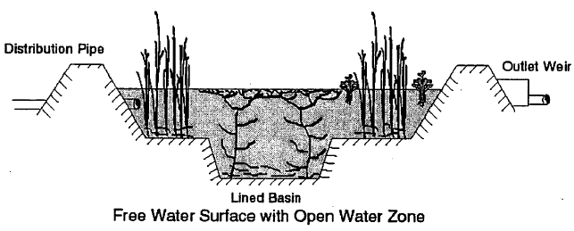
FWS: Open Water Zone
Free Water Surface Wetlands for Wastewater Treatment- A Technology Assessment, EPA 1999

Slide 5
FWS: Floating Aquatic Plant System
Free Water Surface Wetlands for Wastewater Treatment- A Technology Assessment, EPA 1999

Slide 6
Question #1
Name 2 types of Free Water Surface Wetlands.

Slide 7
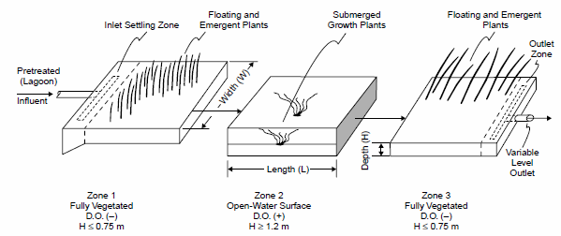
Typical Elements of FWS Wetland
Constructed Wetlands: Treatment of Municipal Wastewaters, EPA 2000

Slide 8
Design Considerations
Hydraulic Retention Time
2 to 3 days in each cell (EPA 2000)
Depth
Surface Flow: 0.1m to 0.6m (Economopoulou and Tsihrintzis, 2004)
Open Water Zone: ≥ 1.2m (EPA 2000)
L:W Ratio
2:1 to 5:1 (Economopoulou and Tsihrintzis, 2004)
Vegetation Porosity
0.65 to 0.75 (Reed et al., 1995)

Slide 9
Design Considerations- Continued
Influent Parameters
Quantity
pH
BOD/COD
Metals
Nutrients
Salinity
Temp
Influent Parameters Determine Final Design!

Slide 10
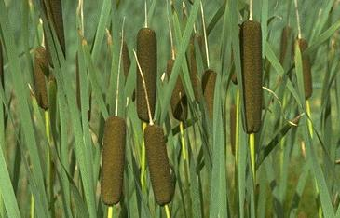
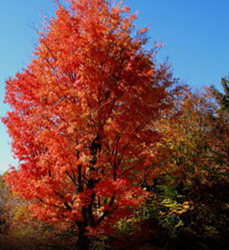
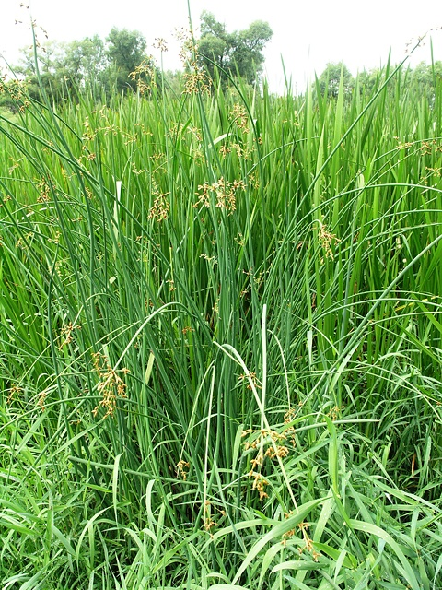
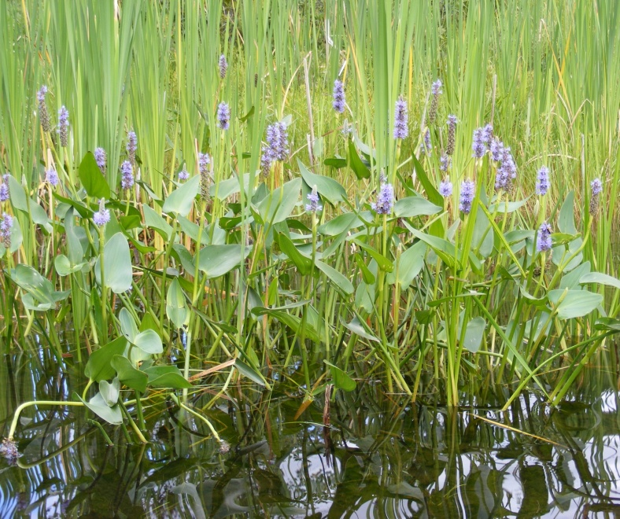
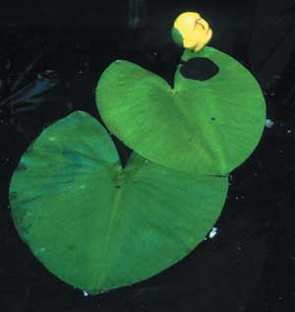
Plants Used in FWS Wetlands
Cattail
Red Maple
Soft Stem Bulrush
Pickerlweed
Lilies

Slide 11
Pros and Cons
Advantages
Disadvantages
Low construction and operational costs
Year-round operation in all but coldest climates (EPA 2000)
Provide wildlife habitat and promote biodiversity
Effective for treating organics, nutrients, pathogens, and metals
Effective handling of shock loads compared to conventional treatments (Schroder et al., 2007)
Large area requirements
Acts as both a sink and potential source of metals and nutrients (Kongroy et al., 2011)
Removal rates lower in colder climates (Kadlec and Wallace, 2009)
Potential problems with mosquito and other vector insects (Thullen et al. 2002)

Slide 12
Question #2
What is the biggest disadvantage of a FWS?

Slide 13
References
Cameron, Kimberley, Madramootoo, Chandra, Crolla, Anna and Kinsley, Christopher. “Pollutant removal from municipal sewage lagoon effluents with a free-surface wetland.” Water Research, Volume 37, Issue 12, , July 2003, Pages 2803-2812.
Davis, Luise. United States. Department of Agriculture. Constructed Wetlands Handbook. Web. <http://water.epa.gov/type/wetlands/restore/upload/constructed-wetlands-handbook.pdf>.
Economopoulou, Maria, and Vassilios Tsihrintzis. Design Methodology of Free Water Surface Constructed Wetlands. Water Resources Management 18. (2004): 541-565. Print.
Ibekwe, A.M., S.R. Lyon, M. Leddy, and M. Jacobson-Meyers.Impact of Plant Density and Microbial Composition on Water Quality from a Free Water Surface Constructed Wetland. Journal of Applied Microbiology.102 (2007): 921-936. Print.
Kadlec, Robert H., Wallace, Scott D., Treatment Wetlands. 2nd ed. Boca Raton: Taylor & Francis Group, LLC, 2009. eBook.
Porntawee Kongroy, Netnapid Tantemsapya, Ying-Feng Lin, Shuh Ren Jing &
Wanpen Wirojanagud (2012): Spatial Distribution of Metals in the Constructed Wetlands, International
Journal of Phytoremediation, 14:2, 128-141
Schroder, Peter, Juan Navarro-Avino, et al. "Phytoremediation Technologies." Phytoremediation Technologies. 14.7 (2007): 490-497.
Reed, S. C., Crites, R. W., and Middlebrooks, E. J., Natural Systems for Waste Management and Treatment, 2nd ed. New York: McGraw-Hill, Inc, 1995. eBook.
Rittman, Bruce, McCarty, Perry. “Environmental Biotechnology: Principles and Applications.” McGraw Hill. New York, NY. 2001.
Rogozinski, Lynn, and Janis Farmer. "Groundwater Treatment Via Constructed Wetland." National Groundwater Association. BP Oil Company. Web. 1 Dec 2012. <http://info.ngwa.org/GWOL/pdf/920157405.PDF>.
Thullen, Joan S., Sartoris, James J., and Walton, William E. “Effects of vegetation management in constructed wetland treatment cells on water quality and mosquito production.” Ecological Engineering, Volume 18, Issue 4, , 1 March 2002, Pages 441-457.
United States. Environmental Protection Agency. Free Water Surface Wetlands for Wastewater Treatment. Washington D.C.: USEPA Office of Water, 1999. Web. 29 Nov 2012. <http://water.epa.gov/type/wetlands/restore/upload/2004_12_20_wetlands_pdf_FW_Surface_Wetlands.pdf >
United States. Environmental Protection Agency. Orlando, FL-Wetland Treatment Systems: A Case History- The Orlando Easterly Wetland Reclamation Project. Washington D.C.: USEPA Office of Water, 1993. Web. 29 Nov 2012. <http://www.epa.gov/owow/wetlands/pdf/Orlando.pdf>
United States. Environmental Protection Agency. Wastewater Technology Fact Sheet: Free Water Surface Wetlands. Washington D.C.: USEPA Office of Water, 2000. Web. 29 Nov 2012. <http://www.epa.gov/owow/wetlands/pdf/Orlando.pdf>

