Slide 1
DESERTIFICATION IS A SERIOUS THREAT TO THE AFRICAN ENVIRONMENT
Humans are causing the sahel region to shrink, making the desert grow larger each year.

Slide 2
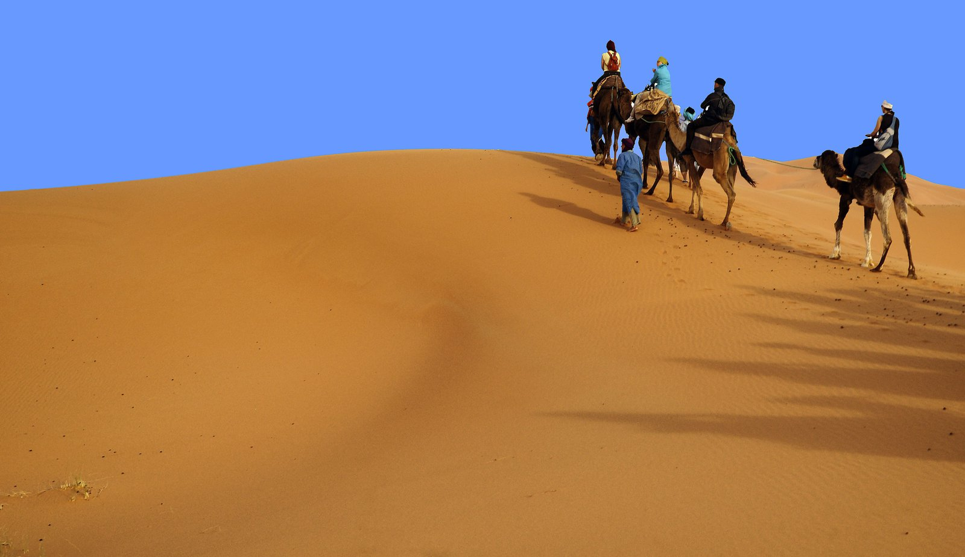
The sahel is shrinking and the desert is growing!

Slide 3
What Are Humans Doing To Cause Desertification?
Overgrazing-animals eat all of the grass which causes the fertile soil to weaken and blow away.
Over farming-planting the same crop over and over which takes the nutrients out of the soil
Deforestation- cutting down trees for firewood to cook or clear fields to plant crops
Drought-lack of rain causes the soil to blow away
Development-scraping away topsoil to build roads and buildings

Slide 4
When Was Desertification Recognized?
The United Nations recognized desertification in 1976 in Africa after a ten year drought, and realized the environment was in danger. A document was written for ways to prevent desertification, but countries did not have the finances to fund such a project for huge areas of land. So until now, prevention has not been that successful. However, more organizations and people are pitching in to help.

Slide 5
How Can Desertification Be Stopped? (Draw a picture for each answer with a caption)
Plant trees in the sahel. Trees help to put nutrients back into the soil, add moisture to the air, and cool the ground. (C.A.R.E. group)
Dig water basins to catch run off rain water and keep it near plants (sculpting the land).
Build stone walls along the desert to hold back blowing sand.
They found out certain types of rocks could be used as fertilizer to help vegetation grow.

Slide 6
What Else Can They Do?
Foreign Aid groups teach rural farmers to rotate crops so the soil remains more fertile.
Farmers could plant perennial flowers in addition to crops to prevent the soil from blowing away. Some perennials need little water but hold the soil firmly in place.
Get farmers to better understand that their actions are causing the problem…education!

Slide 7
Anything Else?...Yes!
The number of animals grazing on the affected lands need to be reduced, allowing plants to re-grow. Move herds frequently to new grazing areas.
Covering the soil with a layer of leaves and sawdust reduces the rate of evaporation, and inhibits growth of weeds.

Slide 8
So What’s the Problem?
Getting enough funding to buy trees
Having enough water to keep newly trees watered
Getting farmers to change their traditional ways when they depend of their livestock grazing close by
Reeducating people
Too big of an area to control

