Slide 1
Fiscal & Monetary Policy

Slide 2


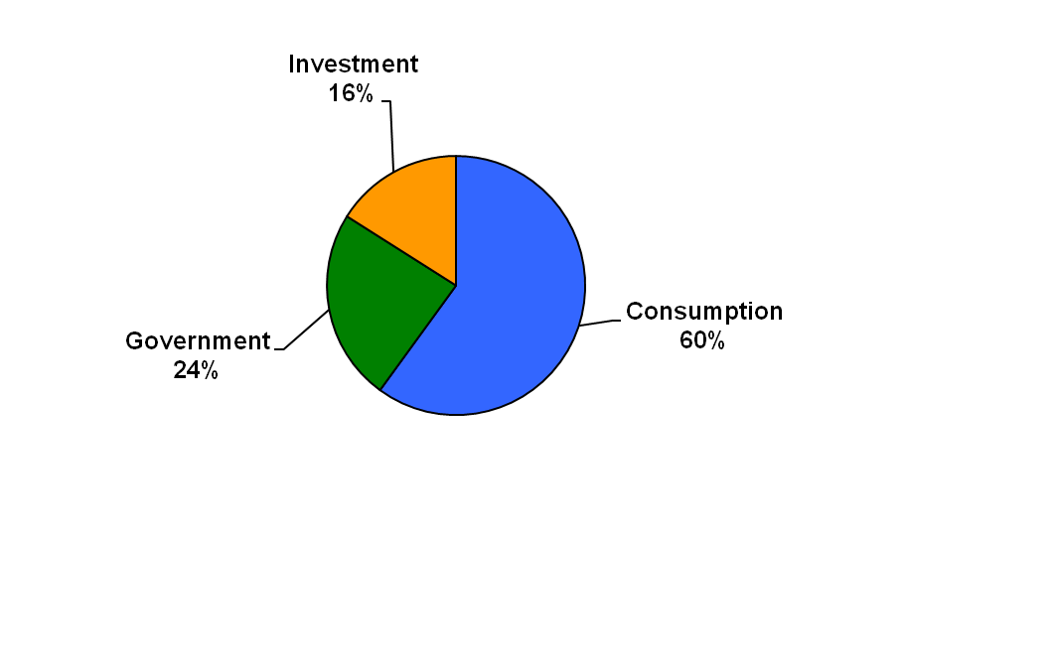
The US Government spent $3.70 Trillion dollars in 2012. That’s approximately $12,000 per person!
Put another way, government spending is approximately a quarter of all domestic expenditures.
GDP = $16T

Slide 3
While our government is bigger than some, it is much smaller than others
Government as a % of GDP
USA

Slide 4

Dissecting the Federal Budget
In 2012, The US Government spent $3.70 T
Determined by existing law (ex: Social Security, Medicare)
Mandatory: $2.116T (58%)
Discretionary: $1.344T (36%)
+
Interest: $240B (6%)
Total: $3.70T
Determined by Congress on an annual basis (ex: Defense)
Discretionary spending requires an annual appropriations bill while mandatory spending does not.
Source: Office of Management and Budget

Slide 5
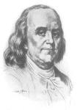
Financing The Government
“In this world, nothing is certain, but death and taxes”
Income Tax
Alternative Minimum Tax
Estate Tax
2012
Individual Income Taxes: $1,145B
Corporate Income Taxes: $327B
Social Insurance Taxes: $927B
Other Revenues: $210B
+
Total: $2.609T

Slide 6
US Income Tax Rates (Single Filers)
Taxable Income | Tax Rate
$0 - $7,150 | 10%
$7,151 - $29,050 | 15%
$29,051 - $70,350 | 25%
$70,351 - $146,750 | 28%
$146,751 - $319,100 | 33%
$319,101 + | 35%
Note: These Tax Brackets are annually indexed for inflation
Standard Deduction: $5,000
Personal Exemption: $3,200
+
$8,200
Taxable Income = Gross Income - $8,200

Slide 7
Taxable Income | Tax Rate
$0 - $7,150 | 10%
$7,151 - $29,050 | 15%
$29,051 - $70,350 | 25%
$70,351 - $146,750 | 28%
$146,751 - $319,100 | 33%
$319,101 + | 35%
The Tax Brackets indicate marginal tax rates – i.e. the percentage of each additional dollar earned that gets paid in taxes
Suppose that you earn $85,000 per year (single filer)
$7,150 * .10 = $715
$21,900 * .15 = $3,285
$41,300 * .25 = $10,325
$6,450 * .28 = $1,806
Gross Income: $85,000
Standard Deduction: $5,000
Personal Exemption: $3,200
-
-
+
Taxable Income
$76,800
Tax Bill = $16,131
$16,131
Your “Effective Rate” =
X 100 = 19%
$85,000

Slide 8
The Government must make up the difference between taxes collected and spending on current programs by borrowing
2012 Expenditures
2012 Revenues
2012 Surplus/Deficit
On-Budget: $2.939T
On Budget: $1.949T
On-Budget: - $990
+
Off-Budget: $761B
+
Off Budget: $660B
+
Off-Budget: - $101
Total: $3.70T
Total: $2.609T
Total: - $1.091T
This is the official deficit that’s reported
In 2012, the government spent $2.939T on programs other than social security
$1.949T Was paid for with current taxes
$990B was borrowed from the public
In 2012, The Social Security Administration spent $761B on current benefits
$660B Was paid for with current taxes
$101B was borrowed from the public

Slide 9
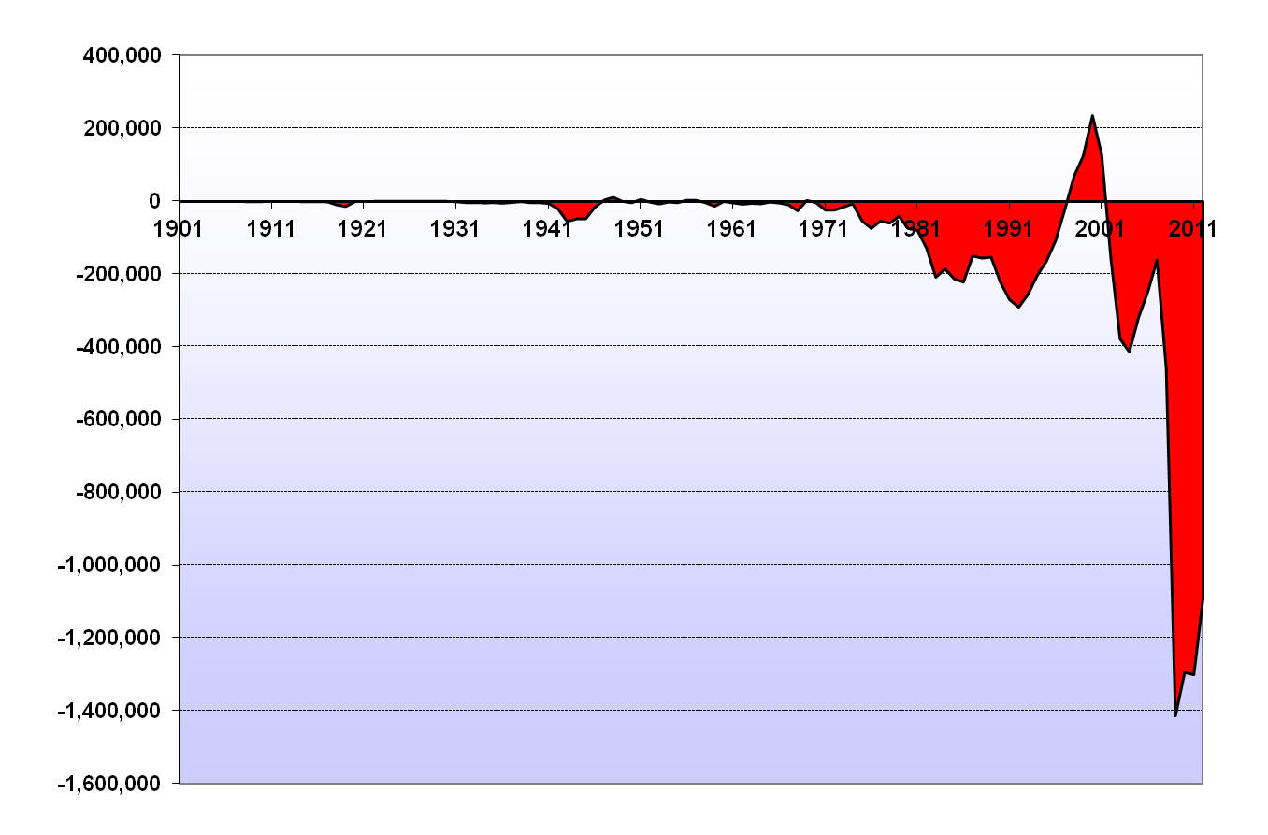
The US budget was essentially balanced until the early 1970’s
Deficit/Surplus (Millions of Current Dollars)

Slide 10
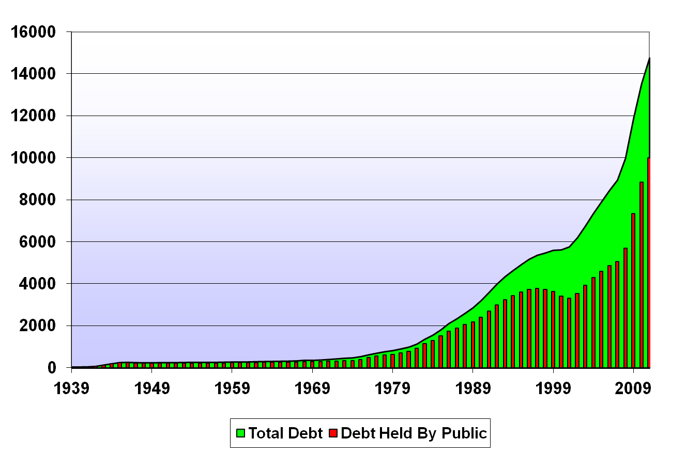
Total Debt outstanding represents the cumulative effect of past deficits (stocks vs. flows)

Slide 11
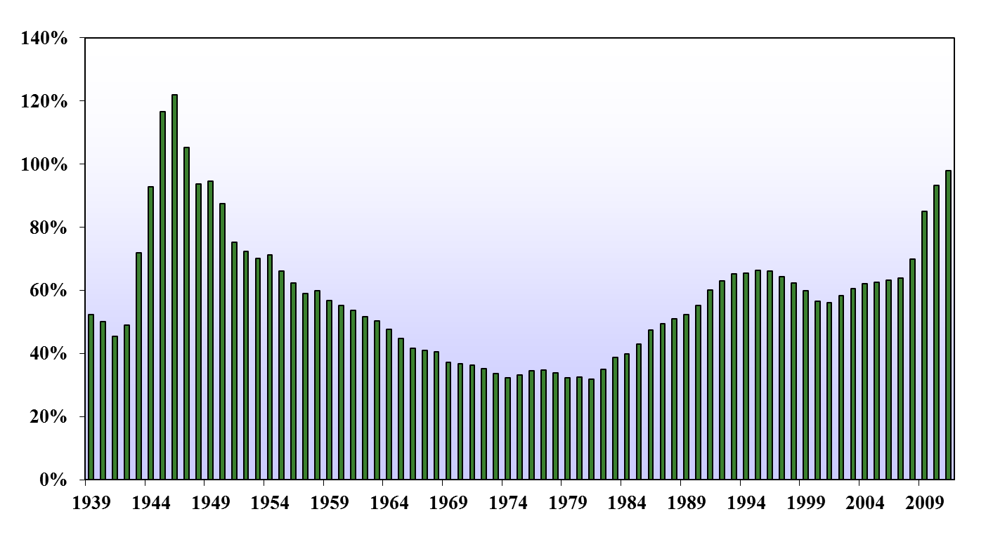
What really matters is debt relative to ability to pay (GDP) While the US economy grew at an average rate of 6% (Nominal), growth of the debt has changed dramatically
Debt as a Percentage of GDP
Debt growth at 2.5% per year
Debt growth at 8.5% per year

Slide 12
Can we sustain our current policies? NO!
Debt is manageable as long as it grows at a slower pace than income (i.e. we can grow out if it!)
Current Deficit
+ Interest Rate
GPD Growth
Total Debt
Growth of Debt
Our economy would need to grow at 12% per year to sustain our current projected deficits (i.e. maintain a constant Debt/GDP ratio)!!!
$1T
+ .05
= .12
$16T
Treasury Rate

Slide 13
Can we sustain our current policies?
Alternatively, let’s calculate the deficit that is sustainable (Debt/GDP is constant)
Sustainable
Deficit
GPD
Growth
Nominal
Interest Rate
Total Debt
$16T
7%
5%
Given the above numbers, we can sustain a $320B Deficit

Slide 14

Two arguments for Fiscal Policy
Efficiency
Efficiency refers to the collective well being of an economy.
Equity
Equity refers to the distribution of well being across individual in an economy.
Can we use fiscal policy to increase aggregate income? (i.e. increase total welfare.)
Can we use fiscal policy to redistribute income in a “fair” way?

Slide 15
Let’s suppose that the economy is currently at full employment (the unemployment rate is 5%) and GDP equals $15T
Let’s assume an 8% interest rate equates savings with total borrowing (public and private)
$12T
$3T

Slide 16
Now, suppose that uncertainty about the future causes consumers and businesses to cut their planned expenditures by 10%
$1.2T
The drop in consumption (increase in savings) along with the drop in investment should lower the interest rate (let’s say to 4%)
$10.8T
$3T
$13.8T

Slide 17
Okun’s law states that a 1% change in the unemployment rate would be associated with a 2% drop in output
$1.2T
We have an 8% “output gap”. This should be associated with a 4% rise in unemployment (the unemployment rate rises from 5% to 9%
$10.8T
$3T
$13.8T

Slide 18
As the economy corrects itself, the immediate impact would be a drop in the interest rate
Eventually, the price level falls, which lowers the interest rate even further
$1.2T
As 4% output gap would be associated with a 4/2 = 2% rise in unemployment
We end up with a long, painful recession…
To get back to full employment, we need to interest rate to drop even farther…

Slide 19
What if the government could move the IS curve back to the right by $1.2T. The could return the economy to full employment…
$1.2T
We have a drop in demand of $1.2T
Suppose that the government replaced that drop in private spending with an increase in public spending?

Slide 20
“If I Had a Hammer…”
Suppose that the government pays $100 for a new hammer from the local hardware store
Now, suppose that the hardware store owner takes his $100 in new income and spends $95 (95%) at the grocery store
Now, suppose that the grocer owner takes his $95 in new income and spends $90.25 (95%) at the local tavern…..
This will continue to ripple out…

Slide 21
“If I Had a Hammer…”
Lets add up all the increases in income due to the initial government purchase of a $100 hammer
Hardware Store: $100
Grocer: $95
Tavern: $90.25
-------- $85.74
-------- $81.45
The initial $100 increase in government spending raised total income by $2,000 (a factor of 20)
Total: $2,000
Marginal Propensity to Consume

Slide 22
If the government bought $120B worth of hammers, that should do the trick!
Before
$1.2T
$10.8T
$3T
After
$11.88T
$3.12T
Suppose that we have a savings rate of 10%

Slide 23
Let’s take the US Economy….we saw a rise in unemployment from 5% to 10% in this last recession…
Multiply by 2 (Okun’s law)
$1.4T
10% drop in output
5% cyclical unemployment
A stimulus package of $56B should do it!
The personal savings rate at the time was around 4%

Slide 24
But the government stimulus plan was over $700B and nothing happened…
From 2009 to now, the unemployment rate fell from 10% to 7.6%. That 2.4% drop in unemployment should be associated with a 4.8% rise in production. Given our $16 Trillion dollar economy, that’s a gain of $768B
If we credit the entire gain to the $700B stimulus package, we have a multiplier of
A 7.6% unemployment implies 2.6% cyclical unemployment – that’s 5.2% of GDP - $832B
We would need another stimulus package bigger than the first to get back to full employment!
$832B/1.1= $756B

Slide 25
“If I Had a Hammer…”
Lets add up all the increases in income due to the initial government purchase of a $100 hammer
The initial $100 increase in government spending raised total income by $2,000 (a factor of 20)
Hardware Store: $100
Grocer: $95
Tavern: $90.25
-------- $85.74
-------- $81.45
Marginal Propensity to Consume
Total: $2,000
This argument relies on (among other things) the government not having to pay for its purchases!!!

Slide 26
Consider the Jones’: The Jones’ live in Buffalo NY. Mr. Jones works 40 hours per week at a local factory. They have an annual household income of $50,000.
Jones’ Family Budget
Income: $50,000
Taxes: $10,000
$40,000
Consumption: $30,000
Savings: $10,000
Remember…this is determined by the Jones’ wealth – not just current income
Suppose that Obama announces that they will spend $200B on a bridge that will go halfway to Hawaii. Each household will be taxed $1,000 to pay for this project.

Slide 27
How should this spending plan influence the Jones’?
Jones’ Family Budget
Income: $50,000
Taxes: $11,000
$39,000
Consumption: $30,000
Savings: $9,000
Tax Increase of $1,000
This one time project should have a negligible impact on the Jones’ wealth and, hence a negligible impact on consumption
Savings drops by $1000

Slide 28
So, the government raises spending by $1,000 per person, and household consumption is left unchanged (household savings drops by $1,000)
$1,000
The IS curve moves to the right by $1,000 – i.e. the government multiplier equals 1

Slide 29
Suppose that the government decides to spend $1,000 wastefully every year…
The IS curve moves to the right by $0– i.e. the government multiplier equals 0!
Households adjust to the permanently lower income by spending less

Slide 30
Maybe we can use tax policy to get the economy going…Lets look at a breakdown of Mr. Jones tax liability
Income: $50,000
Taxes: $10,000
Mr. Jones taxable income of $45,000 put him in the 30% tax bracket
Tax Code
Taxable Income Tax Rate
$0 - $10,000 15%
$10,000 - $30,000 20%
$30,000 - $50,000 30%
$30,000 + 35%
Income Tax Rate Tax Paid
$10,000 15% $1,500
$20,000 20% $4,000
$15,000 30% $4,500
Total: $10,000
Mr. Jones’ effective tax rate is 20%
Standard Deduction = $5,000

Slide 31
Suppose the government passes a “middle class tax cut”. The top two brackets are reduced from 30% and 35% to 25% and 30%. Also, the standard deduction is lowered to $2,000. How does this impact Mr. Jones?
Income: $50,000
Taxes: $10,000
Mr. Jones taxable income of $48,000 put him in the 25% tax bracket
Tax Code
Taxable Income Tax Rate
$0 - $10,000 15%
$10,000 - $30,000 20%
$30,000 - $50,000 25%
$30,000 + 30%
Income Tax Rate Tax Paid
$10,000 15% $1,500
$20,000 20% $4,000
$18,000 25% $4,500
Total: $10,000
Mr. Jones’ effective tax rate is still 20%
Standard Deduction = $2,000

Slide 32
Suppose the government passes a “middle class tax cut”. The top two brackets are reduced from 30% and 35% to 25% and 30%. Also, the standard deduction is lowered to $2,000. How does this impact Mr. Jones?
Old Tax Code
New Tax Code
Income Tax Rate Tax Paid
$10,000 15% $1,500
$20,000 20% $4,000
$15,000 30% $4,500
Income Tax Rate Tax Paid
$10,000 15% $1,500
$20,000 20% $4,000
$18,000 25% $4,500
Total: $10,000
Total: $10,000
A drop in Mr. Jones’s marginal tax rate increases the incentive to work – labor supply increases. This should raise production

Slide 33
A cut in marginal tax rates that leaves average rates unchanged raises the economy’s capacity as employment rises. But what about expenditures?
A permanent tax cut will increase investment (because higher employment raises the productivity of capital)
Capacity output increases from the tax cut

Slide 34
Alternatively, suppose the government passes a “lower income class tax cut”. The bottom two brackets are reduced from 15% and 20% to 10% and 15%. The standard deduction is kept at $5,000. How does this impact Mr. Jones?
Income: $50,000
Taxes: $8,500
Mr. Jones taxable income of $45,000 put him in the 30% tax bracket
Tax Code
Taxable Income Tax Rate
$0 - $10,000 10%
$10,000 - $30,000 15%
$30,000 - $50,000 30%
$30,000 + 35%
Income Tax Rate Tax Paid
$10,000 10% $1,000
$20,000 15% $3,000
$15,000 30% $4,500
Total: $8,500
Mr. Jones’ effective tax falls to 17%
Standard Deduction = $5,000

Slide 35
Alternatively, suppose the government passes a “lower income class tax cut”. The bottom two brackets are reduced from 15% and 20% to 10% and 15%. The standard deduction is kept at $5,000. How does this impact Mr. Jones?
Old Tax Code
New Tax Code
Income Tax Rate Tax Paid
$10,000 15% $1,500
$20,000 20% $4,000
$15,000 30% $4,500
Income Tax Rate Tax Paid
$10,000 10% $1,000
$20,000 15% $3,000
$15,000 30% $4,500
Total: $10,000
Total: $8,500
If households are rational and forward looking, they should recognize that the tax cut will need to be repaid and thus will not feel better off…
If households are not rational and forward looking, they will feel better off and work less

Slide 36
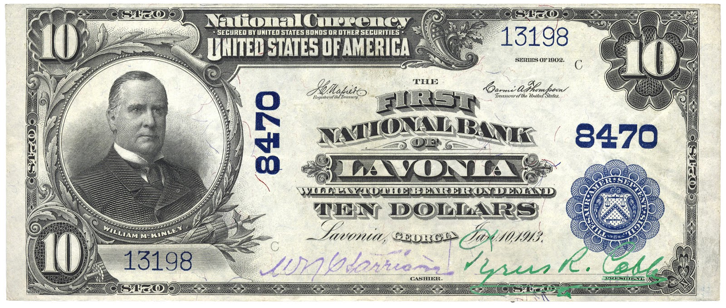
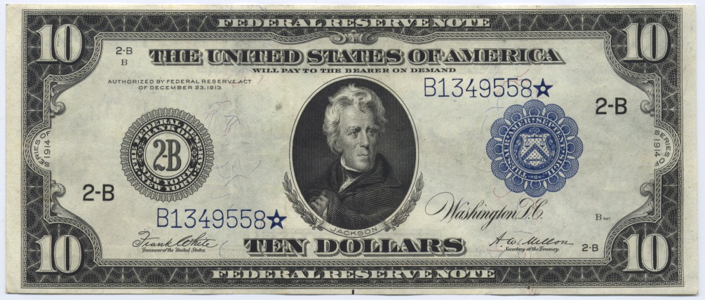
From the mid 1800’s until 1913, the National Currency of the US consisted primarily of National Banknotes – issued by nationally chartered commercial banks
The Federal Reserve Act was passed on Dec. 23, 1913. From then on, Federal Reserve notes are our national currency – issued by the newly created Federal Reserve Bank
Note: The Federal Reserve System is a private bank. It is actually owned by the banks within the Federal Reserve System

Slide 37
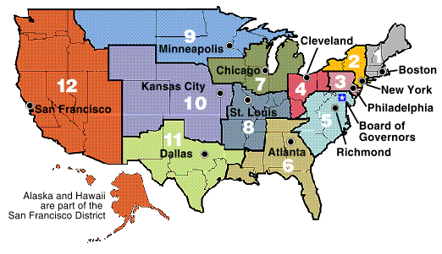
The Federal Reserve System Divides the country into 12 Districts numbered 1 - 12 from east to west

Slide 38
Each district has a Federal Reserve Bank with a bank president elected by the bank’s board of directors for 4 year renewable terms
Bank President
Board of Directors
Class A (4)
Class B (4)
Class C (4)
Member Banks
Local Business
Federal Reserve Board

Slide 39







The Chairman is elected from the Board for a renewable 4 year term
Sarah Raskin
(2010)
Daniel Tarullo
(2009)
Jerome Powell
(2012)
Janet Yellen (Vice Chairman)
(2010)
Elizabeth Duke
(2008)
Ben Bernanke
(2006)
Jeremy Stein
(2012)
The Federal Reserve board is headquartered in Washington DC. The Board Consists of 7 “Governors” appointed by the President and confirmed by the Senate for 14 Year Non-Renewable terms

Slide 40
The Federal Open Market Committee (FOMC) is the policymaking group of the Federal Reserve System. They meet approximately 8 times per year. Policies are determined by majority vote
Board of Governors (7)
NY Fed President (1)
Regional Fed Presidents (4)
Generally, all 12 bank presidents are present at the meeting, but only 5 can vote. The NY Fed president has a permanent vote while the remaining presidents vote on a revolving basis.

Slide 41
  The Federal Reserve System primary responsibilities are:
    “Lender if Last Resort”
    Regulate the banking industry
    Control the money supply
    Provide banking services for the federal government
    Check Clearing

Slide 42
Credit Channels under the Federal Reserve System
All commercial banks can borrow from the Fed at any time. These loans are called discount window loans. The Fed sets the interest rate is charges on these loans (The discount rate).
Federal Reserve
Commercial banks lend to one another through the Federal Funds Market. The interest rate for these loans is a market determined interest rate. The Federal reserve can influence this interest rate.

Slide 43
The Fed actually has several discount lending programs
Type of Credit | Interest Rate Policy
Primary (No Questions Asked) | Fed Funds + .5%
Secondary (Additional Financial Information Required) | Fed Funds + 1.0%
Seasonal (Must demonstrate reoccurring seasonal liquidity needs, <$500M in Deposits) | Fed Funds + .2%

Slide 44
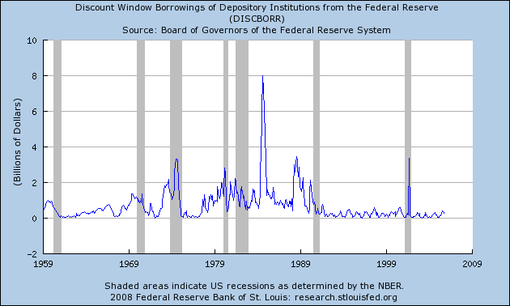
Discount window lending is typically not a sizeable amount…

Slide 45
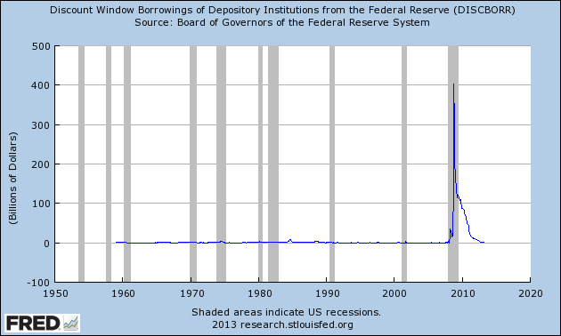
Unless trouble arises!

Slide 46
The Fed regulates bank lending by setting the Reserve Requirement. It has no impact on the monetary base, but it restricts the ability of banks to create loans – this influences the broader aggregates.
Type of Liability | Reserve Requirement
Transaction Account
$0 - $7M | 0%
$7M - $47.6M | 3%
More than $47.6M | 10%
Time Deposits | 0%
Eurocurrencies | 0%
The Fed influences this!

Slide 47

By purchasing and/or selling securities, the Fed can directly control the quantity of non-borrowed reserves in the banking sector.
The Fed debits/credits the reserve account of the dealer’s bank
Federal Reserve
Dealers Buy/Sell bonds from the Fed
Bond Dealer
Most transactions are done with repurchase agreements (Repos). These are purchases/sales along with an agreement to reverse the transaction at a later date

Slide 48
For most of its history, the US has followed a gold standard
US Treasury
A Gold Standard has two rules:
The government sets an official price of gold ($35/oz)
The government guarantees convertibility of currency into gold at a fixed price
Assets
Liabilities
$7,000 (Gold) (200 oz. @ $35/oz)
$10,000 (Currency)
$3,000 (T-Bills)
Reserve Ratio = 70%
Value of Gold Reserves
$7,000
Reserve Ratio =
=
Currency Outstanding
$10,000
During most of the gold standard era, the Government had a reserve ratio of around 12%

Slide 49
By committing to convertibility at $35 an ounce, the government restricted its ability to increase/decrease the money supply
US Treasury (P = $35)
Assets
Liabilities
Price
Supply
$7,000 (Gold) (200 oz. @ $35/oz)
$10,000 (Currency)
$3,000 (T-Bills)
$35
100 oz. Gold @ $35/oz
$3,500 (Currency)
Demand
Reserve Ratio = 70%
Q
Suppose that the Treasury purchased gold to increase the supply of currency outstanding (i.e. increase the money supply)

Slide 50
By committing to convertibility at $35 an ounce, the government restricted its ability to increase/decrease the money supply
US Treasury (P = $35)
Price
Assets
Liabilities
Supply
$7,000 (Gold) (200 oz. @ $35/oz)
$10,000 (Currency)
$3,000 (T-Bills)
$35
Demand
Q
Reserve Ratio = 70%
As the market price rises above $35 (due to increased demand), households start buying gold from the Treasure @ $35/oz and sell it in the open market. This reverses the original transaction

Slide 51
The gold standard and prices:
Recall that in the long run, the price level is directly proportional to the ratio of money to output:
(Gold Reserves)
M =
Reserve Ratio
With a (relatively) fixed supply of money, prices remained stable in the long run

Slide 52
The gold standard and the supply of gold:
US Treasury (P = $35)
Price
Supply
Assets
Liabilities
$7,000 (Gold) (200 oz. @ $35/oz)
$10,000 (Currency)
$35
$3,000 (T-Bills)
100 oz. Gold @ $35/oz
$3,500 (Currency)
Demand
Q
Reserve Ratio = 70%
From time to time, new gold deposits were discovered. This increased supply would push down the market price. In response, households would buy the cheap gold and sell it to the Treasury for $35. This would increase the money supply.

Slide 53
The gold standard and the business cycle:
US Treasury (P = $35)
Price
Assets
Liabilities
Supply
$7,000 (Gold) (200 oz. @ $35/oz)
$10,000 (Currency)
$35
$3,000 (T-Bills)
(-) Gold
(-) Currency
Demand
Q
Reserve Ratio = 70%
Typically, during recessions, the price of gold would rise (flight to quality). High gold prices would cause households to buy gold from the Treasury to sell in the market. This would force the treasury to lose reserves and contract the money supply.

Slide 54
Gold Standard: Long Run vs. Short Run
Long Run: By restricting the long run supply of money, the gold standard produced constant, low average rates of inflation (bankers are happy)
Short Run: By forcing monetary policy to be subject to fluctuating gold prices, the gold standard exacerbated the business cycle (farmers are unhappy)

Slide 55
Currently, the Fed follows an interest rate target. The target interest rate (Fed Funds Rate) is adjusted according to a ‘Taylor Rule”
FF = 2% + (Inflation) - 1.25(Unemployment – 5%) + .5(Inflation – 2%)
Long Run: When the economy is at full employment ( Unemployment = 5%) and inflation is at its long run target (2%), the Fed targets the Fed Funds Rate (Nominal) at
FF = 2% + (2%) - 1.25(5% – 5%) + .5(2% – 2%) = 4%
Short Run: During recessions (when inflation is low and unemployment is high), the Fed lowers its target. During expansions, when inflation is high and unemployment is low), the Fed raises its target.

Slide 56
Suppose that the Fed is Targeting the Interest Rate at 5%
Suppose an increase in GDP raises Money Demand
The Fed needs to increase the monetary base by
5%
1,000
= $125
8
(An Open Market Purchase of Treasuries)
Change in M2 = $1,000

Slide 57
Suppose that the Fed wants to lower its target to 4% (expansionary monetary policy)
A $250 purchase of Treasuries would be required
2,000
5%
= $250
8
4%
M2 Multiplier
Change in M2 = $2,000

Slide 58
The primary monetary policy goal is to keep the economy at full employment.
Target interest rate
The Taylor rule is meant to approximate this
Full employment output

Slide 59
A rise in expenditures will create a positive output gap…
A drop in expenditures will create a negativeoutput gap…
New target
New target
Positive gap
negative gap
The fed should raise their target interest rate by contracting the money supply (sell bonds)
The fed should lower their target interest rate by increasing the money supply (buy bonds)

Slide 60
Let’s look a the US economy now…
CPI Inflation rate (year on year growth): 1.7%
Unemployment Rate: 7.6%
FF = 2% + (1.7%) - 1.25 (7.6% – 5%) + .5 (1.7% – 2%) = .3%
If we plug these numbers into the Taylor rule, we get
The financial crisis created a large increase in money demand as people flocked toward cash (LLM Shifts Left)
The crash of the housing market destroyed a lot of wealth with dramatically lowered consumer spending (IS shifts left)
Current Target = 0%
2009

