Slide 1
Trade-Based Money Laundering
Defined by the Financial Action Task Force (FATF) as, “the process of disguising the proceeds of crime and moving value through the use of trade transactions in an attempt to legitimize their illicit origins.”

Slide 2
Invoice Manipulation Made Simple
Money moved out:
- By importing goods at overvalued prices or exporting goods at undervalued prices
Money moved in:
- By importing goods at undervalued prices or exporting the goods at overvalued prices

Slide 3
True Examples of Abnormal U.S. Trade Prices
High U.S. Import Prices
Plastic buckets from Czech, $972/unit
Briefs and panties from Hungary, $739/doz
Cotton dishtowels from Pakistan, $153/unit
Ceramic tiles from Italy, $4,480/sq meter
Metal tweezers from Japan, $4,896/unit
Razors from the U.K., $113/unit
Camshafts from Saudi Arabia, $15,200/unit
Iron bolts from France, $3,067/kg
Toilet tissue from China, $4,121/kg
Low U.S. Export Prices
Live cattle to Mexico, $20.65/unit
Radial truck tires to U.K., $11.74/unit
Toilet bowls to Hong Kong, $1.75/unit
Bulldozers to Colombia, $1,741/unit
Color video monitors to Pakistan, $21.90/unit
Missile launchers to Israel, $52.03/unit
Prefabricated buildings to Trinidad, $1.20/unit

Slide 4
Exports/Imports of Refrigerators

Slide 5
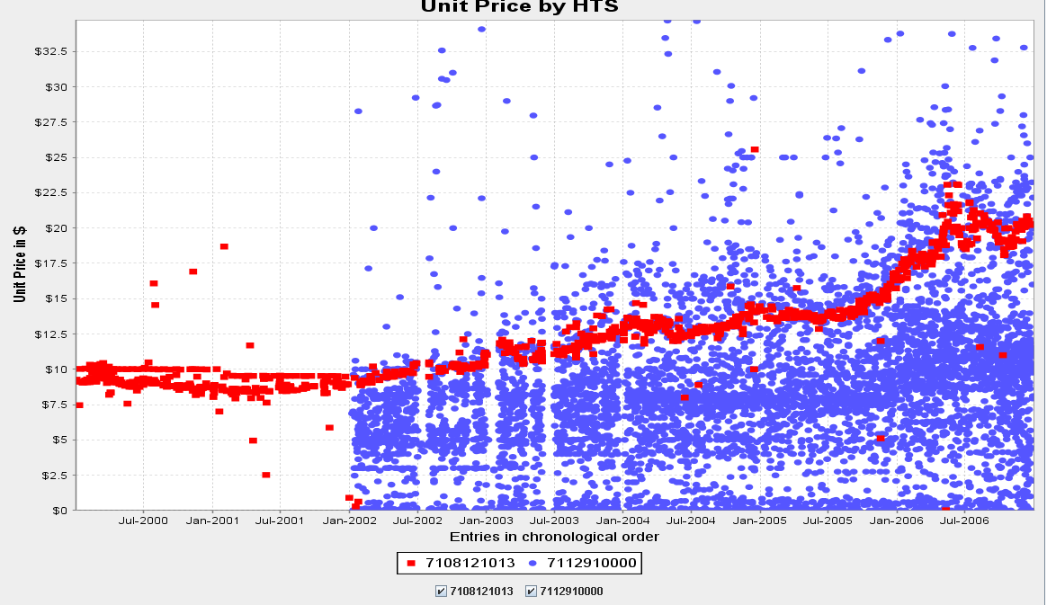
HS gold scrap (in blue). Gold scrap for valuation purposes is actually undefined. There is no legitimate business reason why there would be importations of gold scrap in blue over the red baseline price of “4-9”gold bullion. Even importations of scrap closely under the baseline are suspect.

