Slide 1
MONEY LAUNDERING
“The Basics”

Slide 2
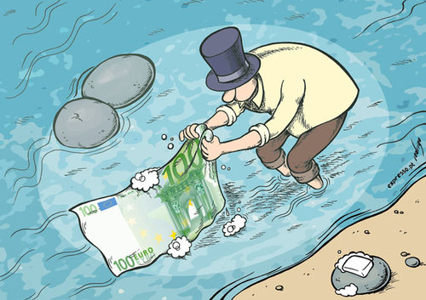
WHAT IS MONEY LAUNDERING?
ALL
Procedures,
Methods and
Transactions
designed to change the identity of the source of illegally obtained money so that it appears to have come from a legitimate source.

Slide 3
STAGES OF MONEY LAUNDERING
Step 3: Integration
Step 2: Layering
Step 1: Placement

Slide 4
STAGES OF MONEY LAUNDERING
Money Laundering is a dynamic three (3) stage process:
1. PLACEMENT – moving the funds from direct association with the crime; examples
2. LAYERING – disguising the trail to foil pursuit; and
3. INTEGRATION – making the money available to the criminal once again with its occupational and geographic origins hidden from view

Slide 5
PLACEMENT
This is the first step in the money laundering process
and involves the introduction of the money into the
financial system.
In most instances, the money from illicit sources are
co-mingled with money from legitimate business.
This is the stage that the launderers are most
Vulnerable; hence the need for relevant gatekeepers.

Slide 6
LAYERING
Having introduced the monies into the financial system, steps
are taken to disguise the source of the funding; as such layers
of transactions are carried out. Layering can take place
through electronic transfer of funds …
At this stage, there is usually difficulty in detecting and
investigating money laundering.

Slide 7
INTEGRATION
This is the final stage of the money laundering
process. At this stage, the monies are integrated into
the legitimate economy and assimilated with all other
assets and can be used for any purpose.
The aim at this stage is to reunite the funds with the
criminal in a manner that doesn’t raise suspicion and
appears to be legitimate.

Slide 8
The Legal framework
The Proceeds of Crime Act
The Proceeds of Crime (Money laundering Prevention) Regulations
Terrorism Prevention Act
Et al

Slide 9
PROCEEDS OF CRIME ACT (POCA)
Introduced for two (2) major reasons:
To strengthen government’s efforts to detect and confiscate money and property obtained through criminal acts;
and
2) To better prevent instances of
money laundering.
Notes:
The proceeds of crime can be anything cash, property, shares, cars, art work etc.

Slide 10
The Gatekeepers

Slide 11
The Gatekeepers
There are two (2) categories of businesses within the regulated sector:
1. Financial institutions:
2. Designated non-financial institutions:

Slide 12
The Gatekeepers
Businesses in the regulated sector are required
to comply with the requirements of POCA and
its regulations as well as the directions of the
Competent and Supervisory Authorities.

Slide 13
Some Regulatory Requirements of Businesses within the Regulated Sector
1. Reporting
2. Record keeping
3 Establishing internal control mechanisms
4. Undertaking risk based assessments

Slide 14
Penalties for Money Laundering and Terrorism financing
Money laundering: individual- fine $3 million and/or imprisonment up to 20 years; body corporate- fine
Failure to implement regulatory controls by regulated businesses – fine up to $400, 000
Failure to report and tipping off - fine up to $1 million and or imprisonment up to 12 months

Slide 15
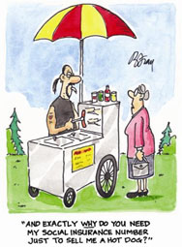
‘Know Your Customers’

Slide 16
‘Know Your Customers’
Business in the regulated sector are prohibited
from forming a business relationship or
engaging in a one-off transaction unless it takes
the necessary steps to establish the identity of
the other part and verify that identity.

Slide 17
Identification and Verification
IDENTIFICATION
Customers are to produce satisfactory evidence of their identity once they engage in business transaction with a financial institution.
Exceptions:
a. A regulated business
b. Small one-off transactions
c. electronic arrangements

Slide 18
Identification and Verification
Some examples of satisfactory evidence include:
A valid Passport
A valid National ID
A valid Driver’s Licence

Slide 19
Identification and Verification
VERIFICATION
Verifying a customer’s identity consists of checking the information provided by the customer against information obtained from a reliable and independent source.

Slide 20
Enhanced Due Diligence
Regulation 7A(4) of the MLPR requires that,
where a business relationship or one-off
transaction is determined to be high-risk, a
business in the regulated sector shall carry out
enhanced due diligence measures which includes
but is not limited to the following:
1. Obtain senior management approval to
commence or continue the business
relationship or one off transaction.

Slide 21
2. Verification of the source of funds or wealth
held by the applicant for business and all
other persons concerned in the business
relationship or one off transaction.
3. Enhanced monitoring throughout the
course of the business relationship or one
off transaction.

Slide 22
Enhanced Due Diligence
Politically Exposed Persons
Financial institutions are required to implement
“Enhanced Due Diligence” for transactions
involving high risk activities, businesses, foreign
countries, linked accounts and politically
exposed persons

Slide 23
Politically Exposed Persons
A Politically Exposed Person is any individual who in relation to any State carries out functions
analogous to any of the following:
a head of state;
a head of government;
a member of any House of Parliament;
a Minister of Government;
A member of the judiciary;
a military official above the rank of Captain;
a member of the police of or above the rank of Assistant Commissioner;

Slide 24
a Permanent Secretary, Chief Technical Director or chief officer in charge of the operations of a Ministry, department of Government, executive agency or statutory body;
a director or chief executive of any company in which the Government owns a controlling interest;
an official of any political party;
an individual who carries out any prominent function at the behest of an international organisation;
an individual who is a relative or is known to be a close associate of any of the above.

Slide 25
“Close associate” means an individual who is a business partner, or associated in any other form, in a common commercial enterprise with the person concerned;
“Relative” means the person’s spouse (legal and common law), child, step child, adopted child, spouse of child, parents, brother or sister.

Slide 26
New Kidz on the Block
In 2013 there were numerous amendments to POCA and Regulations (consequential amendments were also made to other pieces of legislations). Chief among these amendments were:
A prohibition on cash transactions over $1 M – exceptions being regulated deposit-takers and cambios;
Requirement of a Risk Based Approach to products, technologies, customers and transactions;

Slide 27
3. Application of statutory sanctions by the Competent Authority where another legislation allows for regulatory actions to be taken in respect of offences under paragraph 6 (2) of the Regulations;
4. Provision of guidance to regulated businesses as to high risk relationships and the need for enhanced due diligence;

Slide 28
The End!

