Slide 1
System of supervision of the investment funds industry
Mirosław Jeżowski

Slide 2
Legal basis – EU level (UCITS)
Council Directive 85/611/WE (UCITS)
Commision Directive 2007/16/UE implementing Council Directive 85/611/WE (eligible assets)

Slide 3
Legal basis – national level (UCITS, non-UCITS)
Act on capital market supervision
Act on Investment funds

Slide 4
Act on capital market supervision
Article 3
The competent authority supervising the capital market and the market of financial instruments which are sought to be admitted to trading on that market, within the meaning of legal acts enacted by institutions and authorities of the European Union, shall be the Polish Financial Supervision Authority, hereinafter referred to as the “Authority”.
Article 4
The objective of the supervision shall be to ensure proper operation of the capital market and, in particular, security of trading and protection of investors and other market participants, as well as compliance with the principles of fair trading. The means of exercising supervision shall be defined in this Act and in other regulations.

Slide 5
Act on capital market supervision
Article 5
The Authority’s supervision shall cover entities which conduct activities on the capital market on the basis of authorisations issued by the Authority or another competent administrative authority, as well as other entities – to the extent that they are subject to the obligations related to the participation in such market, as specified in other regulations, and in particular:
issuers carrying out public offerings of securities and issuers whose securities are admitted to trading on a regulated market,
investment funds,
investment fund management companies,
other entities providing services to investment funds, including entities commissioned by investment fund management companies to perform those companies’ obligations.

Slide 6
Act on investment funds
Scope of supervision
Investment funds
registered in
the Republic of Poland
all activities (licensing,
on-going supervision)
Foreign funds
sale of a foreign fund’s units
Foreign management
companies
conduct of activities in
the Republic of Poland
6

Slide 7
Act on Investment funds (1)
Article 226
On the basis of an authorisation issued by the Chairman of the PFSA, the person named therein shall have the right to enter the premises of:
a management company, in order to verify whether such company’s activities comply with the provisions of the law, the statutory documents or the authorisation granted to such company;
a depositary, in order to verify whether such depositary’s activities connected withacting as a depositary comply with the provisions of the law or the agreement on the maintenance of a register of the fund’s assets;
a distributor in order to verify whether its activities connected with intermediation in the sale and redemption of units or the redemption of investment certificates comply with the provisions of the law, the agreement concluded with the fund and the authorisation;
the outsorcers in order to verify whether their activities connected with the performance of their obligations under the agreement with the management company comply with such agreement and the investment fund's articles of association;

Slide 8
Act on Investment funds (2)
Article 226
an entity maintaining the register of the investment fund’s unit-holders, in order to verify whether its activities connected with the performance of its obligations under the agreement with the investment fund comply with such agreement and the investment fund’s statutory documents;
a foreign management company, a branch of the foreign management company or a foreign fund, a company managing open-end investment funds that are registered in an EEA or OECD member state, a branch of such company or open-end investment fund registered in an EEA or OECD member state and situated in the Republic of Poland, in order to verify whether their activities are conducted in compliance with the regulations effective in the Republic of Poland.

Slide 9
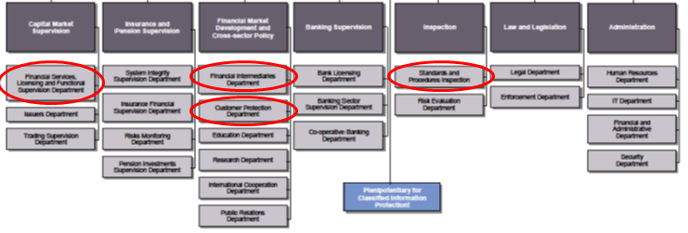
Organisation of supervision – KNF (PFSA)

Slide 10
Organisation of supervision - KNF
Financial Services,
Licensing and Functional
Supervision Dept
Financial Intermediaries
Dept
Customer Protection
Dept
Standards and procedures
inspection Dept
licensing of the funds and management companies
on-going supervision of the fund’s market
licensing of the distributors of fund’s units
register of the distributors of fund’s units
Inspections in the distributors of fund’s units
administration proceedings against the distributors of fund’s units
fund’s advertisements supervision
unitholders compaints
inspections in the entities of the fund’s market

Slide 11
Organisation of supervision - KNF
Financial Services, Licensing and Functional Supervision Dept
Close-end Funds Unit
Open-end Funds Unit
Supervision over the
Investment Funds Unit
licensing of the close-end funds and management companies
licensing of the open-end funds and management companies
notifications of the foreign funds
Supervision over the funds and management companies
Licensing Supervision

Slide 12
Supervised entities
Supervision over the
Investment Funds Unit
Management
Companies
Transfer agents
Depositories
Outsourcing
Investment
Funds
Foreign funds

Slide 13
Compliance based approach
ex-ante on-going ex-post
Supervision
over the
statutes of
the funds
during licencing
Passive
supervision
over the
reports of
the funds
Active
supervision
(inspections)

Slide 14
Ex-ante - examples
Supervision over the statutory documents of the funds during licencing
Supervision over the members of the board of directors:
possible penalty,
background (CV, job experience),
ethics
Supervision over the statutory documents:
audit of the law
audit of the valuation
logical correctness.

Slide 15
On-going
On-going supervision component
Reports (current, periodical)
Information sent to PFSA upon request
Interventions

Slide 16
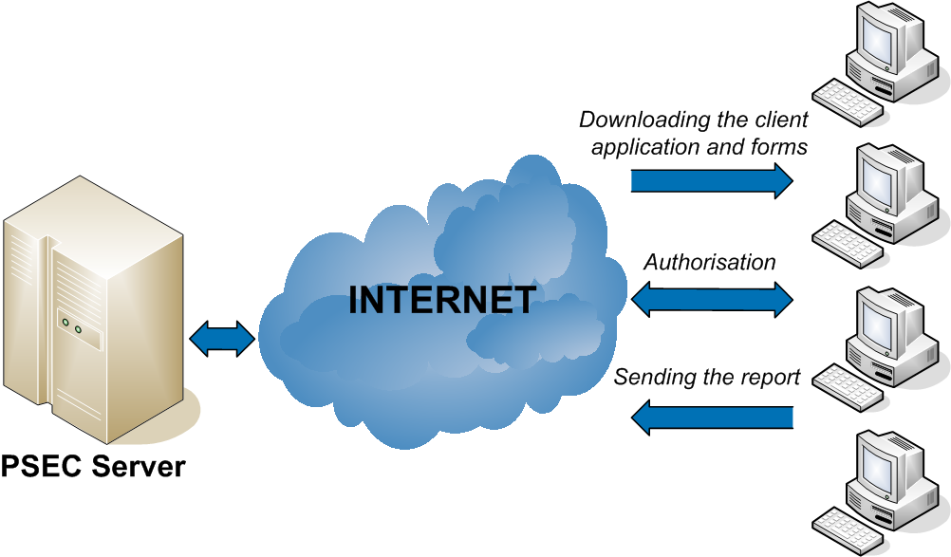
On-going / Transfer of information
KNF MC / IF / DEPO

Slide 17
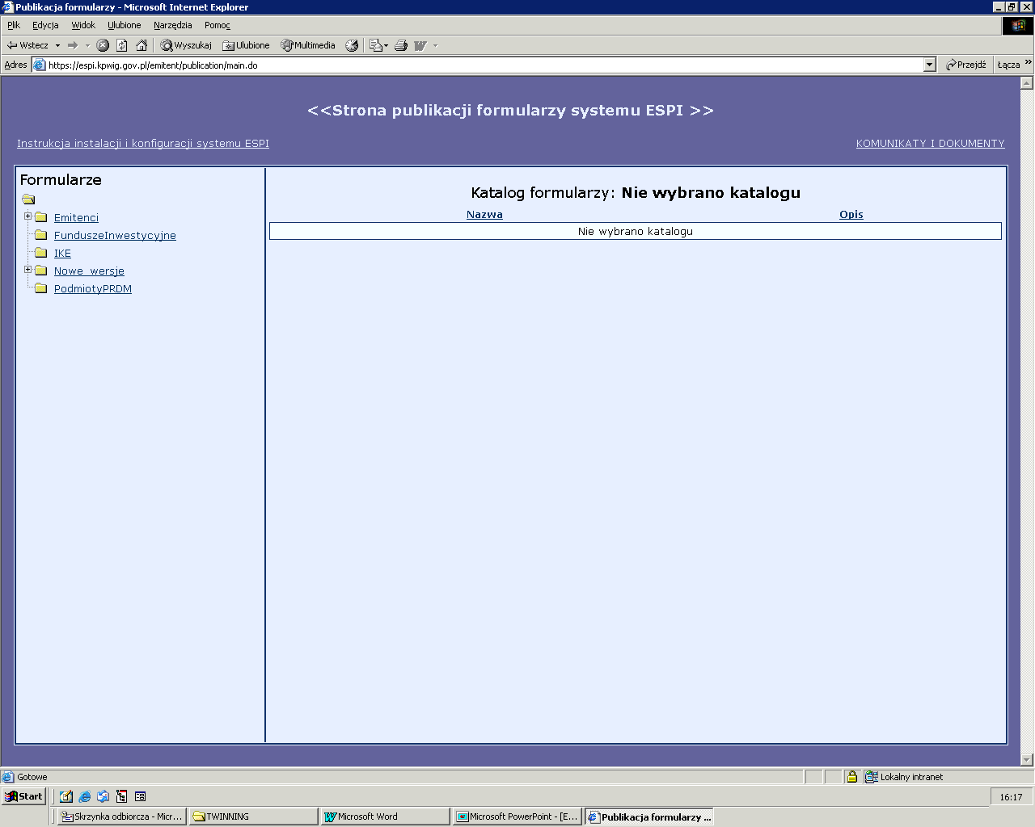
On-going / Transfer of information

Slide 18
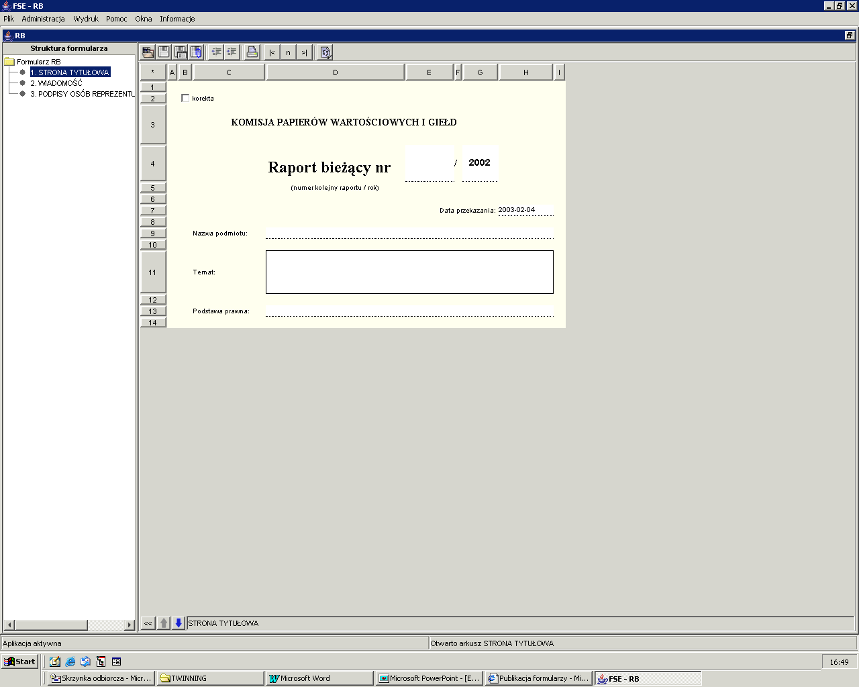
On-going / Transfer of information

Slide 19
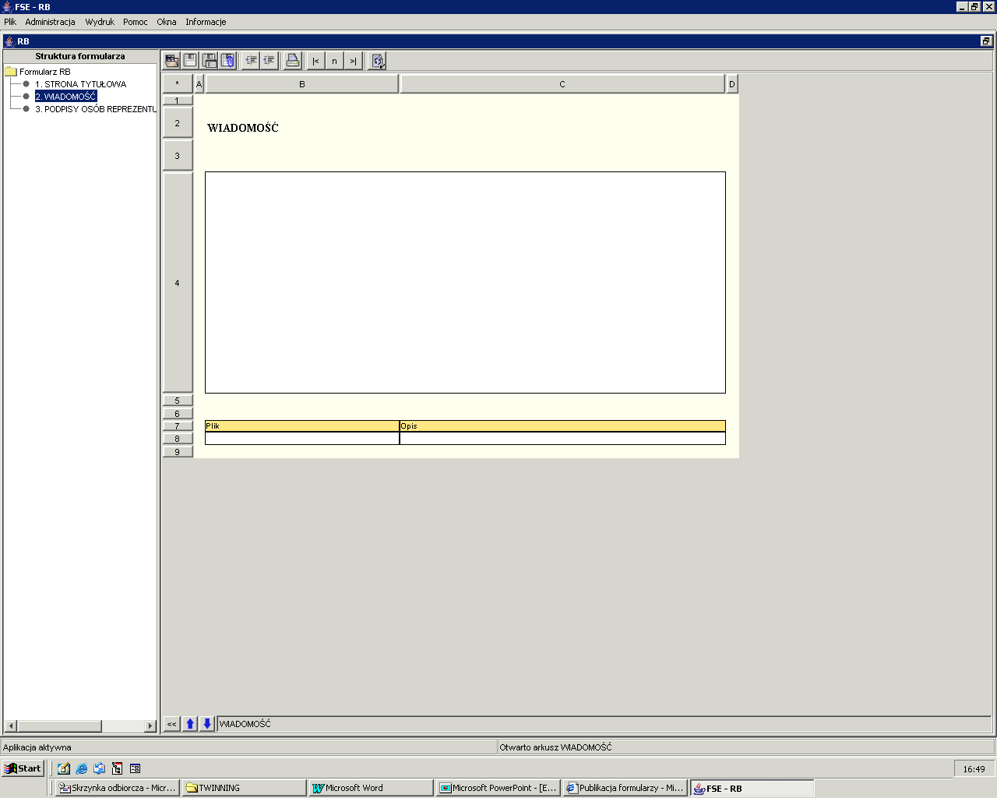
On-going / Transfer of information

Slide 20
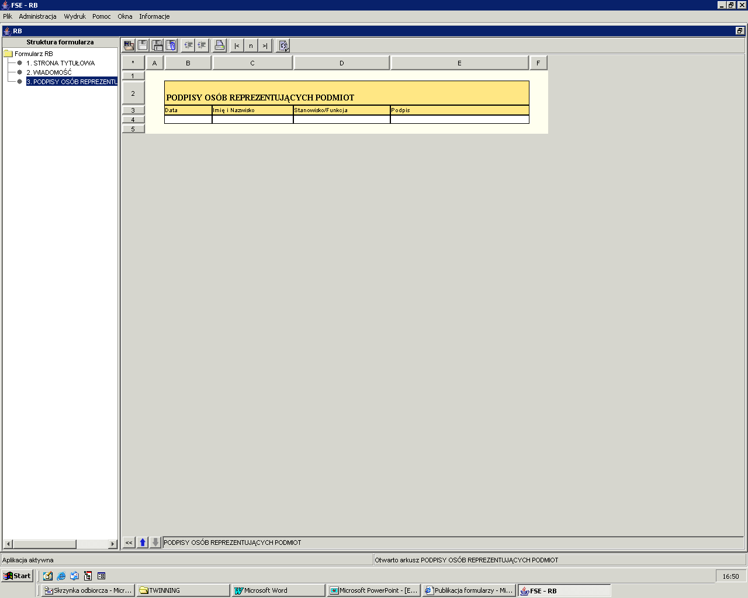
On-going / Transfer of information

Slide 21
Ex-post
Ex-post supervision component
Inspections
Administrative proceedings

Slide 22
Risk based approach
Scope of the risk-based-approach
operational risk
market risk
credit risk

Slide 23
Operational risk
Operational risk – population of risks attached to the different features and quality of the trading, settlement and valuation procedures operated by the Management Companies, which may increase the chances of losses due to human or technical errors (point of view of the UCITS investor).
From the UCITS point of view the most important are those operational risks that also affect investors’ interests by their direct impact on the fund’s portfolio.
Source: Risk management principles for UCITS
Ref: CESR/09-178

Slide 24
Market risk
Market risk - risk of fluctuations in the market value of the securities invested by the funds, which may vary over time (volatility clusters) reflecting different market conditions.
Theory suggests that, when financial transactions take place within efficient environments (markets populated by a plethora of marginal and symmetrically informed investors), asset prices embed all available information and, as a consequence, market risk can be considered as the only value-related relevant risk factor, either at the level of each security held by the fund or at the level of the entire portfolio.
Source: Risk management principles for UCITS
Ref: CESR/09-178

Slide 25
Credit risk
Credit risk
Counterparty risk
Issuer risk
Source: Risk management principles for UCITS
Ref: CESR/09-178

Slide 26
Opened part
Discussion
Questions

