Slide 1
Google searches and stock returns
Laurens Bijl, Glenn Kringhaug, Peter Molnár and Eirik Sandvik
Norwegian University of Science and Technology
Seminar at Masaryk University
December 17, 2015

Slide 2
Introduction
Google searches provide unique opportunity to study information gathering by economic agents.
Useful in many different fields, including economics and finance

Slide 3
Value of football players and google searches (joint with Neverlien)
We have very detailed panel data about players in the main UK football league
Performance (how many goals they scored, how much time they played,…)
Estimated market of the players
Google search data
Conclusions:
Value of each player depends on his characteristics, performance, etc.
But also on the google searches
Is this surprising?

Slide 4
Possible applications of google searches
Predicting mortgage applications
Predicting sales of various goods
Predicting macroeconomic variables that are known with delay (unemployment, GDP, …)
Useful in many different fields, including economics and finance
Many of these might be very useful, but main findings would be probably obvious

Slide 5
Google searches in finance
Stock returns are extremely difficult to predict
Large resources are put into it. If you can, you can earn tons of money
As a result, it is unclear whether google should predict stock returns
Even if yes, should high google searches predict high or low stock returns?
Therefore, basically any result is non-trivial.

Slide 6
Summary: google searches and stock returns
Can Google searches predict stock returns of individual companies?
Yes
Magnitude?
This effect if profitable even after transaction costs
Time scale?
Long lasting effect

Slide 7
What can explain stock returns?
Risk factors
Stock market risk => CAPM
Risk inherent in small companies => SMB (small minus big) factor
HML (high minus low) book-to-market ratio
Liquidity risk
…
This way of thinking is consistent with equilibrium (more risky investment needs to provide higher returns on average)

Slide 8
What can predict stock returns?
Very rich literature
The attention theory by Barber and Odean (2008):
Retail investors are net buyers of attention-grabbing stocks.
Investor attention results in a temporarily positive price pressure.
An increase in attention leads on to a buying pressure from uninformed investors.
In the long run, however, these stocks should underperform.
Google searches can be considered as a very good measure of investor attention.

Slide 9
What should we study?
Stock market as a whole?
Google searches => Stock market return
Or stock returns of individual companies?
Google searches => individual stocks’ returns
We choose individual stocks
Data reason
Search term reason

Slide 10
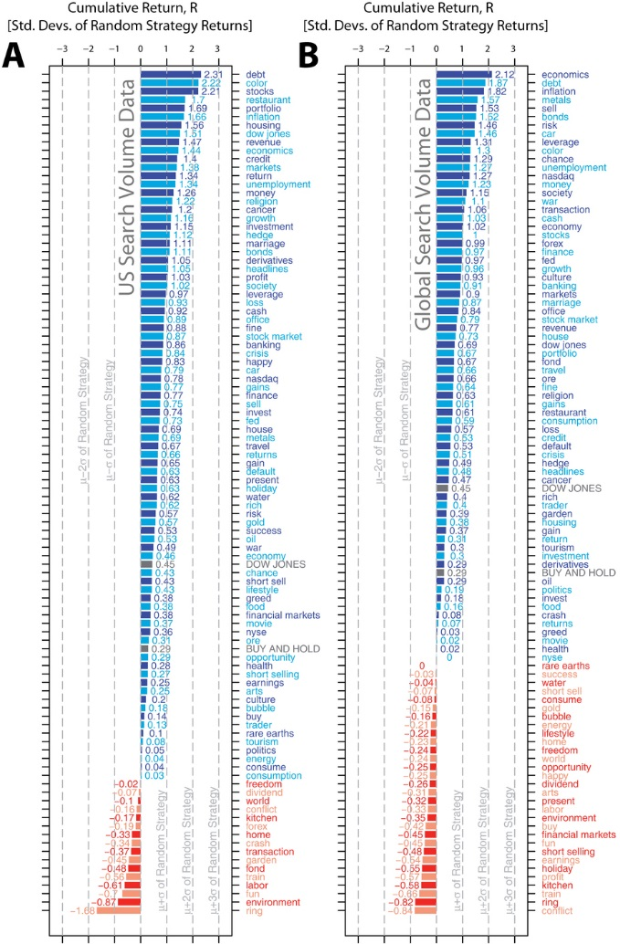
Google searches and stock market
Preis et al (2013):
“debt” predict stock market, but so does “color” …data snooping?

Slide 11
Literature
Da, Engelberg, Gao: In search for attention, JF2011 …the good one
Individual stocks
High Google searches over previous week predict high returns over 2 weeks with subsequent reversal
Our contribution:
Google searches not only over previous week, but also:
previous day (daily data)
Previous quarter (long-term effect)

Slide 12
Data
Companies in the S&P 1500 index
Due to data availability we end up with 519 companies
Main focus 2010 to 2014; also previous time periods, but with less stocks
Daily data (most existing research uses weekly data)

Slide 13
Raw and standardized Google searches
DD, DTE and FAST are tickers of three selected companies

Slide 14
Method
Panel data regression:
Return = α + βX, where X are explanatory variables:
Market return, SMB and HML factors …the same time index as return
Past return
Google searches …standardized (take away mean and standard deviation)
Volatility
Trading volume …standardized
Bid-ask spread
Daily, weekly and quarterly averages of all explanatory variables
Trading strategy based on regression results

Slide 15
Results: past returns
Standardized coefficients from regression
Bef

Slide 16
Bid-ask spread

Slide 17
Volatility

Slide 18
Volume

Slide 19
Google searches

Slide 20
Robustness
Large, medium and small companies:
In short-term (daily and weekly) google searches have very similar impact
Long-term impact is concentrated on “small” companies
Company name vs. ticker:
Very similar results (on smaller sample doe to tickers like “HOT” removed)
Google searches with financial filter
very similar results (on smaller sample)
Subperiods (2005 – 2007, 2007 – 2009, 2009 – 2011, 2012 – 2014)
Results are very similar in every single subperiod

Slide 21
Trading strategy
Predict performance of stocks, buy 25% best, sell 25% worst and combine this will buy-and-hold
Only past information (return, volatility, volume, bid-ask spread, Google searches)
Daily, weekly and monthly rebalancing
Benchmarks:
Equally weighted portfolio (not S&P 1500)
Benchmark strategy (predictors: return, volatility, volume, bid-ask spread)
Both excluding and including transaction costs

Slide 22
Cumulative excess return over buy-and-hold
Before transaction costs

Slide 23
Comparison vs. buy-and-hold
Before transaction costs, both daily, weekly and monthly rebalancing is profitable, after transaction costs only monthly rebalancing is profitable
Strategy that includes google searches outperforms both buy-and hold by 1.5% annually after transaction costs and 2.3% before t.c.
Sharpe ratio also improved
daily and weekly rebalancing does not work better even with no transaction costs
Therefore, superiority of monthly rebalancing is not solely due to transaction costs

Slide 24
CAR over benchmark trading strategy
Before transaction costs
After transaction costs

Slide 25
Comparison vs. benchmark strategy
Benchmark strategy based on past return, volatility, volume, bid-ask spread
Strategy with Google searches included perform better
Difference is larger for less frequent rebalancing

Slide 26
Conclusions
Google searches can predict stock returns
The effect is long-lasting
Short-term increase in google searches has negative impact on stock returns with subsequent partial reversal
Long-term increase in google searches has positive impact on returns
Stronger for smaller stocks, therefore likely even stronger on stocks we do not studied (outside S&P 1500)
significant also economically (trading); 1.5% / 2.3% annually
Useful particularly for infrequent trading

Slide 27
IPO (initial public offering)
Filing date (company officially announces IPO)
IPO date ….on average 15 weeks in between
We study whether google searches between filing and IPO date can predict first day and long term returns
First day return: return to institutional investors
Long term return: return to retail investor

Slide 28
Consensus about IPO
Large first day return
Small long-term returns
… in accordance with attention story

Slide 29
Literature
Da, Engelberg, Gao: In search for attention, JF2011
High Google searches predict:
positive first day returns
negative long-term returns
… in accordance with attention story

Slide 30
Our IPO results joint with Krogsrud, Lillefjaere, and Ween
Da, Engelberg, Gao: In search for attention, JF2011
High Google searches predict:
positive first day returns
positive long-term returns
We use different data (2011-2014)
We study impact of long-term increase/decrease in search activity

Slide 31
Google searches and FX (currency) volatility (joint with Young and Poulsson)
USD against AUD, CAD, CHF, EUR, GBP, JPY, NZD
Volatility models based on daily data (e.g. GARCH) need to calculate volatility as a moving average over many days due to noise
No surprise google searches can help
We use much more precise models based on the concept of Realized Variance calculated from high frequency data
Google searches anyways improve volatility forecasts

Slide 32
Google searches…
…and stock volatility: same results
… and post-earnings announcement drift: also interesting and significant results
Altogether, I conducted 5 studies (together with coauthors) on various topics and all found significant results

Slide 33
General conclusion
Use most broadly defined searches, e.g.
Not “EUR/USD”
Not “EUR USD”
Use instead “EUR”, “USD” and take average
It is important to distinguish long term and short term increase/decrease google searches

