Slide 1
Over/Under Reaction of Stock Markets
Presented By:
Ryan Pinjuv
Matthew Duplantis
Boyong Park
Richard Crocco

Slide 2
Does the stock market overreact?
By: Bondt and Thaler

Slide 3
Part 1: Introduction
Do Markets Over/Underreact?
Can past stock price movement predict future stock performance?
If stock prices systematically overreact, then their reversal should be predictable from past return data alone.

Slide 4
Two Hypotheses
Two hypotheses follow:
Extreme movements in stock prices will be followed by subsequent price movements in the opposite direction.
The more extreme the initial price movement, the greater the subsequent adjustment will be.
Both hypotheses imply a violation of weak-form market efficiency.

Slide 5
Efficient Market Hypothesis
Overreaction Hypothesis

Slide 6
Empirical Tests Performed
* Market-adjusted abnormal Returns
<= Residuals
1. NYSE common stocks(CRSP)
- 1926 – 1982
2. Portfolio Formation Period
- Compute Cumulative Abnormal Returns for 36 month
=>CUj=$\sum_{t=−35}^{t=0}{ujt}$ (Starting Dec 1932)
- Repeat this step for 16 times(1930-32,1933-35,….,1975-1977)
- Form portfolio with High 35 Stocks(W), Low 35 Stocks(L)
between 1930-1977 for 16 period.
3. Hold the winner and loser portfolio for 36 months, calculate
CAR of all the stocks in the portfolio for the next
36 months.(1933-35,1936-1938,….1978-1980)
Notes:
Cui= Cumulative excessive return
Portfolio formation Period; 1930-1932, 1933-1935…..1975-1977

Slide 7
Empirical Tests Performed
3. Calculate Average CARw,t and CARL,t (ACARw,t, ACARL,t)
- Overreaction Hypothesis, t>0, ACARw,t <0, ACARL,t>0
- [ACARL,t - ACARw,t] > 0 => Loser beats the Winner
4. T-test
Notes:
In order to judge whether, for any month t, the average residual return
makes a contribution to either ACARw,, or ACARL,~w,e can test whether it
is significantly different from zero. The sample standard deviation of the
winner portfolio is equal to
st = J c ~ = ~ = ~ ( A-RA~R,w~,t,I2~/N - 1.
Since s t / m represents the sample estimate of the standard error of ARw,t,
the t-statistic equals
Tt = ~~w,tl(~tlm).
Similar procedures apply for the residuals of the loser portfolio

Slide 8
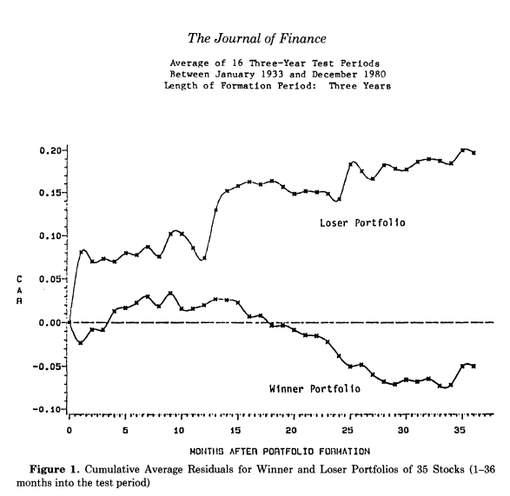
Result
Period(24-36)
Notes:
Loser is overreact much larger then Winner Portfolio. Must of the excessive returns realized in Jan.(t=1, 13, 25)
No reversal is observed for the period as short as one year.

Slide 9
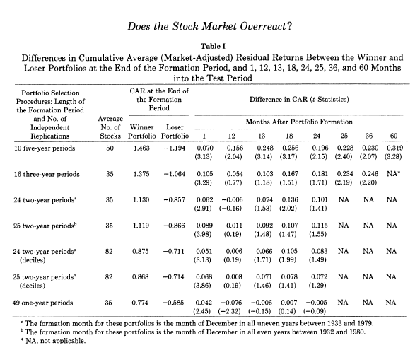
Result
Notes:
Average Betas of the winner portfolios are larger than loser. Loser portfolios not only outperform the winner portfolios but less risky

Slide 10
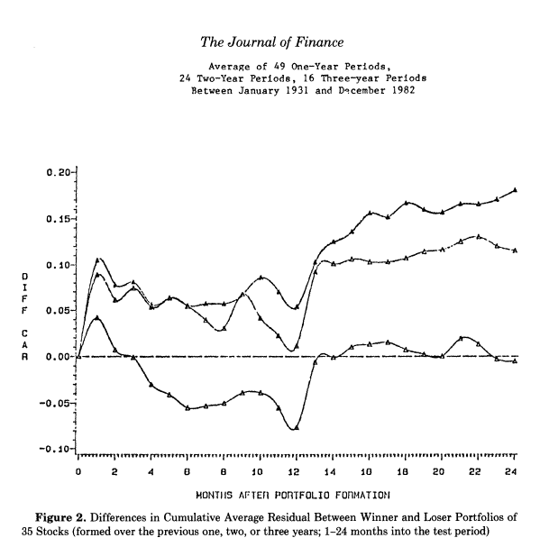
Result
(Loser PTFL – Winner PTFL)
3 Year
2 Year
1 Year
Winner>Loser
Notes:
Three year period(upper curve) exceeds the same statistic for the experiments based on two and one-year formation periods.
But those are clearly affected by the same underlying seasonal pattern.

Slide 11
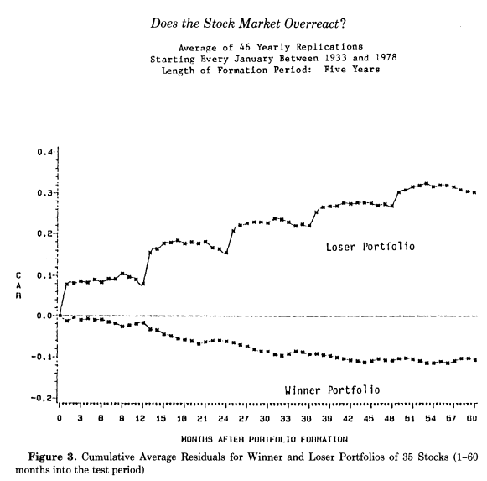
More January Effect
Notes:
60 month period, January effect can be found extensively, also Oct-Deb, decline in value because tax-loss selling hypothesis.

Slide 12
Empirical Results
The results of the tests are consistent with the overreaction hypotheses.
Over the last half-century, loser portfolios of 35 stocks outperform the market by an average of 19.6%, 36-months after portfolio formation.
Winner portfolios earn about 5% less than the market, so that the difference in cumulative average residual between the extreme portfolios equals 24.6%(t-stat:2.20).

Slide 13
Other Notable Findings
The overreaction effect is asymmetric, meaning it is much larger for losers than winners.
Most of the excess returns are realized in January.
The overreaction phenomenon mostly occurs during the 2nd and 3rd year of test period.
Results are insensitive to the choice of December as the choice of formation.
The hypothesis predicts that as we focus on stocks that go through more (or less) extreme return experiences, the subsequent price reversals will be more (or less) pronounced.
Loser portfolios not only outperform the winner portfolios; if the CAPM is correct, they are also significantly less risky.

Slide 14
Conclusion:“Does the Stock Market Overreact?”
Most people overreact to unexpected and dramatic news.
Consistent with the predictions of the overreaction hypothesis, portfolios of prior losers are found to outperform prior winners.
36 months after portfolio formation, the losing stocks have earned about 25% more than the winners, even though the latter are significantly more risky.
The large positive excess returns earned by the loser portfolio every January remains without explanation. The effect is observed as late as 5 years after portfolio formation.

Slide 15
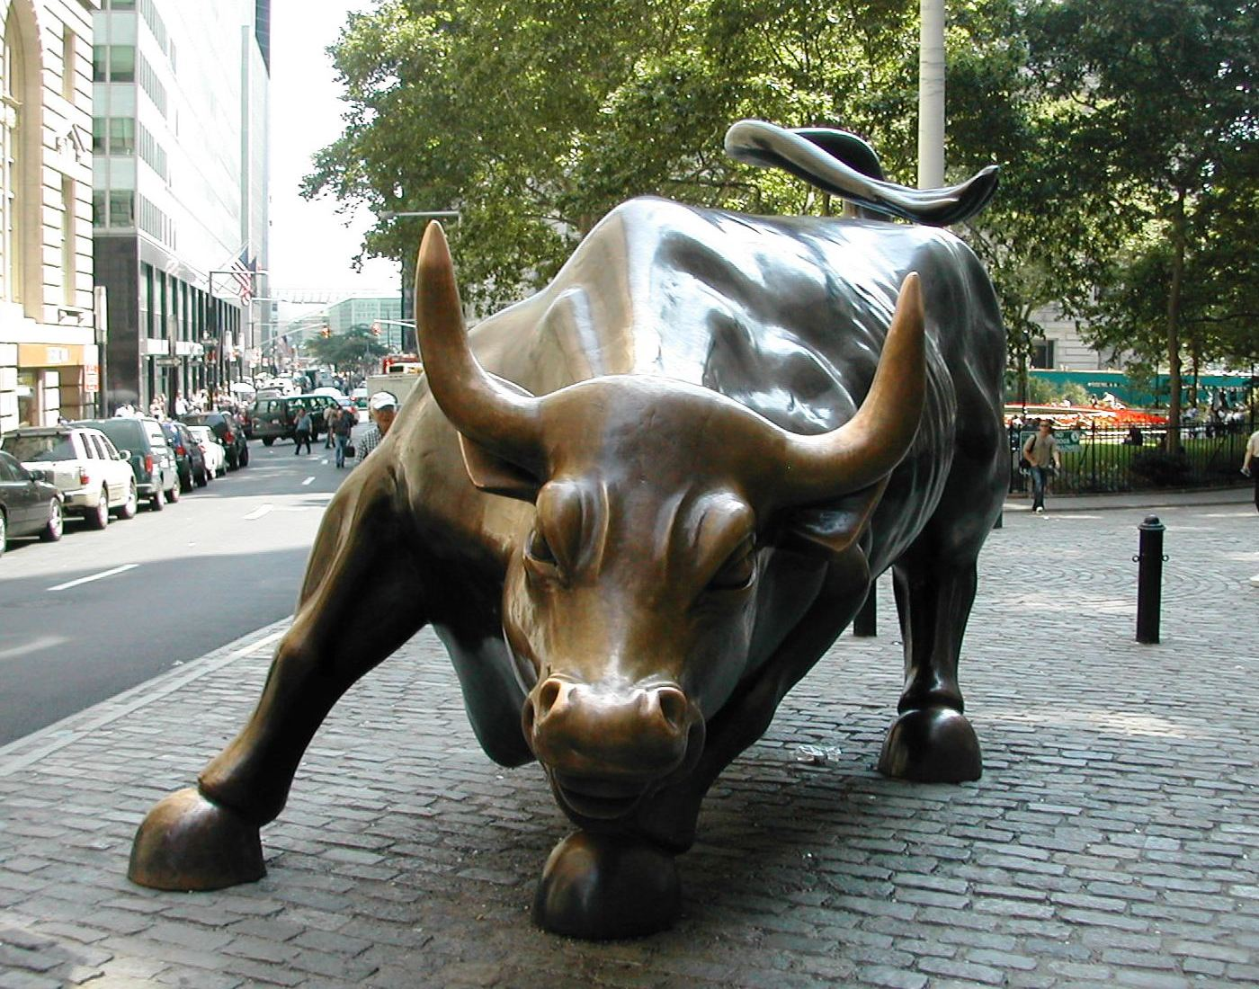
Returns to Buying Winners and Selling Losers: Implications for Stock Market Efficiency
By: Jegadeesh and Titman
(1993)

Slide 16
Part 2: Introduction
The purpose of this paper is to present another point of view based on shorter term results when compared to the longer term holding periods suggested in the De Bondt and Thaler paper
Specially they focused on portfolios that held their positions for no more than one year

Slide 17
Test
This paper tests Relative Strength strategies; which means it test strategies that use past stock performance to predict future performance.
They chose to focus on analyzing past returns of up to one year
The positions in the portfolios were held for up to one year
The sample period was for the NYSE & AMEX for the years 1965-1989
There were a total of 32 portfolios created in the process

Slide 18
Portfolio Creation
Panel A: First set of 16 portfolios
Use past 3,6,9, or 12 month performance to pick stocks for the portfolio
Holding periods of 3,6, 9 or 12 months.
Panel B: A second set of 16 portfolios
a 1 week lag time between the observation period and the formation of the portfolio.
Use past 3,6,9, or 12 month performance to pick stocks for the portfolio
Holding periods of 3,6, 9 or 12 months.

Slide 19
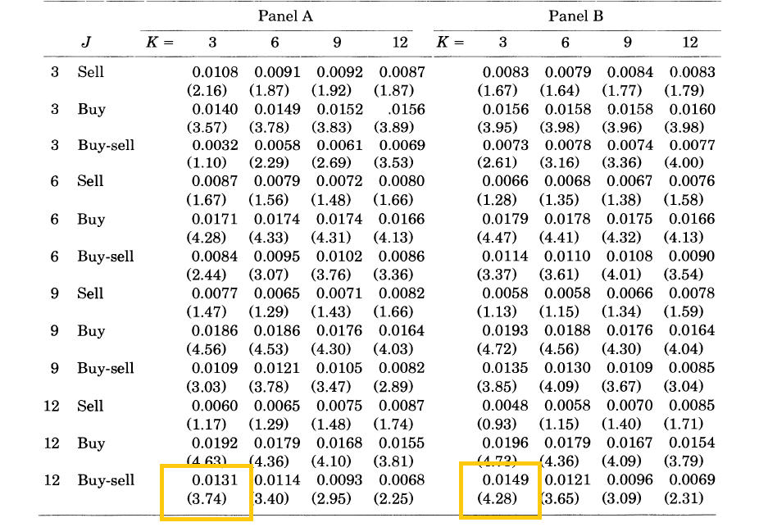
Results

Slide 20
Results Discussion
Panel A:
Buy minus sell portfolios resulted in positive returns throughout the panel meaning portfolios comprised of past winners outperformed portfolios comprised of past losers.
This was most pronounced in the 12 month formation period, 3 month holding period
Panel B
Same 12 month observation period followed by a 3 month holding period yielded the highest difference between the results

Slide 21
Interpretation of Results
Over the short term, portfolios that are comprised of winning stocks preform better than portfolios comprised of loser stocks.
These results are different than what was proposed in the Be Bondt and Thaler paper however the two papers did look at different observation and holding periods.

Slide 22
Results from DeBont & Thaler
Period(24-36)
Notes:
Loser is overreact much larger then Winner Portfolio. Must of the excessive returns realized in Jan.(t=1, 13, 25)
No reversal is observed for the period as short as one year.

Slide 23
Testing was conducted to determine if these results were due to other systematic risks:
Additional tests focused on 6 month observation with 6 month holding periods which are considered representative of all 32 strategies.
The first test focused on Beta and Market Cap

Slide 24
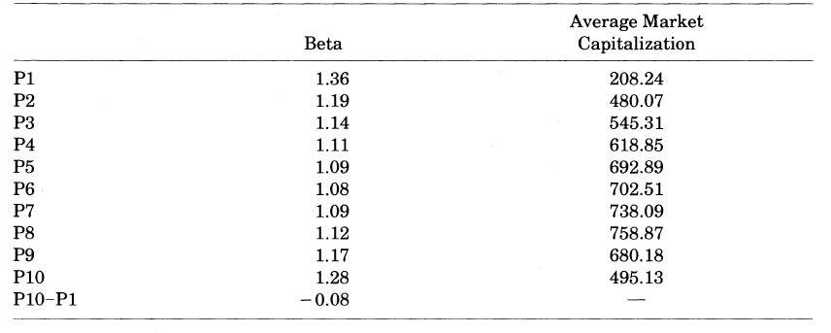
Beta and Market Cap Test
Changes in Beta and Market Cap among different portfolios do not explain the results in Panals A & B.

Slide 25
Additional Test done to try and explain results in Panel A & B
January Effect
Covariance
Lead-Lag Effects
None of these tests gave indication that the results found in Panels A & B are the result of some other systematic risk.

Slide 26
Conclusion
Bondt & Thaler
- Past losers outperformed past winners
over 3-5 year period.
- January effect is large portion of the return and
last up to 5 years.
Jegadeesh & Titman
- Over the short term, winner stocks PTFO
perform better than loser PTFO stocks.(12/3)
- However, this momentum disappears after
holding more than 12 months.

