Slide 1
PowerPoint Presentation to Accompany Management Third Canadian Edition John R. Schermerhorn, Jr. Barry Wright
Prepared by: Jim LoPresti
University of Colorado, Boulder
Revised by: Dr. Shavin Malhotra
Ryerson University, Toronto, Ontario

Slide 2
Ethics, Social Responsibility, and Sustainability

Slide 3
Chapter 4 Learning Objectives
4.1 Define ethical behaviour.
4.2 Describe how ethical dilemmas complicate the workplace.
4.3 Explain how to maintain high ethical standards.
4.4 Describe what is social responsibility, governance, and sustainability and explain the significance of each.

Slide 4
What Is Ethical Behaviour?
Ethics
Code of moral principles
Set standards of “good” or “bad” or “right” or “wrong” in one’s conduct.
Ethical behaviour
What is accepted as good and right in the context of the governing moral code.

Slide 5
What Is Ethical Behaviour?
Law, Values, and Ethical Behaviour:
Legal behaviour is not necessarily ethical behaviour.
Personal values help determine individual ethical behaviour.

Slide 6
What Is Ethical Behaviour?
Law, Values, and Ethical Behaviour:
Values are broad beliefs about what is appropriate behaviour.
Terminal values—references about desired ends
Instrumental values—preferences regarding the means to desired ends

Slide 7
What Is Ethical Behaviour?
Alternative Views of Ethics
Utilitarian view
greatest good to the greatest number of people
Individualism view
primary commitment is to one’s long-term self-interests

Slide 8
What Is Ethical Behaviour?
Alternative Views of Ethics continued
Moral-rights view
respects and protects the fundamental rights of all people
Justice view
fair and impartial treatment of people according to legal rules and standards
Procedural justice: policies and rules fairly applied
Distributive justice: equal treatment for all people
Interactional justice: people treated with dignity and respect

Slide 9
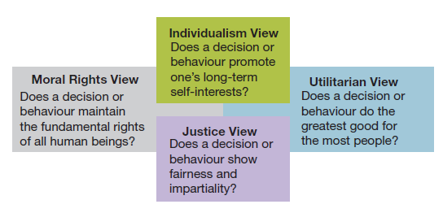
Figure 4.1 Four views of ethical behaviour.
What Is Ethical Behaviour?

Slide 10
What Is Ethical Behaviour?
Cultural Issues in Ethical Behaviour:
Cultural relativism
Ethical behaviour is always determined by cultural context.
Cultural universalism
Behaviour unacceptable in one’s home environment should not be acceptable anywhere else.
Considered by some to be ethical imperialism

Slide 11
What Is Ethical Behaviour?
Figure 4.3 Cultural relativism and universalism in international business ethics.
Source: Developed from Thomas Donaldson, “Values in Tension: Ethics Away from Home,” Harvard Business Review, vol. 74 (September-October 1996), pp. 48-62.

Slide 12
What Is Ethical Behaviour?
How international businesses can respect core or universal values:
Respect for human dignity:
Create a culture that values employees, customers, and suppliers.
Maintain a safe workplace.
Produce safe products and services.
Respect for basic rights
Protect rights of employees, customers, and communities.
Avoid anything that threatens safety, health, education, or living standards.
Be good citizens
Support social institutions, including economic and educational systems.
Work with local government and institutions to protect the environment.

Slide 13
Ethics in the Workplace
An ethical dilemma occurs when choices, although having potential for personal and/or organizational benefit, may be considered unethical.
Ethical dilemmas include:
Discrimination
Sexual harassment
Conflicts of interest
Customer confidence
Organizational resources

Slide 14
Ethics in the Workplace
Checklist for dealing with ethical dilemmas:
Recognize the ethical dilemma
Get the facts
Identify your options
Test each option: Is it legal? Is it right? Is it beneficial?
Decide which option to follow
Double-check decision by asking “spotlight” questions:
“How would I feel if my family found out about my decision?”
“How would I feel about this if my decision were in the local news?”
Take action

Slide 15
Ethics in the Workplace
Situational Context and Ethics Intensity:
Situational context: ethics intensity or issue intensity indicates the degree to which a situation is recognized to pose ethical challenges
Personal Factors and Moral Development:
Family influences, religious values, personal and financial needs: ethical framework is a personal rule or strategy for making ethical decisions

Slide 16
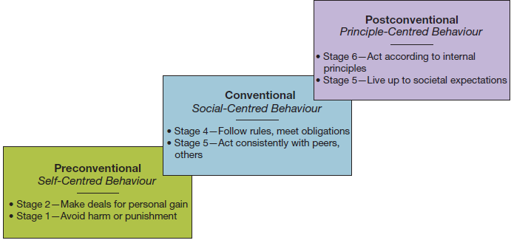
Figure 4.5 Kohlberg’s levels of individual moral development
Ethics in the Workplace
Kohlberg’s levels of individual moral development:
preconventional level
conventional level
postconventional level

Slide 17
Ethics in the Workplace
Internal Environment and Ethics Culture
Supervisory behaviour, peer group norms and behaviour, and policy statements and written rules influence ethical behaviour.
External Environment and Industry Norms
Government laws and regulations, societal norms and values, and competitive climate in an industry influence ethical behaviour.

Slide 18
Ethics in the Workplace
Ethical behaviour can be rationalized by convincing yourself that:
behaviour is not really illegal
behaviour is really in everyone’s best interests
nobody will ever find out
the organization will “protect” you

Slide 19
Maintaining High Ethical Standards
Whistleblowers
Expose the misdeeds of others to:
Preserve ethical standards
Protect against wasteful, harmful, or illegal acts
Laws protecting whistleblowers vary
Barriers to whistleblowing include:
Strict chain of command
Strong work group identities
Ambiguous priorities

Slide 20
Maintaining High Ethical Standards
Ethics Training:
Structured programs that help participants to understand ethical aspects of decision making.
Helps people incorporate high ethical standards into daily life.
Helps people deal with ethical issues under pressure.

Slide 21
Maintaining High Ethical Standards
Codes of Ethics:
Formal statement of an organization’s values and ethical principles regarding how to behave in situations susceptible to the creation of ethical dilemmas.
Areas often covered by codes of ethics:
Bribes and kickbacks
Political contributions
Honesty of books or records
Customer/supplier relationships
Co-worker relationships
Confidentiality of corporate information

Slide 22
Maintaining High Ethical Standards
Ethical Role Models:
Top managers serve as ethical role models.
All managers can influence the ethical behaviour of people who work for and with them.
Excessive pressure can foster unethical behaviour.
Managers should be realistic in setting performance goals for others.

Slide 23
Maintaining High Ethical Standards
Moral Management:
Immoral manager: chooses to behave unethically
Amoral manager: fails to consider the ethics of her or his behaviour
Moral manager: makes ethical behaviour a personal goal

Slide 24
Maintaining High Ethical Standards
Moral managers influence organizations through:
Ethics mindfulness:
Enriched awareness that leads to consistent ethical behaviour.
Causes a person to behave ethically from one situation to the next.
Can affect the “ethics of gravity” for the organization as a whole.

Slide 25
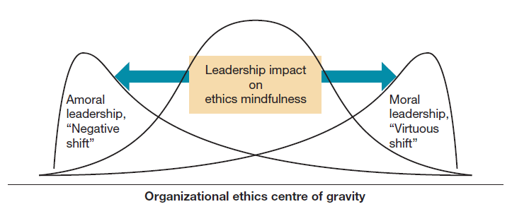
Figure 4.8 Moral management and the ethics centre of gravity in an organization.
Maintaining High Ethical Standards

Slide 26
Maintaining High Ethical Standards
Social entrepreneurship: a unique form of entrepreneurship that seeks novel ways to solve pressing social problems at home and abroad
Housing and job training for homeless
Bringing technology to poor families
Improving literacy among disadvantaged youth
Offering small loans to start minority-owned businesses
Corporate social responsibility: Obligates organizations to act in ways that serve both its own interests and the interests of society at large.

Slide 27
Social Responsibility, Governance, and Sustainability
Stakeholders
Those persons, groups, and other organizations directly affected by the behaviour of the organization and holding a stake in its performance.
Typical organizational stakeholders
Employees
Customers
Suppliers
Owners
Competitors
Regulators
Interest groups

Slide 28
Social Responsibility, Governance, and Sustainability
Perspectives on Social Responsibility:
Classical view: management’s only responsibility is to maximize profits.
Socioeconomic view: management must be concerned for the broader social welfare, not just profits.

Slide 29
Social Responsibility, Governance, and Sustainability
Criteria for evaluating corporate social performance:
Social responsibility audit – assesses organization’s accomplishments in areas of CSR
Determine if the organization meets its:
economic responsibility; is it profitable?
legal responsibility; does it obey the law?
ethical responsibility; is it doing the “right” thing?
discretionary responsibility; does it contribute to the broader community?

Slide 30
Fig. 4.12 Criteria for evaluating corporate social performance.
Social Responsibility, Governance, and Sustainability

Slide 31
Social Responsibility, Governance, and Sustainability
Strategies for pursuing social responsibility:
Obstructionist — meets only economic responsibilities.
Defensive — meets economic and legal responsibilities.
Accommodative — meets economic, legal, and ethical responsibilities.
Proactive — meets economic, legal, ethical, and discretionary responsibilities.

Slide 32
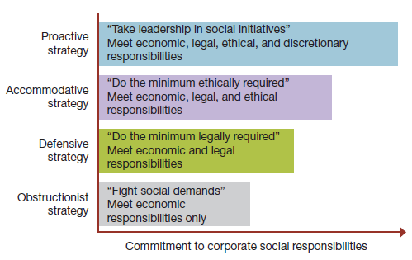
Social Responsibility, Governance, and Sustainability
Figure 4.13 Four strategies of corporate social responsibility—from obstructionist to proactive behaviour.

Slide 33
Social Responsibility, Governance, and Sustainability
Corporate governance:
The oversight of the top management of an organization by a board of directors.
Corporate governance involves:
hiring, firing, and compensating the CEO
assessing strategy
verifying financial records

Slide 34
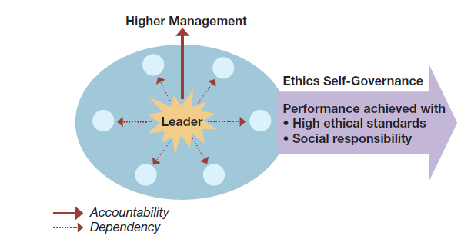
Social Responsibility, Governance, and Sustainability
Figure 4.14 Ethics self-governance in leadership and the managerial role.

Slide 35
Social Responsibility, Governance, and Sustainability
Sustainability:
Development that meets the needs of the present without compromising the ability of future generations to meet their own needs.
Sustainability focuses on:
social rights
environmental protection
economic development

Slide 36
Social Responsibility, Governance, and Sustainability
Benefits of sustainability:
Cost reduction
Resource preservation
Legislative compliance
Positive reputation
Right initiative

Slide 37
Social Responsibility, Governance, and Sustainability
What does a sustainable company look like?
CEO leads the charge
Board of directors and employees are actively involved
Resources are adequately allocated
Follows a holistic approach
Recognized as a sustainable leader

Slide 38
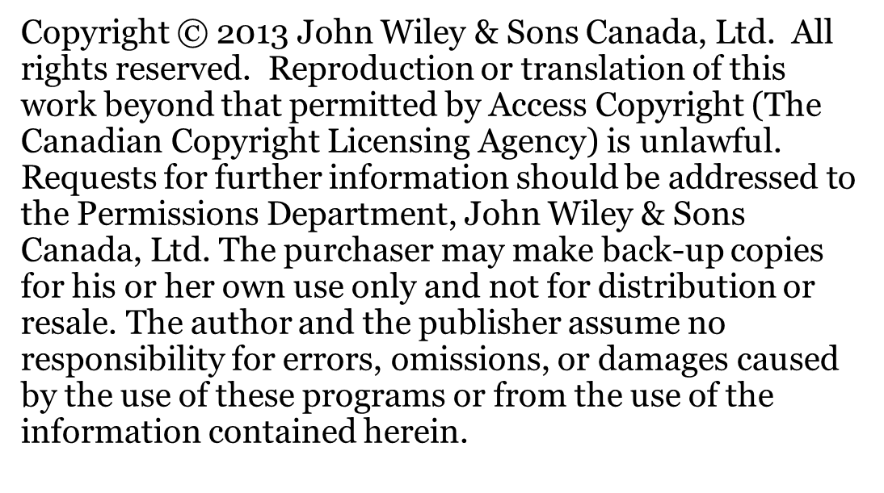
Social Responsibility, Governance, and Sustainability

