Slide 1
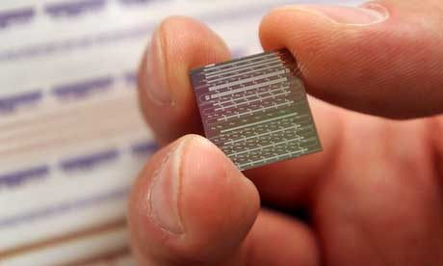
Silicon wafers
Silicon wafer
Microchips are made on silicon wafers.
www.guardian.co.uk
Notes:
Pass out silicon wafers. This is what they print on to make microchips.

Slide 2
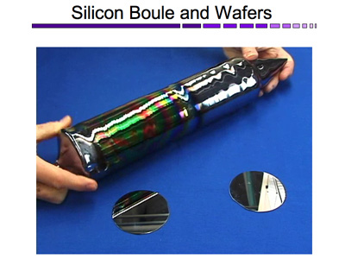
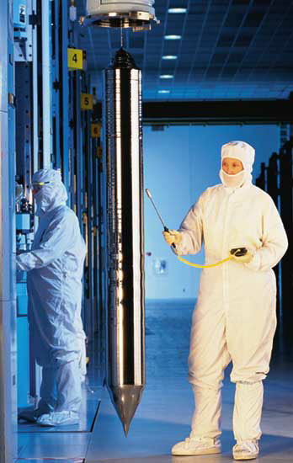
http://mrsec.wisc.edu
en.wikipedia.org
Wafers are cut from boules, which are large logs of uniform silicon.
Looking at this picture, where do you think silicon boules are made? Why do you think so?
Notes:
Those silicon wafer are cut from large pieces of silicon, called boules. Where do you think boules are made based on this picture? What is the person wearing? Where are they if they’re wearing that equipment? (Answer: Clean Room) Yes, silicon wafers need to be pure and very flat to make microchips, and that means no dust!

Slide 3
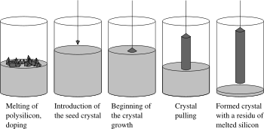
Making silicon boules
Czochralski process:
Melting of polysilicon
Introduction of seed crystal
Beginning of crystal growth
Crystal pulling
Formed crystal
What is silicon?
en.wikipedia.org
Notes:
How do you making a silicon boule? (Walk through process)
Okay, but what is silicon in the first place?

Slide 4
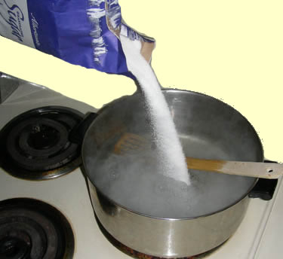
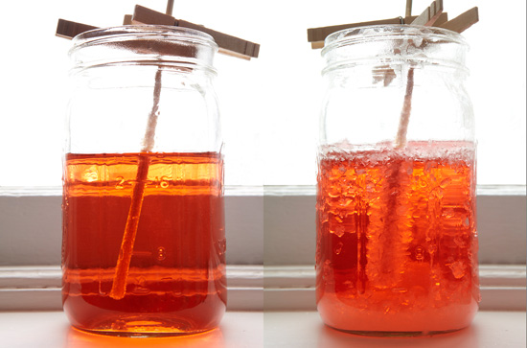
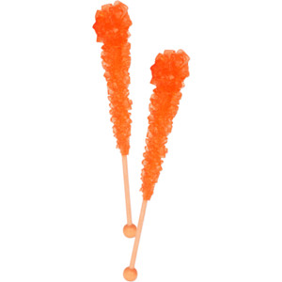
Czochralski process:
Have you ever made rock candy?
What could be some things that the Czochralski process and making rock candy have in common?
What could be some ways that they are different?
Melting of polysilicon
Introduction of seed crystal of silicon
Beginning of crystal growth
Crystal pulling
Formed crystal
Making rock candy:
Dissolve excessive amounts of sugar in water
Introduction of seed crystal of sugar
Many crystals grow on stick
Formed crystals
Notes:
How do you making a silicon boule? (Walk through process)
Okay, but what is silicon in the first place?

Slide 5
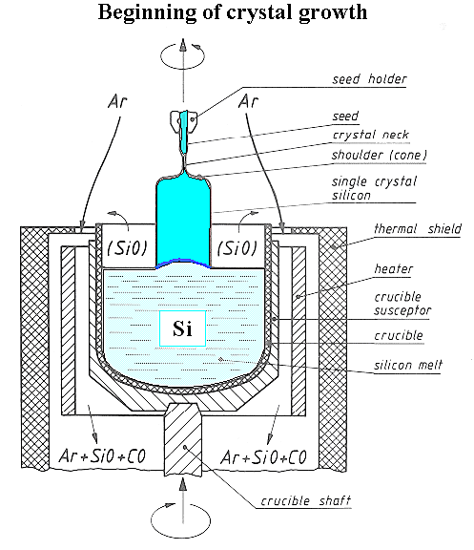
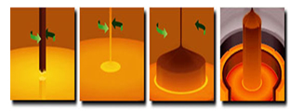
So silicon is made in the Czochralski process, but what is silicon?
What are some things you know about silicon?
en.wikipedia.org
Notes:
How do you making a silicon boule? (Walk through process)
Okay, but what is silicon in the first place?

Slide 6

What is silicon?
Made from silica
Second most abundant element in the Earth’s crust
(sand, rocks, dirt…)
(Guess what’s most common?)
mywedding.com
Notes:
Oxygen is the most abundant element in the Earth’s crust (O, 46.1%, Si 28.2%) http://education.jlab.org/glossary/abund_ele.html

Slide 7
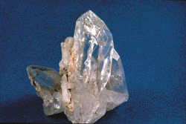
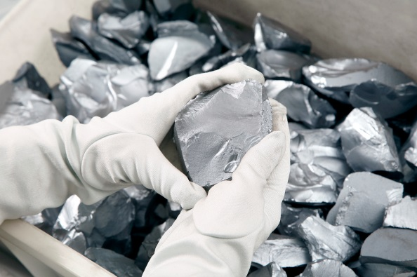
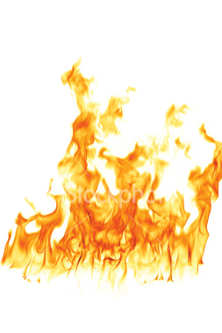
What is silicon?
High-Purity Silica
SiO₂
Electric furnace, high temperatures (over 1900°C!)
Si (polysilicon)
Si
energyandcapital.com
Notes:
Silicon is commercially prepared by the reaction of high-purity silica with wood, charcoal, and coal, in an electric arc furnace using carbon electrodes. At temperatures over 1900 °C, the carbon reduces the silica to silicon according to the chemical equation
SiO2 + C → Si + CO2

Slide 8
Video: Making Silicon Wafers
How do they do it: Silicon Wafers
http://www.youtube.com/watch?v=aWVywhzuHnQ
Notes:
en.wikipedia.org

Slide 9
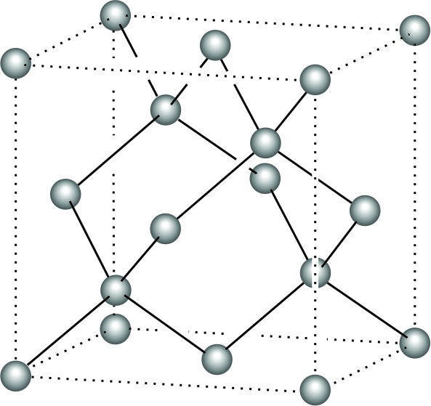
Activity: Cutting Silicon Wafers
Crystalline silicon is strong but brittle.
Crystalline structure
(repeating pattern)
has plane lines that
can break.
http://www.youtube.com/watch?v=MlsxGjJuL7s
Si Unit Cell
Notes:
hyperphysics.phy-astr.gsu.edu
http://www-inst.eecs.berkeley.edu/~ee130/fa07/lectures/Semiconductor_fundamentals_lec1.pdf
blog.oup.com

Slide 10
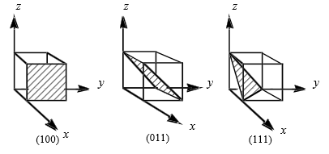
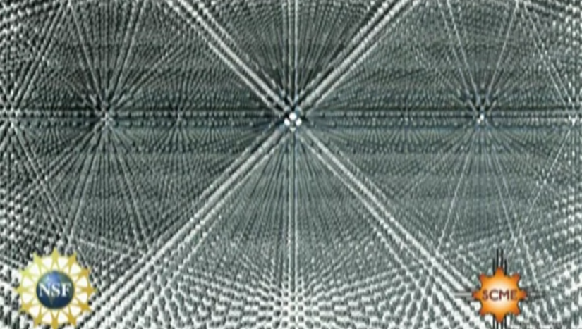
Activity: Cutting Silicon Wafers
Where are the plane lines?
Different sides of unit cell have different names.
Si breaks 90° to the (100) plane
(100) plane
Notes:
hyperphysics.phy-astr.gsu.edu
http://www-inst.eecs.berkeley.edu/~ee130/fa07/lectures/Semiconductor_fundamentals_lec1.pdf

Slide 11
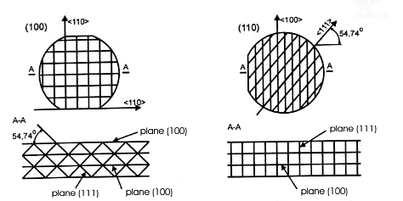
Activity: Cutting Silicon Wafers
Breaks 90° to the (100) plane
How will each wafer break? Why?
Add the wafers and your predictions to
your lab notebook.
Top
Side
Notes:
Printed copy of the wafer diagrams for them to paste into their notebooks.

Slide 12
Activity: Cutting Silicon Wafers
Using a diamond cutter, find the orientation of your wafer
Record your observations
or
Notes:
How is wafer of the left going to break? How is the wafer on the right? (record in notebook) Now try your wafer, which do you think it is?

Slide 13
Video: Making Silicon Wafers
How do they do it: Silicon Wafers
http://www.youtube.com/watch?v=aWVywhzuHnQ
Notes:
en.wikipedia.org

