Slide 1
An evaluation of in vitro and in vivo toxicity of chitosan-pDNA polyplexes
Kae Amaraporn
The Department of Pharmaceutics and Translational Therapeutics College of Pharmacy

Slide 2
Gene delivery to lung
The transmission of DNA encoding for therapeutic gene or protein into the target cells for prevention or treatment of disease
Potential treatment for
Cystic fibrosis, Asthma
Advantages
Easily accessible via airways
Large surface area for transfection
Reduces the risk of systemic side effects
Disadvantages
Repulsion between DNA & cell membrane due to same charge
Enzymatic degradation
Mohammadi, Z., et al., In vivo transfection study of chitosan-DNA-FAP-B nanoparticles as a new non viral vector for gene delivery to the lung. Int J Pharm, 2011. 421(1): p. 183-8. Albelda, S.M., R. Wiewrodt, and J.B. Zuckerman, Gene therapy for lung disease: hype or hope? Ann Intern Med, 2000. 132(8): p. 649-60.
Notes:
Gene therapies utilizing modified viruses or plasmid DNA (pDNA) to re-introduce functional copies of defective or mutated genes
are being investigated for the treatment of a wide range of lung diseases
CF is caused by the mutations in the gene encoding the Cystic Fibrosis Transmembrane Conductance Regulator protein (CFTR)
CF: transporting Cl- and Na+ across the epithelial membrane
CF: mucous build up, decrease mucocillary clearance and inflammation
Disadvantages for gene delivery to the lung
Insufficient gene delivery
Inflammatory response

Slide 3
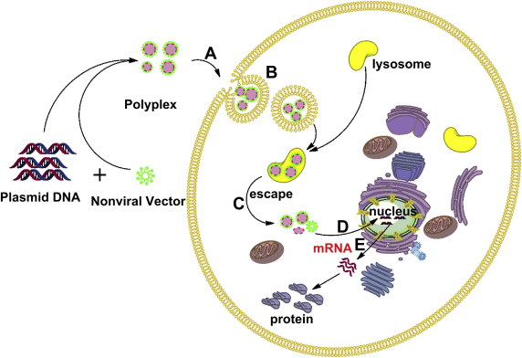
Cationic polymers:DNA complex
Storrie, H. and D.J. Mooney, Sustained delivery of plasmid DNA from polymeric scaffolds for tissue engineering. Adv Drug Deliv Rev, 2006. 58(4): p. 500-14.
Shan, Y., et al., Gene delivery using dendrimer-entrapped gold nanoparticles as nonviral vectors. Biomaterials, 2012. 33(10): p. 3025-35.
Notes:
Advantages:
condense DNA into a small particle, low immunogenicity, easy to manufacture
Disadvantages:
Toxicity, low transfection effieicncy and lack of biodegradability and biocompatibility
Acidic endosome buffering (pH 7.4)
At lower pH, the buffering by PEI causes an influx of Cl- and H2O into endosomes which eventually burst out due to the osmotic pressure then facilitating intracellular release of the complex

Slide 4
Bacterial plasmids
Bacterial plasmids are circular DNA which can replicated independently of the bacterial chromosome.
Bacterial DNA is rich in unmethylated CpGs
activate the immune system
induce inflammatory response (in vivo)
decrease transgene expression
This study, we studied 2 types of pDNAs
CpG(-) is a plasmid free of CpG
CpG(+) is a plasmid containing CpG
www.qiagen.com
Notes:
CpG: unmethylated 2’-deoxyribo (cytidine-phosphateguanosine)
The best nanoplex is high transfection efficiency, low toxicity, low or non-induced inflammatory response
Recently, there are studies shows that CpG motifs in plasmids are associated with…
↓ Transgene expression
Induce inflammatory response (in vivo)

Slide 5
Objectives
To characterized and optimized chitosan/pDNA polyplex formulations
Size and charge
Ability to condense plasmids
To investigate the toxicity and transfection efficiency in A549 and HEK293
MTS assay
Luciferase assay
To investigate the inflammatory response induced by the polyplexes in a mouse model

Slide 6
Experiments and Results

Slide 7
Objectives
To characterized and optimized chitosan/pDNA polyplex formulations
Size and charge
Ability to condense plasmids
To investigate the toxicity and transfection efficiency in A549 and HEK293
MTS assay
Luciferase assay
To investigate the inflammatory response induced by the polyplexes in a mouse model

Slide 8
Preparation of the chitosan/pDNA polyplex
(+) charged polyelectrolyte was poured into (-) charged polyelectrolyte then vortexted for 20-30 s leading to the formation of the polyplexes
30 min
Chitosan
in Acetate buffer
CH/DS-pDNA
nanoplex
pDNA
Dextran
sulfate
*pDNA 50 ug/ml *CH:DS = 10:1 (w/w)
*Concentration of chitosan depends on N/P ratios

Slide 9
Characterization
Size
Charge
CH/CpG(-)
CH/CpG(+)
Notes:
- The nanoplexes were measured by Zetasizer Nano ZS in acetate buffer, pH 5.46, at 25°C. Data expressed as mean ± SD (n=3).

Slide 10
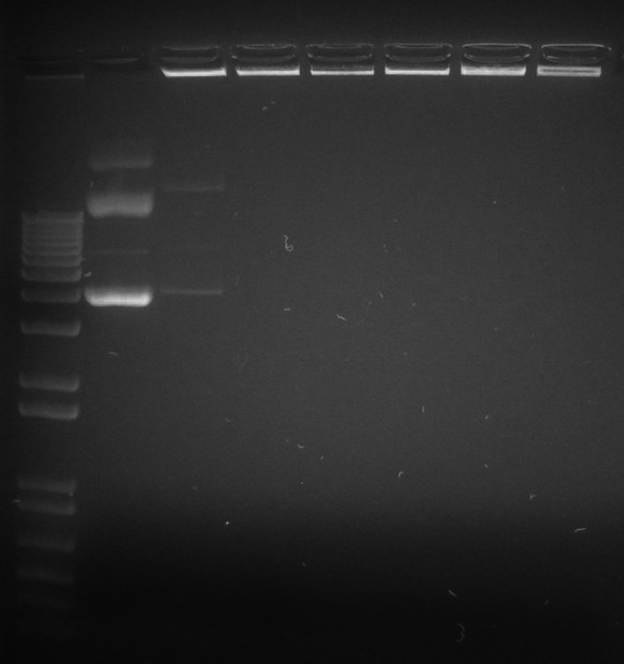
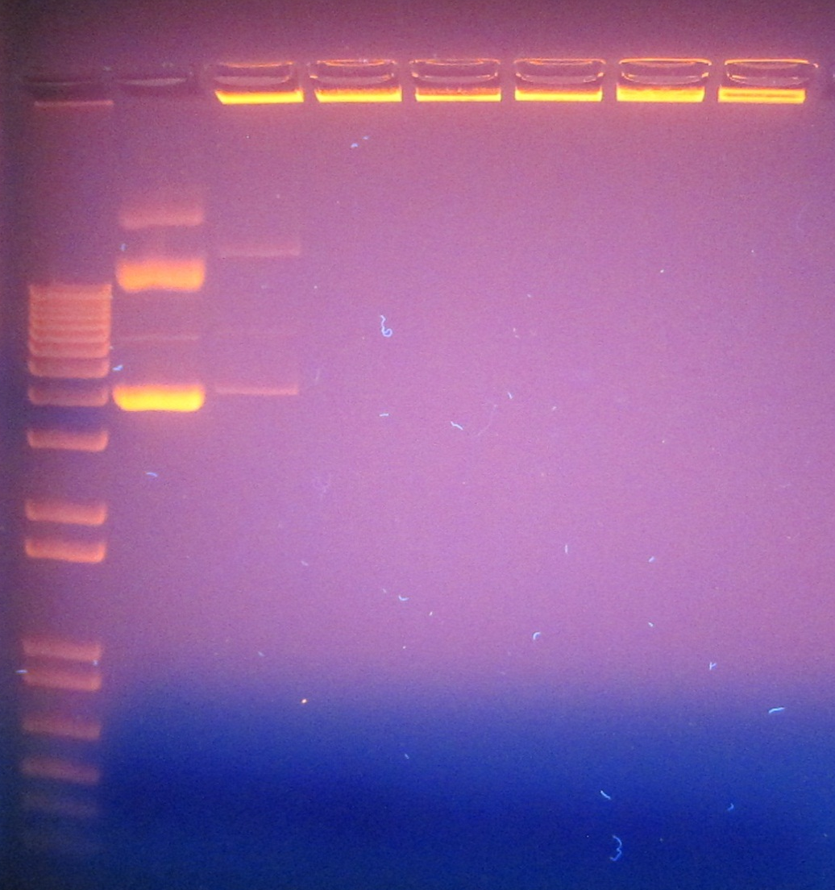
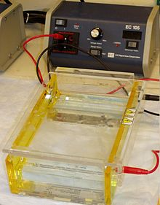
Gel Retardation Assay
DNA ladder
pDNA
N/P 1
N/P 5
N/P 10
N/P 20
N/P 60
N/P 100
1% Agarose gel contains ethidium bromide loaded with CH/CpG(+) polyplexes.
Chitosan can entrapped pDNA and inhibit DNA migration at N/P ratios > 1.
Notes:
Condensation of DNA by chitosan

Slide 11
Objectives
To characterized and optimized chitosan/pDNA polyplex formulations
Size and charge
Ability to condense plasmids
To investigate the toxicity and transfection efficiency in A549 and HEK293
MTS assay
Luciferase assay
To investigate the inflammatory response induced by the polyplexes in a mouse model

Slide 12
Cell lines
A549
Human lung carcinoma
HEK293
Human embryonic kidney
www.atcc.org
Notes:
A549 – adenocarcinomic human alveolar basal epithelial cells
Squamous Adherent cells
They grow as monolayer cells
HEK293

Slide 13
Cationic polymers:DNA complex
Storrie, H. and D.J. Mooney, Sustained delivery of plasmid DNA from polymeric scaffolds for tissue engineering. Adv Drug Deliv Rev, 2006. 58(4): p. 500-14.
Shan, Y., et al., Gene delivery using dendrimer-entrapped gold nanoparticles as nonviral vectors. Biomaterials, 2012. 33(10): p. 3025-35.
Notes:
Advantages:
condense DNA into a small particle, low immunogenicity, easy to manufacture
Disadvantages:
Toxicity, low transfection effieicncy and lack of biodegradability and biocompatibility
Acidic endosome buffering (pH 7.4)
At lower pH, the buffering by PEI causes an influx of Cl- and H2O into endosomes which eventually burst out due to the osmotic pressure then facilitating intracellular release of the complex

Slide 14
Transfection efficiency
Firefly luciferase activity assay
Firefly luciferase is
61kDa protein – cosubstrate to catalyzes luciferin oxidation
sensitive assay to study gene expression
www.promega.com
Notes:
Firefly luciferase: good reporter to study gene expression because
The reporter activity is available immediately upon the translation since the protein does not require post translational processing
The protein does not require post translational procession
The assay is very sensitive because its light production has the highest quantum effiency known for any chemiluminescent reaction and no background luminescence is found in the host cells or the assay chemistry
The assay is rapid requiring only a few seconds per sample
luciferin + ATP → luciferyl adenylate + PP_{i}
luciferyl adenylate + O₂ → oxyluciferin + AMP + light
Translation: Wikipedia
The third stage of protein biosynthesis (part of the overall process of gene expression).
mRNA produced by transcription is decoded by the ribosome to produce a specific amino acid chain which will later fold into an active protein.
In bacteria, the translation occurs in the cell’s cytoplasm.
In eukaryotes, it occurs across the membrane of endoplasmic reticulum. (tRNA)
Initiation, elongation, translocation and terminition

Slide 15
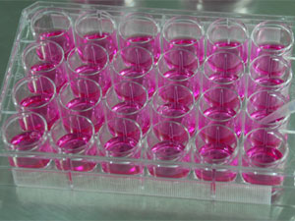
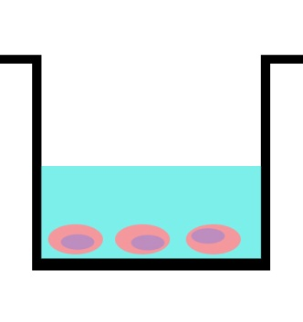
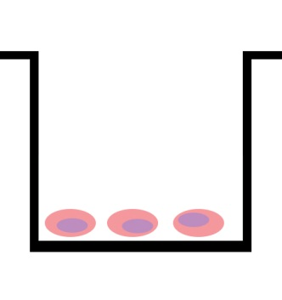
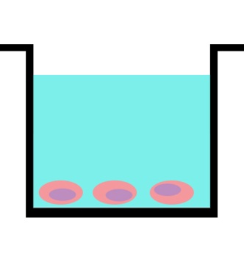
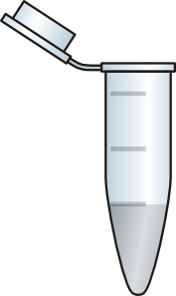
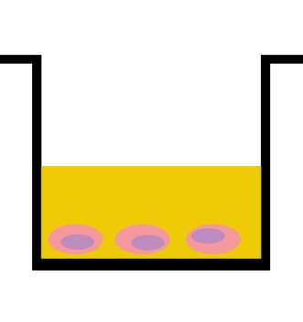
Transfection experiment
24-well plate
1 day
CH/pDNA
0 h
4 h
24 h
PBS and RLB
48 h
Luciferase assay and Micro BCA assay
Notes:
A549 and HEK293, 24-well plate cell density 8X10⁴ cells/well 24 h prior transfection
0h: + CH/pDNA (N/P 1-100) (100 µl)
(pDNA 5 µg/well) + serum free media (500 µl)
4h: + fresh complete media
24h: replaced media with fresh complete media
48h: removed media, wash with PBS + RLB 2xfreeze-thaw cycles centrifuged at 13200rpm, 5 mins
Luciferase assay (Promega) (RLU value)
Micro BCA assay (Pierce) (mg of protein)

Slide 16
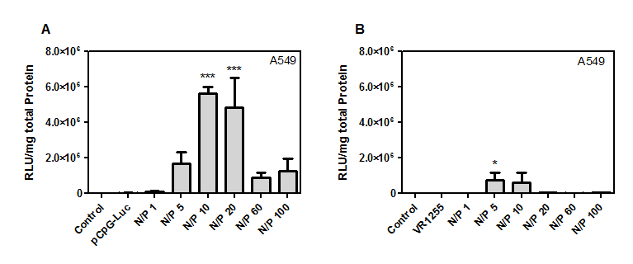
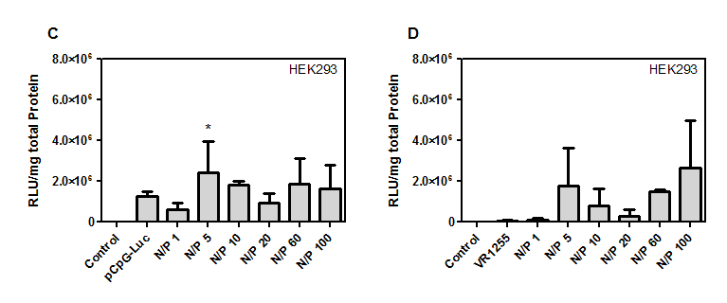
Luciferase expression
CH/CpG(-)
CH/CpG(+)

Slide 17
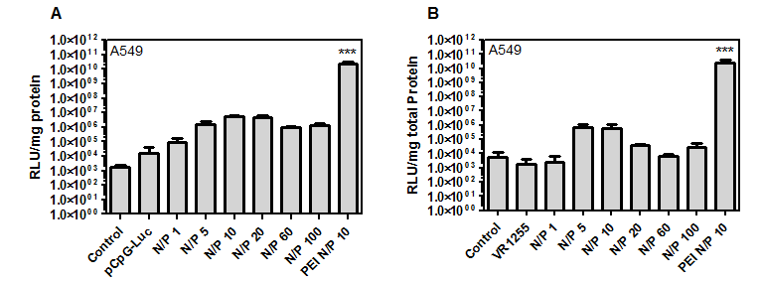
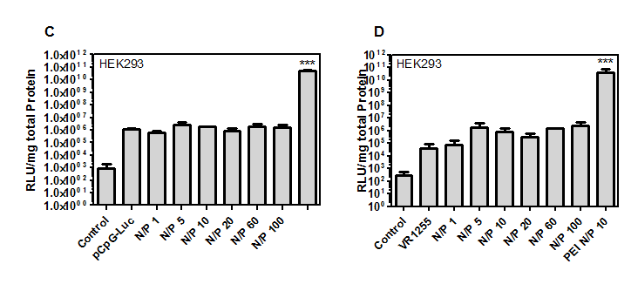
Luciferase expression
pCpG-Luc: CpG-free plasmids
VR1255: plasmids contain CpG
CH/pCpG-Luc
CH/VR1255

Slide 18
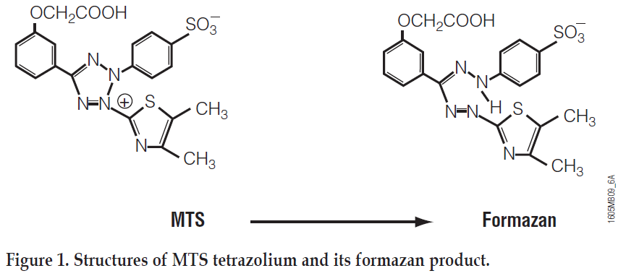
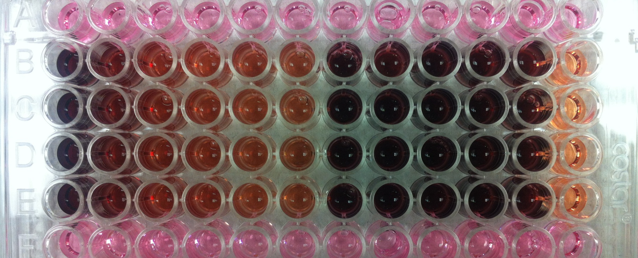
MTS assay
MTS is bioreduced by cells into formazan (color).
The quantity of formazan production is proportional to number of living cells.
www.promega.com
Notes:
This conversion is from NADPH or NADH produced by dehydrogenase in metabolically active cells.

Slide 19
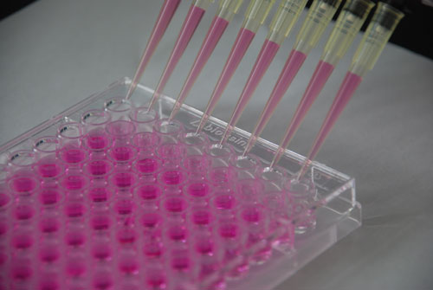
MTS assay
96-well plate
1 day
CH/pDNA
0 h
4 h
MTS reagent
48 h
Notes:
A549 and HEK293, 96-well plate cell density 1X10⁴ cells/well 24 h prior
0h: + CH/pDNA (N/P 1-100)
(pDNA 1 µg/well) + serum free media
4h: + fresh complete media
48h: replaced media with 100 µl fresh complete media + 20 µl of CellTiter 96® Aqueous One solution (Promega)
incubate at 37° for 1-4h in a humidified, 5% CO₂
Measured the absorbance at 490 nm

Slide 20
Cytotoxicity assay: MTS
CH/CpG(-)
CH/CpG(+)
CH/CpG(-)
CH/CpG(+)

Slide 21
MTS assay (vary conc)
pCpG-Luc: CpG-free plasmids
VR1255: plasmids contain CpG
A549 96-well plate cell density 10⁴ cells/well 24 h prior
0h: + CH/pDNA (N/P 1-100)
(pDNA 1-33 µg/well) 120 µl + serum free media
4h: + fresh complete media
48h: replaced media with 100 µl fresh complete media + 20 µl of CellTiter 96® Aqueous One solution (Promega)
incubate at 37° for 1-4h in a humidified, 5% CO₂
Measured the absorbance at 490 nm

Slide 22
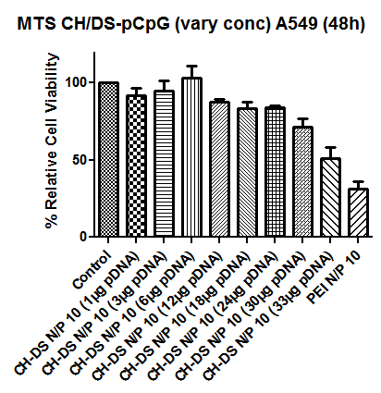
MTS assay
pCpG-Luc: CpG-free plasmids
VR1255: regular plasmids
Increasing Chitosan N/P ratio = Reducing % relative cell viability
Compare with PEI/pDNA, Chitosan/DS-pDNA nanoplexes still consider less toxic in every N/P ratio.
At CH/pCpG-Luc N/P 10 (33 µg pDNA/well): 51.26%

Slide 23
Objectives
To characterized and optimized chitosan/pDNA polyplex formulations
Size and charge
Ability to condense plasmids
To investigate the toxicity and transfection efficiency in A549 and HEK293
MTS assay
Luciferase assay
To investigate the inflammatory response induced by the polyplexes in a mouse model

Slide 24
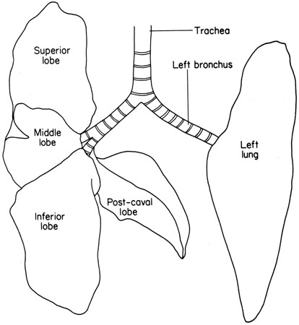
In vivo study
CH/pDNA polyplexes
CH/pDNA polyplexes
1 h
24 h
C57Bl/6 (n=6)
Luciferase assay
Micro BCA assay
BAL
fluid
Supernatant from homogenized lung
Total cell count
Total protein/LDH
Cytokines

Slide 25
Luciferase expression in mice lungs
Mice treated with CH/CpG(-) shows highest luciferase expression.

Slide 26
Number of cells in BAL fluids
Mice treated with CH/CpG(-) shows maximum number of total cell count in BAL fluids.
Among three types of white blood cells, BAL fluids contain high neutrophils in both types of polyplexes.

Slide 27
Total protein and LDH activity

Slide 28
Cytokines
IL-6
IL-12
KC
MIP-1α
TNF-α

Slide 29
Conclusion
Characteristic of Chitosan/pDNA polyplex
size ∼ 100-170 r.nm
charge ∼ 20-30 mV
CH/pDNA polyplex shows low cytoxicity in A549 and HEK293. There is no difference in toxicity between the nanoplex created using CpG(-) or CpG(+).
The polyplex prepared from from CpG-free plasmids shows …
higher transgene expression in A549 and in mice lungs
less inflammation in vivo
N/P ratio and DNA content of Chitosan/pDNA polyplex plays an important role in achieving high gene expression with minimal toxicity and inflammation.

Slide 30
Future work
To study lung histopathology of mice when treated with the chitosan/pDNA polyplex
Lung abnormalities
Abnormal inflammatory infiltrates
To develop chitosan/pDNA polyplex formulation which can form complex at high concentration and give high transfection efficiency
To investigate the difference between nasal instillation and aerosol delivery

