Slide 1
Nanocomposites
Prof.P. Ravindran,
Department of Physics, Central University of Tamil Nadu, India
&
Center for Materials Science and Nanotechnology, University of Oslo, Norway
http://folk.uio.no/ravi/cutn/NMNT

Slide 2
Nanocomposites
Nanocomposites are a broad range of materials consisting of two or more components, with at least one component having dimensions in the nm regime (i.e. between 1 and 100 nm)
Typically consists of a macroscopic matrix or host with the addition of nanometer-sized particulates or filler
Filler can be: 0 D (nano-particles), 1 D (nano-wires, nano-tubes), 2 D (thin film coatings, quantum wells), or 3 D (embedded networks, co-polymers)
e.g. CNTs in a polymer matrix

Slide 3
Nanocomposites
Common matrix materials are rubber, engineering plastics or polyolefines with a small content of nanoscale materials. Usually less than 5% of nanomaterials are used to improve thermal or mechanical properties
Typical ways to produce Nanocomposites are In-Situ-Polymerization and melt blending / compounding
Three types of nano material are commonly melt blended with plastics: Nano clay, nano tubes and nano scale particles (SiO₂, ZrO₂, Ag)

Slide 4
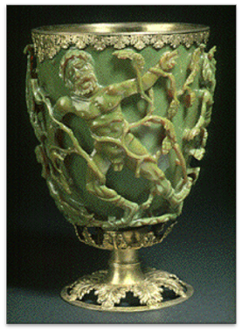
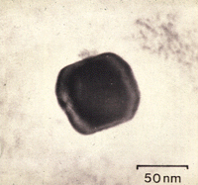
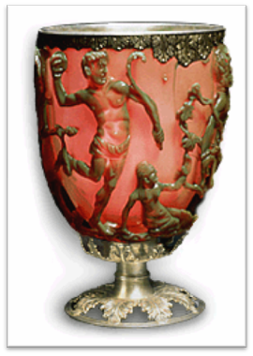
Nanocomposites
Resulting nanocomposite may exhibit drastically different (often enhanced) properties than the individual components
Electrical, magnetic, electrochemical, catalytic, optical, structural, and mechanical properties
Lycurgus Cup
Lycurgus Cup is made of glass.
Roman ~400 AD,
Myth of King Lycurgus
Appears green in reflected light and red in transmitted light
http://www.britishmuseum.org/explore/highlights/highlight_objects/pe_mla/t/the_lycurgus_cup.aspx
Notes:
TEM used to discover the nature of the optical properties (small Au and Ag NPs)

Slide 5
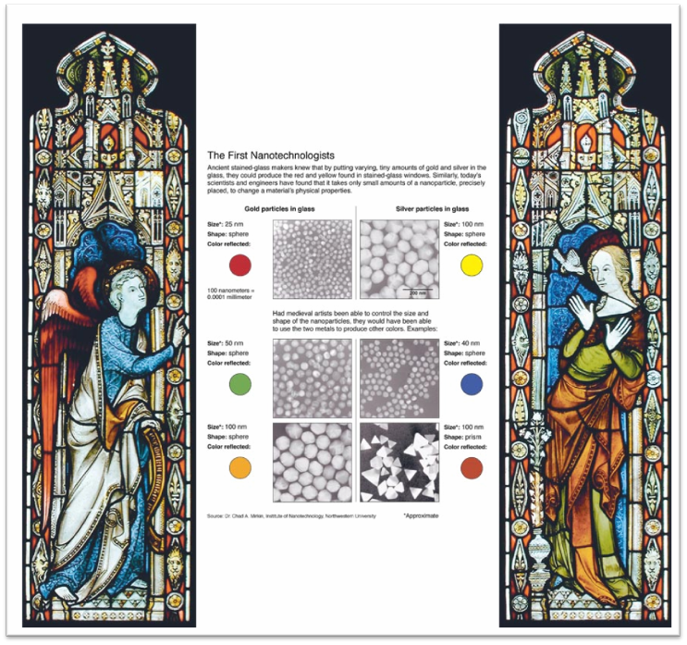
Nanocomposites
The Institute of Nanotechnology http://www.nano.org.uk/
Technology re-discovered in the 1600s and used for colored stained glass windows

Slide 6
Nano Effect
Very high surface area to volume ratios in nanostructures
Nanocomposites provide large interface areas between the constituent, intermixed phases
Allow significant property improvements with very low loading levels (Traditional microparticle additives require much higher loading levels to achieve similar performance)

Slide 7
Nano Effect
Apart from the properties of the individual components in a nanocomposite, the interfaces play an important role in enhancing or limiting overall properties of system
Controls the degree of interaction between the filler and the matrix and thus influences the properties
Alters chemistry, polymer chain mobility, degree of cure, crystallinity, etc.

Slide 8
Surface to Volume Ratio
Si Cube with (100)-Directed Faces
Si Cube Volume | Surface-to-Volume Atomic Ratio
(1 μm)³ | 0.081%
(100 nm)³ | 0.81%
(10 nm)³ | 8.1%
(5 nm)³ | 16%
(2 nm)³ | 41%
(1 nm)³ | 82%
Surface and interface properties (e.g. adhesive and frictional forces) become critical as materials become smaller
High surface area materials have applications in: energy storage, catalysis, battery/capacitor elements, gas separation and filtering, biochemical separations, etc.
Notes:
Surface and interface properties become critical
High surface area materials (porous materials or solutions of nanoparticles)
1 μm³ 0.1% while 2 nm³ 40%
As N goes down properties like atomic ionization, chemical reactivities, magnetic moments, polarizabilities, and geometric structures, material engineering by controlling N
Take advantage in energy storage, catalysis, battery/capacitor elements, gas separation and filtering, biochemical separations, etc.
Surfaces and interfaces dominated adhesive and frictional properties of small scale materials.
Also affect the plastic response of a material and the brittle or ductile behavior

Slide 9
Nanocomposites
Other Properties and Benefits
Interaction of phases at interface is key:
Adding nanotubes to a polymer can improve the strength (due to superior mechanical properties of the NTs)
A non-interacting interface serves only to create weak regions in the composite resulting in no enhancement
Most nano-particles do not scatter light significantly
Possible to make composites with altered electrical or mechanical properties while retaining optical clarity
CNTs and other nano-particles are often essentially defect free

Slide 10
Nanocomposites and Potential Applications
Nanoclays in Polymers
Liquid and Gaseous barriers
Food packaging applications (processed meats, cheese, cereals) to enhance shelf life
Reduce solvent transmission through polymers such as polyamides for fuel tank and fuel line components
Reduce water absorption in polymers (environmental protection)
Reduction of flammability of polymeric materials (e.g. polypropylene) with as little as 2% nanoclay loading

Slide 11
Nanotubes in Polymers
High strength materials
Modulus as high as 1 TPa and strengths as high as 500 GPa
Significant weight reductions for similar performance, greater strength for similar dimensions (military and aerospace applications)
Electrically conductive polymers

Slide 12
Nanocomposites Characterization Techniques
Several techniques used for nanocomposites including:
Nuclear Magnetic Resonance
Neutron Scattering Methods
X-Ray Diffraction
Atomic Force Microscopy
Scanning Electron Microscopy
Transmission Electron Microscopy
Transmission Electron Microscopy and X-ray Diffraction are the most common techniques

Slide 13
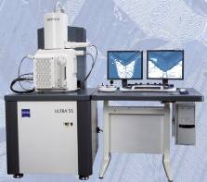
SEM Capabilities
Backscattered Imaging
(BSI)
Secondary Electron Imaging
(SEI)
• Compositional Contrast
• Surface Topography,
Morphology, Particle
Sizes, etc.
Scanning Electron Microscope
(SEM)
Transmitted Electron Imaging
(TEI)
Electron Backscattered Electron Diffraction
(EBSD)
• Internal ultrastructure
Energy-Dispersive
X-ray Spectrometry
(EDS)
• Crystallographic Info
• Elemental composition, mapping and linescans
Notes:
I tell you what TEM can do, Knowing that you tell me what info you need from sample

Slide 14
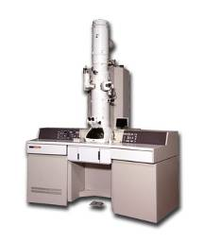
TEM Capabilities
Bright- and Dark-Field Imaging
(BF/DF imaging)
Electron Diffraction
(ED)
• Crystallographic Info
• Internal ultrastructure
Nanostructure dispersion
Defect identification
Transmission Electron Microscope
(TEM)
High-Resolution
Transmission Electron Microscopy
(HR-TEM)
Electron Energy Loss Spectroscopy
(EELS)
• Interface structure
• Defect structure
Energy-Dispersive
X-ray Spectrometry
(EDS)
• Chemical composition
Other Bonding info
• Elemental composition, mapping and linescans
Notes:
I tell you what TEM can do, Knowing that you tell me what info you need from sample

Slide 15
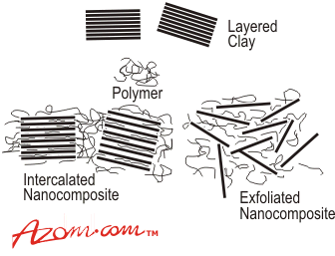
Layered Silicates (Nanoclay) and Polymer Nanocomposites
Improved properties related to the dispersion and nanostructure (aspect ratio, etc.) of the layered silicate in polymer
The greatest improvement of these benefits often comes with exfoliated samples.
Intercalate: Organic component inserted between the layers of the clay
Inter-layer spacing is expanded, but the layers still bear a well-defined spatial relationship to each other
Exfoliated: Layers of the clay have been completely separated and the individual layers are distributed throughout the organic matrix
Results from extensive polymer penetration and delamination of the silicate crystallites
http://www.azom.com/details.asp?ArticleID=936

Slide 16
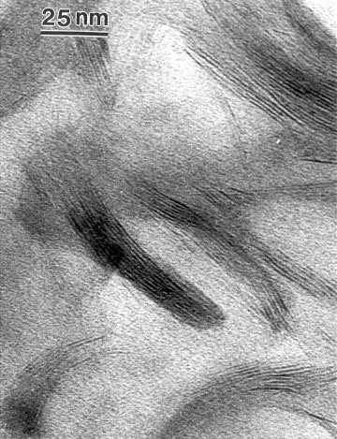
Polymer-Layered Silicate Nanocomposites
Organoclay nanocomposite (10% in Novalac-Based Cyanate Ester)
XRD gives average interlayer d-spacing while TEM can give site specific morphology and d-spacing
In this case, XRD gave no peaks
Many factors such as concentration and order of the clay can influence the XRD patterns
XRD often inconclusive when used alone
TEM of Intercalated Nanoclay
J. Applied Polymer Science, 87 1329-1338 (2003).

Slide 17
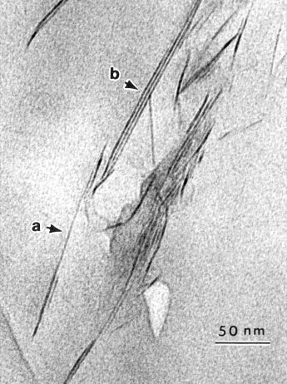
Polymer-Layered Silicate Nanocomposites
In the author’s own words:
“The majority of PLSNs that we investigated were best described as intercalated/exfoliated. By XRD, they would be simply defined as intercalated, in that there was an observed increase in the d-spacing as compared to the original clay d-spacing. However, the TEM images showed that although there were indeed intercalated multilayer crystallites present, single exfoliated silicate layers were also prevalent, hence, the designation of an intercalated/exfoliated type of PLSNs.”
TEM Image of an Intercalated/Exfoliated PS Nanocomposite
Small Intercalated Clay Layers
Exfoliated Single Layers
J. Applied Polymer Science, 87 1329-1338 (2003).

Slide 18
TEM Images of Clay/Epoxy Nanocomposites
Change of basal spacing of organo-clay nanocomposites during processing of epoxy/clay nanocomposites by the sonication technique
TEM images of nanoclay in different epoxy systems showing intercalated(white arrows)/exfoliated (black arrows) nanocomposite hybrids
Increase in basal d-spacings in nanoclay platelets observed by TEM and XRD
In some cases from 1.8 nm up to 8.72 nm
Polymer Engineering and Science, 46(4) 452-463 (2006).

Slide 19
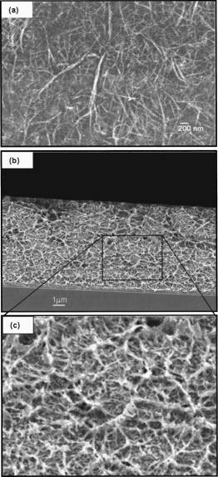
Carbon Nanotube/Polymer Nanocomposites
Surface and cross-sectional SEM images of (5 wt % SWNTs)/polystyrene composite film
SWNTs solubilized in chloroform with poly(phenyleneethynylene)s (PPE) along with vigorous shaking and/or short bath sonication
The functionalized SWNT solution mixed with a host polymer (polycarbonate or polystyrene) solution in chloroform to produce a nanotube/polymer composite solution
Composite film prepared from this solution on a silicon wafer either by drop casting or by slow-speed spin coating
J. Appl. Phys., 83 2928-2930 (2003).
Notes:
SWNTs produced by the high pressure carbon monoxide
HiPco process were purchased from Carbon Nanotechnologies,
Inc., and were solubilized in chloroform with poly(phenyleneethynylene)
s (PPE) along with vigorous shaking
and/or short bath sonication. The mass ratio of PPE:SWNTs
was kept at 0.5. The resulting PPE-functionalized SWNT
solution was then mixed with a host polymer (polycarbonate
or polystyrene) solution in chloroform to produce a homogeneous
nanotube/polymer composite solution. The uniform
composite film was prepared from this solution on a silicon
wafer with a 100 nm thick thermal oxide layer either by drop
casting or by slow-speed spin coating. The sample was then
heated to 80– 90 °C to remove residual solvent. Nanotube
polymer composite films with various SWNT loadings from
0.01 to 10 wt% in polystyrene as well as in polycarbonate
were prepared according to the above procedure.

Slide 20
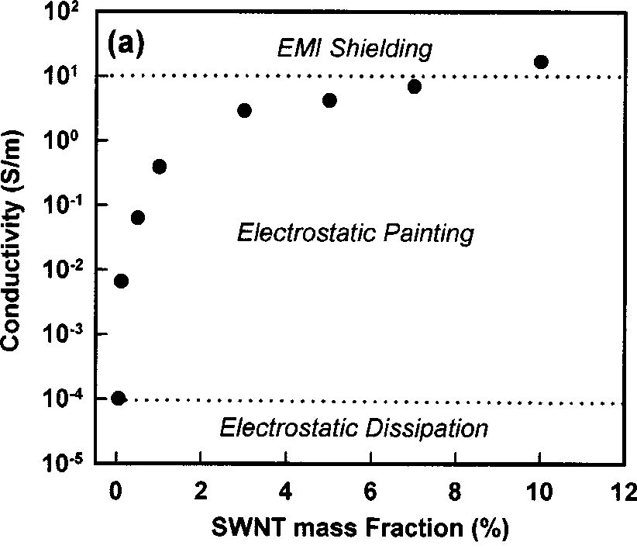
Carbon Nanotube/Polymer Nanocomposites
The conductivity of pure polystyrene is about 10⁻¹⁴ S/m (The conductivity of pristine HiPCO-SWNT buckypaper is about 5.1X10⁴ S/m)
Conductivity of composite increases sharply between 0.02 and 0.05 wt% SWNT loading indicating the formation of a percolating network
Rapid increase in electrical conductivity of composite materials takes place when the conductive filler forms an infinite network of connected paths through the insulating matrix
J. Appl. Phys., 83 2928-2930 (2003).

Slide 21
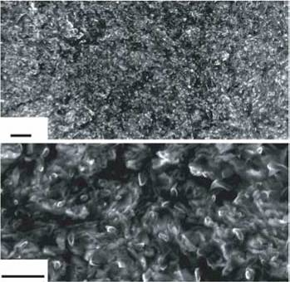
Graphene-Based Polymer Nanocomposites
Polystyrene/chemically modified graphene composite made by solution based processing technique followed by hot pressing or injection molding to form continuous specimens
SEM images shows sheets of graphene are crumpled, wrinkled, and at times folded
At 2.4 Vol % the composite appears to be almost entirely filled with the graphene sheets even though 97.6 Vol % is still filled by the polymer
This visual effect is due to the enormous surface area of the sheets
SEM Images of 2.4 Vol % Graphene Nanocomposites
1 μm
500 nm
Nature 442 282-286 (2006).

Slide 22
Polymer-Layered Silicate Nanocomposites
Consideration of architecture (cyclic vs. linear) and kinetics (medium viscosity and shear) is critical for nanocomposite formation
Important consequence of the charged nature of the clays is that they are generally highly hydrophilic and therefore incompatible with a wide range of polymer types
Organophilic clay can be produced by ion exchange with an organic cation
e.g. in Montmorillonite the sodium ions in the clay can be exchanged for an amino acid such as 12-aminododecanoic acid (ADA) to make clay hydrophobic and potentially more compatible with polymers

Slide 23
Polymer-Layered Silicate Nanocomposites
Modifiers used for the layered silicate that participate in the polymerization (functional groups such as initiators, comonomers, and chain transfer agents)
Suggested that these participating modifiers create tethered polymer chains that maintain stable exfoliation before and after melt processing
Often silicate (not organically modified) added in post polymerization step
Latex particles have cationic surface charges (arising from choice of emulsifier) and the silicate layers have anionic charges, electrostatic forces promote an interaction between the silicate and polymer particles

Slide 24
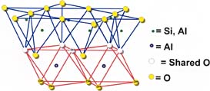
Polymer-Layered Silicate Nanocomposites
Platelet thickness ~ 1nm, aspect ratios ~ 100-1500, and surface areas ~ 200 m²/gram
Important to understand the factors which affect delamination of the clay: ion-dipole interactions, use of silane coupling agents and use of block copolymers
Example of ion-dipole interactions is the intercalation of a small molecule such as dodecylpyrrolidone in the clay. Entropically-driven displacement of the small molecules then provides a route to introducing polymer molecules

Slide 25
Polymer-Layered Silicate Nanocomposites
Unfavourable interactions of clay edges with polymers can be overcome by use of silane coupling agents to modify the edges
Block copolymers: One component of the copolymer is compatible with the clay and the other with the polymer matrix

Slide 26
Cellulose
Cellulose is one of the most important natural polymers, an almost inexhaustible raw material, and a key source of sustainable materials on an industrial scale.
Novel methods for nanocellulose production range from top-down methods involving enzymatic/chemical/physical methodologies for their isolation from wood and forest/agricultural residues to the bottom-up production of cellulose nanofibrils from glucose by bacteria.
Such isolated cellulosic materials with one dimension in the nanometer range are referred to generically as nanocelluloses.

Slide 27
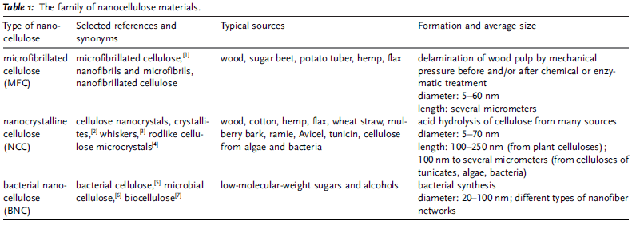
Family of Nanocellulose Materials
Angewandte Chemie International Edition Volume 50, Issue 24, pages 5438-5466, 20 MAY 2011

Slide 28
Nanocelluloses: A New Family of Nature‐Based Materials
Angewandte Chemie International Edition Volume 50, Issue 24, pages 5438-5466, 20 MAY 2011
Notes:
Transmission electron micrographs of a) MFC1c and b) NCC;8 c) scanning electron micrograph of BNC.
© This slide is made available for non-commercial use only. Please note that permission may be required for re-use of images in which the copyright is owned by a third party.

Slide 29
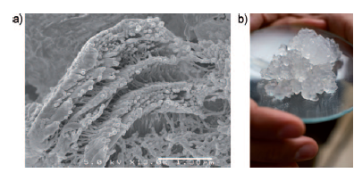
The forcing of suspensions of wood-based cellulose fibers through mechanical devices, such as high-pressure homogenizers, produces microfiber composite (MFC). This mechanical treatment delaminates the fibers and liberates the microfibrils (around 20 nm wide, Figure a). The microfibrils have a high aspect ratio and exhibit gel-like characteristics in water (Figure b), with pseudoplastic and thixotropic properties.
Thixotropy is a time-dependent shear thinning property. Certain gels or fluids that are thick (viscous) under static conditions will flow (become thin, less viscous) over time when shaken, agitated, or otherwise stressed (time dependent viscosity). They then take a fixed time to return to a more viscous state.

Slide 30
Nanocellulose Application in Composites
Nanocellulose has been reported to improve the mechanical properties of e.g. thermosetting resins, starch-based matrixes, soy protein, rubber latex, poly(lactide).
The composite applications may be for use as coatings and films, paints, foams, packaging.
http://en.wikipedia.org/wiki/Nanocellulose

Slide 31
Production of cellulose nanocomposites
Casting of aqueous MFC dispersions by using water-soluble matrix materials, such as starches (the simplest method)
Casting of MFC dispersions to which a latex dispersion has been added (the latex enables the use of a hydrophobic matrix, and good dispersion may be attained)
Dispersion of MFC and casting of films from a solvent in which the matrix material can be dissolved (this method usually requires surface modification of the MFC for good dispersion)

Slide 32
Production of cellulose nanocomposites
Dispersion of dried MFC (modified or not) into a hydrophobic matrix
Reinforcement of porous MFC films with an agent to improve their properties
Use of aqueous MFC dispersions to form composite materials with the matrix in the form of fibers by papermaking, pressing, and press molding

Slide 33
Dufresne et al.
They used cellulose nanowhiskers, but from sources that gave nanocrystals whose length was comparable to that of MFC.
Such sources included tunicin and parenchyma cell walls from agricultural residues, such as sugar beet and potato tubers.
The matrix material was typically a poly(styrene-co-n-butyl acrylate) (PBA) latex with a low glass-transition temperature.

Slide 34
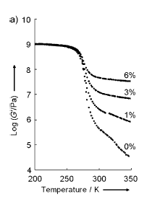
Dufresne et al.
Tunicin whiskers had an amazing reinforcing effect on the PBA latex; the reinforcing effect reached several orders of magnitude in the rubbery region of the polymer at low whisker concentrations.
The modulus of the composite with a loading level as low as 6 wt % is more than 2 order of magnitude higher than the one of the unfilled matrix.

Slide 35
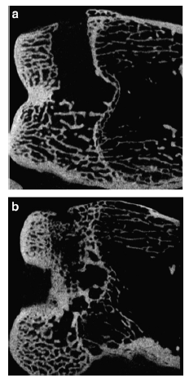
In vivo biocompatibility of ultra-short single-walled carbon nanotube/biodegradable polymer nanocomposites for bone tissue engineering
Representative micro CT images of the rabbit femoral condyle twelve weeks after the implantation of either a (a) PPF or (b) US-tube/PPF scaffold.

