Slide 1
Thickness of Aluminium coating on SEP silicon detectors

Slide 2
Light contamination
Photons with energies above the silicon bandgap (1.1 eV) excite electron-hole pairs, causing noise in a silicon detector.
I.e., wavelengths below 1130 nm.
Caused serious problems on STEREO STE.
Light from sunlit lunar hemisphere causes substantial noise in lowest energy channels of ARTEMIS SST.

Slide 3
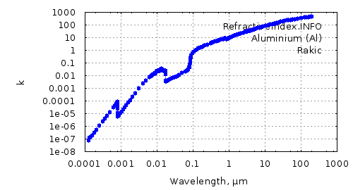
Solution: Aluminium layer
The aluminium layer is vapor-deposited on the silicon detector in vacuum.
This layer reflects light, reducing noise in the detector.
Attenuation of light is given by:
is the attenuation coefficient, given by:
n(λ) is the complex index of refraction, given by Rakic et al. [1995] & www.refractiveindex.info.
k ≡ Im[n(λ)], the imaginary part of the complex refractive index, is also known as the extinction coefficient
Wavelength-dependent attenuation for different Al thicknesses

Slide 4
How much light will reach the detector?
Convolve the typical spectral radiance of Mars [Tinetti et al., 2005] thiswith the wavelength-dependent attenuation.
Integrate over the spectrum and multiply by the geometric factor of the detector (3.64 x 10⁻⁵ m² sr).
Each extra 100 Å cuts light intensity by a factor of 3.5-4
Assumes Mars fills detector FOV
Si: 1 amp/watt. Want to keep current below 10 nA. 900 Å will do that.

Slide 5
How does this compare with SST?
SST has 200 Å Al and sees the sunlit moon.
Moon/Mars albedo ratio = 0.12/0.15.
Moon/Mars solar flux ratio = (1.0/1.5)² = 0.44
Therefore, we can directly compare:
300 Å = factor of 10
500 Å = factor of 100
700 Å = factor of 1000
900 Å = factor of 10,000

Slide 6
How is proton sensitivity affected?
SRIM calculations tell us how much energy protons lose traversing aluminium layer + silicon dead layer.
We can assume a threshold of 20 keV for detection.
Therefore, we can calculate the low-energy threshold for incident protons [e.g. see left panel: 36 keV for 1000 Å].
1000 Å
200 Å
1000 Å
200 Å

Slide 7
Trade-off: proton threshold vs. photocurrent
Al layer (Å) | p cutoff (keV) | Photocurrent (W)
200 | 26.6 | 7.5 x 10⁻⁵
300 | 27.7 | 2.0 x 10⁻⁵
400 | 28.9 | 5.5 x 10⁻⁶
500 | 30.1 | 1.5 x 10⁻⁶
600 | 31.4 | 4.3 x 10⁻⁷
700 | 32.6 | 1.2 x 10⁻⁷
800 | 33.7 | 3.6 x 10⁻⁸
900 | 35.1 | 1.1x 10⁻⁸
1000 | 36.2 | 3.2 x 10⁻⁹

Slide 8
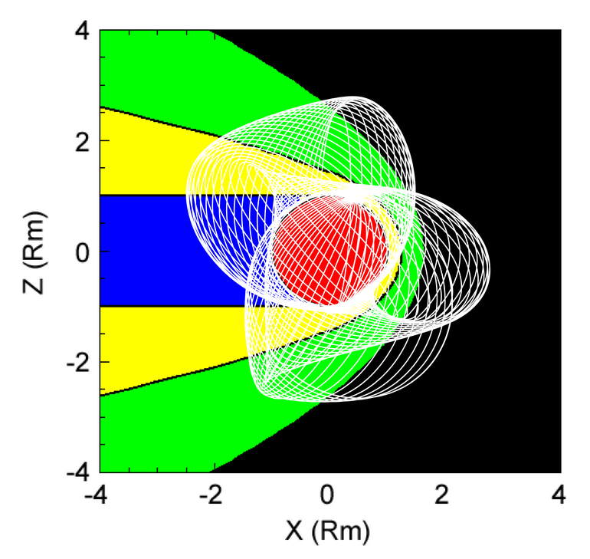
Contamination will be worse for rear-facing detectors
2 of the 4 FOVs are in the negative z-direction and will often see the sunlit side of Mars when the SC is on the dayside.
The positive z-direction FOVs will still sometimes see daylit Mars, but from a SZA of 135° & always <25% of the disk.
Total light will be several times lower, so could accept thinner Al layer.

Slide 9
Conclusion: need at least 700 Å Al
Preferably 900 Å on the rear-facing detectors.
Might get away with 700 Å of the front facing detectors, but only gains 2.5 keV in proton low-energy threshold.

