Slide 1
Silver Nanoparticles
Michael Yip
BIO 464
TuTh 2 – 3:15

Slide 2
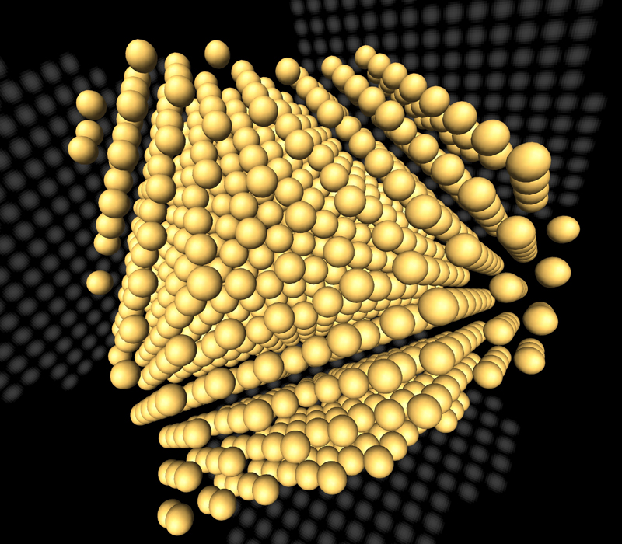
Structure of Compound

Slide 3
Physical/Chemical Properties
High electrical/thermal conductivity, surface-enhanced Raman scattering, chemical stability, catalytic activity, non-linear optical behavior
At least 6 days or as long as several months for complete dissolution of a 5 nm Ag NP in oxidized conditions

Slide 4
Production History
Colloidal chemical reduction of silver salts with borohydride, citrate, ascorbate or other reductant
Ag⁰ atoms agglomerate into oligomeric clusters that become colloidal Ag NPs
Particle stabilizer (capping agent) present in suspension during synthesis to reduce particle growth and aggregation, allows manipulation of NP surface
Size and aggregation controlled by stabilization through steric, electrostatic, or electro-steric repulsion

Slide 5
Uses and Application
Woodrow Wilson Database lists 1015 consumer products on the market that uses NPs, with 259 containing Ag NPs
Broad range of bacteriocidal activity of and low cost of manufacturing Ag NPs
Ex. plastics, soaps, pastes, metals, textiles, inks, microelectronics, medical imaging
Creams and cosmetics items (32.4%)
Health supplements (4.1%)
Textiles and clothing (18.0%)
Air and water filters (12.3%)
Household items (16.4%)
Detergents (8.2%)
Others (8.6%)
Table 1. Major products in the market containing Ag NPs (from Woodrow Wilson Database, March 2010).

Slide 6
Mode of Entry in Aquatic Environment
Ag NPs discharged into environment during manufacturing/incorporation of NPs into goods, during usage/disposal of goods containing Ag NPs
Majority of discharged Ag NPs may partition into sewage sludge by advanced waste treatments, which can be used as fertilizer in agricultural soil in countries including UK and USA

Slide 7
Chemical Reactivity with Environment
pH, ionic strength/composition, natural organic macromolecules (NOMs) temperature, and nanoparticle concentration affect aggregation or stabilization of Ag NPs
Organic matter and sulfide affect Ag speciation in freshwater systems and reduce silver bioavailability
Marine ecosystems more susceptible to bioaccumulation due to silver-chloro complex availability

Slide 8
Toxic Effects Noted
High exposure to silver compounds can cause argyria (bluish skin coloration due to Ag accumulation in body tissues)
Currently no evidence to suggest humans are affected by using consumer products containing Ag NPs

Slide 9
Mode of Entry into Organisms
Intact NPs transported into cytoplasm by endocytosis (invagination of the plasma membrane)
Association of Ag NPs with plasma membrane and release of free metals within surface layers
Ag NP aggregates may through semi-permeable cell walls of organisms (ex. plants, bacteria, fungi)
Ability to bioaccumulate through cell membrane ion transporters, similar to Na⁺ and Cu⁺

Slide 10
Toxicity to Aquatic Life
LC10 values at 0.8μg L⁻¹ for certain freshwater fish species (ex. rainbow trout)
No Observed Effect Concentration (NOEC) as low as 0.001μg L⁻¹ (Ceriodaphnia dubia) compared to 2mg L⁻¹ for freshwater/seawater algae
Ag ions can reach branchial epithelial cells by Na⁺ channels coupled to proton ATPase in apical membrane of gills, travel to the basolateral membrane and block Na⁺/K⁺ ATPase influencing ionoregulation of Na⁺/Cl⁻ ions

Slide 11
Toxicity to Aquatic Life
Circulatory collapse and death can occur at higher concentrations (μM) due to blood acidosis
10-80 nm Ag NPs affect early life development, including spinal cord deformities, cardiac arrhythmia, and survival
Ag NPs can accumulate in gills and liver tissue, affecting the ability to cope with low oxygen levels and inducing oxidative stress

Slide 12
Defense Strategies for Detoxification
Filter feeders (ex. mussels and oysters) efficient at removing larger particles (> 6μm), low retention of NPs
Expression of genes involved in toxicological responses to xenobiotics (ex. cyp1a2) may induce oxidative metabolism
Induction of metal-sensitive metal-sensitive metallothionein 2 (MT2) mRNA by zebrafish when exposed to Ag NPs, prevent oxidative stress and apoptosis
Secretion of polysaccharide-rich algal exopolymeric substances (EPS) by marine diatoms (Thalassiosira weissflogii) may induce greater tolerance to Ag⁺ ions

Slide 13
References
Bielmyer, G.K., Bell, R.A., & Klaine, S.J. (2002). Effects of ligand-bound silver on Ceriodaphnia dubia, Environ Toxicol Chem (21), pp. 2204–2208.
Blaser, S.A., Scheringer, M., MacLeod, M., & Hungerbühler, K. (2008). Estimation of cumulative aquatic exposure and risk due to silver: contribution of nano-functionalized plastics and textiles, Sci Total Environ (390), pp. 396–409.
Bury, N. R. and Wood, C.M. (1999). Mechanism of branchial apical silver uptake by rainbow trout is via the proton-coupled Na+ channel, Am J Physiol Regul Integr Comp Physiol (277), pp. R1385–R1391.
Capek, I. (2004). Preparation of metal nanoparticles in water-in-oil (w/o) microemulsions, Adv Colloid Interface Sci (110), pp. 49–74.
Choi, J.E., Kim, S., Ahn, J.H., Youn, P., Kang, J.S., Park, K., Yi, J., & Ryu, D-Y. (2010). Induction of oxidative stress and apoptosis by silver nanoparticles in the liver of adult zebrafish, Aquatic Toxicology (Amsterdam) (100), pp. 151-159.
Christian, P. (2009). Nanomaterials: properties, preparation and applications. In: J. Lead and E. Smith, Editors, Environmental and human health impacts of nanotechnology, Wiley-Blackwell, Chicester.
Fabrega, J., Luoma, S.N., Tyler, C.R.; Galloway, T.S., & Lead, J.R. (2011). Silver nanoparticles: Behaviour and effects in the aquatic environment. Environment International (37), pp. 517-531.
Köhler, A.R., Som, C., Helland, A., & Gottschalk, F. (2008). Studying the potential release of carbon nanotubes throughout the application life cycle, J Cleaner Prod (16), pp. 927-937.

Slide 14
References
Liu, J. and Hurt, R.H. (2010). Ion release kinetics and particle persistence in aqueous nano-silver colloids, Environ Sci Technol (44), pp. 2169–2175.
Luoma, S.N. (2008). Silver nanotechnologies and the environment: old problems and new challenges?, Woodrow Wilson International Center for Scholars or The PEW Charitable Trusts, Washington DC.
Miao, A-J, Schwehr, K.A., Xu, C., Zhang, S-J, Luo, Z., Antonietta, Quigg, A., & Santschi, P.H. (2009). The algal toxicity of silver engineered nanoparticles and detoxification by exopolymeric substances, Environmental Pollution (157), pp. 3034-3041.
Moore, M.N. (2006). Do nanoparticles present ecotoxicological risks for the health of the aquatic environment?, Environ Int (32), pp. 967–976.
Ratte, H.T. (1999). Bioaccumulation and toxicity of silver compounds: a review, Environ Toxicol Chem (18), pp. 89–108.
Scown, T.M., Santos, E. M., Johnston, B.D.; Gaiser, B., Baalousha, M., Mitov, S., Lead, J.R.. Stone, V., Fernandes, T.F., Jepson, M., van Aerle, R., & Tyler, C.R. (2010). Effects of Aqueous Exposure to Silver Nanoparticles of Different Sizes in Rainbow Trout, Toxicological Sciences (115), pp. 521-534.
Sharma, V.K., Yngard, R.A., & Lin, Y. (2009). Silver nanoparticles: green synthesis and their antimicrobial activities, Adv Colloid Interface Sci (145), pp. 83–96.
Silver, S. (2003). Bacterial silver resistance: molecular biology and uses and misuses of silver compounds, FEMS Microbiol (Rev 27), pp. 341–353.
Van Aert S, Batenburg K.J., Rossell M.D., Erni, R., & Van Tendeloo. G. (2011) Three-dimensional atomic imaging of crystalline nanoparticles, Nature, doi:10.1038/nature09741
Wood, C.M., Hogstrand, C., Galvez, F., & Munger, R.S. (1996). The physiology of waterborne silver toxicity in freshwater rainbow trout (Oncorhynchus mykiss) 1. The effects of ionic Ag+, Aquat Toxicol (35), p. 93.

