Slide 1
Viscoelastic properties
Polymers have both ideal elastic and viscous behavior depending on time and temperature.

Slide 2
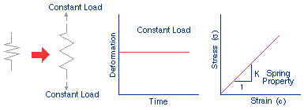
Ideal (elastic) Solid
Hooks Law
response is independent of time and the deformation is dependent on the spring constant.

Slide 3
Ideal Solid

Slide 4
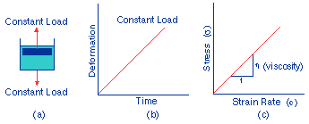
Ideal Liquid
η= viscosity
de/dt = strain rate
The viscous response is generally time- and rate-dependent.

Slide 5
Ideal Liquid

Slide 6
The behaviour of linear elastic were given by Hooke’s law:
or
The behaviour of linear viscous were given by Newton’s Law:
E= Elastic modulus
σ = Stress
e= strain
de/dt = strain rate
dσ/dt = stress rate
η= viscosity
** This equation only applicable at low strain

Slide 7
Viscoelastic behavior
Behaviour of most polymer is in between behaviour of elastic and viscous materials.
At low temperature & high strain rate,
Polymer demonstrate elastic behaviour,
At high temperature & low strain rate,
Polymer demonstrate viscous behaviour
At intermediate temperatures & rate of strain
Polymer demonstrate visco-elastic behaviour

Slide 8
Polymer is called visco- elastic because:
Showing both behaviour elastic & viscous behaviour
Instantaneously elastic strain followed by viscous time dependent strain
Load released
elastic
Load added
viscous
viscous
elastic

Slide 9
Maxwell Model

Slide 10
Kelvin Voigt Model

Slide 11
Burger Model

Slide 12
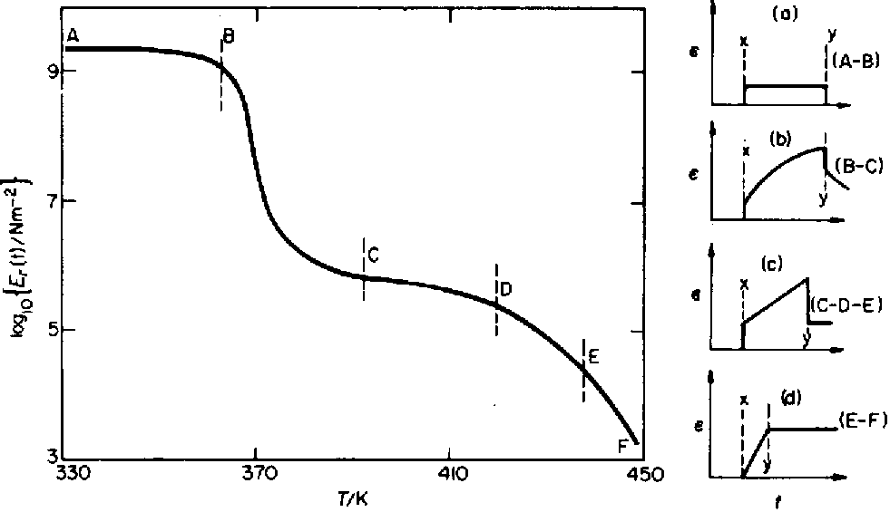
Static Modulus of Amorphous PS
Glassy
Leathery
Rubbery
Viscous
Polystyrene
Stress applied at x
and removed at y

Slide 13
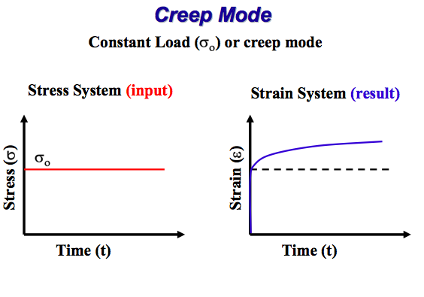

Slide 14
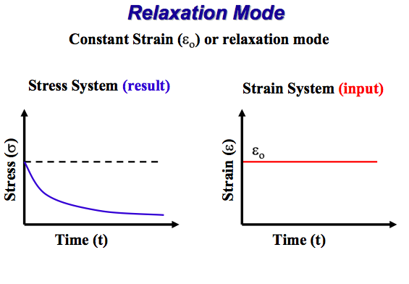

Slide 15
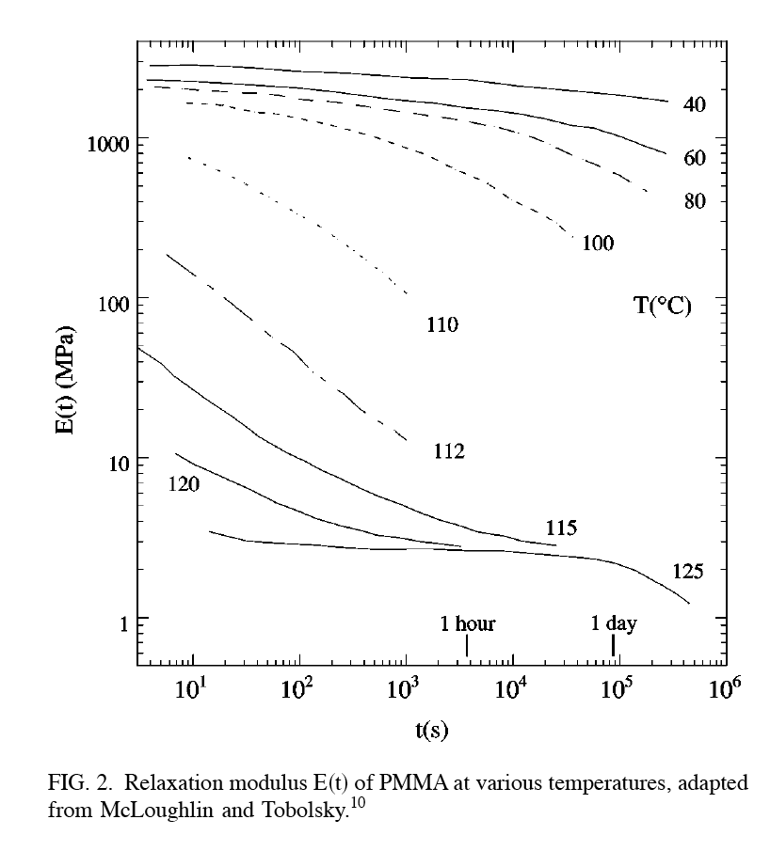
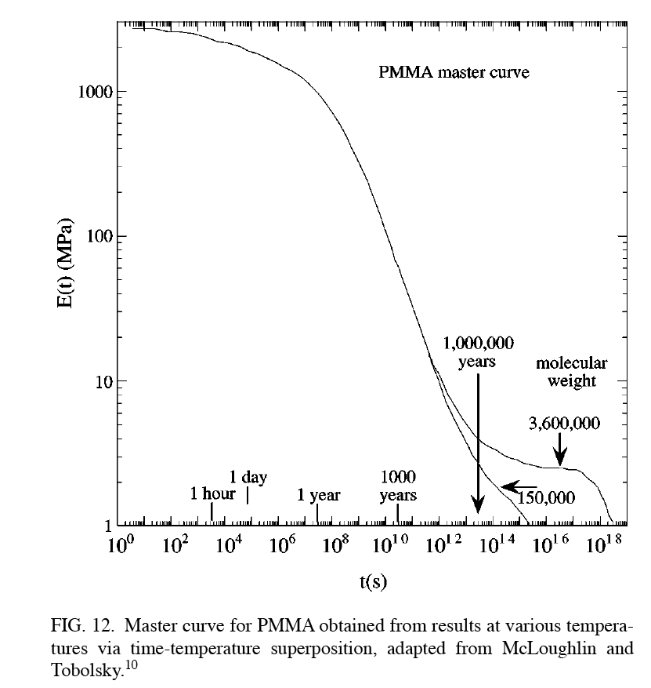

Slide 16
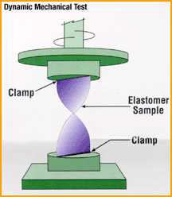
Dynamic Mechanical Analysis

Slide 17
Spring Model
γ = γ₀⋅sin (ω⋅t)
γ₀ = maximum strain
ω = angular velocity
Since stress, τ, is
τ = Gγ
τ = Gγ₀sin(ωt)
And τ and γ are in phase

Slide 18
Dashpot Model
Whenever the strain in a dashpot is at its maximum, the rate of change of the strain is zero ( γ = 0).
Whenever the strain changes from positive values to negative ones and then passes through zero, the rate of strain change is highest and this leads to the maximum resulting stress.

Slide 19
Kelvin-Voigt Model

Slide 20
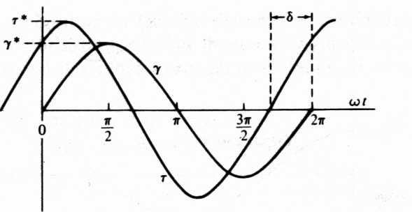
Dynamic (Oscillatory) Testing
In the general case when the sample is deformed sinusoidally, as a response the stress will also oscillate sinusoidally at the same frequency, but in general will be shifted by a phase angle δ with respect to the strain wave. The phase angle will depend on the nature of the material (viscous, elastic or viscoelastic)
Input
Response
where 0°<δ<90°
τ  stress 
γ  strain 
η  viscosity
G  modulus
3.29

Slide 21
Dynamic (Oscillatory) Testing
By using trigonometry:
(3-1)
In-phase component of the stress, representing solid-like behavior
Out-of-phase component of the stress, representing liquid-like behavior
Let’s define:
where:
3.30

Slide 22
Physical Meaning of G’, G”
Equation (3-1) becomes:
We can also define the loss tangent:
For solid-like response:
For liquid-like response:
G’  storage modulus
G’’  loss modulus

Slide 23
Real Visco-Elastic Samples

Slide 24
Typical Oscillatory Data
Rubber
G’
G’  storage modulus
log G
G’’  loss modulus
G’’
log ω
Rubbers – Viscoelastic solid response:
G’ > G” over the whole range of frequencies

Slide 25
Typical Oscillatory Data
Melt or solution
G₀
Less liquid like
G’  storage modulus
log G
G’’  loss modulus
G’’
More liquid like
G’
log ω
Polymeric liquids (solutions or melts) Viscoelastic liquid response:
G” > G’ at low frequencies
Response becomes solid-like at high frequencies
G’ shows a plateau modulus and decreases with ω⁻² in the limit of low frequency (terminal region)
G” decreases with ω⁻¹ in the limit of low frequency

Slide 27
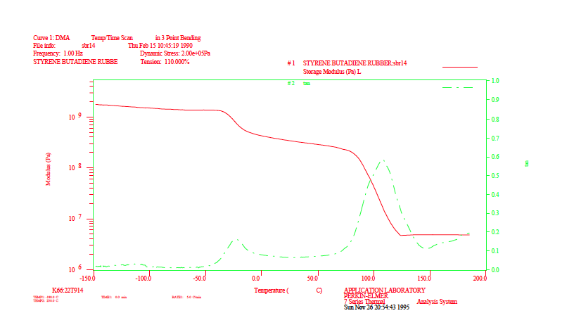
Blend

Slide 28
Epoxy

Slide 29
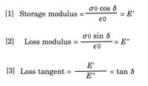
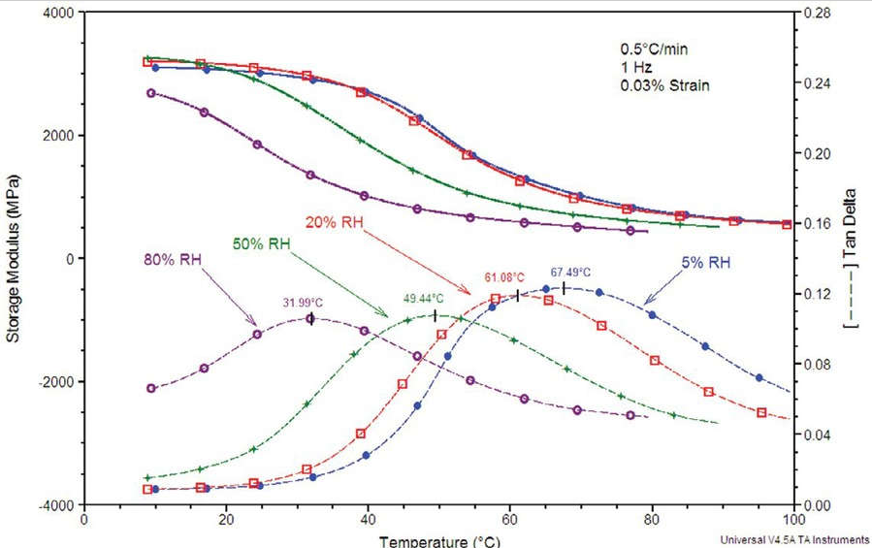
Nylon-6 as a function of humidity

Slide 30
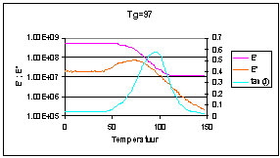
E’  storage modulus
Polylactic acid
E’’  loss modulus

Slide 31
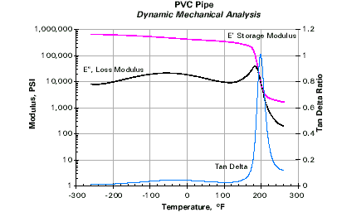
Tg 87 °C

Slide 32
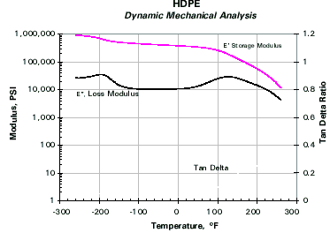
Tg -123 °C (-190 F)
Tm 135 °C (275 F)

Slide 33
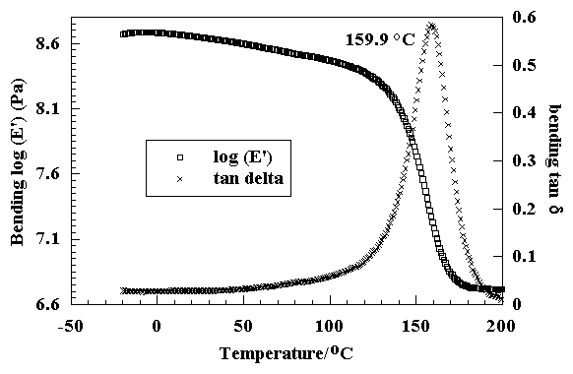
G’  storage modulus
Polyurethane foam (Tg 160 C)
G’’  loss modulus

Slide 34
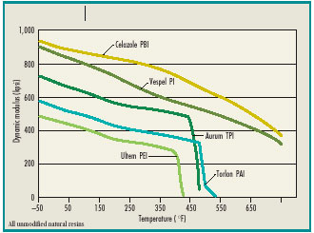

Slide 35
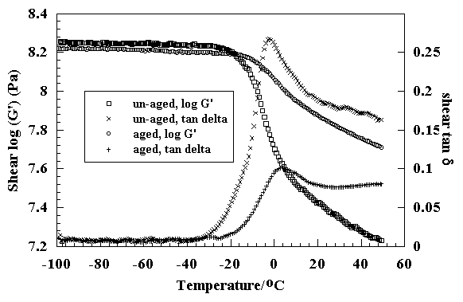
G’  storage modulus
G’’  loss modulus
These data show the difference between the behaviour of un-aged and aged samples of rubber, and were collected in shear mode on the DMTA at 1 Hz. The aged sample has a lower modulus than the un-aged, and is weaker. The loss peak is also much smaller for the aged sample.

Slide 36
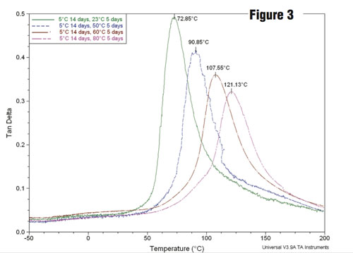
Tan d of paint as it dries

Slide 37
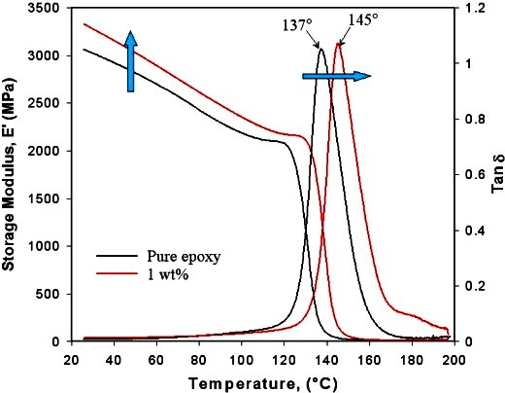
Epoxy and epoxy with clay filler

Slide 38
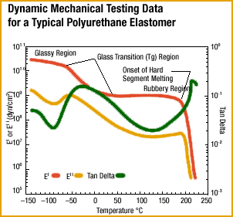

Slide 39
Dynamic test of a Voigt solid

Slide 40
Benefits of Dynamic Testing

