Slide 1
ME 330 Manufacturing Processes POWDER METALLURGY

Slide 2
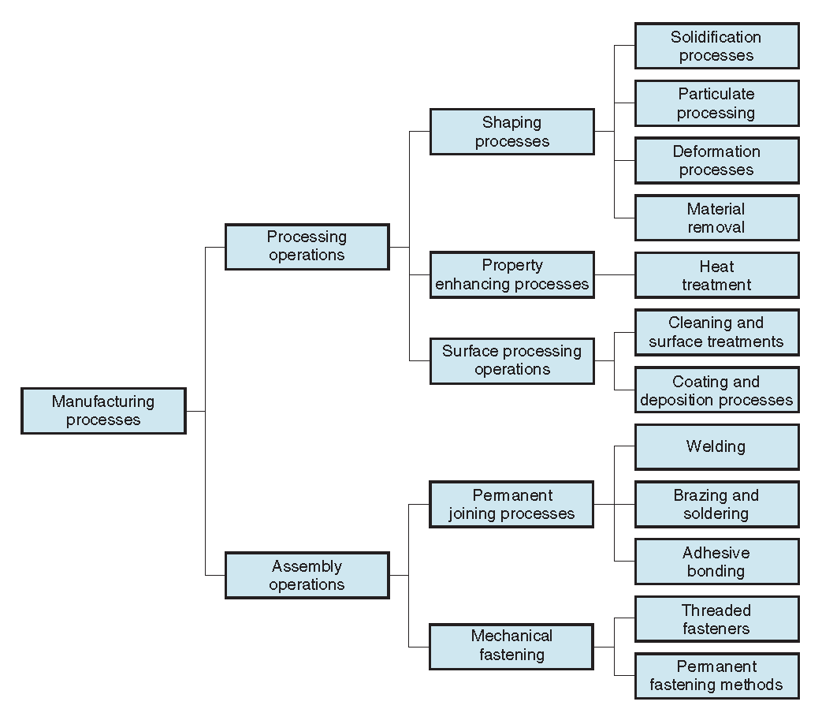
Overview of processes

Slide 3
Principle of the process
Structure/Configuration
Process modeling
Defects
Design For Manufacturing (DFM)
Process variation

Slide 4
Principle and generic process
Metal is made into metallic powders
Having a die in which powders are put
Pressing with punch vertically the powders to produce a product which is the same shape as the die -> green compact
Sintering – green compacts are heated to bond the particles into a hard, rigid mass with temperatures being below melting point

Slide 5
Principle and generic process – unique features
Mass produced to net shape or near net shape, eliminating or reducing the need for subsequent machining
Wastes very little material - ~ 97% of starting powders are converted to product (no sprues, runners, and risers as in casting)
Be made with a specified level of porosity to produce
- Filters, oil‑impregnated bearings and gears

Slide 6
More Reasons Why PM is Important
Certain metals that are difficult to fabricate by other methods can be shaped by powder metallurgy
Tungsten filaments for incandescent lamp bulbs are made by PM
Certain alloy combinations and composites made by PM cannot be produced in other ways
PM compares favorably to most casting processes in dimensional control (I.E. can usually achieve ±0.005 in)
PM production methods can be automated for economical production

Slide 7
Limitations and Disadvantages
High tooling and equipment costs
Metallic powders are expensive
Problems in storing and handling metal powders
Degradation over time
Fire hazards with certain metals
Limitations on part geometry because metal powders do not readily flow in the die during pressing
Variations in density throughout part may be a problem, especially for complex geometries

Slide 8
PM Products
Gears, bearings, sprockets, fasteners, electrical contacts, cutting tools, and various machinery parts
are ideal for PM because:
Their geometries are defined in two dimensions (lend themselves well for compaction)
There is a need for porosity in the part to serve as a reservoir for lubricant

Slide 10
Principle of the process
Structure/Configuration
Process modeling
Defects
Design For Manufacturing (DFM)
Process variation

Slide 11
PM Work Materials
Largest tonnage of metals are alloys of iron, steel, and aluminum
Other PM metals include copper, nickel, and refractory metals such as molybdenum and tungsten
Metallic carbides such as tungsten carbide are often included within the scope of powder metallurgy
Remark: metallic carbides are difficult to be made by other approaches.

Slide 12
Engineering Powders
A powder can be defined as a finely divided particulate solid
Geometric features of engineering powders:
Particle size and distribution
Particle shape and internal structure
Surface area

Slide 13
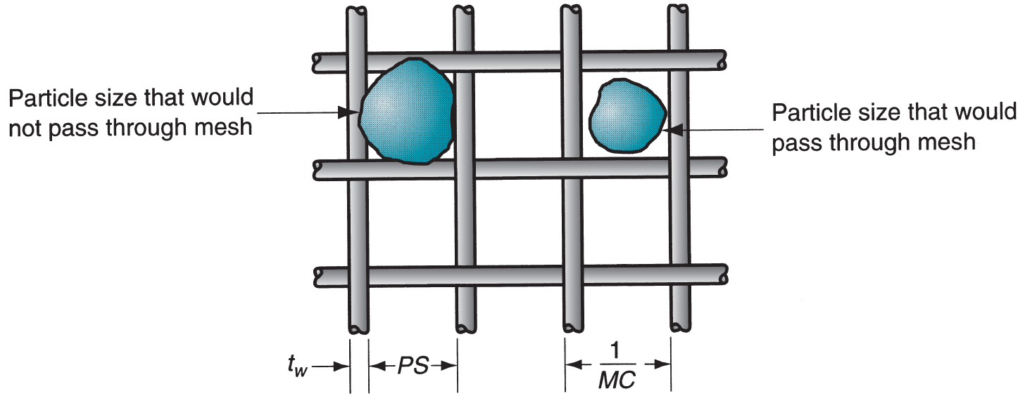
Measuring Particle Size
Most common method uses screens of different mesh sizes
Mesh count - refers to the number of openings per linear inch of screen
Higher mesh count = smaller particle size
Since the mesh is , the count is equal in both directions (Length x Width)

Slide 14
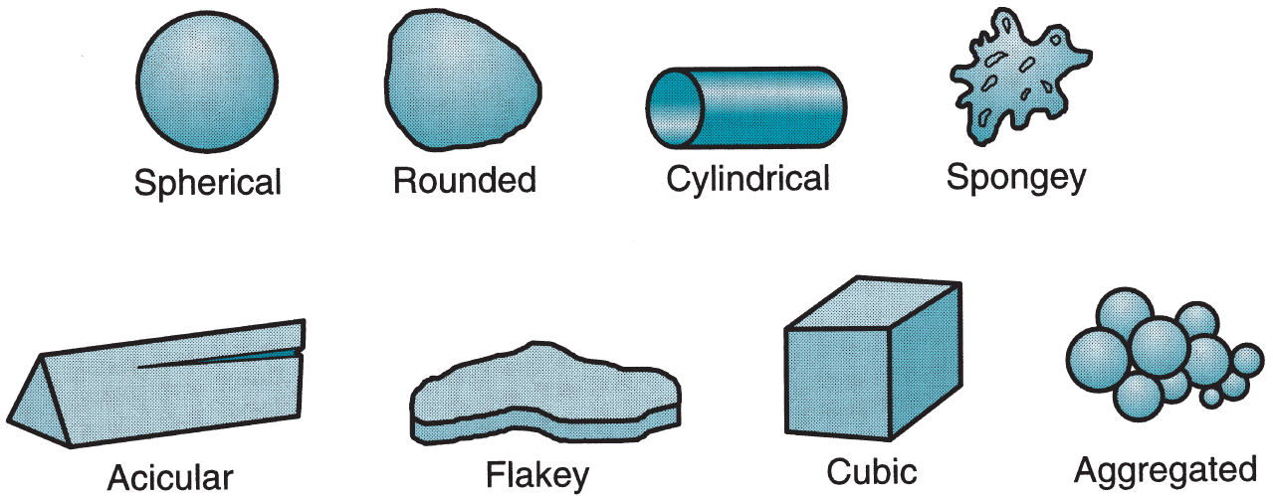
Particle Shapes in PM

Slide 15
Inter-particle Friction
Affects the ability of a powder to flow readily & pack tightly
Smaller particle sizes generally show greater friction
Spherical shapes have the lowest inter-particles friction
As shape deviates from spherical, friction between particles tends to increase
Lubricants are often added to powders to reduce inter-particle friction and facilitate flow during pressing

Slide 16
Particle Density Measures
True density - density of the true volume of the material; alternatively, the density of the material if the powders were melted into a solid mass
Bulk density - density of the powders in the loose state after pouring
Bulk density is less than true density because of pores between particles,

Slide 17
Packing Factor
Bulk density divided by true density
Typical values for loose powders are 0.5 to 0.7
If powders of various sizes are present, smaller powders fit into spaces between larger ones, thus higher packing factor
Packing can be increased by vibrating the powders, causing them to settle more tightly
Pressure applied during compaction greatly increases packing of powders

Slide 18
Production of Metallic Powders
Any metal can be made into powder form
Three principal methods by which metallic powders are commercially produced
Atomization
Chemical
Electrolytic
In addition, mechanical methods (I.E. grinding) are occasionally used to reduce powder sizes

Slide 19
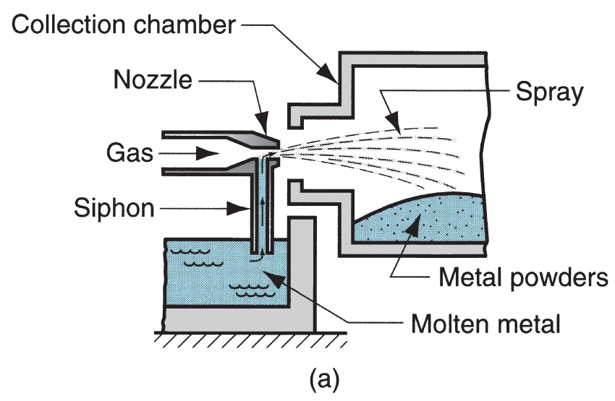
Gas Atomization Method
High velocity gas stream flows through expansion nozzle, siphoning molten metal and spraying it into container.
Droplets solidify into powder form

Slide 20
Conventional Press and Sinter
Conventional PM part-making sequence consists of:
Blending and mixing of powders
Compaction - pressing into desired shape
Sintering - heating to temperature below melting point to cause solid‑state bonding of particles and strengthening of part
In addition, secondary operations are sometimes performed to improve such things as dimensional accuracy and increase density

Slide 21
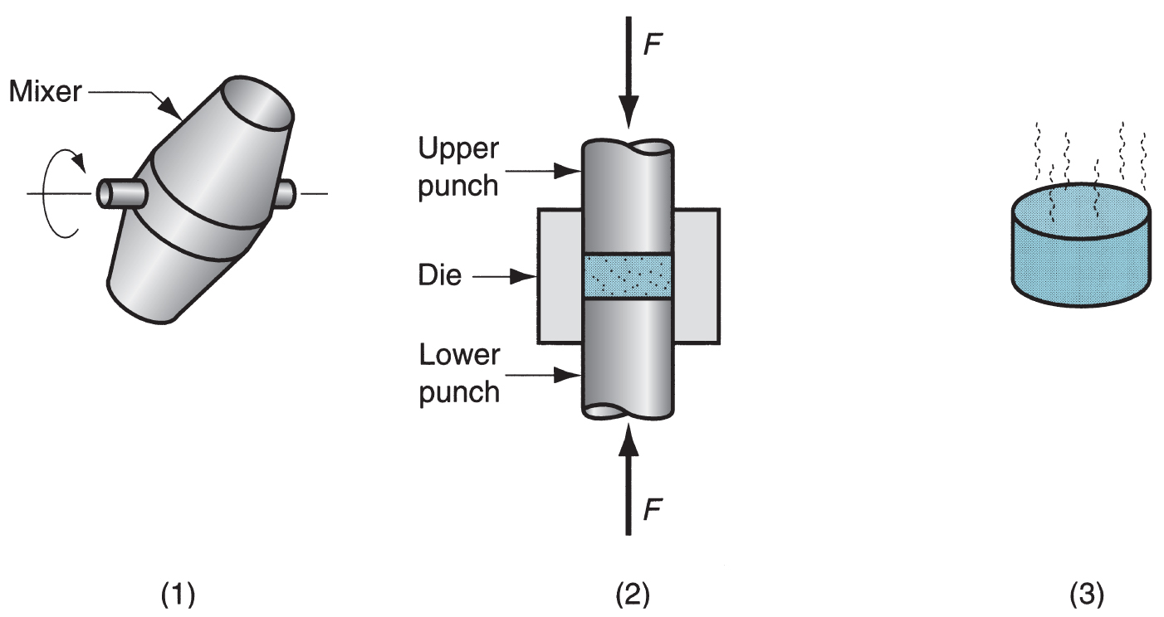
Conventional PM Production Sequence
(1) Blending, (2) compacting, and (3) sintering

Slide 22
Blending and Mixing of Powders
For successful results in compaction and sintering, the starting powders must be homogenized
Blending - powders of the same chemistry but possibly different particle sizes are intermingled.
Different particle sizes are often blended to reduce porosity
Mixing - powders of different chemistries are combined

Slide 23
Compaction
Application of high pressure to the powders to form them into the required shape
Conventional compaction method is pressing, in which opposing punches squeeze the powders contained in a die
The work part after pressing is called a green compact, and the word green meaning not fully processed
The green strength of the part when pressed is adequate for handling but far less than after sintering

Slide 24
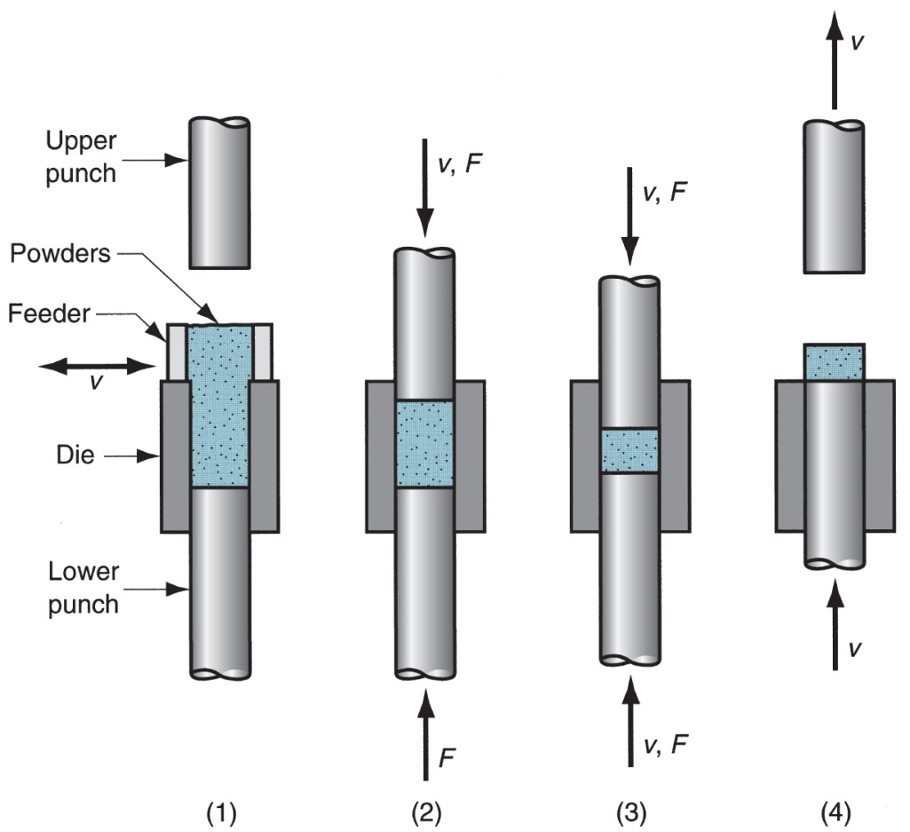
Conventional Pressing in PM
Pressing in PM:
filling die cavity with powder;
Initial position;
final positions of upper and lower punches during pressing;
part ejection

Slide 25
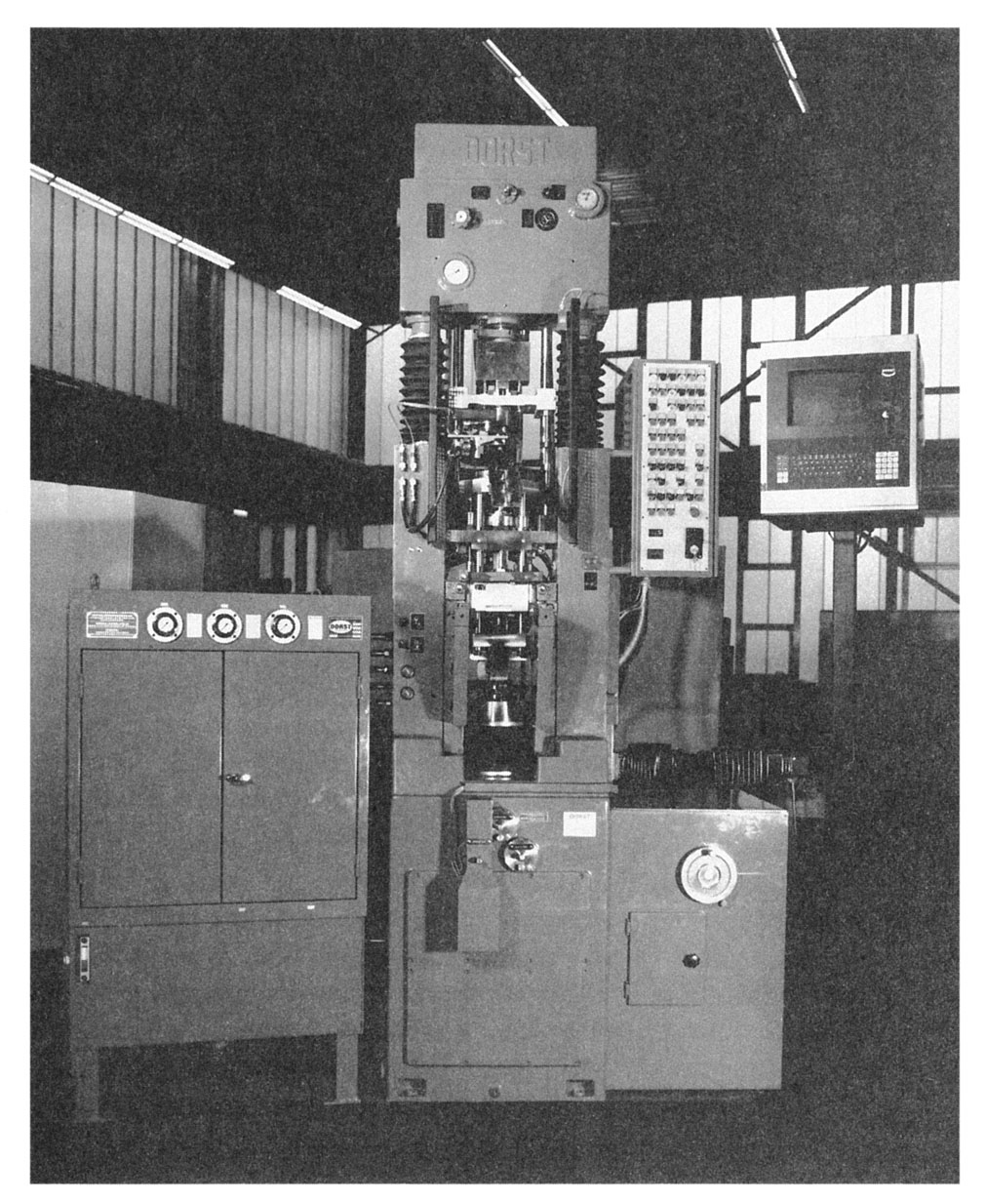
Press for Conventional Pressing in PM
450 kN (50‑ton) hydraulic press for compaction of PM parts (photo courtesy of Dorst America, Inc.).

Slide 26
Sintering
Heat treatment to bond the metallic particles, thereby increasing strength and hardness
Usually carried out at 70% to 90% of the metal's melting point (absolute scale)
Generally agreed among researchers that the primary driving force for sintering is reduction of surface energy
Part shrinkage occurs during sintering due to pore size reduction

Slide 27
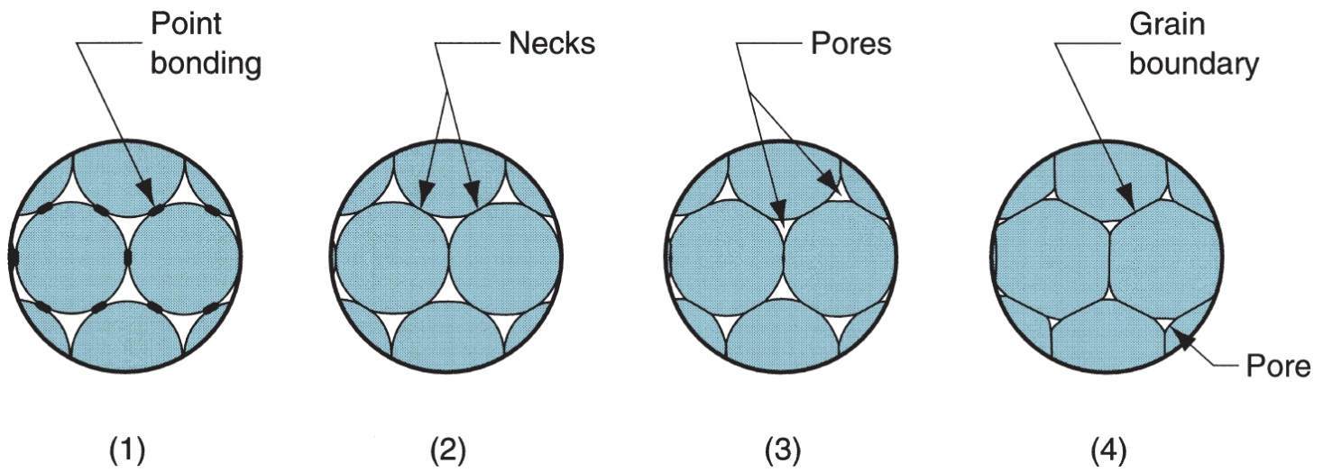
Sintering Sequence on a Microscopic Scale
Particle bonding is initiated at contact points;
contact points grow into "necks";
pores between particles are reduced in size;
grain boundaries develop between particles in place of necked regions

Slide 28
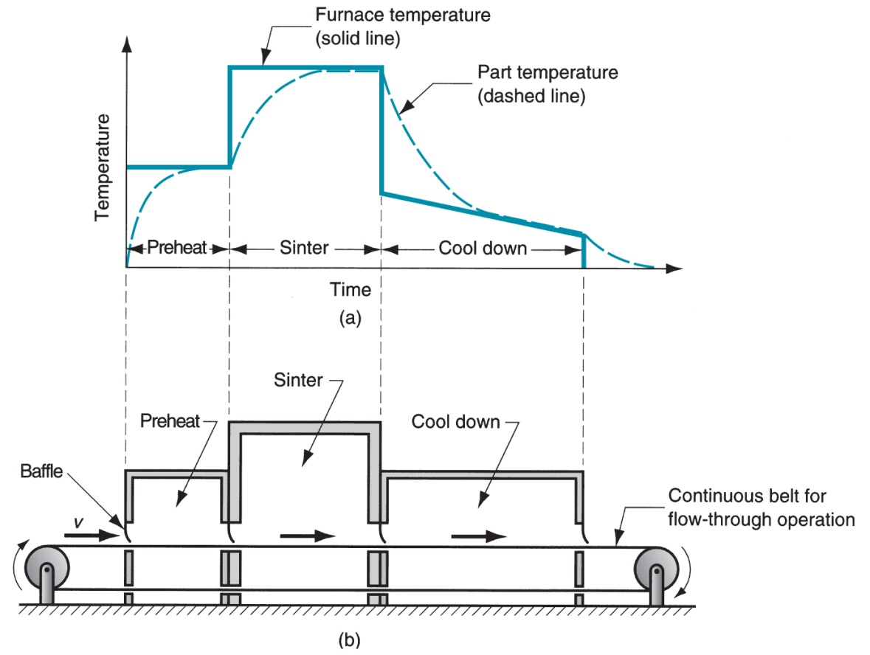
Sintering Cycle and Furnace
(a) Typical heat treatment cycle in sintering; and
(b) schematic of a continuous sintering furnace

Slide 29
Densification and Sizing
Secondary operations are performed on sintered part to increase density, improve accuracy, or accomplish additional shaping
Repressing - pressing in closed die to increase density and improve properties
Sizing - pressing to improve dimensional accuracy
Coining - pressing details into its surface
Machining - for geometric features that cannot be formed by pressing, such as threads and side holes

Slide 30
Impregnation and Infiltration
Porosity is a unique and inherent characteristic of PM technology
It can be exploited to create special products by filling the available pore space with oils, polymers, or metals
Two categories:
Impregnation
Infiltration

Slide 31
Impregnation
The term used when oil or other fluid is permeated into the pores of a sintered PM part
Common products are oil‑impregnated bearings and gears
Alternative application is when parts are impregnated with polymer resins that seep into the pore spaces in liquid form and then solidify to create a pressure tight part

Slide 32
Infiltration
Operation in which the pores of the PM part are filled with a molten metal
The melting point of the filler metal must be below that of the PM part
Heating the filler metal in contact with the sintered part is done so capillary action draws the filler into the pores
Resulting structure:
Is nonporous,
Has a more uniform density, &
Has improved toughness and strength

Slide 33
Alternative Pressing and Sintering Techniques
Conventional press and sinter sequence is the most widely used shaping technology in powder metallurgy
Some additional methods for producing PM parts:
Isostatic pressing - hydraulic pressure is applied from all directions to achieve compaction
Powder injection molding (PIM) - starting polymer has 50% to 85% powder content. Polymer is removed and PM part is sintered
hot pressing - combined pressing and sintering

Slide 34
Four Classes of PM Parts
The Metal Powder Industries Federation (MPIF) defines four classes of powder metallurgy part designs, by level of difficulty in conventional pressing:
(a) Class I Simple thin shapes;
(b) Class II Simple but thicker;
(c) Class III Two levels of thickness; and
(d) Class IV Multiple levels of thickness

Slide 35
Principle of the process
Structure
Process modeling
Defects
Design For Manufacturing (DFM)
Process variation

Slide 36
Design Guidelines for PM Parts
Large quantities required to justify cost of equipment and special tooling
Minimum quantities of 10,000 units suggested
PM is unique in its capability to fabricate parts with a controlled level of porosity
Porosities up to 50% are possible
PM can be used to make parts out of unusual metals and alloys
Materials that are difficult if not impossible to produce by other means

Slide 37
Design Guidelines for PM Parts
Part geometry must permit ejection from die
Part must have vertical or near‑vertical sides, although steps are allowed
Design features on part sides like holes and undercuts must be avoided
Vertical undercuts and holes are permissible because they do not interfere with ejection
Vertical holes can have cross‑sectional shapes other than round without significant difficulty (Ex. Squares, keyways)

Slide 38
Design Guidelines for PM Parts
Screw threads cannot be fabricated by PM
They must be machined into the part
Chamfers and corner radii are possible in PM
But problems occur in punch rigidity when angles are too acute
Wall thickness should be a minimum of 1.5 mm (0.060 in) between:
holes
a hole and outside wall
Minimum hole diameter ~ 1.5 mm (0.060 in)

Slide 39
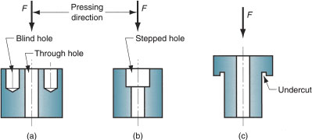
Permissible Part Features for Part Ejection
(a) Vertical holes (blind and through)
(b) Vertical stepped hole
(c) Undercut in vertical direction

Slide 40
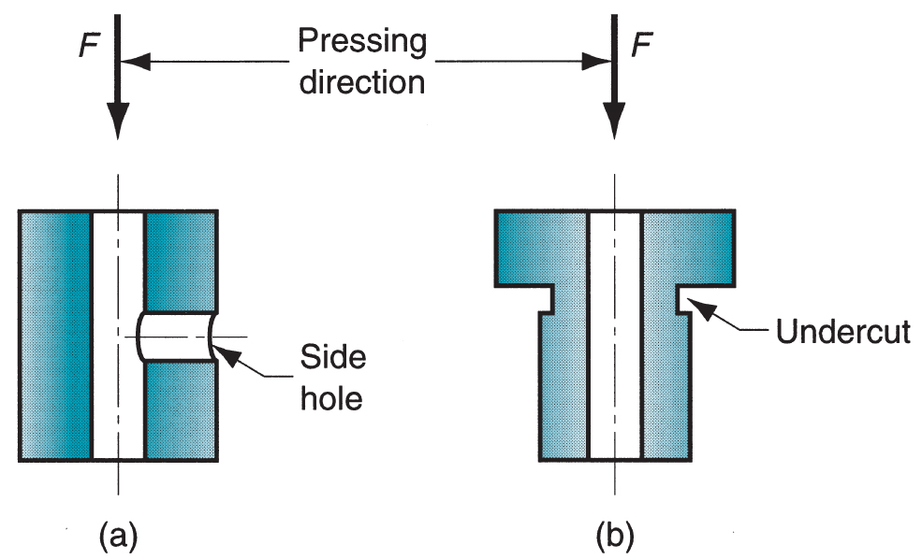
Not Permissible Part Features: Makes Part Ejection Impossible
Part features to be avoided in PM:
(a) side holes and
(b) side undercuts

Slide 41
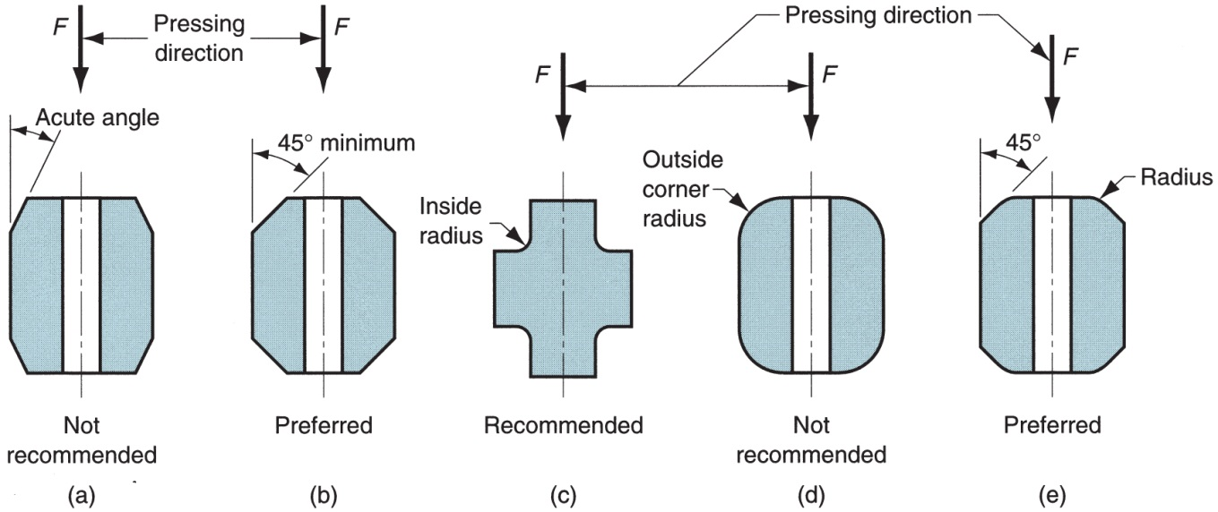
Chamfers and Corner Radii
Punch is less rigid & fragile at its edge, hence follow these guidelines:
(a) Avoid acute angles;
(b) use larger angles for punch rigidity;
(c) inside radius is desirable;
(d) avoid full outside corner radius;
(e) better to combine radius and chamfer

