Slide 1
Tool Steels & Their Heat Treatments
Presented by
Professor Ali Hussein ATAIWI

Slide 3
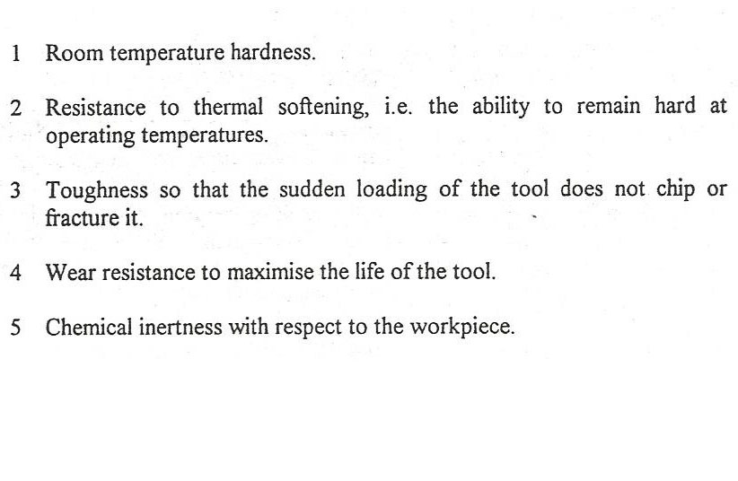

Slide 4
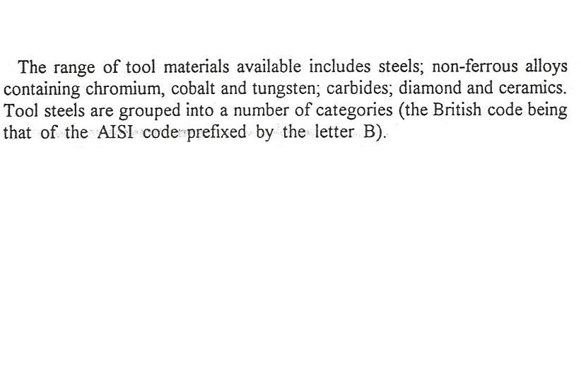

Slide 5
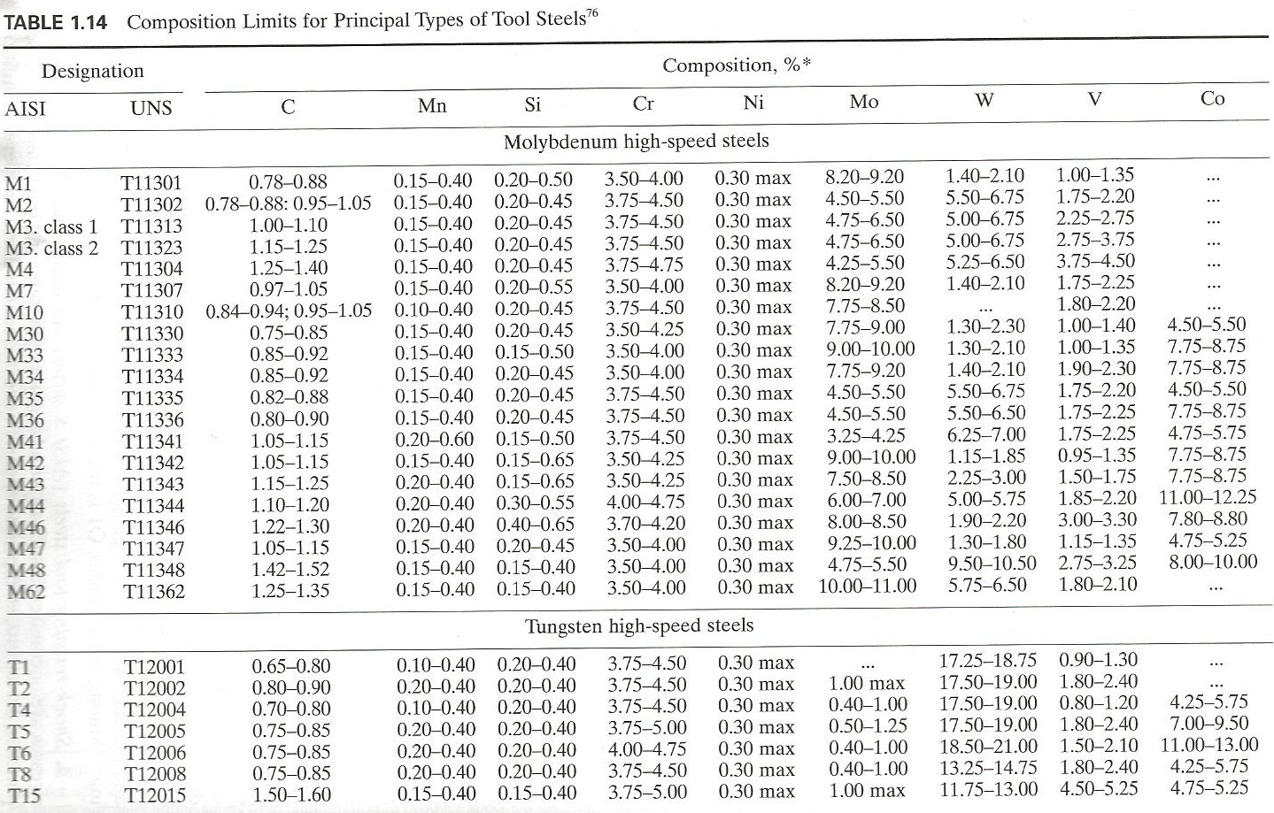

Slide 6
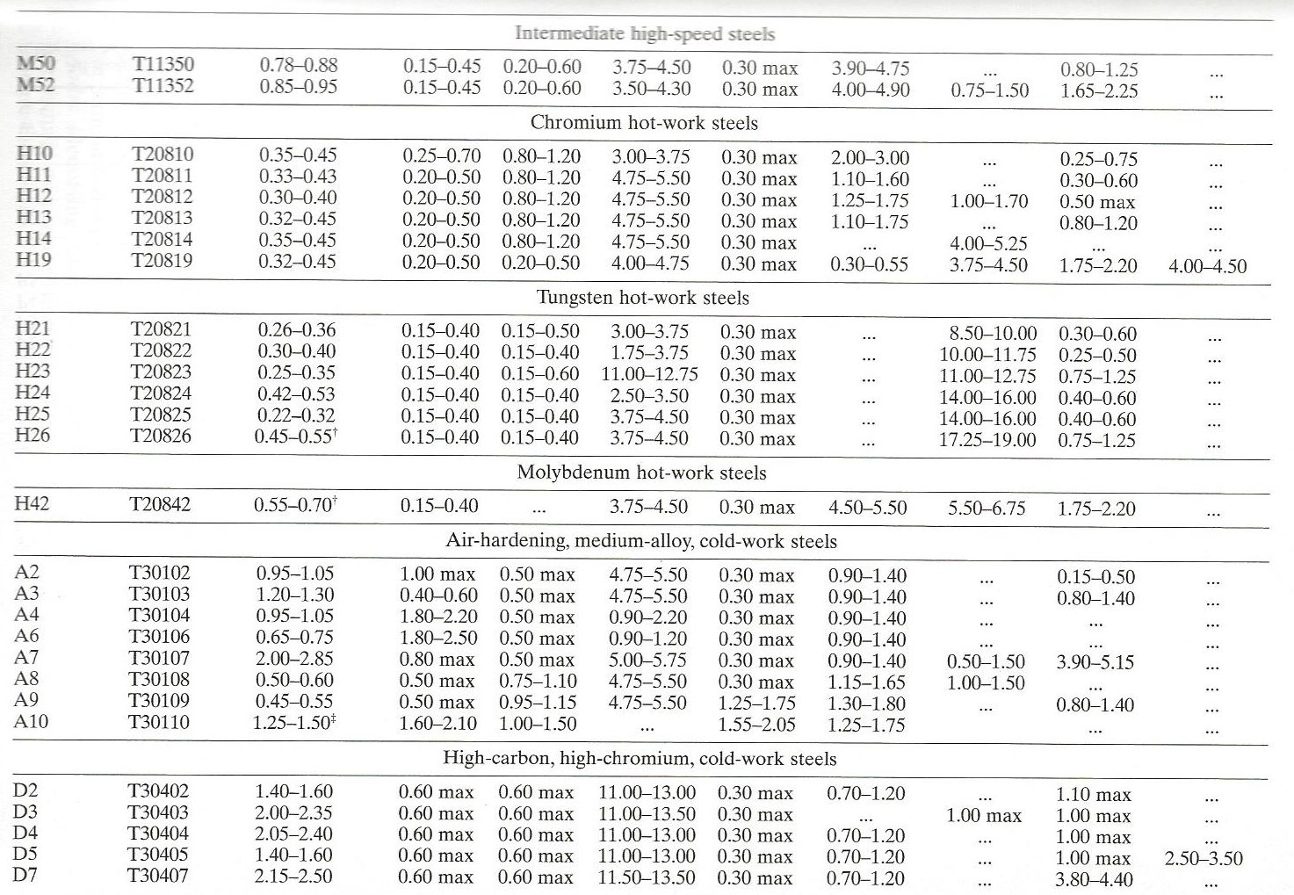

Slide 7
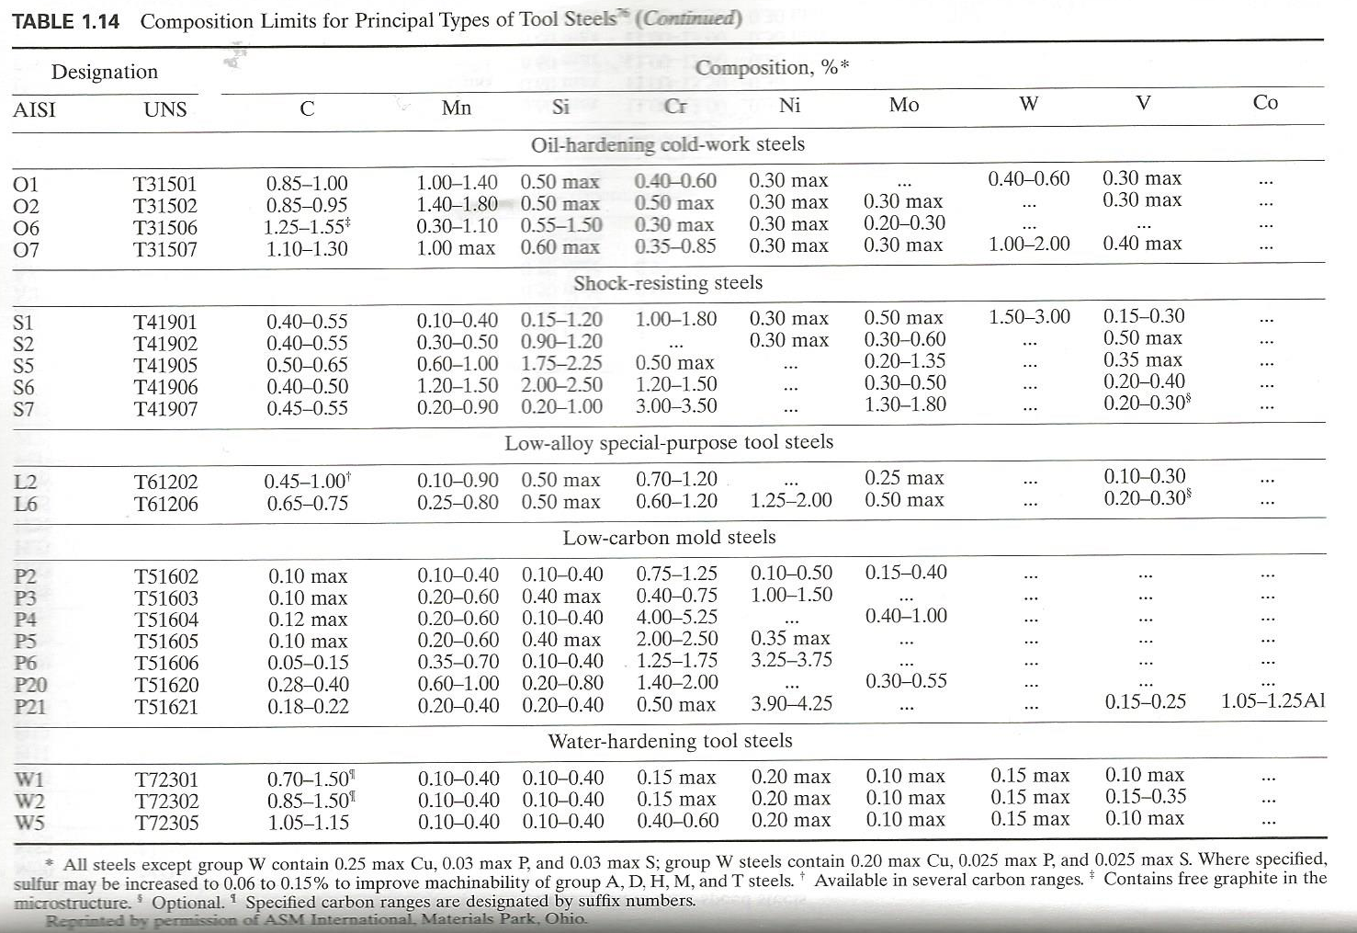

Slide 8
The heat treatment of tool steels is as important to their success as the selection of the class/grade itself. With few exceptions, all tool steels must be heat treated to develop specific combinations of wear resistance, resistance to deformation or breaking under loads, and resistance to softening at elevated temperature. Heat treating procedures vary significantly among the various classes of tool steel.

Slide 9
Water –Hardening Tool Steels (W steels)
Water-hardening tool steels containing 0.90 to 1.00% carbon are the most widely used. Carbon content affects heat treating temperatures, which outlines recommended heat treating practices for these steels.
As a class, water-hardening tool steels are relatively low in hardenability, although they are arbitrarily classified and available as shallow-hardening, medium-hardening, and deep-hardening types. Their low hardenability is frequently an advantage, because it allows tough core properties in combination with high surface hardness.

Slide 10
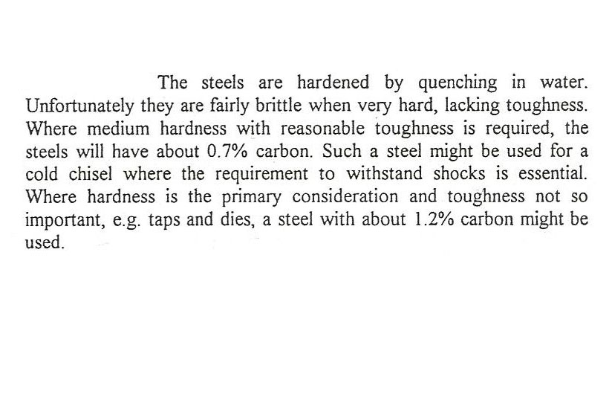

Slide 11
Normalizing.
Except in special instances where experience has proved it beneficial, normalizing is not recommended for water-hardening tool steels as received from the supplier. Annealing .
Tool steels of the W types are received from the supplier in the annealed condition. Cold worked carbon tool steel is annealed to soften it for easier machining.

Slide 12
Austenitizing temperatures for water-hardening tool steels normally vary from 760 to 845 ºC . Higher temperatures are sometimes used for special purposes. Hardenability increases as austenitizing temperature increases .The optimum time at austenitizing temperature is from 10 to 30 min. Preheating is unusual except for very large tools or those with intricate cross sections.

Slide 13
Quenching.
To produce maximum depth of hardness in water –hardening tool steels, it is essential that they be quenched as rapidly as possible. In most instances, water or a brine solution consisting of 10 % NaCl (by weight) in water is used .Occasionally, for an even faster quenched, an iced brine solution is employed. Cooling rate is a function of work piece size as well as of quenched medium; for this reason, small pieces can be quenched in oil.

Slide 14
Tempering .
water –hardening tool steels should be tempered immediately after hardening, preferably before they reach room temperature; about 50 º C is optimum . Salt baths, oil bathes, and air furnaces are all satisfactory for tempering.All parts made of these steels should be tempered at temperatures not lower than 175º C . One hour at temperature is usually adequate; additional soaking time will further lower hardness.
*Table 5.15 gives some examples of H.T of tool steels,
and Table 5.14 compare properties of some tool steels
with other tool materials

Slide 15
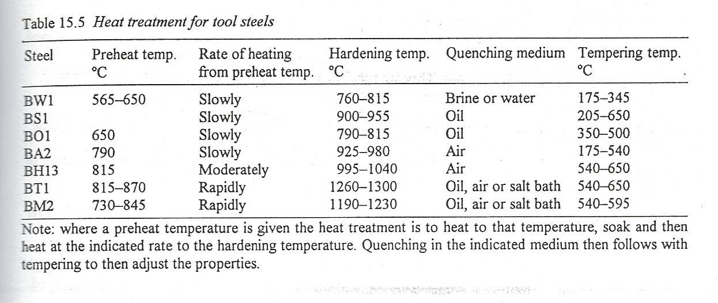

Slide 16
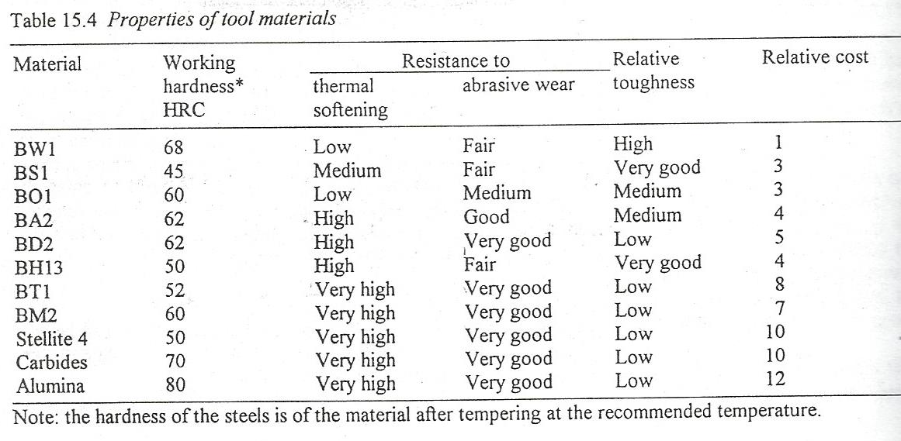

Slide 18
Normalizing
Is not recommended for shock-resisting tool steels.
Annealing.
The high –silicon types (S2, S4, S5, and S6) are susceptible to graphitization and decarburization.. The silicon types should not be soaked at temperature.
Austenitizing
Temperatures for shock-resisting tool steels vary from 815 to 955 º C. Preheating is not mandatory , but it is sometimes desirable for large tools , to minimize distortion, shorten time at the austenitizing temperature , and speed up production.
*Table 5.15 gives examples of H.T of Tool steels.

Slide 19
Oil –Hardening Cold – Work Tool Steels( O-Steels)

Slide 20
Normalizing is desirable and sometimes necessary for parts that have been forged or heated previously to temperatures much higher than the proper austenitizing temperatures, because it produces a more uniformly refined grain structure.
Annealing. Finished or semi finished tools made from oil-hardening cold-work steels should be protected from decarburization or carburization during annealing. This can be accomplished by the use of dry exothermic furnace atmospheres .More often , however , it is accomplished by pack annealing , wherein work to be annealed is packed in a box and surrounded with inert protective material , such as clean cast iron chips or 6-to-8 mesh spent pitch coke.

Slide 21
Austenitizing:
Recommended austenitizing temperatures for oil – hardening tool steel are 790-815 º C
Quenching :
The optimum temperature range for quenching baths consisting of conventional oils is 40 to 60 º C ; agitation is recommended

Slide 22
Tempering :
The O steels should be tempered immediately after quenching (preferably before they quite reach room temperature). These steels usually are not tempered below 120 º C or above 540 º C ; the most commonly used temperature range is from 175 to 205 º C. Tempering times vary with section size. Often a time at temperature of 1hr per inch of thickness (minimum dimension of heaviest section) or per inch of diameter, with a minimum of 1 hr. is used

Slide 23
Medium – alloy air-hardening(A steels), and high-carbon high –chromium(D steels), cold – work tool steels
Normalizing:
Normalizing is not recommended for any the steels in
groups A and D.
Annealing:
These steels are usually supplied in the annealed condition by the manufacturer ,however, they should be annealed after forging and prior to rehardening or welded tools that are to be reworked. The various types are given in table 1.14.

Slide 24
Preheating:
Steels of the A and D groups are usually preheating before being austenitized for hardening . Preheating reduces subsequent distortion in the hardened parts by minimizing non uniform dimensional changes during austenitizing (see table 15.5) .

Slide 25
Austenitizing:
Steels of groups A and D can be austenitized in molten salt baths or in various types of furnaces using gaseous atmospheres.
Quenching:
Steels of groups A and D will attain maximum hardness by cooling in still air, unless sections are extremely large.

Slide 26
Tempering:
Tempering practices for A and D steels parallel those described for O steels begin when the work reaches a temperature of about 50 to 65 º C (120 to 150 F) . However , these steels retain some austenite at this temperature range. Multiple tempering is effective in decreasing the amount of austenite retained in A and D steels and is a common practice in heat treating them. The general precautions and tempering practices outlined for O steels in the preceding section are followed for the A and D steels. However because most of the steels in groups A and D soften less rapidly than group O steels with an increase in tempering temperature, higher tempering temperatures can be used for the A and D steels .

Slide 27
Hot –Work Tool Steels (H Steels) ,See table 1.14

Slide 28
The heat treating practices commonly employed for chromium, tungsten ,and molybdenum types of hot-work tool steels (see table 15. 54).
Normalizing:
Because these steels as a group are either partially or completely air-hardening, normalizing is not recommended
Annealing:.
To minimize scaling and decarburization, small parts are usually pack annealed while large and heavy die blocks are more commonly annealed in controlled –atmosphere furnaces .

Slide 29
Preheating:
Preheating prior to austenitizing is nearly always recommended for all hot-work steels. For H13 the recommended temperature is 815 º C .
Austenitizing
Temperature recommended for hardening of hot-work tool steel H13 are given in table 5.15. Rapid heating from the preheating temperature to the austenitizing temperature is preferred for types H16 through H43.
Tempering
Practice is essentially the same as that recommended for A and D grades .All of the H grades showing some secondary hardening characteristics; therefore, double tempering is recommended . H13 is tempered at 540- 650 º C

Slide 30
High –speed tool steels

Slide 31
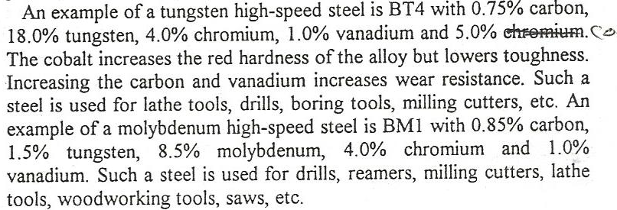
Normalizing
Normalizing of high-speed tool steels is not recommended.

Slide 32
Annealing.(see table 15.5 for T1 & M2 high speed steels)
High-speed steel must be fully annealed after forging or when rehardening is required. To minimize decarburization, pack annealing in tightly closed containers is recommended. The packing material can be dry sand or lime to which a small amount of charcoal has been added; burned cast iron chips also are satisfactory, because the packing material acts to insulate the container. After the steel has reached the annealing temperature range, it should be held at temperature for 1h per inch of thickness of the container and should then be slowly cooled in the furnace (at a rate not exceeding 20 º C per h) until it reaches a temperature of 650 º C ,then a faster rate of cooling is permissible.

Slide 33
Preheating .(see table 15.5 for T1 & M2 high speed steels)
Austenite begins to form at about 760 and preheating for hardening to slightly above this temperature will minimize stresses that might be set up because of the transformation.
Double preheating –in one furnace at 540 to 650 º C and in another at 845 to 870 º C is often recommended to minimize thermal shock
Austenitizing.(see table 15.5 for T1 & M2 high speed steels)
High-speed steels depend on the solution of various complex alloy carbides during austenitizing to develop their heat-resisting qualities and cutting ability.
These carbides do not dissolve to an appreciable extent unless the steel is heated to temperatures near the melting point. Therefore; exceedingly accurate temperature control is required in austenitizing high-speed steels

Slide 34
Quenching.(see table 15.5 for T1 & M2 high speed steels)
High speed steels can be quenched in air, oil or molten salt. However except for thin tools which are air quenched between plates to keep them straight, it is customary to quench in oil from muffle or semi muffle furnaces and in molten salt from a high-temperature salt bath. After its temperature has been equalized in the salt quench, the tool is air cooled. For large cutters heated in a furnace , an interrupted oil quench is often used to minimize quenching strains and prevent cracking .This consists of cooling the cutters in the oil only until they lose color (about 540 º C) and then cooling them in air.

Slide 35
Tempering.(see table 15.5 for T1 & M2 high speed steels)
For example M2 steel is austenitized at 1220 º C. The hardness of high –speed steel is directly affected by tempering temperature and time. M2 undergoes secondary hardening at temperatures above approximately 370 º C and that secondary hardening proceeds at higher temperatures up to about 595 º C depending on time at temperature. These temperatures approximate the practical limits for most tempering operations; lower temperatures do not evoke the secondary hardening response, and higher temperatures produce hardnesses considerably lower than those usually desired.

Slide 36
High-speed steels normally are subjected to a minimum of two separate tempering treatments within the range of 540 to 595 º C. The duration of each treatment is usually 2 h or more at temperature. This process ensures attainment of consistent martensitic structures because the amount of retained austenite in the as-quenched condition will vary significantly because of variations in heat chemistry, prior thermal history ,hardening temperature, and quenching conditions

