Slide 1
THE EUROPEAN UNION
UNITED IN DIVERSITY

Slide 2
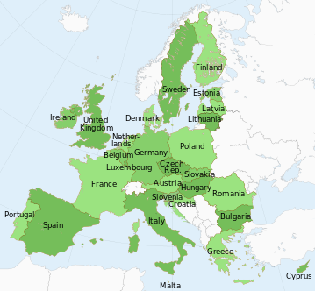
The EU is a unique economic and political partnership between 28 European countries that together cover much of the continent

Slide 3
The History of the European Union
1950→ the European Coal and Steel Community (Belgium, France, Germany, Italy, Luxembourg and the Netherlands)
1957→The European Economic Community and European Atomic Energy Community
1993: the Maastricht Treaty → EUROPEAN UNION

Slide 4
MEMBER STATES
1973→ the first enlargement : Denmark, Ireland and The United Kingdom
1981→Greece
1983→ Spain and Portugal
1995→ Austria, Finland and Sweden
2004 ( 10 new members)→Cyprus, the Czech Republic, Estonia, Hungary, Latvia, Lithuania, Malta, Poland, Slovakia and Slovenia
2008→ Bulgaria and Romania
July 1, 2013 → CROATIA

Slide 5
The 12 stars in a circle symbolize the ideals of unity, solidarity and harmony among the people of Europe

Slide 6
EUROPE DAY (9 MAY)
→ideas of the European Union first put forward on that day by French foreign minister Robert Schuman
The European anthem
→The Bethoven’s Ninth Simphony (1823)

Slide 7
The common currency in 18 out of 28 countries
These countries are known collectively as the Eurozone

Slide 8
Languages spoken
The languages of the European Union are languages used by people within the member states of the EU
They include the twenty-four official languages of the European Union along with a range of others.
The EU asserts that it is in favor of linguistic diversity and currently has a European Commissioner for Education, Culture, Multilingualism and Youth

Slide 9
The EU Institutions
The European Parliament (Europski parlament)
The Council of the EU (Vijeće Europske unije)
The European Commission (Europska komisija)
The European Council (Europsko vijeće)
The Court of Justice of the EU (Sud Europske unije)
The European Central Bank (Europska središnja banka)
The European Court od Auditors (Revizorski sud)

Slide 10
The EU Bodies
10 EU bodies
European External Action Service (EEAS)→manages the EU diplomatic relations with other countries and supports the EU’s strategic partnership with key international players
European Ombudsman→responds to complaints from EU citizens, businesses and organizations; helping to uncover cases of 'maladministration‘
→It is completely independent and does not take orders from any government or organization; once a year, it presents the European Parliament with an activity report

Slide 11
The EU Agencies
→Distinct bodies from the EU institutions→ separate legal entities set up to perform specific tasks under EU law
→Over 40 agencies divided into 4 groups:
Decentralised agencies (technical, scientific, managerial tasks)
Executive agencies (help to manage EU programmes)
EURATOM agencies (support the aims of the European Atomic Energy Community Treaty)
European Institute of Innovation and Technology/EIT (promotes Europe’s ability to develop new technologies)

Slide 12
European Parliament / Europski parlament
Directly elected by EU voters every 5 years
Members of the European Parliament (MEPs) represent the people
The number of MEPs for each country is roughly proportionate to its population
Maximum 751 MEPs (750+the President)
One of the EU’s main law-making institutions, along with the Council of the European Union
3 places of work: Brussels, Luxembourg and Strasbourg

Slide 13
Roles of the European Parliament
Debating and passing European laws (together with the Council)
→works together with the Council to decide on the content of the EU laws and oficially adopt them (ordinary legislative process)
→Lisbon Treaty: more power to influence the content of laws in areas including agriculture, energy policy, immigration and EU funds
→must give its permission for allowing new countries to join the EU

Slide 14
Democratic supervision
→when a new Commission is appointed , its 28 members cannot take up office until Parliament has approved them
→it can call on the Commission to resign during its period in office (motion of censure)
→keeps check on the Commission by examining reports it produces and questioning Commissioners
→MEPs look at petitions from citizens and sets up of committees of inquiry
→When national leaders meet for European Council summits, Parliament gives its opinion on the topics on the agenda

Slide 15
Supervising the budget
→ adopts the EU’s annual budget with the Council of the European Union
→has a committee that monitors how the budget is spent
→every year passes judgment on the Commission's handling of the previous year's budget

Slide 16
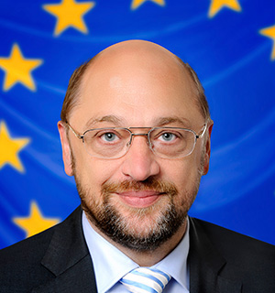
President of the European Parliament
Martin Schulz
presides over the debates and activities of the Parliament
represents the Parliament within the EU and internationally
two and a half year term, can be re-elected once

Slide 17
The Council of the EU /Vijeće EU
This is where national ministers from each country meet do adopt laws and coordinate policies

Slide 18
What does it do?
Passes EU laws→The Council and Parliament share the final say on new EU laws proposed by the Commission
Coordinates economic policies
Signs international agreements→on diverse subjects (environment, trade, development, textiles, fisheries, science, technology and transport)
Approves the annual EU budget→along with the Parliament
Develops the EU’s foreign and defense policies→the Common Foreign and Security Policy
Justice→Coordinates cooperation between courts and police forces of member countries

Slide 19
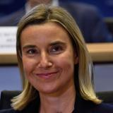
No fixed memebers→at each Council meeting, each country sends the minister for the policy field being discussed
The foreign ministers’ Council has a permanent chairperson : High Representative of the Union for Foreign Affairs and Security Policy (Visoki predstavnik Unije za vanjske poslove i sigurnosnu politiku )→Federica Mogherini
All other Council meetings are chaired by the relevant minister of the country holding the rotating EU presidency

Slide 20
Voting
decisions in the Council of the EU are taken by qualified majority as a general rule → the bigger a country’s population, the more votes it has
double majority voting (2014):
a majority of countries (at least 15)
and a majority of the total EU population (the countries in favour must represent at least 65% of the EU population)
in votes concerning sensitive topics (security, external affairs) decisions by the Council have to be unanimous

Slide 21
The European Commission/ Europska komisija
The Commission is based in Brussels and Luxembourg and has offices (representations) in every EU country and delegations in capital cities around the world.

Slide 22
28 Commissioners (one from each country/5-year term)
The President is nominated by the European Council
Current President is Jean-Claude Juncker
The appointment of all Commissioners (including the President) has to be approved by the European Parliament

Slide 23
Purpose
Proposing new laws to Parliament and the Council
→has ‘the right of inititative’: can propose new laws→the Commission’s departments produce a draft of the proposed new law. If at least 14 of the 28 Commissioners agree with it, the draft is then sent to the Council and Parliament
Managing the EU’s budget and allocating funding
→ With the Council and Parliament, the Commission sets broad long-term spending priorities for the EU
→ manages funding for EU policies and programmes such as 'Erasmus’

Slide 24
Enforcing European law
→ checks that each member country is applying EU law properly
Representing the EU internationally
→speaks on behalf of all EU countries in international bodies
→ negotiates international agreements for the EU

Slide 25
The European Council/ Europsko vijeće

Slide 26
summits where EU leaders meet to decide on broad political priorities and major initiatives
around 4 meetings a year, chaired by a permanent president
Donald Tusk
The European Council elects its President by qualified majority
Two and a half years term, can be re-elected once

Slide 27
What does it do?
setting the EU's general political direction and priorities
dealing with complex or sensitive issues that cannot be resolved at a lower level of intergovernmental cooperation
It has no powers to pass laws

Slide 28
Members
The European Council brings together the heads of state or government of every EU country, the Commission President and the European Council President, who chairs the meetings, the EU’s High Representative for Foreign Affairs and Security Policy
They meet twice every six months, usually in Brussels
Decisions are usually taken by consensus, in some cases, it adopts decisions by unanimity or by qualified majority, depending on what the Treaty provides for
the presidents of the European Council and Commission, and the High Representative for Foreign Affairs and Security Policy do not have a vote

Slide 29
The Court of Justice of the EU/ Sud Europske unije

Slide 30
The European Central Bank/ Europska središnja banka
Based in Frankfurt, Germany
The ECB is completely independent
keeps prices stable (keeps inflation under control), especially in countries that use the euro)
keeps the financial system stable – by making sure financial markets and institutions are properly supervised

Slide 31
The European Court od Auditors/Revizorski sud
Audits EU finances
Its role is to improve EU financial management and report on the use of public funds
based in Luxembourg

Slide 32
has the right to check ('audit') any person or organization handling EU funds
The Court has one member from each EU country appointed by the Council for a six-year term (renewable)
The Court of Auditors has no legal powers of its own, if auditors discover fraud or irregularities they inform OLAF- The European Anti-Fraud Office
present the European Parliament and the Council with an annual report on the previous financial year (the 'annual discharge‘)
has to give its opinion on EU financial legislation and how to help the EU fight fraud

Slide 33
ENLARGEMENT
the process whereby countries join the EU
widening EU membership has promoted economic growth and strengthened democratic forces in countries emerging from dictatorship
Uniting East and West
The Treaty on European Union states that any European country may apply for membership if it respects the EU's democratic values and is committed to promoting them

Slide 34
Who can join?
A country can only join if it meets all the membership criteria:
political – it must have stable institutions guaranteeing democracy, the rule of law and human rights
economic – it must have a functioning market economy and be able to cope with competitive pressure and market forces within the EU
legal – it must accept established EU law and practice – especially the major goals of political, economic and monetary union

Slide 35
How does it work?
The process has 3 stages (all subject to approval by all existing EU countries):
a country is offered the prospect of membership
the country becomes an official candidate for membership
the candidate moves on to formal membership negotiations, a process that usually involves reforms to adopt established EU law

Slide 36
Who can join next?
Currently the EU has offered the prospect of membership to 8 countries: Albania, Turkey, Iceland and all the countries of the former Yugoslavia (except Slovenia and Croatia, already EU members).
5 of these have been granted official candidate status:
Turkey
Serbia
The former Yugoslav Republic of Macedonia
Iceland
Montenegro

Slide 37
EU Foreign Affairs
Foreign affairs = foreign policy
concerns international relations and national interests in foreign countries
handled by the Foreign Affairs Council (FAC)

Slide 38
Foreign Affairs Council
FAC is a configuration of the Council of the European Union
it meets once a month
created in 2009 by the Treaty of Lisbon
consists of the foreign ministers from all EU member states
Ministers responsible for European Affairs, Defence, Development or Trade also participate depending on the items on agenda.

Slide 39
FAC’s tasks:
is responsible for the EU's external action
which includes foreign policy, defense, trade, development cooperation and humanitarian aid
defines and implements the EU's foreign and security policy
ensures the unity, consistency and effectiveness of the EU's external action

Slide 40
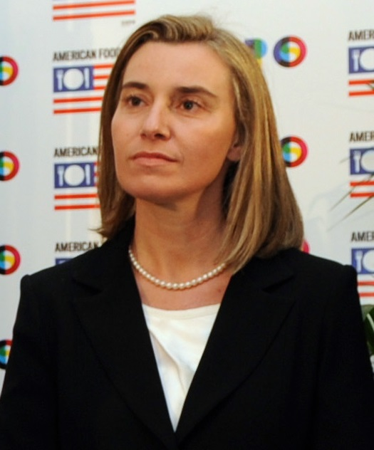
meetings are chaired by the High Representative of the Union for Foreign Affairs and Security Policy → Federica Mogherini.
she is the president of the FAC
her main task is:
to speak for the EU
regarding foreign policy
of the Member States

Slide 41
THE EU LAW
How are EU decisions made?
The EU’s standard decision-making procedure is known as Ordinary Legislative Procedure (or "codecision")
the directly elected European Parliament has to approve EU legislation together with the Council (the governments of the 28 EU countries)

Slide 42
Two steps:
1. The Commission proposes legislation after consulting various NGOs, local authorities, representatives of industries and civil societies…
2. The European Parliament and the Council of the EU review proposals by the Commission and propose amendments → CODECISION PROCEDURE

Slide 43
if the two institutions agree on amendments, the proposed legislation can be adopted
if they cannot agree, a conciliation committee tries to find a solution
both the Council and the Parliament can block the legislative proposal

Slide 45
there are also special legislative procedures used in sensitive areas
in these procedures:
the Council can adopt legislation on its own with just the involvement of the EP and the Council
the Council and the EC can act alone
the EC can act alone

Slide 46
Acquis communautaire
pravna stečevina Europske unije
often shortened to acquis
the accumulated legislation which constitutes the body of European Union law
candidate countries have to accept the acquis before they can join the EU, and make EU law part of their own national legislation
the acquis is divided into 35 chapters for the purpose of negotiation between the EU and the candidate country during the accession process

Slide 47
35 chapters of the acquis
Free movement of goods
Freedom of movement for workers
Right of establishment and freedom to provide services
Free movement of capital
Public procurement
Company law
Intellectual property law
Competition policy
Financial services
Information society and media
Agriculture and rural development
Food safety, veterinary and phytosanitary policy
Fisheries
Transport policy
Energy
Taxation
Economic and monetary policy
Statistics
Social policy and employment
Enterprise and industrial policy
Trans-European networks
Regional policy and coordination of structural instruments
Judiciary and fundamental rights
Justice, freedom and security
Science and research
Education and culture
Environment
Consumer and health protection
Customs union
External relations
Foreign, security and defence policy
Financial control
Financial and budgetary provisions
Institutions
Other issues

Slide 48
European Union law consists of
primary legislation: the treaties (=ugovori)
secondary legislation: the provisions of instruments enacted by the European institutions

Slide 49
Primary legislation: the treaties
a treaty → a binding agreement between EU member countries
sets out EU objectives, rules for EU institutions, how decisions are made and the relationship between the EU and its member countries
the European Union is based on the rule of law
every action taken by the EU is founded on treaties that have been approved voluntarily and democratically by all EU member countries
when new countries joined the EU, the founding treaties were amended

Slide 50
The main treaties are:
Treaty establishing the European Coal and Steel Community
Treaties of Rome: EEC and EURATOM treaties
Merger Treaty - Brussels Treaty
Single European Act
Treaty on European Union - Maastricht Treaty
Treaty of Amsterdam
Treaty of Nice
Treaty of Lisbon

Slide 51
Treaty of Lisbon
Lisabonski ugovor
Signed: 13 December 2007
Entered into force: 1 December 2009
Purpose: to make the EU more democratic, more efficient and better able to address global problems, such as climate change, with one voice
Main changes: more power for the European Parliament, change of voting procedures in the Council, citizens’ initiative, a permanent president of the European Council, a new High Representative for Foreign Affairs, a new EU diplomatic service.

Slide 52
The Lisbon treaty clarifies which powers:
belong to the EU
belong to EU member countries
are shared

Slide 53
Secondary legislation: Main types of instruments
Regulation (=uredba)
Directive (=direktiva)
Decision (=odluka)
Recommendation (=preporuka)
Opinion (=mišljenje)

Slide 54
Regulations
a binding legislative act
it must be applied in its entirety across the EU
addressed to all member states
used in specific areas (e.g. agriculture, customs…)

Slide 55
Directives
a legislative act that sets out a goal that all EU countries must achieve
binding as to the objectives or results to be achieved
it is up to the individual countries to decide how achieve those goals

Slide 56
Decisions
binding on those to whom it is addressed (e.g. an EU country or an individual company)
it is directly applicable

Slide 57
Recommendations and opinions
have no binding force
only suggestions and advisory opinions without any legal obligation to whom they are addressed

Slide 58
EU legislative texts are drafted and published in all official languages
from the legal point of view, they are regarded as originals, not as translations
all language versions are vested with the force of law

Slide 59
Application of the EU law
the EC is responsible for ensuring EU law is applied throughout all Member States
it can impose sanctions on individuals or companies who break EU law
It can take formal action against national authorities asking them to remedy the situation by a certain date
this may involve taking them to the European Court of Justice

Slide 60
THANK YOU FOR YOUR ATTENTION ☺

