Slide 1
Culture and Society of the Middle East

Slide 2
Religion
Religion plays a big role in Middle Eastern society
Religion is considered one of the main pillars of society and individuals are stereotyped based on their religion
Dominant Religions of the Middle East
Islam (Sunni and Shia)
Judaism
Christianity

Slide 3
During Muslim holidays or Ramadan, life is affected by ceremonies and everyone is expected to respect those ceremonies while in public. Office hours and business dynamics change in many Middle Eastern countries during the month of Ramadan. It’s highly recommended that one belongs to a formal religion when in this part of the world as well as avoiding engaging in a religion-based discussion or analysis. Such an interaction can immediately lead to animosity or distance. The best attitude to have is to just be a listener and a learner when it comes to religious conversations. To illustrate how religions are used to identify and organize society, religions and religious sects in Lebanon have been assigned quotas for job openings, and high level positions in the government are required to be filled by certain religious followers. For example, in Lebanon the president must be a Maronite Christian, the prime minister must be a Sunni Muslim, the minister of foreign affairs is usually an Orthodox Christian, etc. In other countries in the Arab world, Christians are not authorized to hold many key positions. - Berich Consulting, LCC

Slide 4
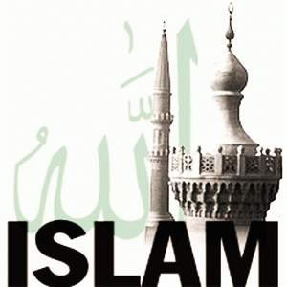
Islam is viewed by many Muslims not simply as a religion, but also as a cultural identity and heritage
The tension is between modernity and tradition (struggle between Islam and western modernity)

Slide 5
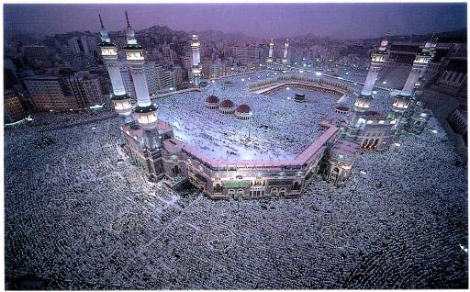
Muslims on pilgrimage to Mecca

Slide 6
Govt. and Politics
Politics affect culture in the Middle East
Factors which influence politics are:
- Civic
- Tribal
- Religious
Common forms of govt. in the Middle East:
- Theocracy (Iran)
- Monarchy (Saudi Arabia)
- Republic (Syria)
- Democracy (Iraq)

Slide 7
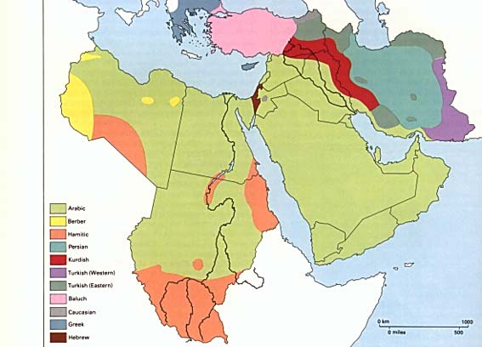
Languages
Arabic is the
dominant language
Other common
languages:
- Hebrew
- English
- French
- Turkish
- Kurdish

Slide 8
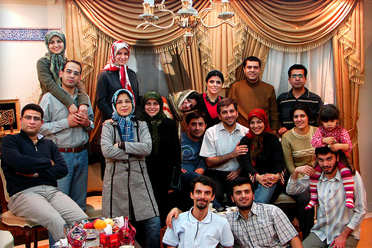
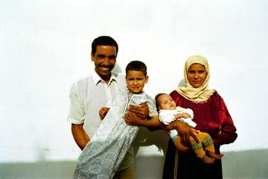
Role of the Family
Basic family unit:
- Extended family
- Nuclear Family
Role of Family:
- Loyalty and Obligation (Values)
- Refuge and Support System
- Children are Taught Respect for Adults

Slide 9
Status of Women
Women’s status vary depending on the country.
- Turkey, Lebanon, Syria, Jordan, and Egypt, educated women have been very active at all levels of society
- Persian Gulf States, most women do not work and they stay at home
Traditionally-oriented men and women don’t see prevailing customs as restrictions-rather as protections
- “Modern influence and Muslim feminism”

Slide 10
Values
Honor (self-respect to self-pride) and expectation of equal treatment regardless of wealth, position, or rank.
Strong loyalty to extended family, friends, and locality, and a great expectation of solidarity.
Norms
Sense of Independence and Resentment of
imposed rules or decisions not sanctioned by social
norms and customs (others cultures).
Hospitality to Guests and Visitors.
No Public Displays of Affection!!

Slide 11
Food
• Middle Eastern Food refers to the cuisine of the various countries and peoples of the Middle East, North Africa, & Western Asia.
Common Foods:
- Hummus (made from chickpeas)
- Baba Ghanoush (eggplant)
- Fatayer (meat pie)
- Labneh (strained yougurt)
- Lamb (primary meat)
- Figs, Dates, Nuts
- Falafel, Keftes, Kofta
- Pita Bread
* Muslims do not drink alcohol
or eat pork (Non-Muslims do)

Slide 12
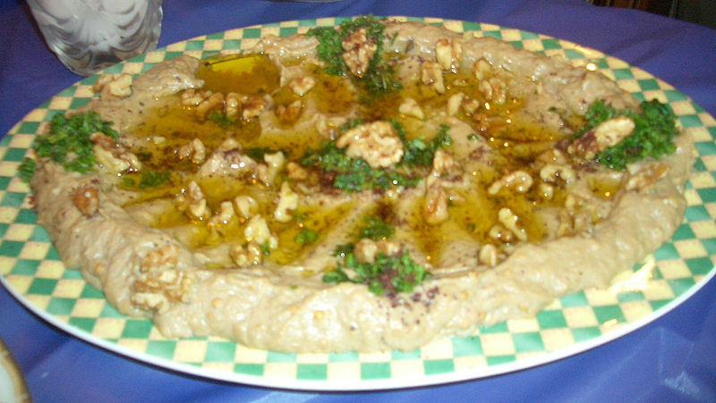
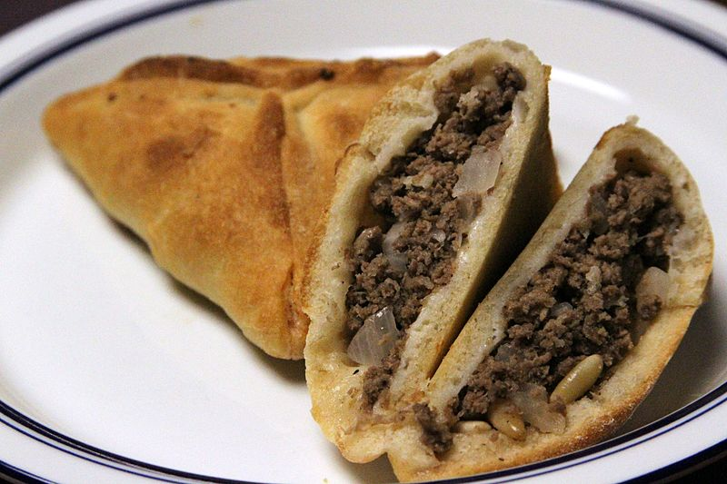
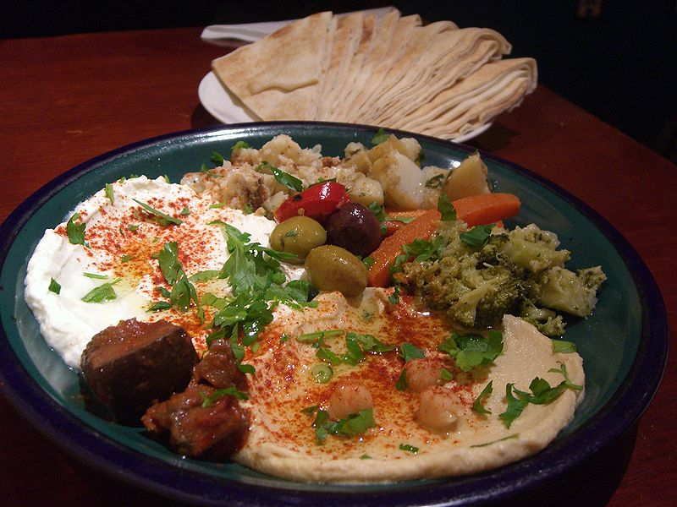
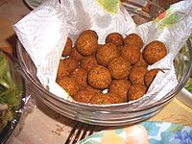
Baba Ghanoush
Fatayer
Labneh w/Hummus
Falafel

Slide 13
Dining Etiquette
• Conversations are animated and loud.
“Breaking bread” is an important event in any relationship building.
• The head of the family or honored guest is normally served first.
• The eldest person has priority in being served food.
• For Muslims, the left hand is reserved for bodily hygiene and considered unclean. Thus, the right hand should be used for eating; shaking hands or handing over an item with one's left hand is an insult.
If invited to a restaurant the host is usually pays

Slide 14
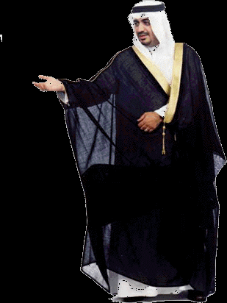
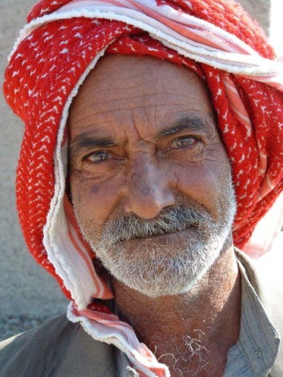
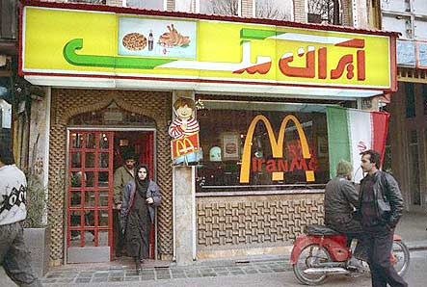
Dress Code
Male Dress:
- Thawb (robe with long sleeves)
- Bisht (cloak worn over Thawb)
- Keffiyeh (traditional headress)
- Westen Style clothes (suits, t-shirts, jeans, slacks)

Slide 15
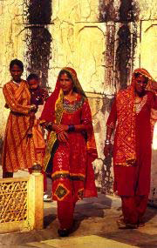
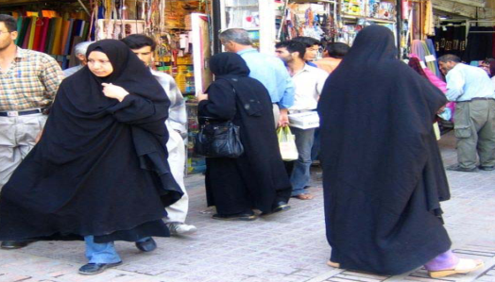
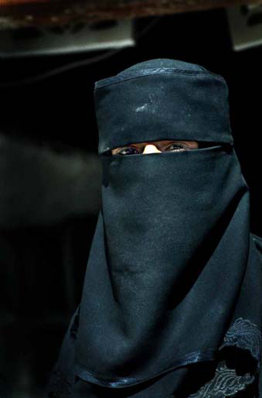
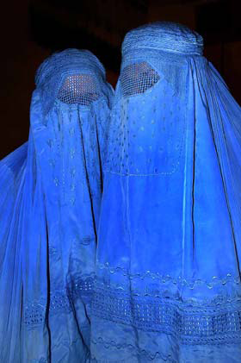
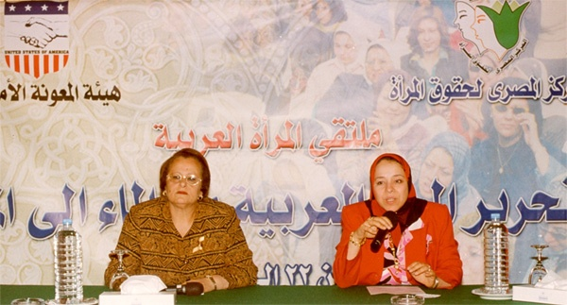
Dress Code
Female Dress:
- Abaya (large black cloak covering the entire body)
- Hijab (headscarf that conceals hair and forehead)
- Niqab (veil that covers the face)
- Burqa (veil that covers the entire body)
- Westen Style clothes (suits, slacks)

Slide 16
Change & Influence
Present day Middle East is a mix of very old cultures and new nations which were organized by European powers after WWI
Most countries in the Middle East maintain a great deal of cultural influence and economic ties with western nations and a powerful Islamic culture!
Nations which influence Middle East culture, economics, and politics:
France
Great Britain
The United States
Russia

Slide 17
Traditional City
Narrow Allies, Plain External Design

Slide 18
Traditional City
Privacy
Open space is located within the traditional house.
All Houses look alike form outside – no decoration.
Court yard is located inside the house.

Slide 19
Traditional City
▲ Umayyad Mosque built 705-715 AD.
◄ Suq (Shopping Mall) Al-Hamiddiyyah.

Slide 20
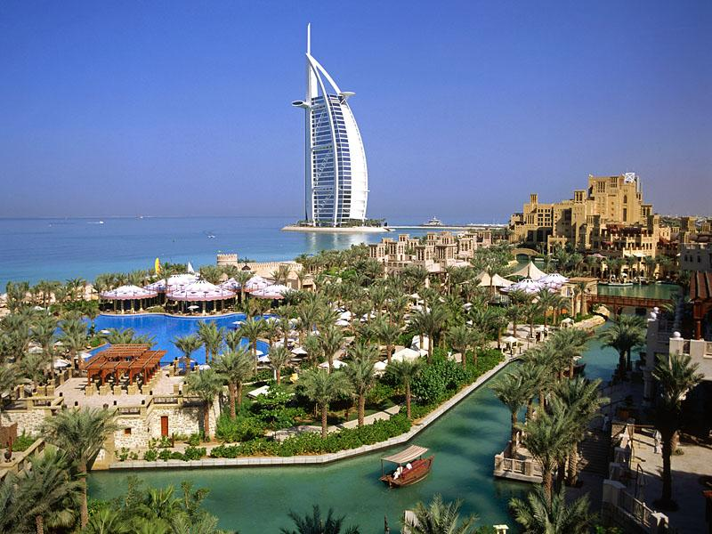
Modern City
“Multi-Story apartment buildings is
the new residential pattern.”
Dubai, U.A.E.
Modern Dubai
Cairo, Egypt

