Slide 1
Culture of Asia

Slide 2
Asian Society
Asian Culture is divided into six sub regions:
1.) Central Asia (Kazakhstan, Kyrgyzstan, Tajikistan, Uzbekistan, and Turkmenistan
2.) East Asia (China, Japan, North Korea, South Korea, Mongolia, and Taiwan)
3.) South Asia (India, Pakistan, Afghanistan, Nepal, Bhutan, Bangladesh,
and Sri Lanka)
4.) West Asia (corresponds with the Middle East)
5.) North Asia (Russia and Mongolia)
6.) Southeast Asia(Burma, Thailand, Laos, Cambodia, Vietnam, Malaysia,
Singapore, Indonesia, and the Philippines)

Slide 3
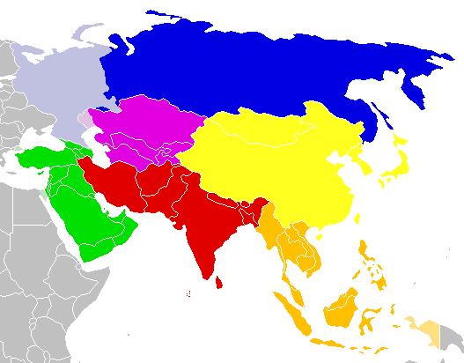
5
1
2
4
3
6

Slide 4
Asian Society
Structure of Asian Society:
- Hunter-Gatherer
- Nomadic
- Agrarian/Rural
- Urban
Asian Society has adapted to the various climate zones across Asia:
- Mountains
- Deserts
- Grasslands/Forests
- Wetlands
- Arctic

Slide 5
Asian culture and society is also a mixture of traditional Asian culture with modern Asian culture

Slide 6
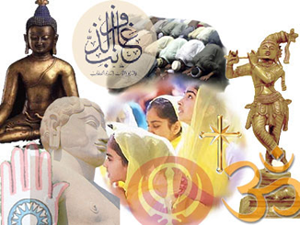
Religion
Asia has a diverse amount of religions which include the following:
- Buddhism
- Hinduism
- Sikhism
- Confucianism
- Taoism
- Shinto
- Islam
- Christianity
- Judaism
- Tribal Religions

Slide 7
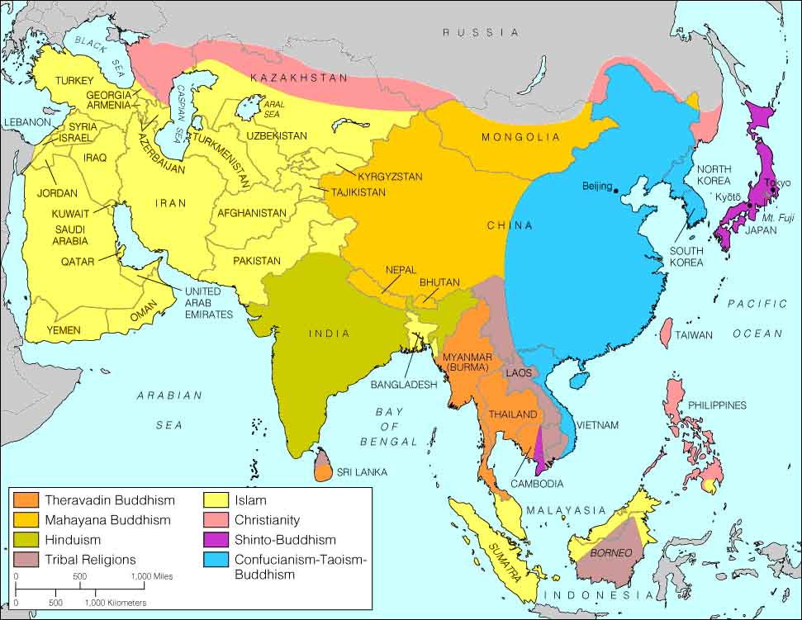

Slide 8
Language
Asia is home to many diverse languages
Most Asian countries have more than one native language
- 600 languages are spoken in Indonesia
- 100 languages are spoken in the Philippines
- 1,683 native languages are spoken in India
The Map on the next slide shows the main “family of languages” in Asia
Next Slide

Slide 9
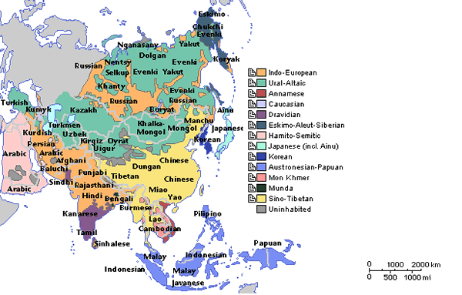

Slide 10
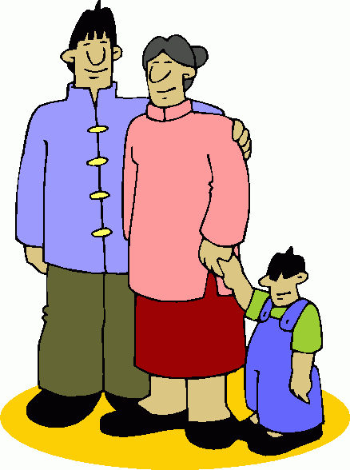
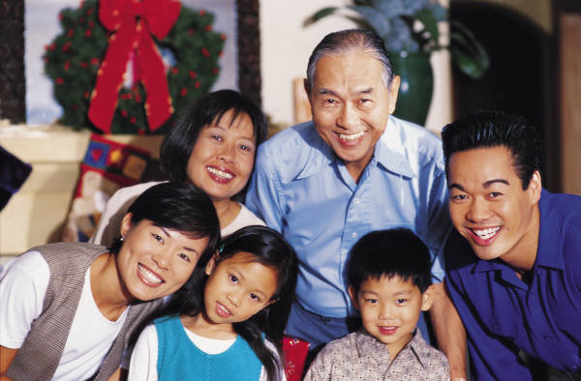
Family Structure
Family is primary
Extended and Nuclear Family structure
Hierarchical family structure:
- males and older individuals holding higher status
Patriarchal (husband led) Gender Roles:
- Males: highly valued & desired; carry family name
- Females: less valued; subservient to males; carry
out duties and chores; bear children
Respect for elders
Loyalty to people in authority
Disciplined
Honor and Loyalty to family

Slide 11
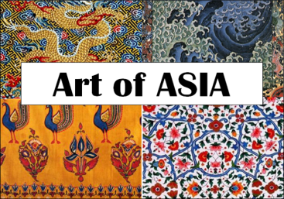
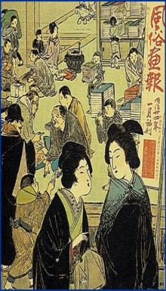
Art, Literature, and Music
The richness of the Asian culture is displayed through art and literature
Due to the many sub regions of Asia, art and literature across Asia is diverse
Art
Porcelain
Ceramics/Pottery
Calligraphy
Paintings
Glass and Metal ware
Rugs and Textiles
Architecture
Literature
Poetry is common form of literature across Asian
Music
Asian music has many styles and varies based on region

Slide 12
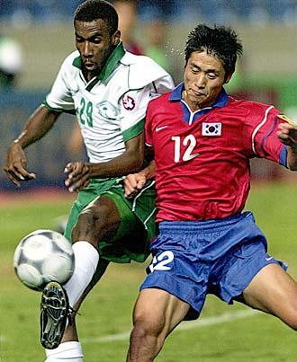
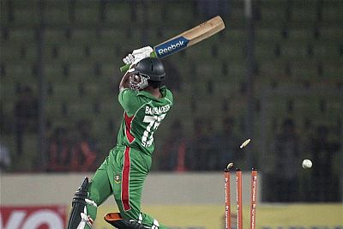
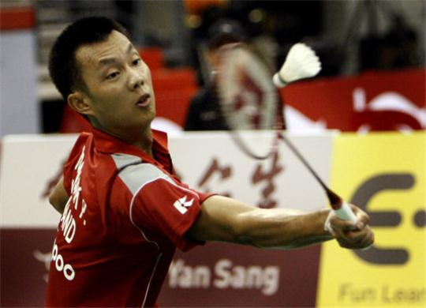
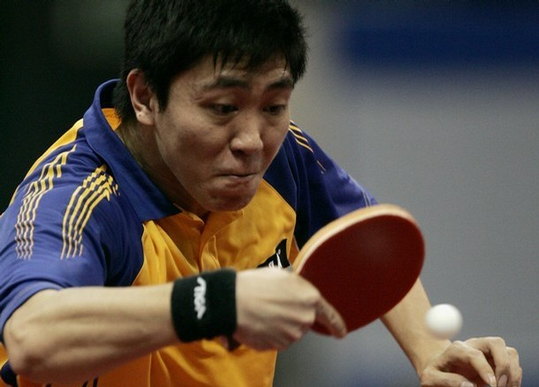
Sports
The following are Popular sports in Asia:
Soccer
Cricket
Badminton
Basketball
Table Tennis

Slide 13
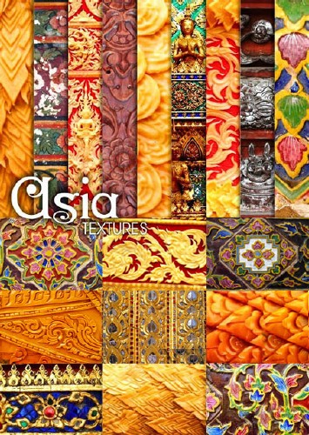
Clothing
Due to the diversity of the Asian continent, clothing styles vary from nation to nation and people to people
Misconception: People in Asia where silk robes with a silk belt and sandals as shoes.
The Truth: Clothing styles fall into categories:
- Traditional (Cultural/Ethnic)
- Modern (Western inspired)
- Religious
- Gender (Male vs. Female)

Slide 14
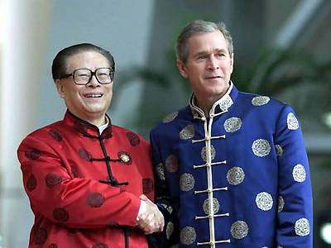
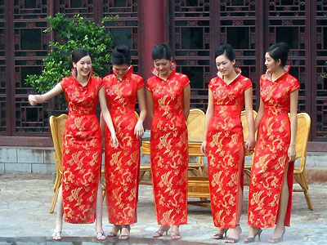
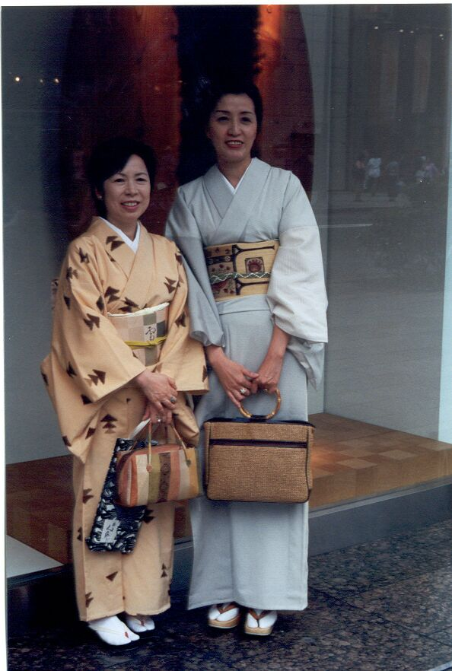
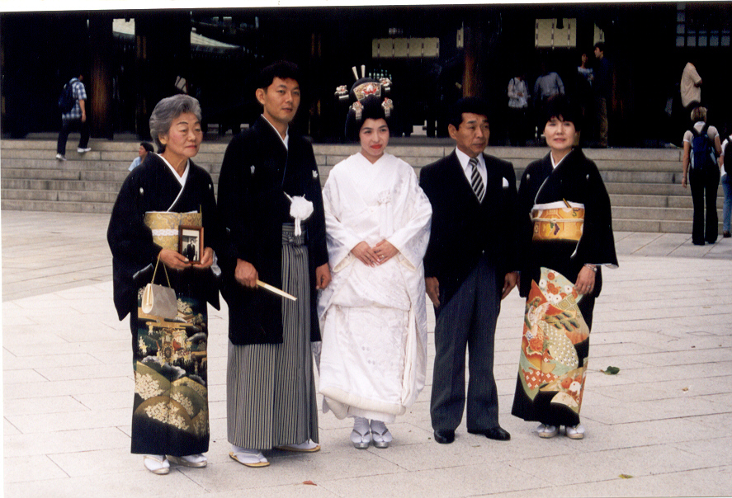
Traditional Clothing of China
Traditional
Clothing
of
Japan

Slide 15
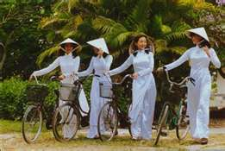
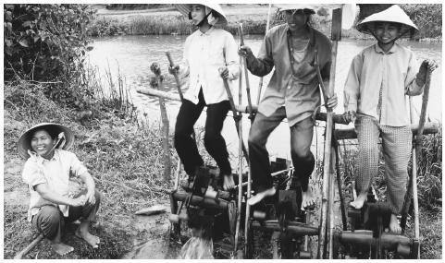
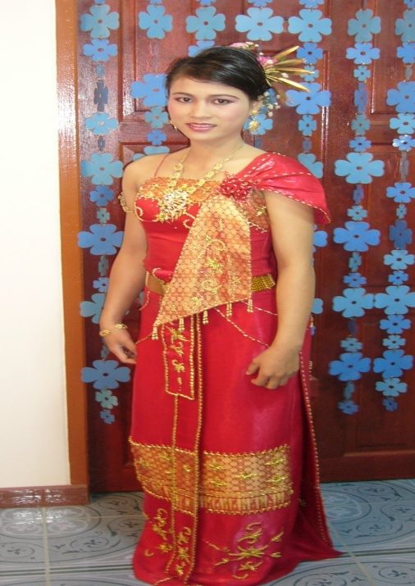
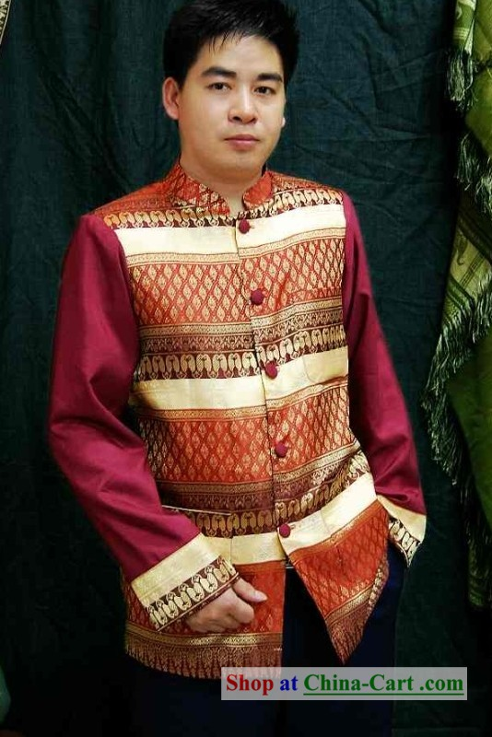
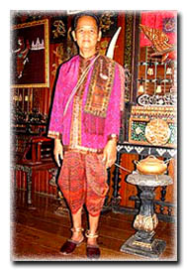
Traditional Clothing of Vietnam
Traditional Clothing
of
Thailand

Slide 16
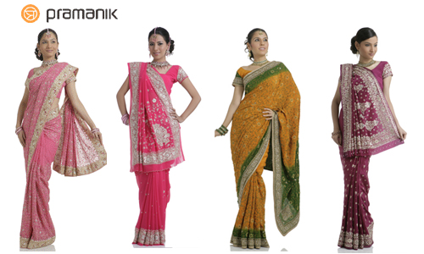
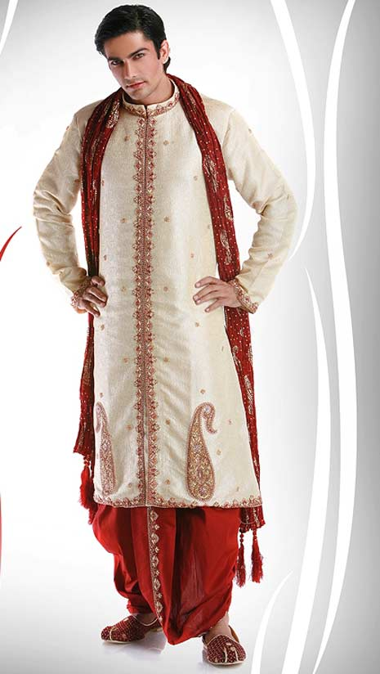
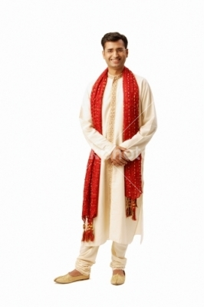
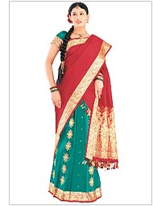
Traditional Clothing of India

Slide 17
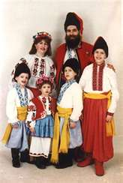
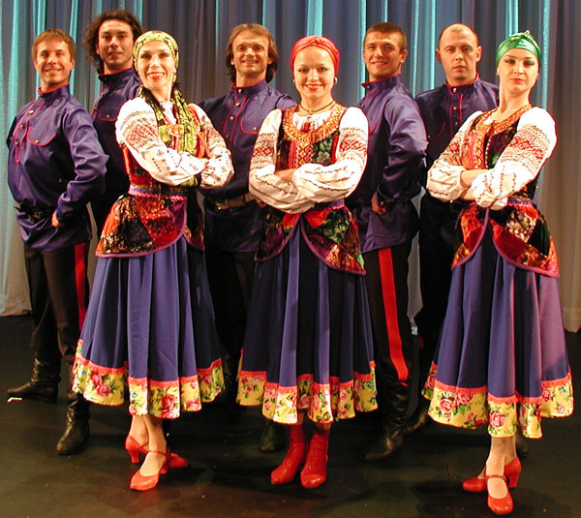
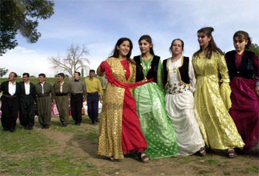
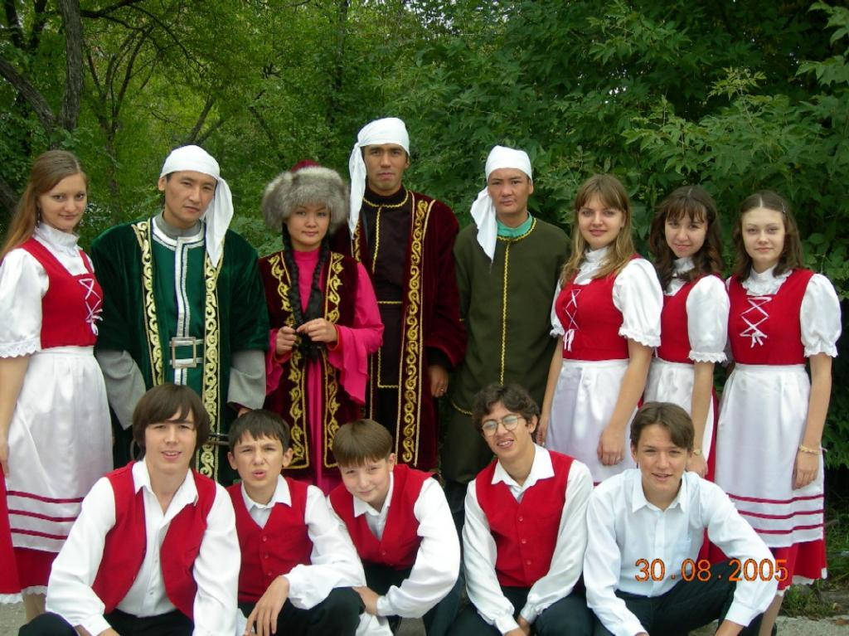
Traditional Clothing
of
Russia
Traditional Clothing
of
Kazakhstan

Slide 18
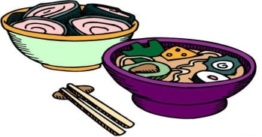
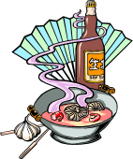
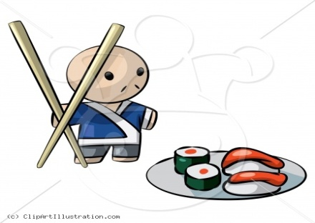
Food
Food in Asia varies depending on the different regions:
Common Foods:
Rice is a staple of most diets
- Noodles, Bread, and Curry are other important staples
Fish dishes
- Raw fish popular in Japan (Sushi & Sashimi)
Goat, Lamb, and Chicken are most common meats
- Hinduism forbids the consumption of beef
Dishes with spices common in Southeast Asia
- Ginger, cumin, cinnamon, nutmeg, and coriander
Stir Fry is most common Asian cooking technique
Dining Etiquette:
Chopsticks are used as eating utensils in
China, Japan, Korea, and Vietnam
Eating with hands is common in India

Slide 19
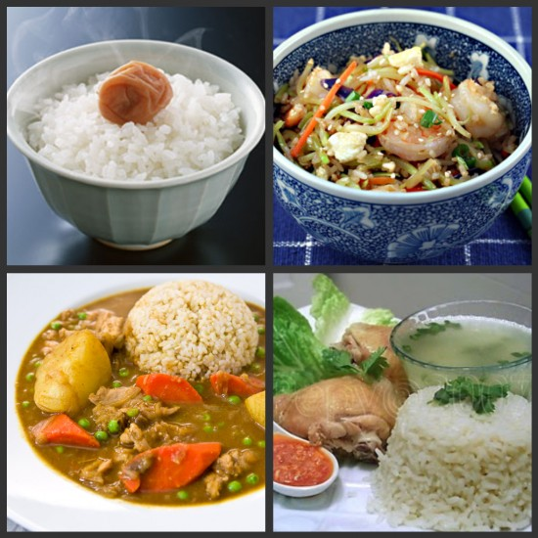
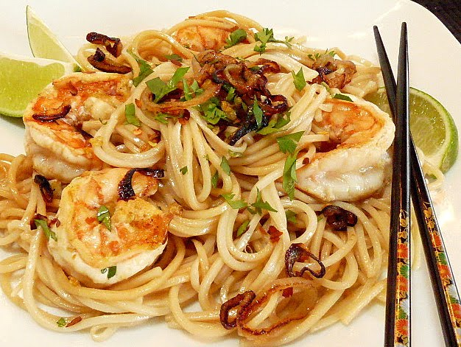
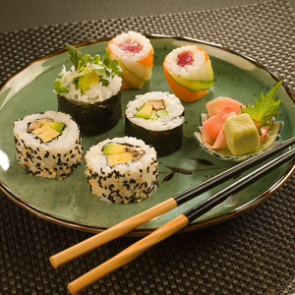
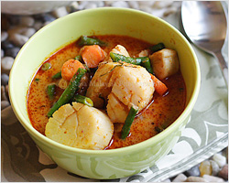
Rice Dishes
Noodle Dish
Sushi Dish
Curry Dish

