Slide 1
Phosphorus Crisis
Brian DeMuri-Haeberle
CBE 555
February 7th, 2010

Slide 2
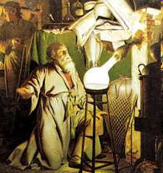
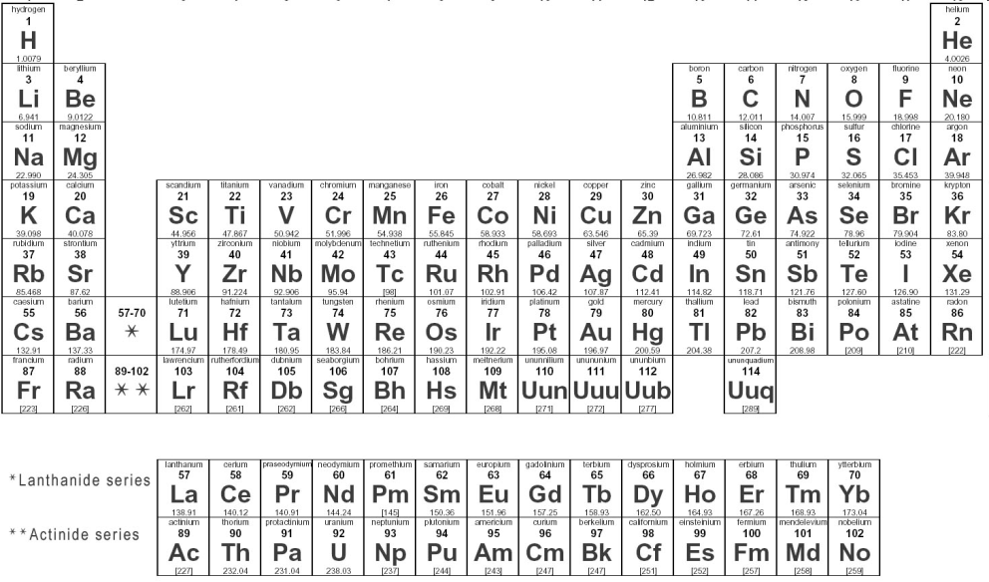
History
1669 Henning Brandt
  Distillation of urine
  Greek origin “It possesses brilliance”
1769 Gahn and Scheele
  Phosphorus from bone ash
1777 Lavoisier recognized as element

Slide 3

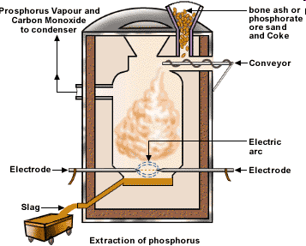
History
1840s
  Matches
  Discontinued due to toxicity
  “Phossy Jaw”
1888 Electric Furnace Process
1940s Detergent
  Late 1970s reformulation

Slide 4




Phosphorus Uses:
Cleaners
Food and Beverages
Electronics
Flame Retardants
Military
Fertilizer
Phosphoric Acid

Slide 5
Human Consumption
RDA: 1000 mg/day
Baking Powder: 100 mg P/g

Slide 6
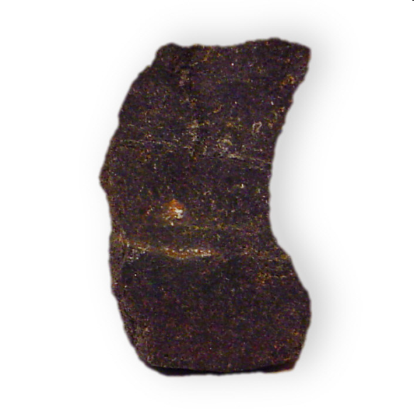
Supply
IGCP
  163,000 million metric tons phosphate rock
Accessibility
  Location (depth)
  Environmentally sensitive land
  Extraction technology

Slide 7
Supply
P reserves not evenly distributed
Morocco largest reserves
China largest producer
  Followed by USA

Slide 8
Demand
37 million metric tons/year
  22 million from mining
USA reserves ~ 35 years
Global reserves ~ 100 years

Slide 9
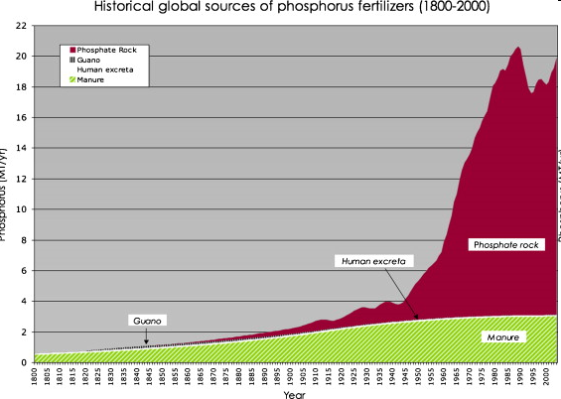
Why Now?
Population
  Increased need, especially for fertilizer
Disruption of natural phosphorus cycle
  Local
  Global

Slide 10
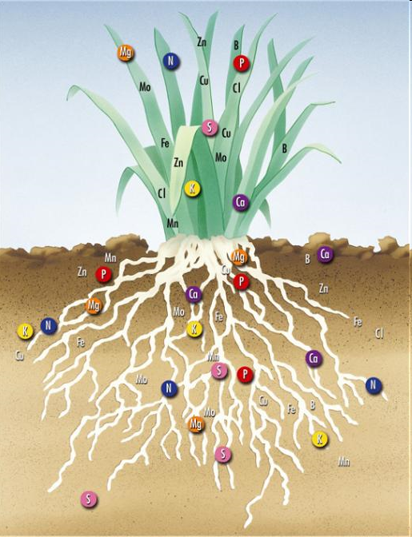
Fertilizer
P use increased dramatically with fertilizer usage
20-27-5
  N-P-K
N2 from air
P and K mines

Slide 11
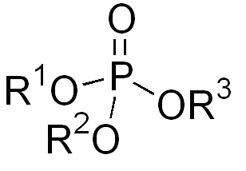
Local Cycle
Weathering releases P
Plants take in P from soil
Other living organisms ingest plants
  Usually in form of PO₄³⁻
  PO₄³⁻ backbone of DNA, cell membranes, and energy storage (ATP)
  Average human has 650 g of P, most in bones
4. Organism waste returns P to soil

Slide 12
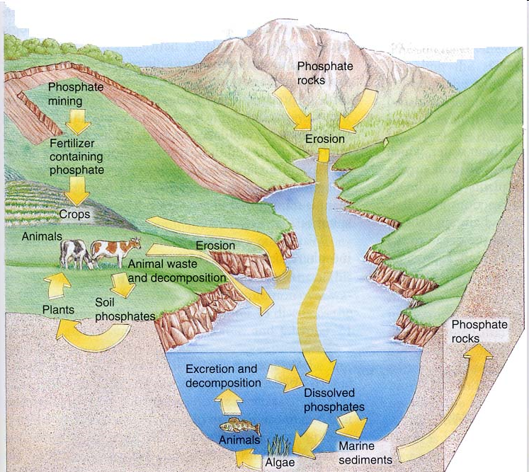
Global Cycle
Land ecosystems
  46x
Ocean marine organisms
  800x
Sediment
Millions of years tectonic uplift returns it to dry land

Slide 13
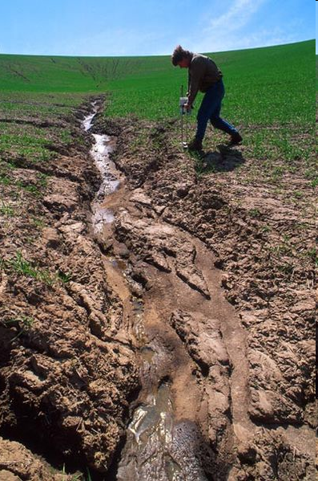
Disruption of Cycles
Agricultural Changes
  Human and animal waste as fertilizer
Modern separation of food production/consumption
Land erosion causes soil runoff

Slide 14
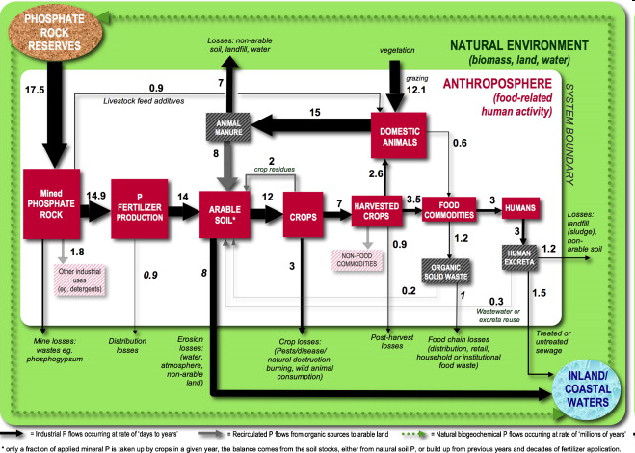
Phosphorus Flow

Slide 15

Production
Electronic furnace process
  Elemental phosphorus
  ~ 10% phosphate rock
Wet acid process
  Phosphoric acid
  ~ 90% phosphate rock

Slide 16
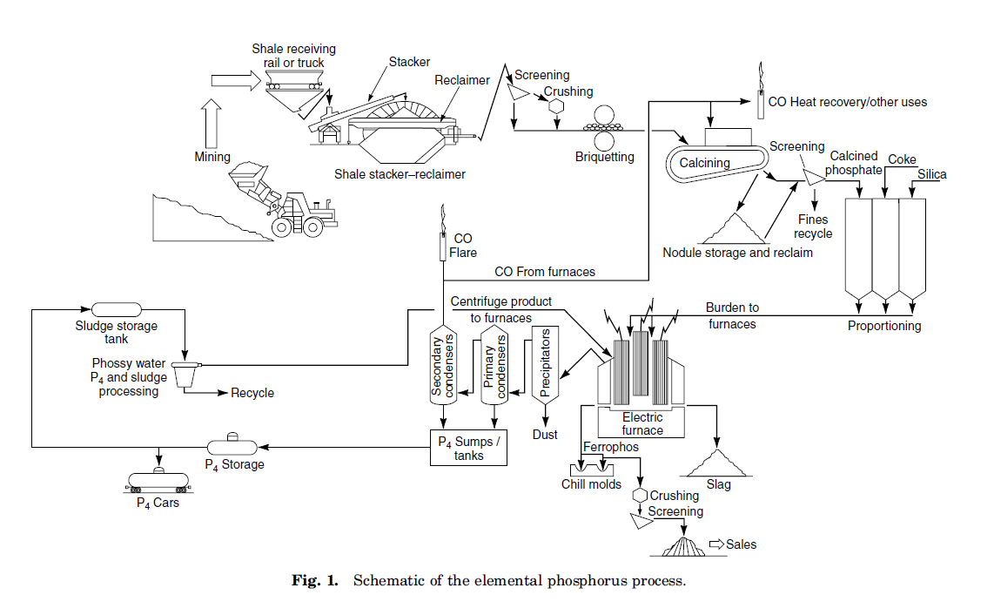
Electronic Furnace

Slide 17
Electronic Furnace
Endothermic Reaction
  2 Ca₅F(PO₄)₃ + 9 SiO₂ + 15 C → 9 CaSiO₃ + CaF₂ + 15 CO(g) + 3 P₂(g)
  2 P₂(g) →P₄
1400-1600°C
Energy intensive
Off-Gas compositions (STP)
  86% CO, 7.5% P₄, 5% H₂, 1% N₂
  120-180 m³/min

Slide 18
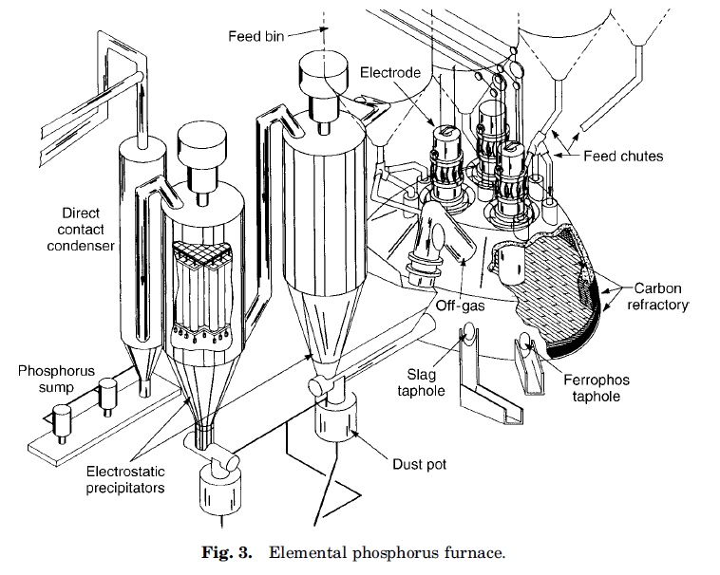
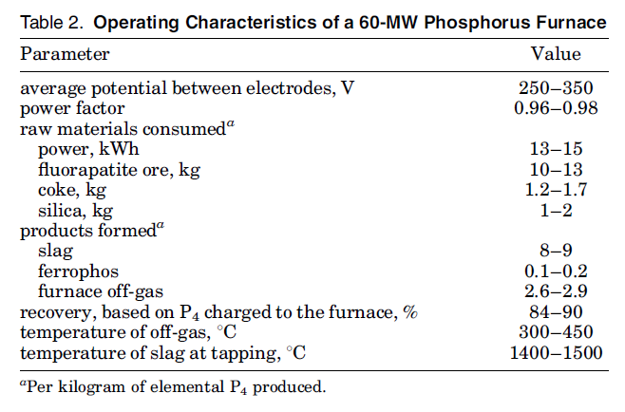
Electronic Furnace

Slide 19
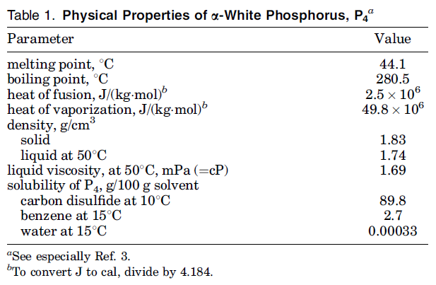
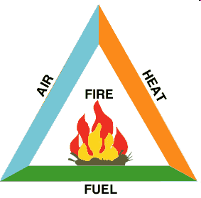
Furnace Product
Dominant commercial form: α-white
  Solid
  Tetrahedral P₄ molecules
  Often yellow due to red phosphorus allotrope
  Auto-ignition temperature = 30°C

Slide 20
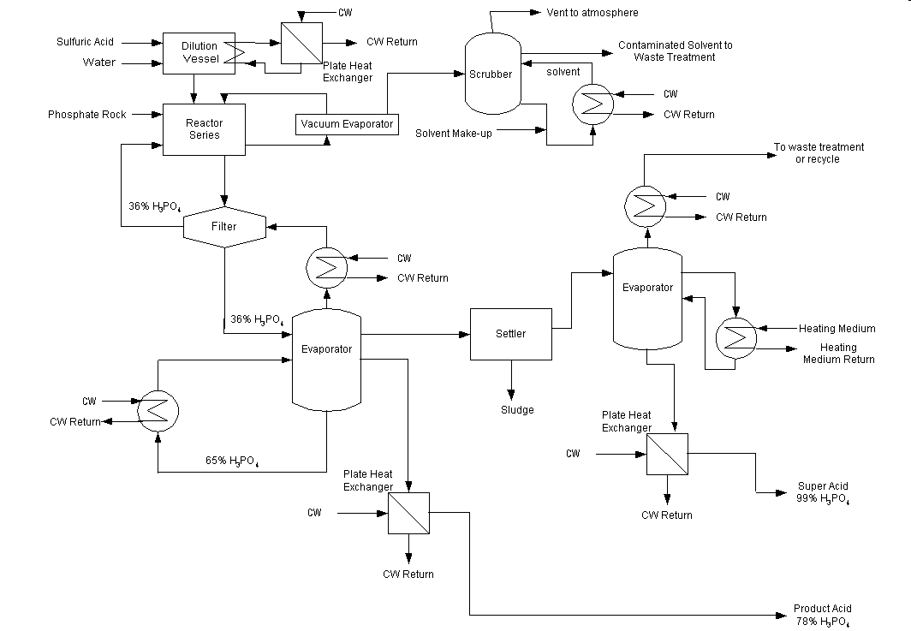
Wet Process
70-90°C
Digestion of phosphate rock with sulfuric acid
Phosphoric acid separated from calcium sulfate by filtration

Slide 21
Future Trends
2009 lowest usage of P due to economy
USGS prediction
  Increase to 130% 2008 value by 2013
Increasing population = increasing use of P
  Fertilizer, phosphoric acid, food industry
Increase in prices could fuel research in better extraction techniques, opening up previously “inaccessible” deposits

Slide 22
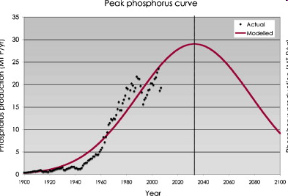
Future Trends
“Peak Phosphorus”
  High quality, easily accessible reserves depleted
  Remaining uneconomical
  Demand increase, supply decrease

Slide 23
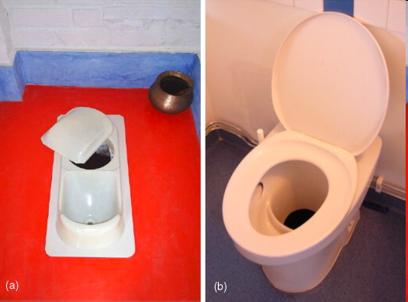
Conservation
Reduce fertilizer usage and erosion
  Terracing and no-till farming
Increase inedible biomass and animal waste use as fertilizer
Wastewater recovery

Slide 24
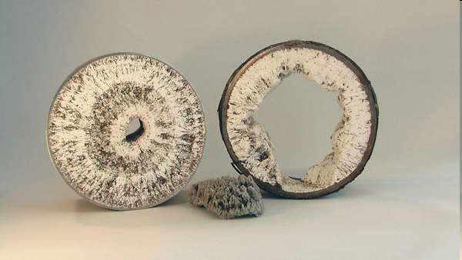
Conservation and Recovery
Netherlands: Thermphos International
  Sewage sludge incineration ash
  Levels close to phosphate rock
Precipitation
  Struvite (ammonium magnesium phosphate)
Bacteria

Slide 25
References
Phosphorus: A Looming Crisis. Vaccari, David A. Scientific American. June 2009. Volume 300, Issue 6. Pg 54-59.
Phosphorus, Kirk-Othmer Encyclopedia of Chemical Technology. J. R. Brummer1, J. A. Keely1, T. F. Munday1, Updated by Staff, Copyright © 2005 by John Wiley & Sons, Inc., August 19, 2005
Phosphoric Acids and Phosphates. David R. Gard. Copyright © 2005 by John Wiley & Sons, Inc. July 15, 2005
The Story of Phosphorus: Global Food Security and Food for Thought. Global Environmental Change. Volume 19, Issue 2. May 2009. Pg 292-305
Mineral Commodities Summary 2010, U.S. Geological Survey. January 26, 2010.http://minerals.usgs.gov/minerals/pubs/commodity/phosphate_rock/mcs-2010-phosp.pdf
Minerals Yearbook, U.S. Geological Survey. http://minerals.usgs.gov/minerals/pubs/commodity/phosphate_rock/myb1-2007-phosp.pdf
USDA National Nutrient Database for Standard Reference, Release 22.
CEEP, 2008. SCOPE Newsletter, Number 70. February. http://www.ceep-phosphates.org/Files/Newsletter/Scope74%20Vancouver%20Nutrient%20Recovery%20Conference.pdf

