Slide 1
Phosphorus in Water

Slide 2
Phosphorus is largely retained in soil by a process called adsorption.
Soils have a limited capacity to store phosphorus, and once the capacity of soil to adsorb phosphorus is exceeded, the excess will dissolve and move more freely with water either directly to a stream or downward to an aquifer.
Surface-water runoff from rainstorms or excess irrigation is the primary way that phosphorus or soil containing phosphorus is transported to streams in most watersheds.

Slide 3
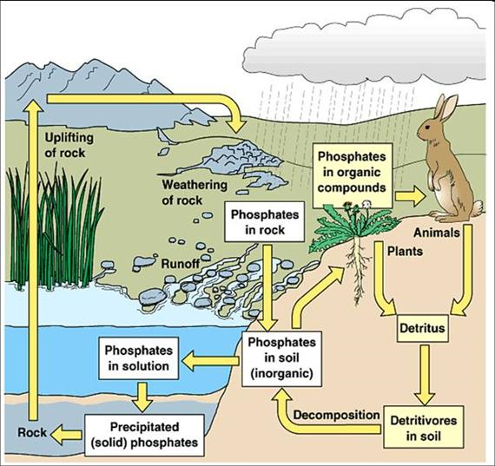
Taken from: www.tankonyvtar.hu

Slide 4
Phosphorus is a common constituent of agricultural fertilizers, manure, and organic wastes in sewage and industrial effluent.
It is an essential element for plant life, but when there is too much of it in water, it can speed up eutrophication (a reduction in dissolved oxygen in water bodies caused by an increase of mineral and organic nutrients) of rivers and lakes.
Soil erosion is a major contributor of phosphorus to streams. Bank erosion occurring during floods can transport a lot of phosphorous from the river banks and adjacent land into a stream

Slide 5
A USGS study on Cape Cod, Massachusetts showed that phosphorus can also migrate with ground-water flows.
Since groundwater often discharges into surface water, such as through stream banks into rivers, there is a concern about phosphorus concentrations in groundwater affecting the water quality of surface water.

Slide 6
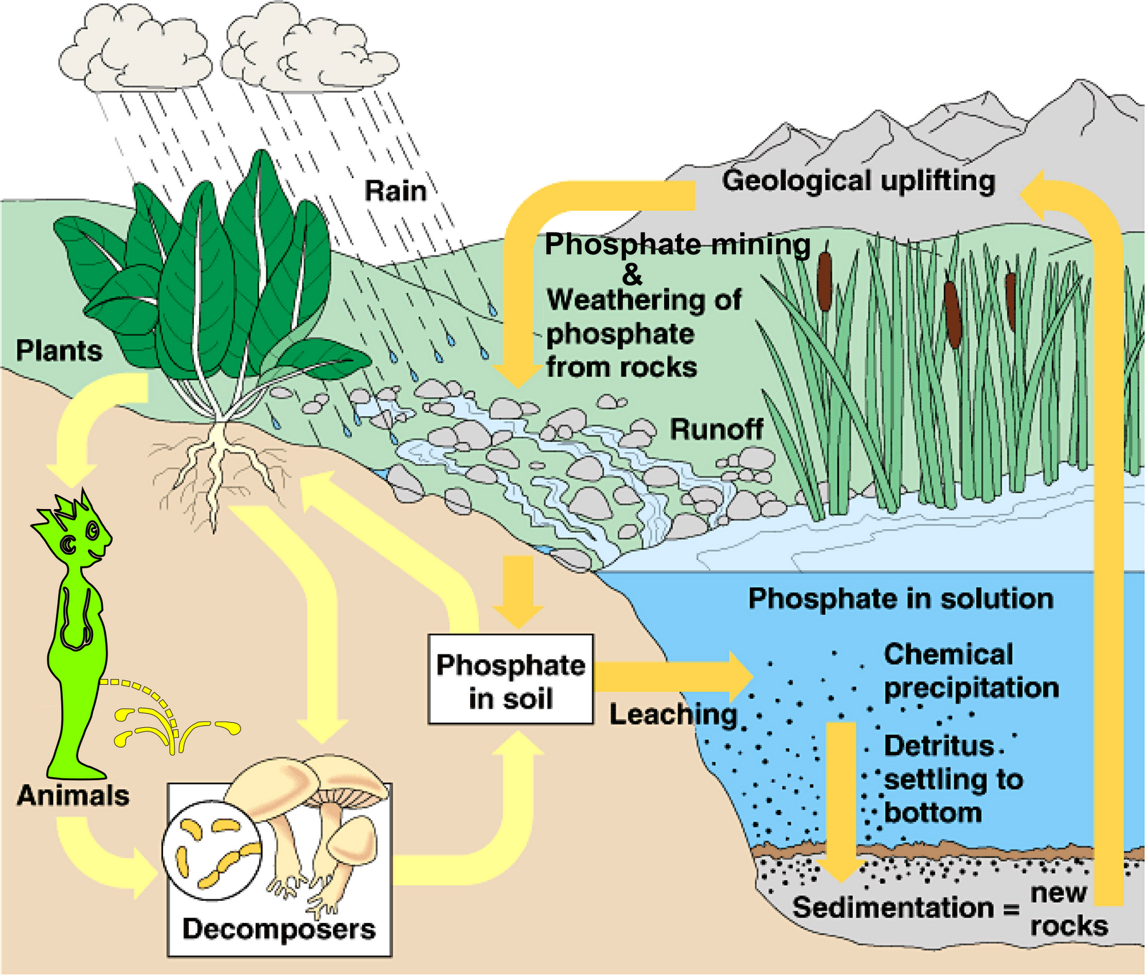
taken from: www.astrobio.net

Slide 7
Phosphorus is an essential element for plant life, but when there is too much of it in water, it can speed up eutrophication (a reduction in dissolved oxygen in water bodies caused by an increase of mineral and organic nutrients) of rivers and lakes.

Slide 8
Pure, "elemental" phosphorus (P) is rare. In nature, phosphorus usually exists as part of a phosphate molecule (PO₄).
Phosphorus in aquatic systems occurs as organic phosphate and inorganic phosphate.
Organic phosphate consists of a phosphate molecule associated with a carbon-based molecule, as in plant or animal tissue.

Slide 9
Aquatic plants take in dissolved inorganic phosphorus and convert it to organic phosphorus as it becomes part of their tissues. Animals get the organic phosphorus they need by eating either aquatic plants, other animals, or decomposing plant and animal material.
As plants and animals excrete wastes or die, the organic phosphorus they contain sinks to the bottom, where bacterial decomposition converts it back to inorganic phosphorus, both dissolved and attached to particles. This inorganic phosphorus gets back into the water column when the bottom is stirred up by animals, human activity, chemical interactions, or water currents. Then it is taken up by plants and the cycle begins again.

Slide 10
In a stream system, the phosphorus cycle tends to move phosphorus downstream as the current carries decomposing plant and animal tissue and dissolved phosphorus. It becomes stationary only when it is taken up by plants or is bound to particles that settle to the bottom of pools.
The term "orthophosphate" is a chemistry-based term that refers to the phosphate molecule all by itself. "Reactive phosphorus" is a corresponding method-based term that describes what you are actually measuring when you perform the test for orthophosphate. Because the lab procedure isn't quite perfect, you get mostly orthophosphate but you also get a small fraction of some other forms.
More complex inorganic phosphate compounds are referred to as "condensed phosphates" or "polyphosphates

