Slide 1
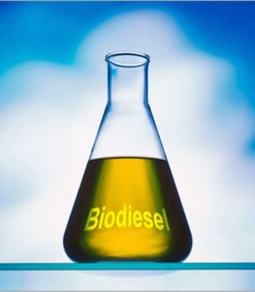
Microalgae for Biodiesel production
Journal review by Cynthia Morris

Slide 2
Diesel vs. Biodiesel Fuel
Petroleum Diesel:
Petroleum diesel fuel is a fractional distillate of crude oil
Diesel engines are more powerful and more efficient than gasoline engines
Diesel fuel has a higher energy density than gasoline
Drawbacks:
Contains sulfur in its emissions
High particulate matter in exhaust
Adds to the CO₂ pollution
Notes:
What is the difference between

Slide 3
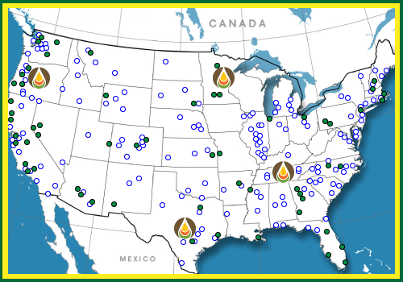
Biodiesel
Rudolf Diesel, the inventor of the Diesel Engine (1892,) originally designed it to run on vegetable oils.
Fuel from Oil seeds or other fats:
US: soybean oil and yellow grease (primarily, recycled cooking oil from restaurants).
Europe: Rapeseed (80%), soybean and palm oil.
Algae : still in the experimental Phase
Biodiesel designations:
B100 100% biodiesel
B20 20% biodiesel
80% Petroleum Diesel

Slide 4
Biodiesel
To be officially sold as a biofuel the material must meet certain government standards:
USA: (ASTM D6751)American Society of Testing and Materials
EPA: registration requirements for fuels and fuel additives -Sec 211 of the Clean Air Act (42 U.S.C. 7545)
European standard (EN 14214)
Brazilian National Petroleum Agency (ANP 255)
Australian Standard for Biodiesel
Notes:
If you are going to develop a new biofuel it must meet these standards.

Slide 5
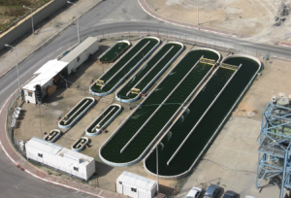
Benefits of Biodiesel from Microalgae
High per-acre productivity
Non-food based feedstock resources (soybeans, canola oil)
Use of non-productive, non-arable land
Utilization of a wide variety of water sources (fresh, brackish, saline, marine, and wastewater)
Production of both biofuels and valuable co-products
Potential recycling of CO₂
Notes:
It can not only use wastewater it can be used to clean wastewater.

Slide 6
Biodiesel process
Triglycerides: 3 fatty acid chains joined together by glycerine units.
Transesterification is performed with methanol and a small quantity of an alkaline catalyst.
Replacing the glycerol with methanol transforms the oil into a fuel
Yields glycerol as a by-product.
(FAME-fatty acid methyl ester)
Notes:
The process starts with triglycerides

Slide 7
Microalgae as feedstock for biodiesel production: Carbon dioxide sequestration, lipid production and biofuel quality.
Authors: Erika C. Francisco, Debora B. Neves,
Eduardo Jacob-lopes and Telma T. Franco
Journal of Chemical Technology and Biotechnology Special Issue : Air Pollution Control

Slide 8
Experiment Rationale:
To evaluate microalgae for biodiesel production by examining their fuel properties
Algae biodiesel must overcome it’s higher production cost than petroleum or soybean based diesel in order to compete
Study was needed to determine the algal species that contained the highest lipid productivity and biofuel quality in order to direct future research
Notes:
The experiments Purpose was
Their main Problem was
They decided that
Specific values needed for this analysis were:

Slide 9
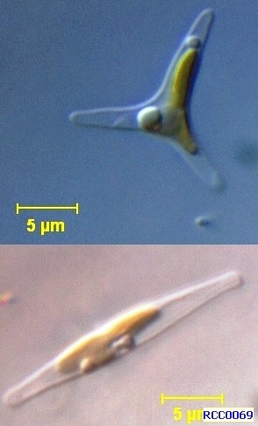
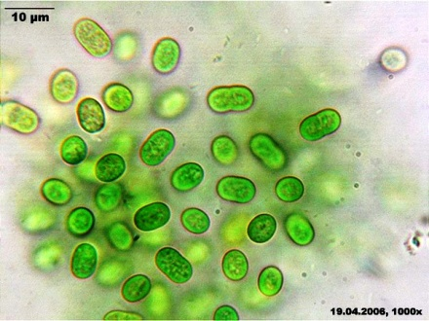
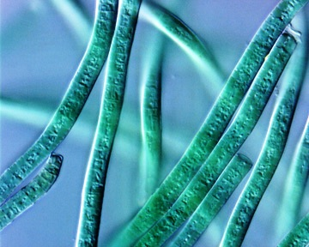
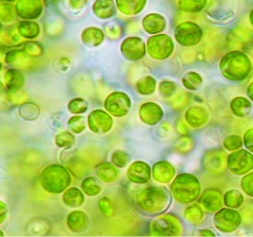
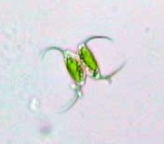
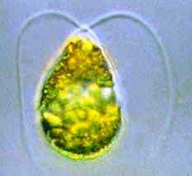
Materials and methods
Chosen because: Known species with high lipid productivity, but not currently used in commercial scale production
Notes:
Focused on the fuel properties of six microalgae strains

Slide 10
Materials and methods
Photobioreactors:
3 Liter volume
Initial cell concentration of 0.1 g /L
Bubbled with a filtered air mixture enriched with 15% CO₂
Illumination by 16 20-W fluorescent lamps 24:0 (Day:Night)
Grown for 168 h
Monitored every 12 h during
the growth phase for:
Cell density
Carbon dioxide concentration
pH
Notes:
The algae were grown in

Slide 11
Materials and methods
Harvesting and Drying
Biomass Determination
The Biomass was separated by decantation and centrifugation.
Dried by freeze drying at -40°C at 50mmHg
Cell concentration in g/L was evaluated by filtering a known concentration of culture media through a 0.45 µm filter and drying at 60°C for 24h

Slide 12
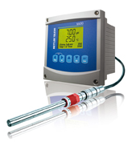
Materials and methods
Carbon Dioxide Sequestration
Total Lipids
Every 12 hrs CO₂ concentration was measured as a function of time (15s intervals for 4min)using a polarograhic probe
Lipids extracted using Bligh and Dyer method.
Total lipid concentration determined gravimetrically by evaporating the liquid fraction in a nitrogen atm and drying in a vacuum oven.

Slide 13
Esterification and preparation of the fatty acid methyl esters for analysis:
250mg Lipid extract added to 5.0 mL NaOH (0.5M) in Methanol
Heated under reflux (5 Min)
Add 15 mL of esterification reagent (NH₄Cl, CH3OH, H2SO4)
Heated under reflux for 3 Min
Transferred to separation funnel and mixed with 25mL petroleum ether and 50mL of deionized water
Phase separation: aqueous phase discarded
Organic Phase collected
Solvent was evaporated and the residue collected
Methyl esters were made soluble in n-heptane for injection into a gas chromatograph

Slide 14
Fatty acid composition
Determined by using a gas chromatograph- mass spectrophotometer (GC-MS)
Identities were confirmed by comparing to standard peaks for a variety of fatty acids
Notes:
Important because the different fuel properties are influenced by the fatty acid profile.

Slide 15
Results and Discussion
Looked for best combo of:
biomass productivity
lipid content
Results show an overall inverse relationship:
When productivity goes up lipid production goes down.
Notes:
Lipid productivity and biomass production-inversely related because of the high metabolic cost of lipid biosynthesis.

Slide 16
Biofuel Quality
CN: a measurement of the fuels ability to auto ignite
US and Brazilian standards ≥45
European and Australian standard ≥51
CFPP: cold filter plugging point: the lowest temp at which a fuel can pass through a 0.45 micrometer filter. Standards vary between countries.
Rapeseed value is -10°C, (additives and blending fuels helps to lower)
Scenedesmus similar to peanut oil (17°C)
Notes:
IV :used to determine the amount of unsaturated fatty acids -higher the number the more double carbon bonds present. >DB >chance of deposit formation, must be less than 120

Slide 17
conclusion
Chlorella vulgaris was the microalgae best suited for use as biodiesel of the strains tested
Its quality characteristics of:
Ester content
Cetane number
Iodine value
Degree of unsaturation
Cold filter plugging point
All complied with limits established by the US, European, Brazilian, and Australian standards.
Notes:
Operation of a continuous photobioreactor with a 0.85 L/m² of working volume with a 120 day cycle would yield the same amount of lipids as that produced by soybeans in a 120 day cycle. (0.46g/m⁻² day⁻¹)

Slide 18
conclusion
Benefits of microalgae:
Can be grown away from farmlands and forests
Oil yields are orders of magnitude higher than from traditional oilseeds
Can be grown through bioconversions of the CO2 from stationary industrial emissions
Drawbacks:
Price of production ranges from $6.50-8.00 per gal
More research needs to be done to improve production efficiency

Slide 19
Limitations
No clear data comparing current feedstocks to these algae.
Used dendograms to compare data

Slide 20
Limitations
Needed better comparison graphing and data
INCREASING CETANE NUMBER (CN) AND STABILITY
BETTER COLD FLOW PROPERTIES
From the National biodiesel board

Slide 21
References
Francisco, E. C., Neves, D. B., Jacob-lopes, E., & Franco, T. T. (2010, March). Microalgae as feedstock for biodiesel production: Carbon dioxide sequestration, lipid production and biofuel quality. Journal of Chemical Technology and Biotechnology , 395-403.
Hess, M. S. (2008). How Biodiesel Works. Retrieved November 24, 2012, from How Stuff Works: http://auto.howstuffworks.com/fuel- efficiency/alternative-fuels/biodiesel.htm/printable
Newman, S. (2008). How Algae Biodiesel Works. Retrieved November 24, 2012, from How Stuff Works: http://science.howstuffworks.com/environmental/green-science/algae- biodiesel1.htm/printable
U.S. DOE 2010. National Algal Biofuels Technology Roadmap. U.S. Department of Energy, Office of Energy Efficiency and Renewable Energy, Biomass Program.

Slide 22
Photo Credits
http://www.aeonbiogroup.com
http://biodiesel.evonik.com/product/biodiesel/en/about/transesterification/pages/default.aspx
http://www.biodiesel.org/what-is-biodiesel/biodiesel-basicshttp://algaeforbiofuels.com/tag/photobioreactors/http://botany.natur.cuni.cz/algo/CAUP/H1998_Chlorella_vulgaris.htm
http://www.microscopy-uk.org.uk/mag/indexmag.html?http://www.microscopy-uk.org.uk/mag/artoct05/mmdesmid.html
http://silicasecchidisk.conncoll.edu/LucidKeys/Carolina_Key/html/Phormidium_Main.html
http://www.tamug.edu/phytoplankton/Research/Phyto_Profiles.html
http://www.circleofblue.org/waternews/2010/world/biofuels-that-save-water-and-land/

