Slide 1
THE DELPHI METHOD
UNDER THE GUIDENCE
OF
PROF. KHAISER NIKAM
SHAJI JOHN
RESEARCH SCHOLAR
DLIS UNIVERSITY OF MYSORE

Slide 2
THE DELPHI METHOD
INTRODUCTION
The Delphi Method is a group decision making technique developed by Olaf Helmer and Norman Dalkey of the Rand Corporation as part of an Air Force sponsored Rand Corporation study in the early 1950's., for the purpose of addressing a specific military problem.
The Delphi Method seeks to achieve a consensus among group members through a series of questionnaires. The series of questionnaires sent either by mail or via computerized systems, to a pre-selected group of experts. Nobody ‘looses face’ because the questionnaires are answered anonymously and individually by each member of the group. The answers are summarized and sent back to the group members along with the next questionnaire.

Slide 3
This process is repeated until a group consensus is reached. This usually only takes two iterations, but can sometimes takes as many as six rounds before a consensus is reached

Slide 4
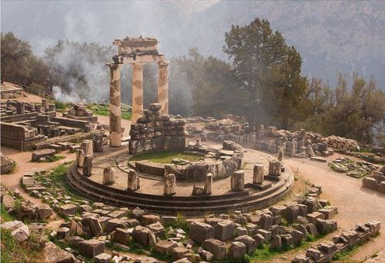
ABOUT THE ORIGIN OF NAME
The Delphi Method takes its name from the legend of the Oracle at Delphi in ancient Greece.
According to the legend, those wishing to gain a glimpse into the future would gather in a special chamber deep within a temple dedicated to the God Apollo located in the coastal town of Delphi.
The crowd would listen to “the Pythia,” a woman, obviously in an entranced state, perched on a three-legged stool, who channeled prophetic messages from the deity through the temple’s priests. The priests translated the Pythia’s otherwise unintelligible utterances. Thus, the ancient priests were the “experts” in interpreting the Pythia’s messages about the future.
DELPHI ARCHAEOLOGICAL SITE

Slide 5
DELPHI - DEFINITIONS
According to Delbecq, Van de Ven, and Gustafson(1975) “The Delphi method is method for the systematic solicitation and collection of judgments on a particular topic through a set of carefully designed sequential questionnaire interspersed with summarized information and feedback of opinions derived from earlier response”
The Delphi method is an exercise in group communication among a panel of geographically dispersed experts (Adler and Ziglio, 1996).

Slide 6
Wechsler characterizes a 'Standard-Delphi-Method' in the following way: 'It is a survey which is steered by a monitor group, comprises several rounds of a group of experts, who are anonymous among each other and for whose subjective-intuitive prognoses a consensus is aimed at. After each survey round, a standard feedback about the statistical group judgments calculated from median and quartiles of single prognoses is given and if possible, the arguments and counterarguments of the extreme answers are fed back...' (Wechsler 1978).

Slide 7
Delphi method is most suitable
The Delphi method is especially useful for futuristic Projects (long-range forecasting 20-30 years), as expert opinions are the only source of information available.
Top secret and complex military projects
When time & cost constraints make frequent face-to-face meetings difficult to arrange.
When the heterogeneity of the participants must be preserved and anonymity assured.
In situations where there is no clear-cut resolution of a given policy issue

Slide 8
DELPHI PROCEDURE
Fowles(1978) describes ten steps for the Delphi method
1 Formation of a Delphi team to undertake a Delphi on a subject.
2 Selection of expert panel(s).
3 Development of the first round questionnaire
4 Testing the questionnaire for proper wording.

Slide 9
5 Transmission to the panelists.
6 Analysis of 1st responses
7 Preparation of 2nd round.
8 Transmission of 2nd round questionnaires to the panelists
9 Analysis of the 2nd round responses (7 to 9 may be repeated to get consensus)
10 Preparation and presentation of report

Slide 10
Delphi Positive
Anonymity can be guaranteed, anonymity for participants make contributions of ideas a safe activity
Conducted in writing and does not require face-to-face meetings
responses can be made at the convenience of the participant
Opportunities for large number of experts to participate
Opportunities for participants to reconsider their opinions
Gives access to groups of widely dispersed experts
Continued

Slide 11
Time for reflection, improving the strength of opinion.
Participants have an equal say
Greater acceptance of Delphi results than other consensus methods.
Learning and motivating experience for participants.
Highly cost-effective, when conducted by experts
Relatively free of social pressure, personality influence, and individual dominance and is, therefore, conducive to independent thinking and gradual formulation of reliable judgments or forecasting of results

Slide 12
DELPHI NEGATIV’S
Large amount of time to conduct several rounds
The complexity of data analysis
The difficulty of maintaining participant enthusiasm throughout process
Potential of Low Response Rates Due to the multiple feedback processes
The power of persuasion or prestigious individuals to shape group opinion
The vulnerability of group dynamics to manipulation
Continued

Slide 13
Manipulation, the responses can be altered by the monitors in the hope of moving the next round responses in a desired direction. Care needed in this regard
The bandwagon effect of a majority opinion
Ambiguity regarding panel size and consensus levels required

Slide 14
THANK YOU

