Slide 1
The Psychology of Hypnosis
By Robert Dufour

Slide 2
Robert Dufour
2nd Year Undergraduate (Psychology w/Thesis)
Received hypnosis training from Institute of Transformation Hypnotherapy, Lansing MI
Additional courses from Clinical Care Network (CCN) Detroit MI.
Office located at Excel 1 Wellness Clinic, 811 Walker Rd.
Occasionally performs stage hypnosis shows
E-mail address hypnoguy81@yahoo.ca

Slide 3
Defining Hypnosis
“The state of mind in which the critical faculty of the mind is bypassed and selective thinking is established.” –Dave Elman “Hypnotherapy” Page 13
Critical Faculty says: “Quitting Smoking is too hard”
In Hypnosis, patient deeply relaxes, bypassing critical faculty
Suggestion: “Drinking water will take away your urge for a cigarette.” seems enjoyable and acceptable.

Slide 4
Clearing Misconceptions
Hypnosis is a natural state of mind
A subject in hypnosis cannot be controlled by the hypnotist
A subject in hypnosis cannot get “stuck” in a trance
Hypnosis and sleep are different states of mind
Neither eye closure nor amnesia are necessary
Hypnosis is virtually safe
Almost anyone can be hypnotized!

Slide 5
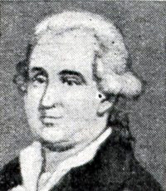
The History of Hypnosis
Franz Mesmer (1734-1815)
Believed that magnetic power flows
through every living thing.
Performed group hypnosis sessions
with “magnetized” tubs.
Made house calls, cured the poor
and the elderly.
Eventually fell out of favour.

Slide 6
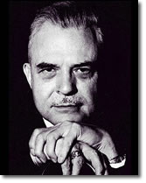
Pioneers in Hypnosis
Hippolyte Bernheim
Milton Erickson, M.D.
James Braid
Ralph Elliotson
James Esdaile

Slide 7
Signs of Hypnosis
Lethargy (unwillingness to move)
Rapid Eye Movement
Slower breathing (from the diaphragm)
Tearing
Time Distortion
Responds to suggestions
High Alpha & Theta brain wave activity

Slide 8
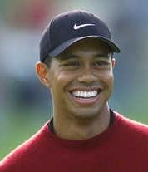
Benefits of Hypnosis
Reduced anxiety
Pain Relief (Patterson, Et al., 2005)
Smoking Cessation
Weight Loss (Johnson, 1997)
Sleeping Disorders
Sports Enhancement
Lower Blood Pressure
Migraines

Slide 9
Different Hypnotic Techniques
Compounding Suggestions
Progressive Relaxation
Fractionation
Conscious Convincer
Post-hypnotic suggestions
Rapid Inductions

Slide 10
Hypnotherapy vs. Stage Hypnosis
Essentially the same state of mind, but different dynamic
Objective in Hypnotherapy: Quitting Smoking, Weight Loss, etc.
Objective in Stage Hypnosis: Entertainment
Amnesia much more frequent in stage hypnosis than in Hypnotherapy
Stage subjects can more easily talk and keep eyes open
Stage hypnotist must be very careful

Slide 11
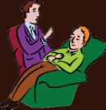
What makes a good Hypnotherapist?
Certified Hypnosis Training
Establishes Rapport
Personalizes Suggestions
Makes recordings for at-home listening
Background in Psychology
Confidence

Slide 12
Hypnosis & Neuroscience
Rainville et al. (2002) studied changes in the brain with 10 subjects in hypnosis
Results: Increased cerebral blood flow in the following areas:
Occipital Lobe
Anterior Cingulate Cortex
Thalamus
Decreased blood flow in cortical areas

Slide 13
Hypnosis & Neuroscience
Diamond et al. (2008) Sought to quantify hypnosis
Looked at hypnotized subjects and asked their depth level (Self-Rated Hypnotic Depth) and heart rate variability (HRV)
Results: Heart Rate amplitude and self-rated hypnotic depth highly correlated (.99)!
May in the future serve as a good measure of hypnotic depth

Slide 14
Hypnosis & Neuroscience
Xu & Cardena (2008) looked at using hypnosis as a way to treat diabetes in conjunction with insulin treatments.
Hypothesis: Diabetes has a major Psychological component that may aid in diabetes.
Results: “Multimodal treatments seem especially promising, with hypnosis as an adjunct to insulin treatments in the management of both type 1 and type 2 diabetes for stabilization of blood glucose and decreased peripheral vascular complications.”

Slide 15
Hypnosis & Neuroscience
Montgomery et al. (2007) looked at using hypnosis for pre and post surgery
Method: 200 women received a 15-minute hypnosis session before lumpectomy
Results: Less pain, fatigue and nausea
Less anesthesia required (lidocaine, propofol)
Decreased time in surgery (10.6 minutes per patient)
Cost savings: $772.71 per patient

