Slide 1
Modern Technologies in Football
Martin Horák, Ondřej Charvát

Slide 2
Goal Line Technology
What is it?
System used in football matches
Decide whether the ball fully cross the line or not
Why Goal-Line Technology?
Hard to decide
Controversial moments in history of football

Slide 3
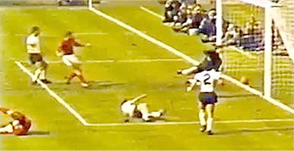
Controvesial moments
Geoff Hurst, England-Germany, WC 1966

Slide 4
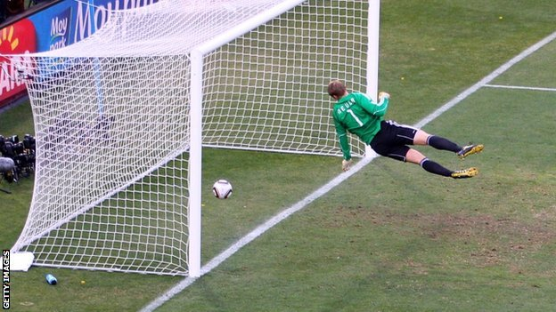
Controvesial moments
Frank Lampard, England-Germany, WC 2010

Slide 5
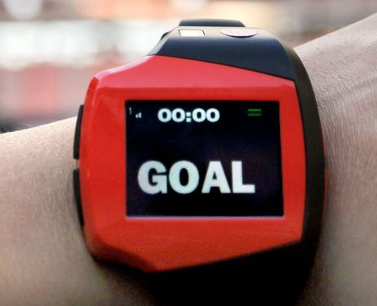
GLT – How it Works?
14 high-speed cameras (500 frames per second)
Image processing – removing objects
3D system – position of the ball and nets
Decision GOAL or NOT
IF there is a goal, system sends a signal to referee’s watch

Slide 6
Using of GLT
English Premier League (since 2013)
Chelsea – Hull
Manchester City – Cardif
World Cup 2014
France – Honduras
Future
German Bundesliga (next season)
Spanish La Liga (2–3 years)

Slide 7
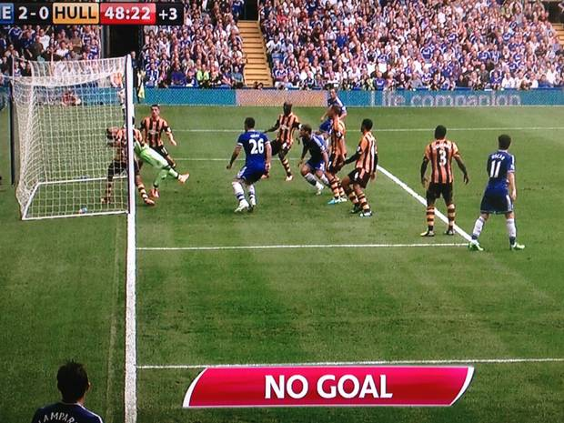
Using of GLT
Branislav Ivanovic, Chelsea – Hull, Premier League

Slide 8
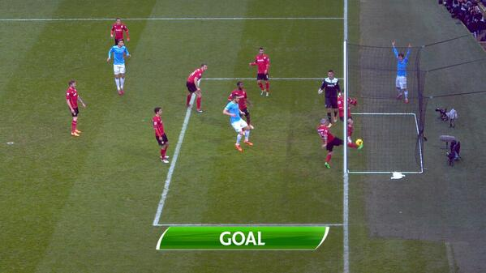
Using of GLT
Edin Dzeko, Manchester City – Cardiff, Premier League

Slide 9
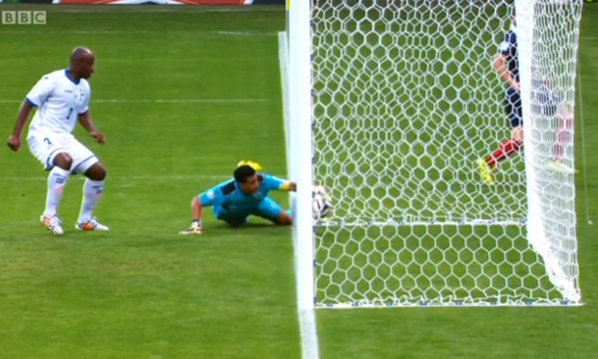
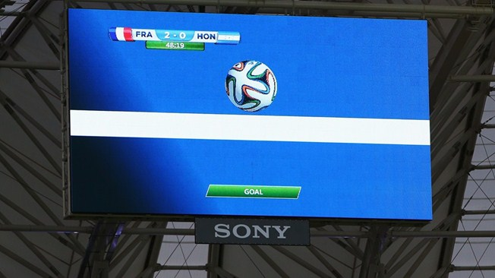
Using of GLT
Karim Benzema,
France – Honduras,
World Cup 2014

Slide 10
Adidas miCoach technology
What‘s it?
Set of devices for improve training activity
Allows to gather training data and analyze them
Why measure?
Measurable = improvable
Better planning of the training plan
Overview of the effort of players

Slide 11
What miCoach contains
FIT SMART – workout intensity coach for running and fitness training
SMART RUN – all-in-one watch for real-time coaching
X_CELL – in-game tracking for heart rate, quickness, hustle and jump height
HEART RATE MONITOR – monitoring of the heart rate
SPEED_CELL – measure max/average speed, distance and other derived indicators
SMART BALL – measures strike spin, speed and trajectory to learn to improve your kick

Slide 12
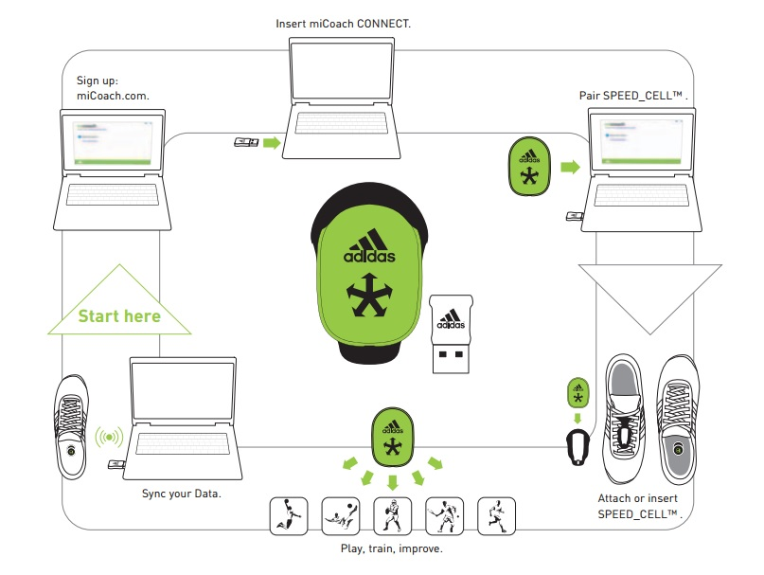
How SPEED_CELL works

Slide 13
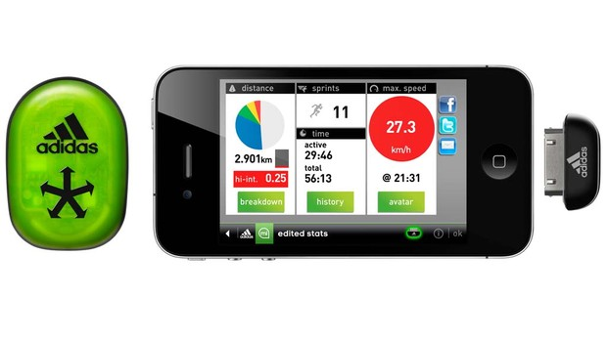
SPEED_CELL app

Slide 14
How SMART BALL works
Pair SMART ball with app
Select your kicking foot
KICK
App will synchronize with SMART BALL and gives you the result
Ball strike, flight path, speed, spin
2000 hrs, 1 hr charging

Slide 15
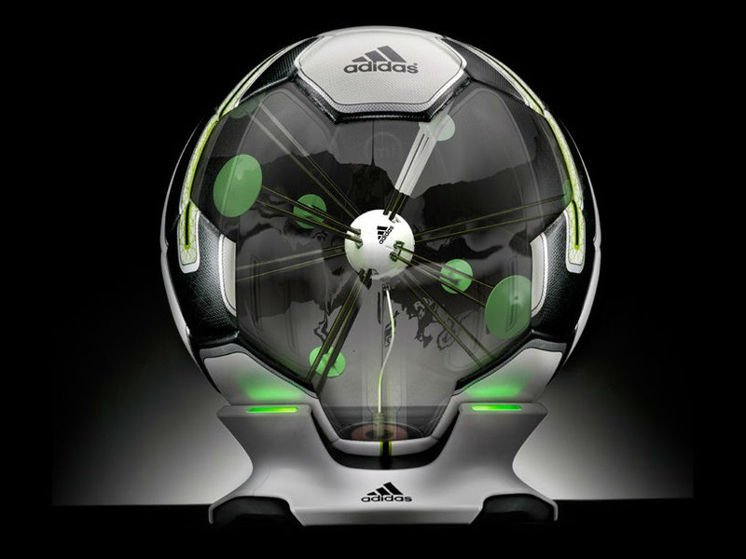
SMART BALL structure

Slide 16
Thank you for your attention..

