Slide 1
E-SUPPLY CHAIN MANAGEMENT
Presentation by
Dhruv Gathani
Chirag Jani

Slide 2
What is E-Supply Chain Management ?
E-SCM may be described as the integrated management approach for planning and controlling the flow of materials from suppliers to end users using Internet technologies
E-SCM refers the complex network of relationships that organizations maintain with trading partners to source, manufacture and deliver products

Slide 3
Components of E-SCM
CUSTOMER ORDER
ADVANCED SCHEDULING
DEMAND FORECASTING`
TRANSPORTATION LOGISTICS
DISTRIBUTION PLANNING
ORDER COMMITMENT

Slide 4
7 Ways to reduce inventory
Improve data accuracy
Cut your lead time
Increase the velocity of your operation
Eliminate misalignment from your process
Clean your attic
Eliminate variation
Replenish based on market demand

Slide 5
BENEFITS OF E-SCM
Supports exchange of real time information
Platform independent
Web visibility & processing capability 24/7
Return on investment
It has open internet application architecture which allows for Rapid deployment & scalability combining unlimited users in real time environment
Incorporates broadcast & active messaging

Slide 6
Companies managing supply chain through Internet
AMUL-Taste of India
ICICI Bank
TELCO
HINDUSTAN LEVER
CRISIL
DELL
ASIAN PAINTS

Slide 7
AMUL – Taste Of India
Formed in the year 1946 Amul is the leading food brand in India
Has been accredited with ISO 9001and HACCP Certification by QAS Australia-the first company in Asia to receive HACCP Certification.
Amul initiated the dairy co-operative movement in India and formed an apex co-operative organization called Gujarat co-operative Milk Marketing Federation(GCMMF) and today 70,000 villages and 200 districts in India are part of it.
GCMMF markets its products through 50 sales offices throughout India and distribution is done through a network of 4,000 stockists who in turn supply 500,000 retail outlets.

Slide 8
GCMMF: An Overview
Members | 12 district co-operative milk producers union
No of producing members | 2.79 million
No of village societies | 13,328
Milk collection(2008-2009) | 3.05 billion liters
Milk collection (Daily average) | 8.4 million liters
Milk Drying capacity | 626 metric tonnes daily per day
Sales Turnover(2008-2009) | Rs 29658 million
GCMMF is an apex co-operative organization that comprises of affiliated member dairies/district milk unions each having it’s own manufacturing unit. These member dairies collect milk from members who supply milk twice a day.

Slide 9
How AMCUS work
Amul has installed over 3000 Automatic milk collection system units(AMCUS) at village societies to capture member information, milk fat content, volume collected and amount payable to each member.
Each farmer is given a plastic card for identification
Computer calculates amount due to farmer on the basis of fat content
The value of the milk is then printed out on slip & handed over to the farmer, who collects the payment from adjacent window
With the help of IT farmers receive their payment within minutes

Slide 10
Supply management through internet
Amul makes over 10 million payment transactions daily. On the logistics more than 5000 trucks move milk from the villages to 200 dairy processing plants twice a day according to a carefully planned schedule.
It’s ERP software named as Enterprise Wide Integrated Application System(EIAS) covers a plethora of operations like market planning advertising and promotion, distribution network planning. Each of amul offices are connected via internet and all of them send daily reports on sales and inventory to the main system at Anand.
Has also connected all zonal, regional & member dairies through VSAT

Slide 11
Supply & distribution
At the supply end a computerized database has been setup of all suppliers & their cattle.
Computer equipment measures & records qualities & quantities collected.
At the distribution end stockists have been provided with basic computer skills. Amul experts assist them in building promotional web pages.
Amul Cyber stores have been setup in India, USA, Singapore and Dubai

Slide 12
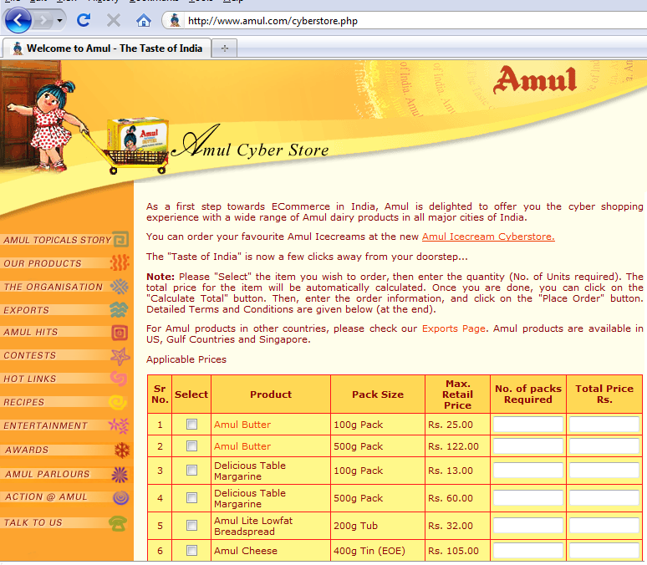
Amul Cyber store

Slide 13
Strong initiatives in e-commerce
Amul has linked distributors to the network & also incorporated web pages of top retailers on their website
Distributors can place their order on website amulb2b.com
Automated supply & delivery chain
Practices just in time supply chain management with six sigma accuracy

Slide 14
Accolades
CIO 100 AWARD recognizes organizations around the world that excel in positive business performance through internet & IT management
GCMMF also won the prestigious Ramkrishna Bajaj National Quality award in 2003 for adopting noteworthy quality management practices for logistics and procurement

Slide 15
Future Plans
Introduce Internet Banking Services & ATMs which will enable Milk societies to credit payments directly to seller’s bank account
Officials at amul are looking at upgrading the plastic cards which are being currently used only for identification purposes, to smart cards which can be used to withdraw cash from ATMs.

Slide 16
Refrences
Supply Chain Management-theories & Practices
By R.P.MOHANTY
S.G.DESHMUKH
E-commerce
By P.T.Joseph
Thank you

