Slide 1
Chromatography

Slide 2
Originally, this technique was used by Tswett (1903) in the separation of plant pigments (chromatography comes from the Greek, chroma, meaning colour) but we now know that it is applicable to all chemical species, whether coloured or not.

Slide 3
PRINCIPLES OF CHROMATOGRAPHY

Slide 4
The Partition Coefficient
When applied to any two-phase system (e.g. liquid–liquid, liquid–solid), a molecule may partition between the phases.
The precise ratio of concentration achieved is ultimately determined by inherent thermodynamic properties of the molecule (in turn, a function of its chemical structure) and of the phases.
In the case of a liquid–liquid system, the relative solubility of the molecule in each liquid will be very important in determining partitioning.
In a liquid–solid system, different sample molecules may adsorb to varying degrees on the solid phase.
Both partition and adsorption phenomena are possible in a column system and this is called column chromatography.

Slide 5
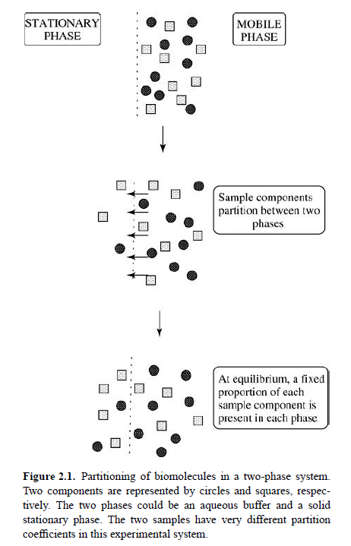

Slide 6
In column chromatography, one phase is maintained stationary (the stationary phase) while the other (the mobile phase) may flow freely over it.
We can express the concentration ratio in such a system as the partition coefficient, K:
K= Cs/Cm
where Cs and Cm are the sample concentrations in the stationary and mobile phases, respectively.

Slide 7
When a mixture made up of several components is applied to such a two phase system, each component will have its own individual partition coefficient. As a result, each will interact slightly differently with the stationary phase and, because of different partitioning between phases, will migrate through the column at different rates.

Slide 8
Phase Systems Used in Biochemistry
In chromatographic systems used in biochemistry the stationary phase is made up of solid particles or of solid particles coated with liquid.
In the former case, chemical groups are often covalently attached to the particles and this is called bonded phase liquid chromatography.
In the latter case, a liquid phase may coat the particle and be attached by noncovalent, physical attraction. This type of system is called liquid–liquid phase chromatography.

Slide 9
Commonly, the particles are composed of hydrated polymers such as cellulose or agarose. Such particles may be immobilized in a column and washed with mobile phase.
Because biomolecules have evolved to function in an aqueous environment, it is usually necessary to use aqueous buffers as the mobile phase if we require the molecule to retain its native structure (e.g. in the purification of active enzymes). If the native structure is not required, however, then it is possible to use more ‘nonbiological’ conditions such as organic solvents.
Liquid–solid or liquid–liquid phases are the most common phase systems used in biochemistry.

Slide 10
Liquid Chromatography
To minimize loss of biological activity, separations are often carried out in aqueous buffers below room temperature. Low temperatures are especially important in the chromatography of cell extracts during, for example, protein purification.
This reduces protease activity which might otherwise destroy the protein of interest. Chromatography with liquid mobile phases is called liquid chromatography (LC).
LC uses an experimental system outlined in Figure 2.2

Slide 11
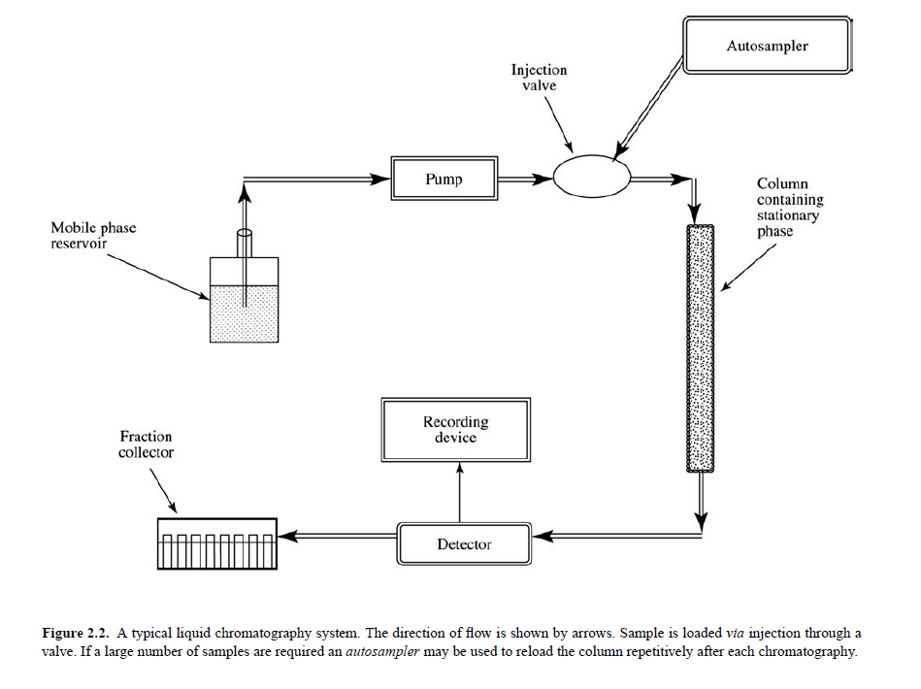

Slide 12
LC uses an experimental system outlined in Figure 2.2.
Separation takes place in a column which contains the stationary phase.
The volume and shape of the column will depend on the amount of sample to be separated and on the mode of chromatography to be used.
Buffer is stored in a reservoir and is pumped through tubing onto the column.
Appropriate valves allow the convenient injection of sample into this flow or the formation of gradients with a second buffer if required.
The stationary phase is packed in the column and, as the sample passes through the bed of stationary phase, separation occurs.

Slide 13
In partition chromatography modes, the sample separates into individual components as it passes through the stationary phase (e.g. gel filtration).
In adsorption chromatography modes, however, it is necessary first to load the entire sample and later to fractionate it. A good example of adsorption chromatography is ion exchange chromatography where the sample components are eluted by means of a gradient of competing salt counterions after all the sample has been loaded onto and washed completely through the column.

Slide 14
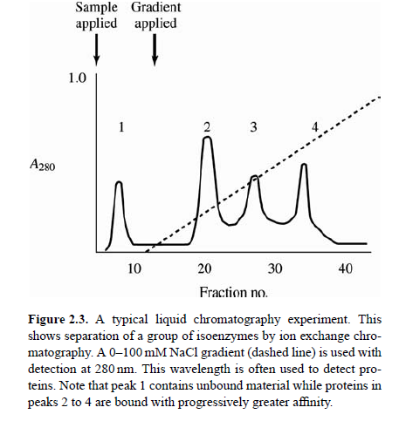

Slide 15
Gas Chromatography
Many biomolecules are sensitive to high temperatures that can lead to destruction of structure and function.
However, some molecules of importance in biochemistry may be converted to derivatives that are structurally stable, though volatile, in the temperature range 200–250 ◦C.
Good examples are trimethylsilated sterols and carbohydrates (esterified at their hydroxyl groups), and methylated esters of fatty acids.
A second category of molecules (e.g. ethanol) is stable and volatile at somewhat lower temperatures without derivatization.
Both of these groups of molecules may be analysed by gas chromatography (GC, also sometimes called gas-liquid chromatography; GLC).

Slide 16
CHROMATOGRAPHY EQUIPMENT
Reservoirs to hold the mobile phase
Glass columns for the stationary phase.
Detection in such a system may be achieved by making manual absorbance measurements after separation or automated.
In such a system, flow may be driven simply by gravity or else by use of a peristaltic pump.
A plot of detector signal versus the retention of sample components is called an elution profile.
Separated peaks may be collected by means of a fraction collector.

Slide 17
Stationary Phases
The stationary phase is required to be mechanically stable (especially to high pressures and liquid shear forces) and chemically inert under the chromatography conditions used.
Often, it is also desirable that it is capable of acting as a support for chemical groups possessing desirable properties for chromatography such as hydrophobicity, ion exchange or affinity ligands.

Slide 19
Elution
Elution from or development of chromatography columns may be achieved in three possible ways, depending on the specific nature of chemical interaction between sample components and stationary phase.

Slide 20
Continuous flow elution or isocratic elution is where mobile phase flowing through the column is continuous both in flow rate and in composition. This is especially applicable in partition chromatography systems. It is usually found that leading (i.e. early eluting) peaks are sharp but poorly resolved with this type of elution while trailing (i.e. late eluting) peaks, by contrast, are well separated but tend to have undergone extensive peak broadening.
This is known as the general elution problem.

Slide 21
Where sample components have adsorbed to the column packing, they often have quite different, individual, affinities for the stationary phase.
Batch flow elution can be used in such a situation and involves the stepwise introduction of different mobile phases in which the pH, polarity, salt concentration or some other component are varied.
Conditions may be selected where one sample component remains bound to the stationary phase while another elutes, usually in a small volume.

Slide 22
Gradient elution, where pH, polarity, salt concentration are varied continuously rather than stepwise.
This type of elution overcomes the general elution problem mentioned earlier, ensuring high-resolution separations throughout the chromatogram within a relatively short range of elution.
Automation allows the creation of complex gradients with a variety of shapes.
Gradients are prepared by continuously mixing two different buffers.

Slide 23
