Slide 1
Modeling and Analysis of DFIG Based Wind Power System Using Instantaneous Power Components Jaimala Gambhir, Tilak Thakur, Puneet Chawla

Slide 2
INTRODUCTION
Energy supply plays an important role in the social and energy consumption.
Scarcity and cost of basic energy resources have become a worldwide challenge.
While coal using conventional carbon-based energy resources will have harmful environmental impacts including global warming and climate change.
Much attention is focused on utilizing renewable energy resources such as wind, photovoltaic, small hydro, wave, tidal, biomass study the fault dynamics of wind farms (employing Doubly Fed Induction Generators, DFIG).
In order to analyse the DFIG performance during transient conditions, control and modelling of DFIG are important and they are discussed in this paper.

Slide 3
CONTROL SCHEMES OF DFIG
Modelling and control of DFIGs have been widely investigated based on well-established vector control (VC) schemes in a stator field-oriented frame of reference.
The vector control is a fast method for independent control of the real/reactive power of a machine.
Direct torque control (DTC) and direct power control schemes (DPC) have been presented as alternative methods which directly control machine flux and torque by selection of suitable vectors.

Slide 4
VECTOR CONTROL SCHEME (VC)
The standard voltage oriented vector control strategy is used for the machine side converter to implement control action.
Since the stator is connected to the utility grid and the influence of stator resistance is small, the stator magnetizing current i_{m} can be considered as constant.
The main objective of the grid side converter is to maintain dc-link voltage constant for the necessary action.
The control scheme utilizes current control loops for i_{d} and i_{q} with the i_{d} demand being derived from the dc-link voltage error through a standard PI controller.
The control design uses two loops, i.e. inner current loop and outer voltage loop to provide necessary control action.

Slide 5
DIRECT TORQUE CONTROL
The direct torque control (DTC) method is an alternative to vector control for DFIG based wind power generation.
Variable switching frequency and high torque ripple are the main limitations of hysteresis based DTC.
To address these limitations, a new DTC method wherein rotor voltage vector is generated in polar form, with space vector modulation based on synchronous reference frame transformation, predictive control and deadbeat control are implemented.

Slide 6
DIRECT POWER CONTROL
The main drawback of the vector control system is that its performance depends greatly on accurate machine parameters pertaining to the stator, rotor resistances, and inductances.
Direct power control (DPC) abandons the rotor current control. Also, DPC achieves active and reactive power control by the modulation of the rotor voltage in accordance with the active and reactive power errors.

Slide 7
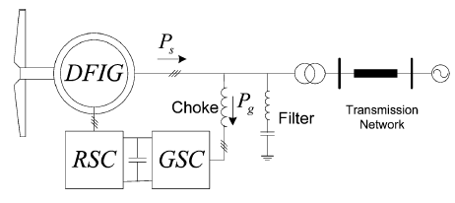
MODELING OF DFIG USING INSTANTANEOUS POWER COMPONENTS
The parameters of DFIG are modeled using instantaneous real and reactive powers as variables.
The back to back power converter consists of rotor side converter which controls speed of the generator and grid side converter to inject reactive power to the system.

Slide 8
The instantaneous real and reactive power components of the grid side converter p_{g}(t) and q_{g}(t) in the synchronous dq reference frame are
(1)
Solving (1) for i_{gd},i_{gq}
(2)
where , let =k_{pq}
Similarly the instantaneous real p_{s}(t) and reactive powers q_{s}(t) of DFIG can be obtained in terms of stator currents as
(3)

Slide 9
The main assumption to simplify the model is assuming an approximately constant stator voltage for DFIG. Using this assumption, k_{pq} is approximately constant with this derivatives of currents will be proportional to the derivatives of power.
The voltage and flux equations of a doubly fed induction machine in the stator voltage synchronous reference can be represented as :
(4)
(5)
(6)
(7)
(8)
(9)
(10)
(11)

Slide 10
where w_{e} represents synchronous frequency, r represents resistance, L represents inductance and suffixes s,r,m represents stator, rotor and mutual quantities respectively. Now the stator voltages and rotor voltage quantities can be rewritten as
(12)
(13)
(14)
(15)
(16)
From (8) and (9) i_{rd} and i_{rq} values can be written as
(17)

Slide 11
Substituting these values in (10),(11) yields
(18)
(19)
Rearranging the terms in (15) and (16) yields
(20)
(21)
Where (22)
Now substituting (17), (20) and (21) in (6) and solving for i_{sd}&i_{sd} we can get
(23)

Slide 12
Using (1), (3) replacing i_{sd},i_{sq}with p_{s} & q_{s} and re arranging the terms yields
(25)
(26)
Stator flux state equation can be obtained by substituting i_{sd} and i_{sq}in (8) and (9) and upon solving we get
(27)
(28)

Slide 13
The electromechanical dynamic model of the machine is presented as
where p = number of poles
H =inertia of the rotor
T_{m} = Mechanical torque of the machine
T_{e} = electromechanical torque
Now based on (27), (26) can be expressed in terms of instantaneous real and reactive power components

Slide 14
CONTROL SYSTEM DESIGN FOR GRID SIDE AND MACHINE SIDE CONVERTERS
The purpose of the rotor side converter is to control the rotor currents such that the rotor flux position is optimally oriented with respect to stator flux in order that the desired torque is developed at the shaft of the machine.
The grid side converter aims to regulate the voltage of the dc bus capacitor.
It is allowed to generate or absorb reactive power for voltage support requirements.
In this scheme the control inputs of the system are U_{rd}, U_{rq} to control real/reactive power of the rotor and U_{gd}, U_{gq} to adjust the dc-link voltage and injected reactive power to the system.

Slide 15
The decoupled voltages of grid side converter and rotor side converter in dq reference frame values are given by
(29)
(30)
(31)
(32)

Slide 16
Where

Slide 17
RESULTS AND DISCUSSIONS
In this section the performance of DFIG based wind farm modeled using MATLAB/SIMULINK under different wind speeds and different dynamic conditions (sag and swell). Here instantaneous power components are used in control theory for pulses to the converters are generated using reference active and reactive power for rotor side controller and reactive power of grid , DC link voltage references are used for Grid side controller
TABLE I
Parameters of the Induction Machine
Rated Power | 1.5/0.9 Mw
Stator Voltage | 415V
Rs(Stator Resistance) | 0.00706 pu
Rr(Rotor Resistance) | 0.005 pu
Ls | 3.071 pu
Lm | 2.9 pu (Referred to the rotor)
Lr (Rotor inductance) | 3.056pu(Referred to the rotor)
Poles | 6
Rated speed | 1100 rpm
DC link Voltage | 850V
f Frequency | 60 Hz
h Inertia of rotor | 5.04 s

Slide 18
SIMULATION UNDER BALANCED GRID CONDITION
It is observed that the active and reactive powers supplied by the utility grid are decoupled and dc link voltage is maintained constant due to the control strategy made in the grid side converter.
SIMULATION RESULTS UNDER VOLTAGE SAG CONDITION
The simulation results under the voltage sag 80% of rated voltage is applied in the faulted period.
The DFIG system produces active power of 1.4 MW which corresponds to maximum mechanical turbine output minus electrical losses in generator.
When the grid voltage changes suddenly from its rated value i.e.415V the stator current as well as rotor current increases and the active power P suddenly oscillates between 0.8 MW to 1.4 MW.

Slide 19
SIMULATION RESULT UNDER VOLTAGE SWELL CONDITION
Simulation results under voltage swell is shown in Fig.3. When the grid voltage increases up to 120% of its rated value the stator current as well as rotor current decreases and the reactive power Q decreases suddenly and then settles to 0kVAr.

Slide 20
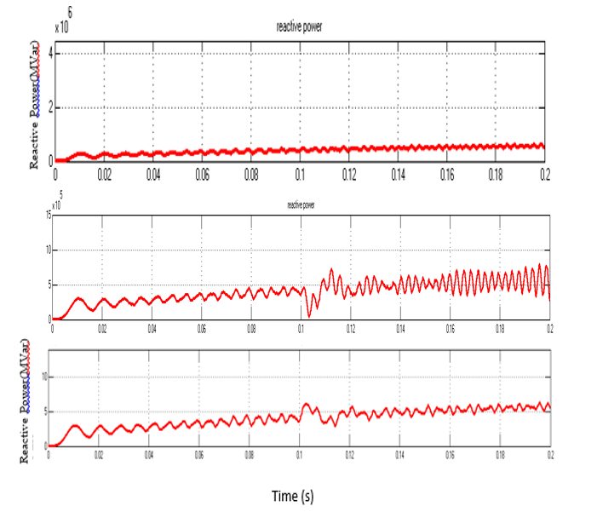
Figure. 2 Active power during balanced grid, voltage sag and voltage swell conditions.
Figure. 3 Reactive power of DFIG during Balanced Condition, Voltage Sag and Voltage Swell Conditions.

Slide 21
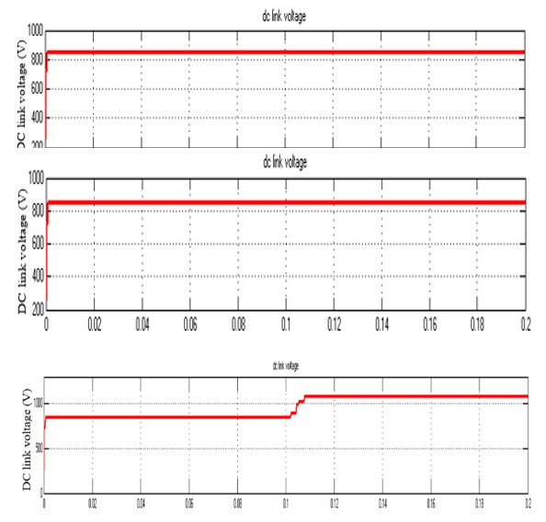
In Fig.4 the behaviour of the generator is observed from 0.11s when the voltage rises to 120% of its rated Value.
Figure. 4 DC Link Voltage during Balanced Condition, Voltage Sag and Voltage Swell Conditions.

Slide 22
CONCLUSION
This paper presented modelling of DFIG using power components as variables and the performance of the DFIG system is analysed under grid voltage fluctuations.
The active and reactive power is controlled independently using the vector control strategy.
.
It has been shown that Direct power control is a more efficient approach compared to modified Direct torque control and Vector Control .
The main aim of the controlling technique is maintaining the DC link voltage constant which is achieved during voltage sag and swell conditions.

Slide 23
REFERENCES
R.Pena, J.C. Clare, G.M. asher,” DFIG using back-to-back converters and itsapplication to variable- speed wind-energy generation,” IEE Proc. Elect. Power Appl., vol. 143, no. 3, pp. 231-241, 1996
S. Soter, R. Wegener, “Development of induction machines in wind power technology,” Proc. IEEE Int. Electric Mach. Drives Conf., vol. 2, pp. 1490-1495, 2007.
W. Leonard, “Control of Electrical Drives,” Springer, New York, 2001.
N. Mohan, T. M. Undeland, W. P. Robbins, “Power Electronics: Converters, Applications and Design,” Clarendon Press, Oxford, UK, 1989.
S. R. Jones, R. Jones, “Control strategy for sinusoidal supply side convertors,” IEE Colloq. Developments in real time control for induction motor drives, vol. 24, 1993.
G. A. Smith, K. Nigim, A. Smith, “Wind-energy recovery by a static Scherbius induction generator,” IEE Proc. C, vol. 128, no.6, pp. 317-324, 1981.
M. Mochmoum, R. Ledoeuff, F. M. Sargos, and M. Cherkaoui, “Steady state analysis of a doubly fed asynchronous machine supplied by a current controlled cyclo converter in the rotor,” IEE Proc. B, vol. 139, no. 2, pp. 114-122 , 1992.
F. Blaabjerg, R. Teodorescu, M. Liserre, A.V. Timbus, “Overview of Control and Grid Synchronization for Distributed Power Generation Systems,” IEEE Trans. Ind. Elect., vol. 53, no. 5, pp.1398-1409, 2006.
T. Noguchi, H. Tomiki, S. Kondo, and I. Takahashi, “Direct power control of PWM converter without power-source voltage sensors,”IEEETrans.Ind. Appl., vol.34, no.3, pp.473–479,May/Jun.1998.
Lie Xu and Yi Wang, “Dynamic Modeling and Control of DFIG-Based Wind Turbines under Unbalanced Network Conditions,” IEEE Trans. On Power Systems, vol. 22, no. 1, pp. 314-322, February 2007.
G. Escobar, A. M. Stankovic, J. M. Carrasco, E. Galvan, and R. Ortega,“Analysis and design of direct power control (DPC) for a three phase synchronous rectifier via output regulation subspaces, ” IEEE Trans.Power Electron., vol.18, no.3, pp.823–830, May 2003.

Slide 24
M. Malinowski, M. P. Kazmierkowski, S. Hansen, F. Blaabjerg, and G. D. Marques ,“Virtual-flux-based direct power control of three-phase PWM rectifiers,” IEEE Trans.Ind.Appl., vol.37, no.4, pp.1019–1027,Jul./Aug.2001.
T. Noguchi, H. Tomiki, S. Kondo, and I. Takahashi, “Direct power control of PWM converter without power-source voltage sensors,” IEEE Trans. Ind. Appl., vol.34, no.3, pp.473–479, May/Jun.1998.
G. Escobar, A. M. Stankovic, J. M. Carrasco, E. Galvan, and R. Ortega, “ Analysis and design of direct power control (DPC) for a three phase synchronous rectifier via output regulation subspaces,” IEEE Trans.Power Electron., vol.18, no.3, pp.823–830, May2003.
M. Malinowski, M. P. Kazmierkowski, S. Hansen, F. Blaabjerg, and GD. Marques,“ Virtual-flux-based direct power control of three-phase PWM rectifiers,” IEEE Trans. Ind. Appl., vol 37, no.4, pp.1019–1027,Jul./ Aug. 2001.
K. P. Gokhale, D. W. Karraker, and S. J. Heikkila,“ Controller for a wound rotor slip ring induction machine,” U. S. Patent 6448735 B1,Sep.2002.
L. Xu and P. Cart wright, “Direct active and reactive power control of DFIG for wind energy generation,” IEEE Trans. Energy Convers.,vol.21, no.3, pp.750–758, Sep.2006.
H. Akagi, Y. Kanazawa, and A. Nabae, “Generalized theory of the instantaneous reactive power in three-phase circuits,” in Proc. Int.Power Electron. Conf., 1983, pp. 1375–1386.

Slide 25
THANK YOU

