Slide 1
Bearing Use in Design

Slide 2
Bearing Terminology
Bearing
=
Raceway
Rolling Elements
Cage
Lubricant
Seal

Slide 3
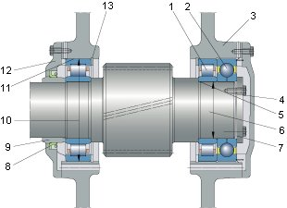
Bearing Arrangement Terminology
Cylindrical roller bearing
Four-point contact ball bearing
Housing
Shaft
Shaft abutment shoulder
Shaft diameter
Locking plate
Radial shaft seal
Distance ring
Housing bore diameter
Housing bore
Housing cover
Snap ring

Slide 4
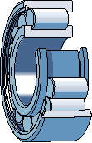
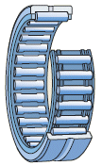
Radial Bearing Types
Deep Groove
Angular Contact
Self Aligning
Cylindrical Roller
Full Complement
Cylindrical Roller
Needle Roller
Tapered Roller

Slide 5
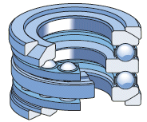
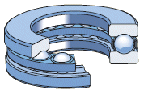
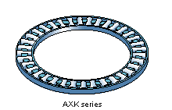
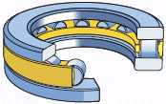
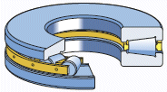
Thrust Bearing Types
Thrust Ball Bearing
Single Direction
Thrust Ball Bearing
Double Direction
Angular Contact
Cylindrical Roller
Needle Roller
Tapered Roller

Slide 6
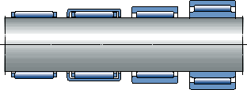
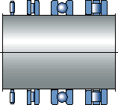
Bearing Selection – Space
Limited Radial Space
Choose bearing with low cross-sectional height
EX. Needle roller and cage assemblies
Limited Axial Space
Choose bearings that can handle combined loads
EX. Cylindrical roller, deep groove, needle roller

Slide 7
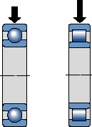
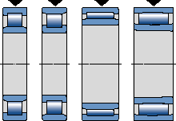
Bearing Selection – Loads
Magnitude
Roller bearings support heavier loads than similar sized ball bearings
Full complement roller bearings support heavier loads than corresponding caged bearings
Radial
Some cylindrical roller and all needle roller

Slide 8
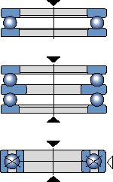
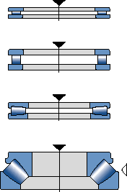
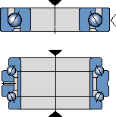
Bearing Selection – Loads
Axial
Thrust ball bearing and four-point contact ball
Angular contact thrust ball bearings

Slide 9
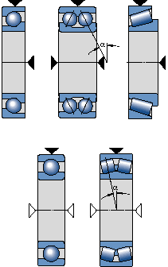
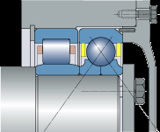
Bearing Selection – Loads
Combined
Greater the angle of contact, greater ability to handle axial loads

Slide 10
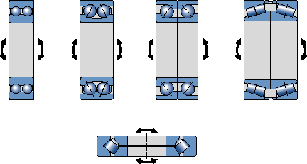
Bearing Selection – Loads
Moment
Eccentric loads resulting in tilting moment
Best: paired single row angular contact bearings or tapered roller bearings

Slide 11
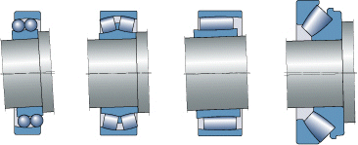
Bearing Selection – Misalignment
Rigid Bearings
Deep groove and cylindrical roller
Cannot accommodate misalignments well
Accommodating Bearings
Self-aligning ball bearings, spherical roller (radial and thrust)

Slide 12
Bearing Selection – Speed
Highest Speeds
Purely Radial Loads
Deep Groove Ball Bearings
Self Aligning Ball Bearings
Combined Loads
Angular Contact
Thrust bearings cannot accommodate as high speeds as radial

Slide 13
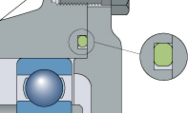
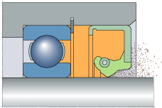
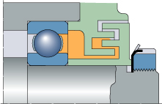
Seals
Purpose
Keep contaminants out, and lubricant in the bearing cavity
Types
Seals in contact with stationary surfaces (static) / sliding surfaces (dynamic)
Non-contact seals
Bellows and membranes

Slide 14
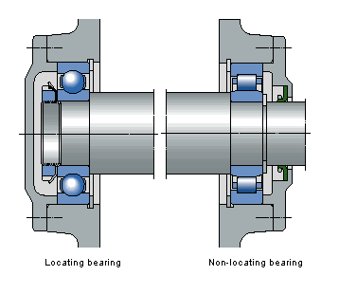
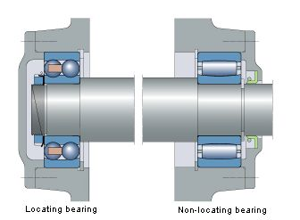
Bearing Arrangement
Locating and Non-locating
Stiff
Deep groove ball bearing with cylindrical roller bearing
Self-Aligning
Self-aligning ball bearing with toroidal roller bearing

Slide 15
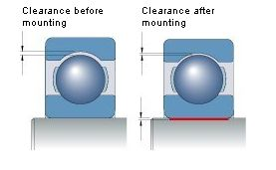
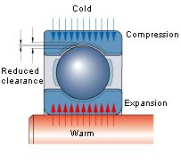
Selection of Fit
The heavier the load, particularly if it is a shock load, the greater the interference fit
Elements will heat up differently causing expansion
Tolerances on shaft and housing
http://www.skf.com/group/products/bearings-units-housings/ball-bearings/principles/application-of-bearings/radial-location-of-bearings/selection-of-fit/recommended-fits/index.html

Slide 16
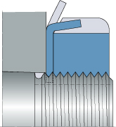
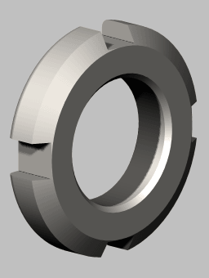
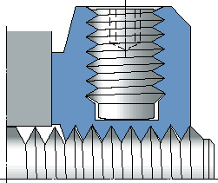
Methods of Location
Locking Washer
Washer engages keyway in shaft
Tab is bent over into slot on circumference of nut
Locking Screw
Prevents nut from turning

Slide 17
Bearing Load
Dynamic
Load to failure after 1,000,000 revolutions (ISO 281:1990)
Shows metal fatigue (flaking, spalling) on rings or rolling elements
Static
Rotate at slow speeds (< 10 RPM)
Perform very slow oscillating movements
Stationary under load for certain extended periods

Slide 18
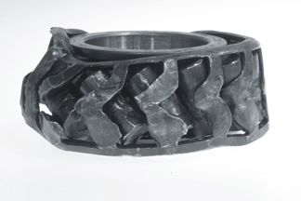
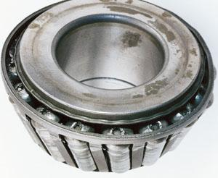
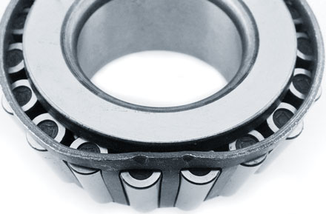
Service Life Factors
Contamination
Wear
Misalignment
Corrosion
Cage Failure
Lubrication
Seal

Slide 19
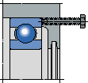
Designing For Disassembly
Add threaded holes to use screws to ‘jack’ bearings out of housings
Add porting and grooves to use high pressure oil to dismount bearings

Slide 20
Introducing Pre-Load
Enhance stiffness
Quiet running
Accurate shaft guidance
Compensates for wear and settling
Longer service life

Slide 21
Bearing Example

Slide 22
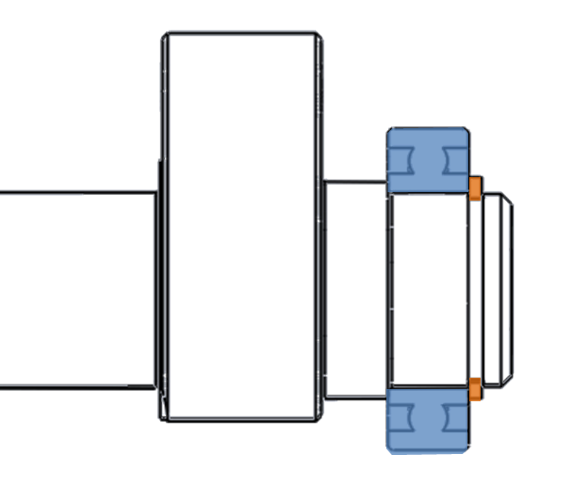
Designing Shafts for Bearings

