Slide 1
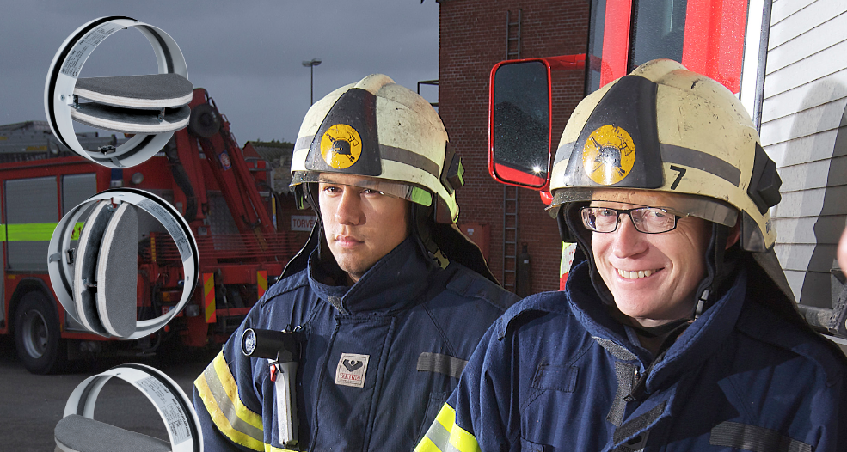
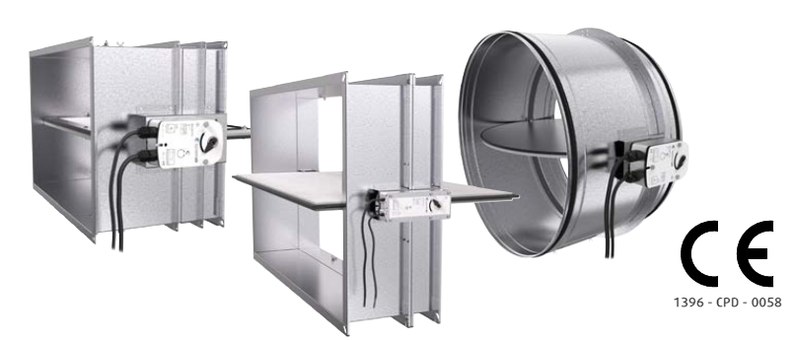
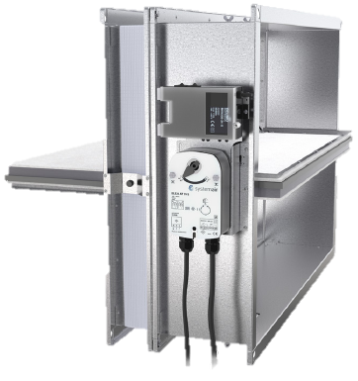
Smoke control dampers
M. Janov PM FSP, IMOS-Systemair, Slovakia

Slide 2
Content
Compartmentisation
FSP types
Definitions of smoke control dampers according to EN12101-8 & EN 1366-10 Smoke control dampers types (SCD)
EU standardisation of smoke control dampers
Classification of single compartment smoke control dampers
Classification of multi compartment smoke control dampers
Example - Classification of single compartment smoke control damper
Example - Classification of multi compartment smoke control damper
Design of the smoke control dampers DKI1
Basic parts of the smoke control damper
Standards used by development of DKI1-R/S
Classification range of DKI1-R and DKI1-S
Ordering codes for DKI1-R and DKI1-S
Dimension ranges of DKI1-R and DKI1-S
Multi compartment smoke dampers for HSEVS
CE certification and harmonized standards
M. Janov PM FSP, IMOS-Systemair, Slovakia

Slide 3
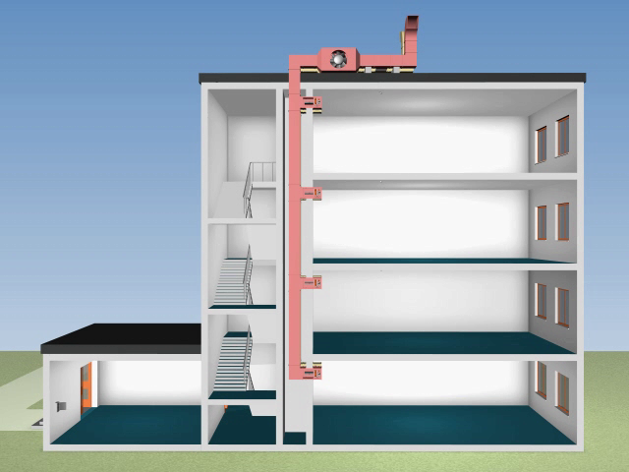
Compartmentisation
Building fire and smoke safe zones or containment sections “Compartmentisation”
Goal:
Prevent Fire & Smoke spreading
Focus on Safety in Case of Fire
Building - type and - use
Using existing HVC installation to increase safety
fire protection
area
Fire resistive ceilings
with defined fire resistivity
Fire resistive wall with defined fire resistivity
Fire resistive closing – in HVAC duct fire damper / fire air grille
Business Conference Jan 2012 M. Janov PM FSP, IMOS-Systemair, Slovakia

Slide 4
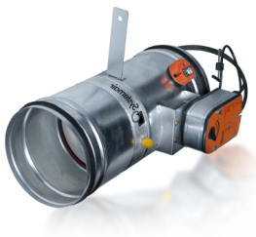
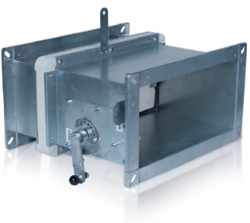
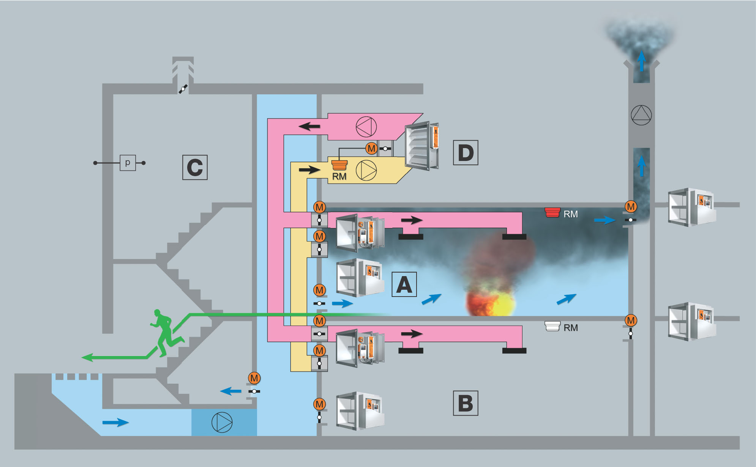
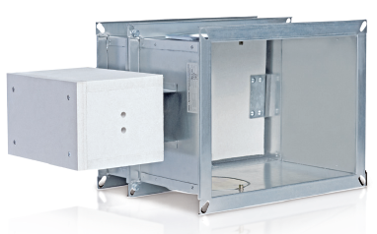
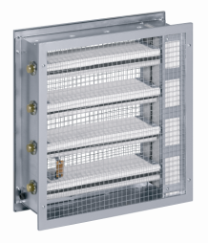
FSP types
Evacuation dampers
Safety position:
OPEN
Fire dampers
Safety position:
CLOSED
Smoke dampers
Fire air grills
Safety position:
OPEN
CLOSED
Safety position:
CLOSED
M. Janov PM FSP, IMOS-Systemair, Slovakia

Slide 5
Smoke control dampers
Safety positions:
OPEN
CLOSED
M. Janov PM FSP, IMOS-Systemair, Slovakia

Slide 6
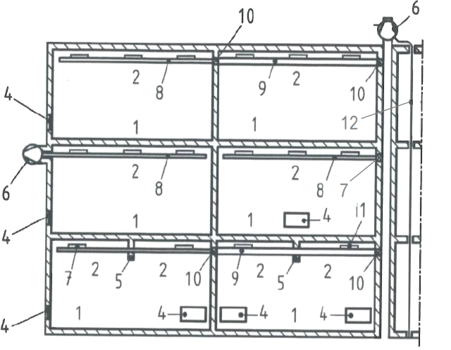
Smoke control dampers
Single / multi compartments
Multi compartment
Fire resistive walls
Single compartments
M. Janov PM FSP, IMOS-Systemair, Slovakia

Slide 7
Types of SCD according to EN 12101-8
7
7
7
11
11
Fire compartment
Smoke reservoir
(position left empty)
Air inlet
Smoke barrier
Powered smoke end heat exhaust ventilator (fan)
Smoke control dampers for single compartments (EN12101-8 & EN 1366-10)
Smoke control ducts for single compartments (EN12101-7 & EN 1366-9)
11
7
7
7
Fire compartment
Smoke reservoir
(position left empty)
Air inlet
Smoke barrier
Powered smoke end heat exhaust ventilator (fan)
Smoke control dampers for single compartments (EN12101-8 & EN 1366-10)
Smoke control ducts for single compartments (EN12101-7 & EN 1366-9)
moke control ducts for multi compartments (EN12101-7 & EN 1366-8)
Smoke control dampers for multi compartments (EN12101-8 & EN 1366-10) mounted inside or outside of wall or floor
Smoke control dampers for multi compartments (EN12101-8 & EN 1366-10) mounted on the surface of the duct
Electrical equipment
7
7
7
10
11
7
M. Janov PM FSP, IMOS-Systemair, Slovakia

Slide 8
Definitions of smoke control dampers according to EN12101-8 & EN 1366-10
7.
Single compartment smoke control damper = smoke control dampers for use in single compartment areas, which may be associated with smoke control duct tested according to EN1366-10 and/or may be installed in an external wall, floor or roof
10.&11.
Multi compartment fire resisting smoke control damper = smoke control dampers for use in multi compartment areas, which may be associated with smoke control duct tested according to EN1366-10 and/or may be installed within or on the face of a fire compartment structure
M. Janov PM FSP, IMOS-Systemair, Slovakia

Slide 9
Standardisation
Goal of standardisation | Fire dampers | Smoke control dampers | Fire air grills
Product Standard | EN 15 650 Ventilation for buildings. Fire dampers | EN 12101-8 Smoke and heat control systems. Part 8: Smoke control dampers
Terminology for fire safety generaly | EN 13 943 Fire Safety. Vocabulary
Test standards | EN 1366 Fire resistance tests for service installations |  | EN 1634 Fire resist. tests Part1: Fire doors and shutter assemblies
 | Part 2: Fire dampers | Part 10: Smoke dampers
Classification standards | EN 13 501 Fire classification of construction products and building elements, classification using data from fire resistance tests
 | Part 3: fire resisting ducts and fire dampers | Part 4: components of smoke control systems | Part 2: excluding ventilation services
Extended application Standards | EN 15 080 Extended applications of results from fire resistance tests for service installations Part 11: Dampers | prEN 15882 Part5 Canceled
M. Janov PM FSP, IMOS-Systemair, Slovakia

Slide 10
Classification of single compartment smoke control damper
E_{T} tt ( pos i*o ) S ∆p C_{nc} O single
E_{T} = E_{600/300} - integrity criterion by 600 or 300°C
tt = all criterias fulfilled tt minutes
pos = v_{ed} = installation in /on the duct running through verticsl supporting construction
* = i→o/i←o/i↔o/ = fire from inner to outer /from outer to inner /from both sides
S = tightnes against smoke spread – penetration < 200 m³/(hm²)
∆p = test by 500/1000/1500 Pa underpressure – 3 pressure levels
nc = 300 or 10 000 cycles test open – close befor fire test
O = AA/MA = automatic/manual activation
Single = single fire compartment usage
M. Janov PM FSP, IMOS-Systemair, Slovakia

Slide 11
Classification of multi compartment smoke control damper
E I tt ( pos i*o ) S ∆p C_{nc} O multi
E = integrity criterion
I = thermoinsulation criteria equal as by fire dampers
tt = all criterias fulfilled tt minutes
pos = v_{edw}/h_{odw} = installation in vertical/horizontal position in/on duct, in wall
* = i→o/i←o/i↔o/ = fire from inner to outer /from outer to inner /from both sides
S = tightnes against smoke spread – penetration < 200 m³/(hm²)
∆p = test by 500/1000/1500 Pa underpressure – 3 pressure levels
nc = 300 or 10000 cycles test open – close befor fire test, mod=20000cycles
O = AA/MA = automatic/manual activation
multi = usage in multi fire compartment areas
M. Janov PM FSP, IMOS-Systemair, Slovakia

Slide 12
Example - Classification of single compartment smoke control damper
E₆₀₀120(v_{ed} i↔o)S1500C₁₀₀₀₀AAsingle
E₆₀₀ = integrity criterion (by 600°C)
120 = all criterias fulfilled 120 minutes
v_{ed} = installation in/on the duct running through vertical supporting construction
i↔o = i – fire from inner to outer side, o – fire from outer to inner side
S = tightnes against smoke spread – penetration < 200 m³/(hm²)
1500 = test by 1500 Pa underpressure
C₁₀ ₀₀₀ = 10 000 cycles test open – close befor fire test
AA = automatic activation
Single = single fire compartment usage
M. Janov PM FSP, IMOS-Systemair, Slovakia

Slide 13
Example - Classification of multi compartment smoke control damper
EI120(v_{ew} i↔o)S1500C_{mod}AAmulti
E = integrity criterion
I = thermo insulation
120 = all criterias fulfilled 120 minutes
v_{ew} = installation in vertical supporting construction
i↔o = i – fire from inner to outer side, o – fire from outer to inner side
S = tightnes against smoke spread – penetration < 200 m³/(hm²)
1500 = test by 1500 Pa pressure
C_{mod} = 20 000 cycles test open – close befor fire test, for modulated actuator
AA = automatic activation
multi = multi fire compartment usage
M. Janov PM FSP, IMOS-Systemair, Slovakia

Slide 14
Products for SHEVS – smoke dampers single
DeclarOfPerform_52_DKI1_EN.zip
TechSpec_TPI-52_DKI1_EN.pdf
InstalMaintenOperInstr_PP-52_DKI1_EN.pdf
1396-CPR-0058
DKIR1 from Ø100 up to Ø630 mm, DKIS1 from 1200x800 up to 1500x800 mm: E₆₀₀120(v_{ed} i ↔ o)S500C₁₀₀₀₀AAsingle
DKIS1 from 100x100 up to 1200x800 mm :
E₆₀₀120(v_{ed} i ↔ o)S1500C₁₀₀₀₀AAsingle
M. Janov PM FSP, IMOS-Systemair, Slovakia

Slide 15
Products for SHEVS – smoke dampers multi
DeclarOfPerform_53_DKISMA_EN.zip
TechSpec_TPI-53_DKISMA_EN.pdf
InstalMaintenOperInstr_PP-53_DKISMA_EN.pdf
1396-CPR-0112
DKISMA: EI120(v_{ew} i ↔ o)S1500C_{mod}AAmulti
M. Janov PM FSP, IMOS-Systemair, Slovakia

Slide 16
THANK YOU FOR THE ATTENTION!
Miroslav JANOV
product manager for Fire Safety Products
IMOS-Systemair sro, 90043 Kalinkovo 371, Slovakia
www.systemair.sk
Business Conference Jun 2011 M. Janov PM FSP, IMOS-Systemair, Slovakia

