Slide 1
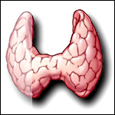
Thyroid Pathophysiology
Christy Dosiou, MD, MS
Clinical Associate Professor - Division of Endocrinology
Stanford University School of Medicine

Slide 2
Learning objectives
At the end of this lecture you should be able to:
Know the clinical implications of thyroid anatomy
Describe thyroid hormone synthesis and regulation of thyroid function
Describe the effects of thyroid hormone and the clinical manifestations of thyroid dysfunction
Discuss the conditions that can cause thyroid dysfunction
Be able to interpret basic thyroid function tests
Discuss the mechanism of action of antithyroid drugs

Slide 3
Why do we care about the thyroid?
The largest endocrine gland
Affects all organ systems
Thyroid disease is very prevalent
Hypothyroidism affects about 4.6% of the US population
Hyperthyroidism affects about 1.3% of the US population
Incidence of thyroid cancer increasing rapidly in recent years
Treatment of thyroid disease is straightforward and highly effective

Slide 4
Outline
1. Thyroid in Health
Anatomy and histology
Thyroid hormone structure
Thyroid hormone synthesis
Iodine and the thyroid
Regulation of thyroid function
Thyroid hormone transport
Thyroid hormone action
Thyroid hormone metabolism

Slide 5
Outline
Thyroid in Disease
A “thyroid-focused” history and physical exam
Laboratory evaluation
Imaging of the thyroid
Hyperthyroidism
Hypothyroidism
Thyroid tests in illness
Thyroid nodules and thyroid cancer

Slide 6
Thyroid
Named by Thomas Wharton in 1659
Thyreos (Greek Θυρεóς): an oblong shield, because it “contributes much to the rotundity and the beauty of the neck, filling up the vacant spaces round the larynx and making its protuberant parts almost to subside, and become smooth, particularly in females, to whom for this reason a larger gland has been assigned, which renders their necks more even and beautiful”
Wharton, Adenographia, 1659

Slide 7
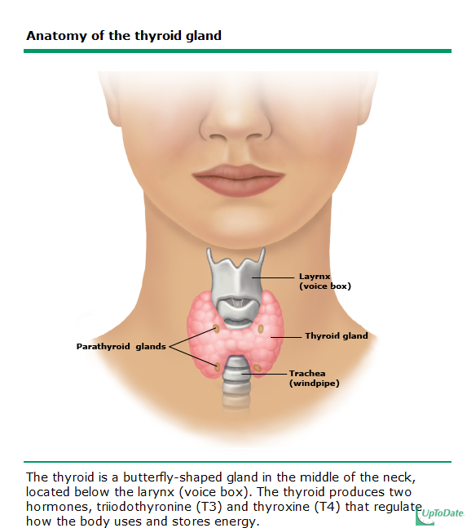

Slide 8
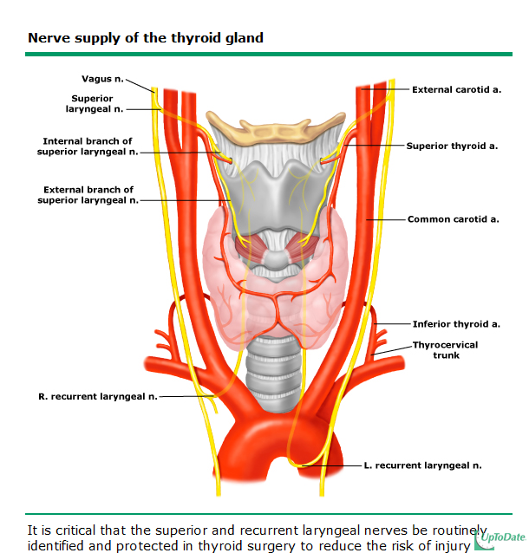

Slide 9
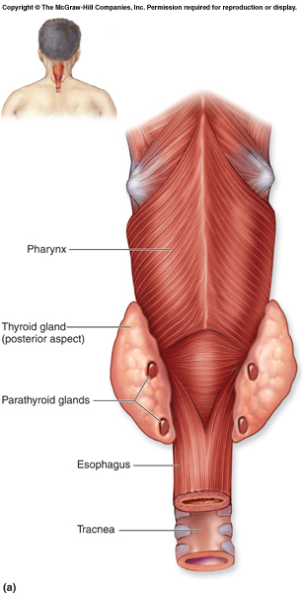
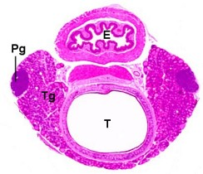
http://reni.item.fraunhofer.de/reni/trimming/manus.php?mno=029
http://academic.kellogg.edu/herbrandsonc/bio201_mckinley/endocrine%20system.htm

Slide 10
Thyroid anatomy: clinical implications
Symptoms caused by enlargement: dysphagia, dyspnea
Risks of thyroidectomy:
parathyroid gland injury
recurrent laryngeal nerve injury

Slide 11
Symptoms/signs of thoracic inlet obstruction by retrosternal goiter
Marked facial plethora
Compression of the jugular veins
- “Thyroid cork”
Basaria et al., NEJM 2004; 350: 1338.

Slide 12
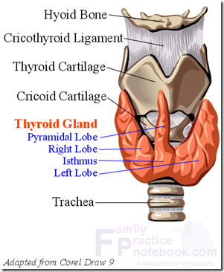
Embryogenesis
The thyroid originates in the 4th week of gestation as an outpouching at the base of the tongue which grows downward.
Migration course is marked by the thyroglossal duct, which usually atrophies by the 10th week.
Portions of the tract and thyroid tissue remnants may persist giving rise to thyroglossal duct cysts, usually presenting as midline cystic upper neck masses.
Pyramidal lobe (caudal remnant) present in about 20%.
Fetal thyroid gland begins to function at 12 weeks gestation.
https://web.duke.edu/anatomy/embryology/craniofacial/headEmbryoImage7.jpg
https://imueos.wordpress.com/2010/05/21/anatomy-of-the-thyroid-gland/

Slide 13
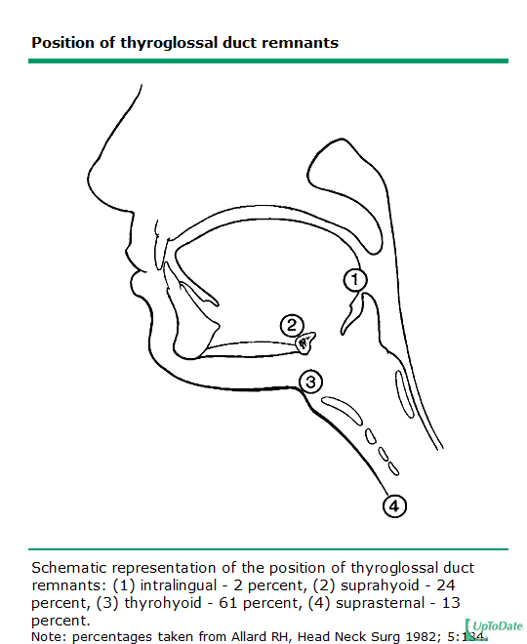
Moaddab MH, Siavash MN Engl J Med 2008; 358:1712

Slide 14
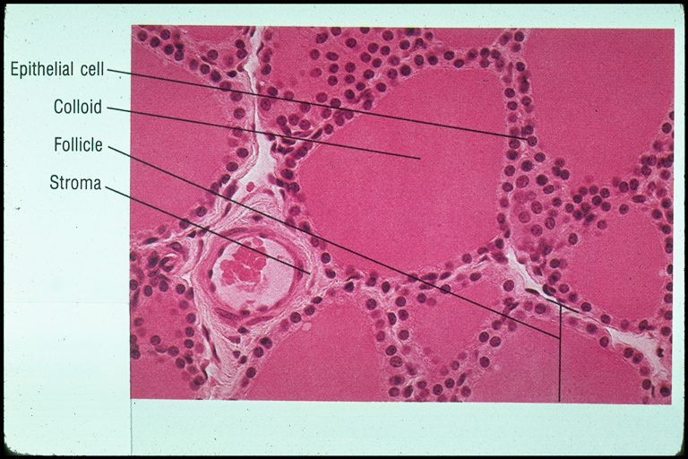
The thyroid follicle

Slide 15
Thyroid gland: Parafollicular cells
Interspersed among the follicles
Produce calcitonin:
Reduces calcium by opposing effects of parathyroid hormone
Minor role in normal calcium homeostasis
Can be used for treatment of acute hypercalcemia
Tumor marker for medullary thyroid cancer

Slide 16
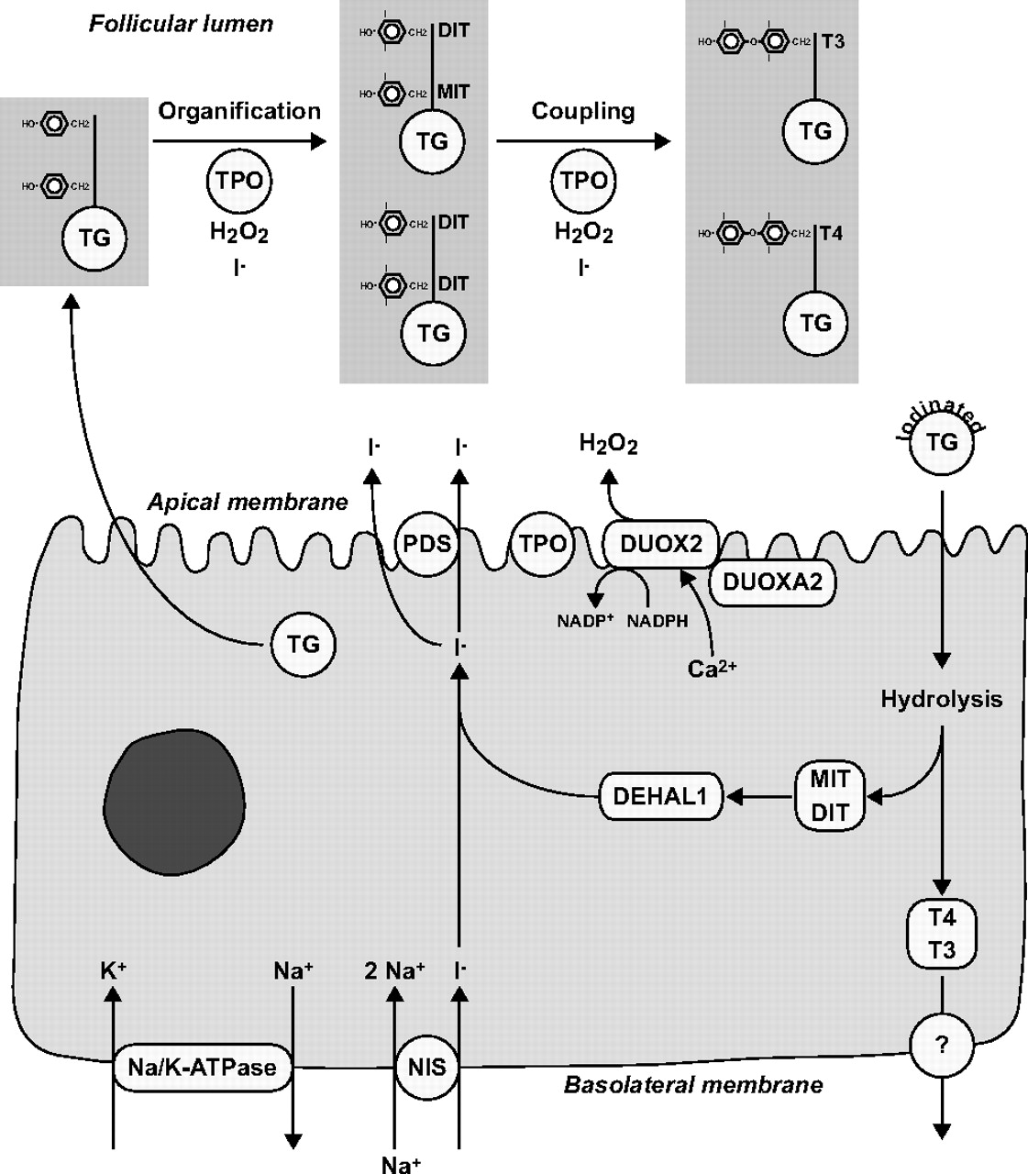
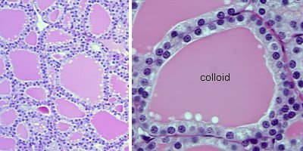
Thyroid gland:
Follicular cells
Bizhanova, A. et al. Endocrinology 2009;150:1084-1090
Copyright ©2009 The Endocrine Society

Slide 17
Thyroid hormone structure
Prohormone
Active hormone
www.uptodate.com

Slide 18
Thyroglobulin
Very large glycoprotein (660 kDa)
132 tyrosines; 20-30 available for iodination
Provides 3 month supply of thyroid hormone
Transcription enhanced by TSH
Useful marker for thyroid cancer

Slide 19
Thyroid hormone
synthesis
Bizhanova, A. et al. Endocrinology 2009;150:1084-1090
Copyright ©2009 The Endocrine Society

Slide 20
Thyroid hormone synthesis
Active transport of I- across basement membrane (NIS)
Oxidation of iodide and iodination of select tyrosyl residues in thyroglobulin (Organification)
Coupling of iodotyrosine molecules within thyroglobulin to form T3 and T4
Endocytosis and proteolysis of thyroglobulin with release of T3 and T4
Deiodination of iodotyrosines and recycling of iodide

Slide 21
Thyroid hormone synthesis
Ross McDougall

Slide 22
T4 and T3
T4: 90% of the thyroid hormone secreted by the thyroid
prohormone; converted to T3 peripherally
t1/2 is 7 days
99.97% protein-bound
T3: active hormone; 10% of the thyroid hormone secreted by the thyroid
produced mainly (80%) by peripheral deiodination of T4
t1/2 is 1 day
99.7% protein- bound
acts through nuclear receptor

Slide 23
Regulation of thyroid function
Autoregulation depending on iodine supply
Hypothalamic-pituitary axis (TRH and TSH)

Slide 24
Iodine and the thyroid
Thyroid hormones are 59% (T3) -65% (T4) iodine by weight
Transported across the basement membrane through the Na+/I- symporter (NIS)
Concentration in the thyroid is 30-40 x that of plasma
NIS activity stimulated by TSH and TSH R Abs; is saturable with large amounts of iodine and competitively inhibited by perchlorate
Iodine also concentrated by salivary, gastric, and breast tissue but those not affected by TSH

Slide 25
Iodine and the thyroid
Enters diet in food and water
Optimal daily intake: 150 mcg for adults; 200 mcg in pregnancy/lactation
If intake is < 50 mcg daily, gland function impaired
Dietary intake in the US higher in the 1980s due to use of iodide as dough conditioner; in the 1990s bromine salts replaced iodine
Other dietary sources: iodized salt, multivitamins, iodine-containing medications, dairy, eggs, saltwater fish, seaweed, shellfish, soy sauce
Thyroid takes up 115 mcg of iodide in 24 hrs

Slide 26
Radioactive iodine: clinical use
1. Hyperthyroidism
2. Thyroid cancer
* Competition of radioiodine tracer with other sources of iodine

Slide 27
Iodine and the thyroid
Autoregulation by thyroid follicular cells protects body from fluctuations in dietary iodide intake
Iodide deficiency:
Increases MIT to DIT ratio
Increased synthesis of T3 relative to T4 and increased T4 to T3 deiodination
Decrease in T4
Increase in TSH
Goiter and in adults hypothyroidism; in neonate may result in cretinism

Slide 28
Worldwide iodine status – 2014
112 countries sufficient
29 deficient
11 with excess
¹Zimmermann and Boelaert, Lancet Diabet Endocrinol 2015; 3:286- 95

Slide 29
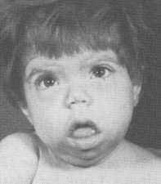
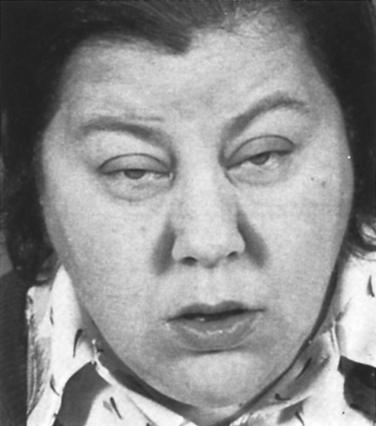
Iodine deficiency
Cretinism
Hypothyroidism

Slide 30
Iodine and the thyroid
Iodide excess:
sudden exposure to high levels results in INHIBITION of iodide organification and therefore decreased thyroid hormone synthesis (Wolff-Chaikoff effect)
within 2-4 weeks organification resumes; likely due to decreased trapping of iodide due to ?decreased NIS activity
“Escape” does not occur in autoimmune thyroid disease
can cause hyperthyroidism (Jod-Basedow effect) in patients with latent Graves’ or multinodular goiters

Slide 31
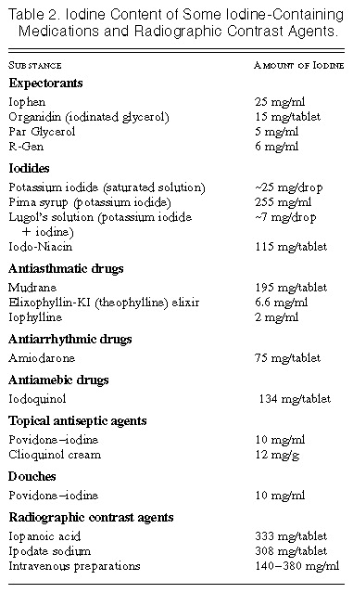
Iodine Content of Some Iodine-Containing
Medications and Radiographic Contrast Agents
Wood AJ et al. N Engl J Med 1995;333:1688-1694.

Slide 32
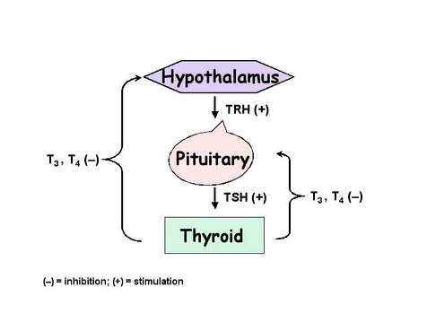
Hypothalamic-Pituitary-Thyroid Axis
yenoh93.medceu.com

Slide 33
Thyrotropin Releasing Hormone
Tripeptide synthesized in the paraventricular nucleus of the hypothalamus
Stimulates synthesis, glycosylation, and release of TSH
Stimulates prolactin synthesis and release
Secretion of TRH is stimulated by:
Decreased T3 and T4
Neuronal “pulse generator”
Secretion of TRH is inhibited by:
Increased T3 and T4
Hypothalamic tumors

Slide 34
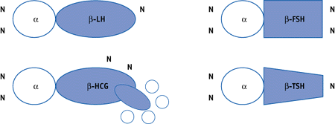
Thyroid Stimulating Hormone
Acts through TSHR (G protein linked), to stimulate cAMP production
Stimulates growth of thyroid cells, iodine uptake, synthesis and release of thyroid hormone
Mutations of TSH receptor can be activating or inactivating
Recombinant TSH used in treatment of thyroid cancer

Slide 35
Thyroid Stimulating Hormone
Synthesis and release is stimulated by:
TRH
Decreased T4 and T3
Synthesis and release is inhibited by:
Increased T4 and T3
Medications (somatostatin, dopamine, glucocorticoids)
Severe illness
Pituitary tumors

Slide 36
Thyroid hormone transport
Both T4 and T3 are mostly protein-bound
T4 is 99.97% protein-bound
T3 is 99.7% protein-bound
Free hormones responsible for hormonal activity, participate in feedback to the pituitary and are subject to metabolism
Binding proteins serve as:
means of transport
a large reservoir of thyroid hormone
protection of tissues from massive hormone release

Slide 37
Thyroid hormone transport
TBG
Synthesized by the liver
High affinity for T3 and T4
Carries about 70% of circulating thyroid hormone
Levels increase in pregnancy, estrogen therapy, hepatitis; decreased by anabolic steroids, glucocorticoids, systemic illness
Transthyretin
Binds 10% of circulating T4; has much less affinity for T3
Albumin
Carries 15% of T4 and T3

Slide 38
TBG and maintenance of Free T4
Normal TT4, Normal FT4
Normal TT4, Low FT4
High TT4, Normal FT4
estrogen
TSH
T4 synthesis
TT4
T
B
G
T
B
G
T
B
G
TT4
TT4
FT4
FT4
FT4

Slide 39
Thyroid hormone transport into cells
Transport depends on thyroid hormone transporters
Differentially expressed in various tissues; allow selective entry of thyroid hormones into cells
Organic anion transporters (e.g. OATP1)
Amino acid transporters (e.g. MCT8)

Slide 40
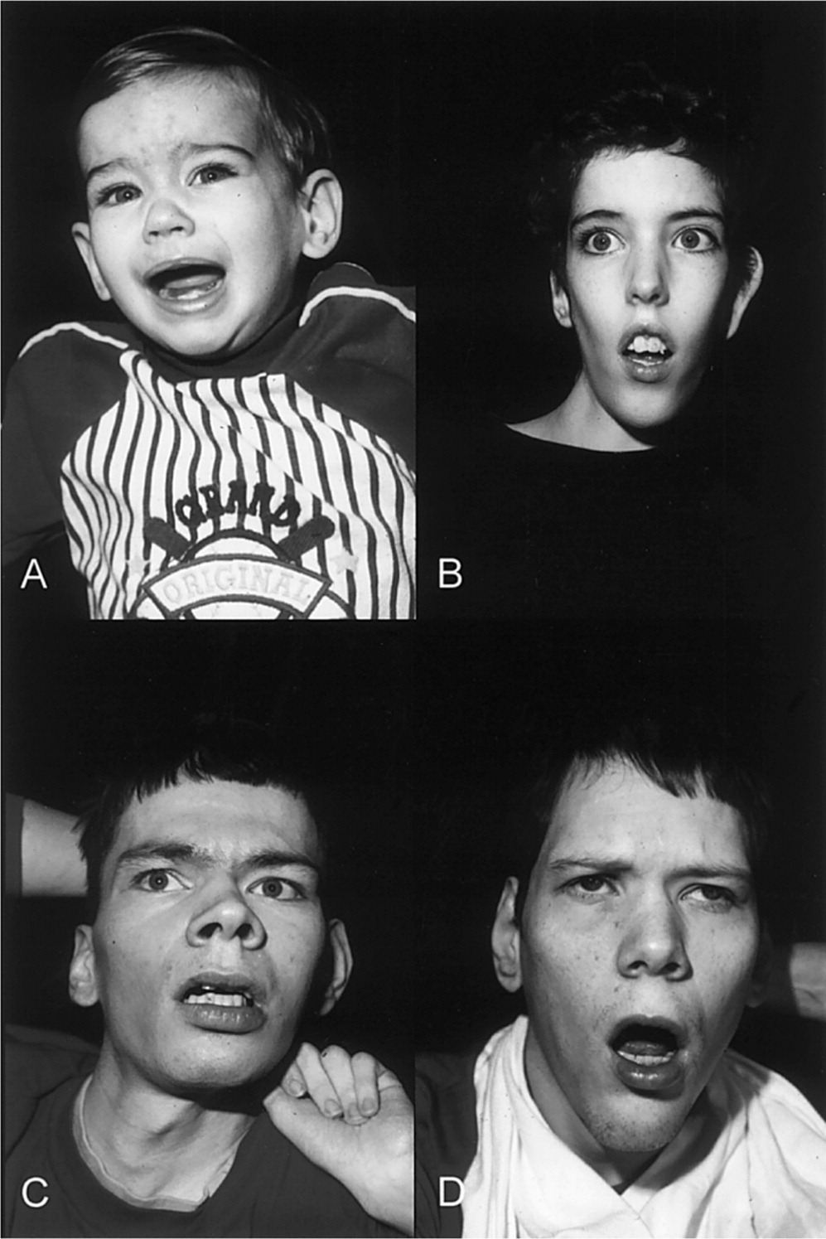
MCT8 mutation and the Allan-Herndon-Dudley Syndrome
Severe X-linked mental retardation
Spastic paraplegia
Abnormal thyroid function tests
Schwartz et al., Am J Hum Genetics 2005, 77:41

Slide 41
Thyroid hormone receptors
TRα (1 and 2) and TRβ (1 and 2) receptors
Concentration varies in tissues, changes during development
TRα1: predominant in skeletal and cardiac muscle, bone, GI tract
TRα2: does not bind T3; function unknown
TRβ1: predominant in liver, kidney, brain
TRβ2: expressed in hypothalamus, anterior pituitary, cochlea
Mutations in TRβ causing lower affinity for T3: thyroid hormone resistance (generalized or pituitary only)
Mutations in TRα: growth and developmental retardation, skeletal dysplasia, constipation

Slide 42
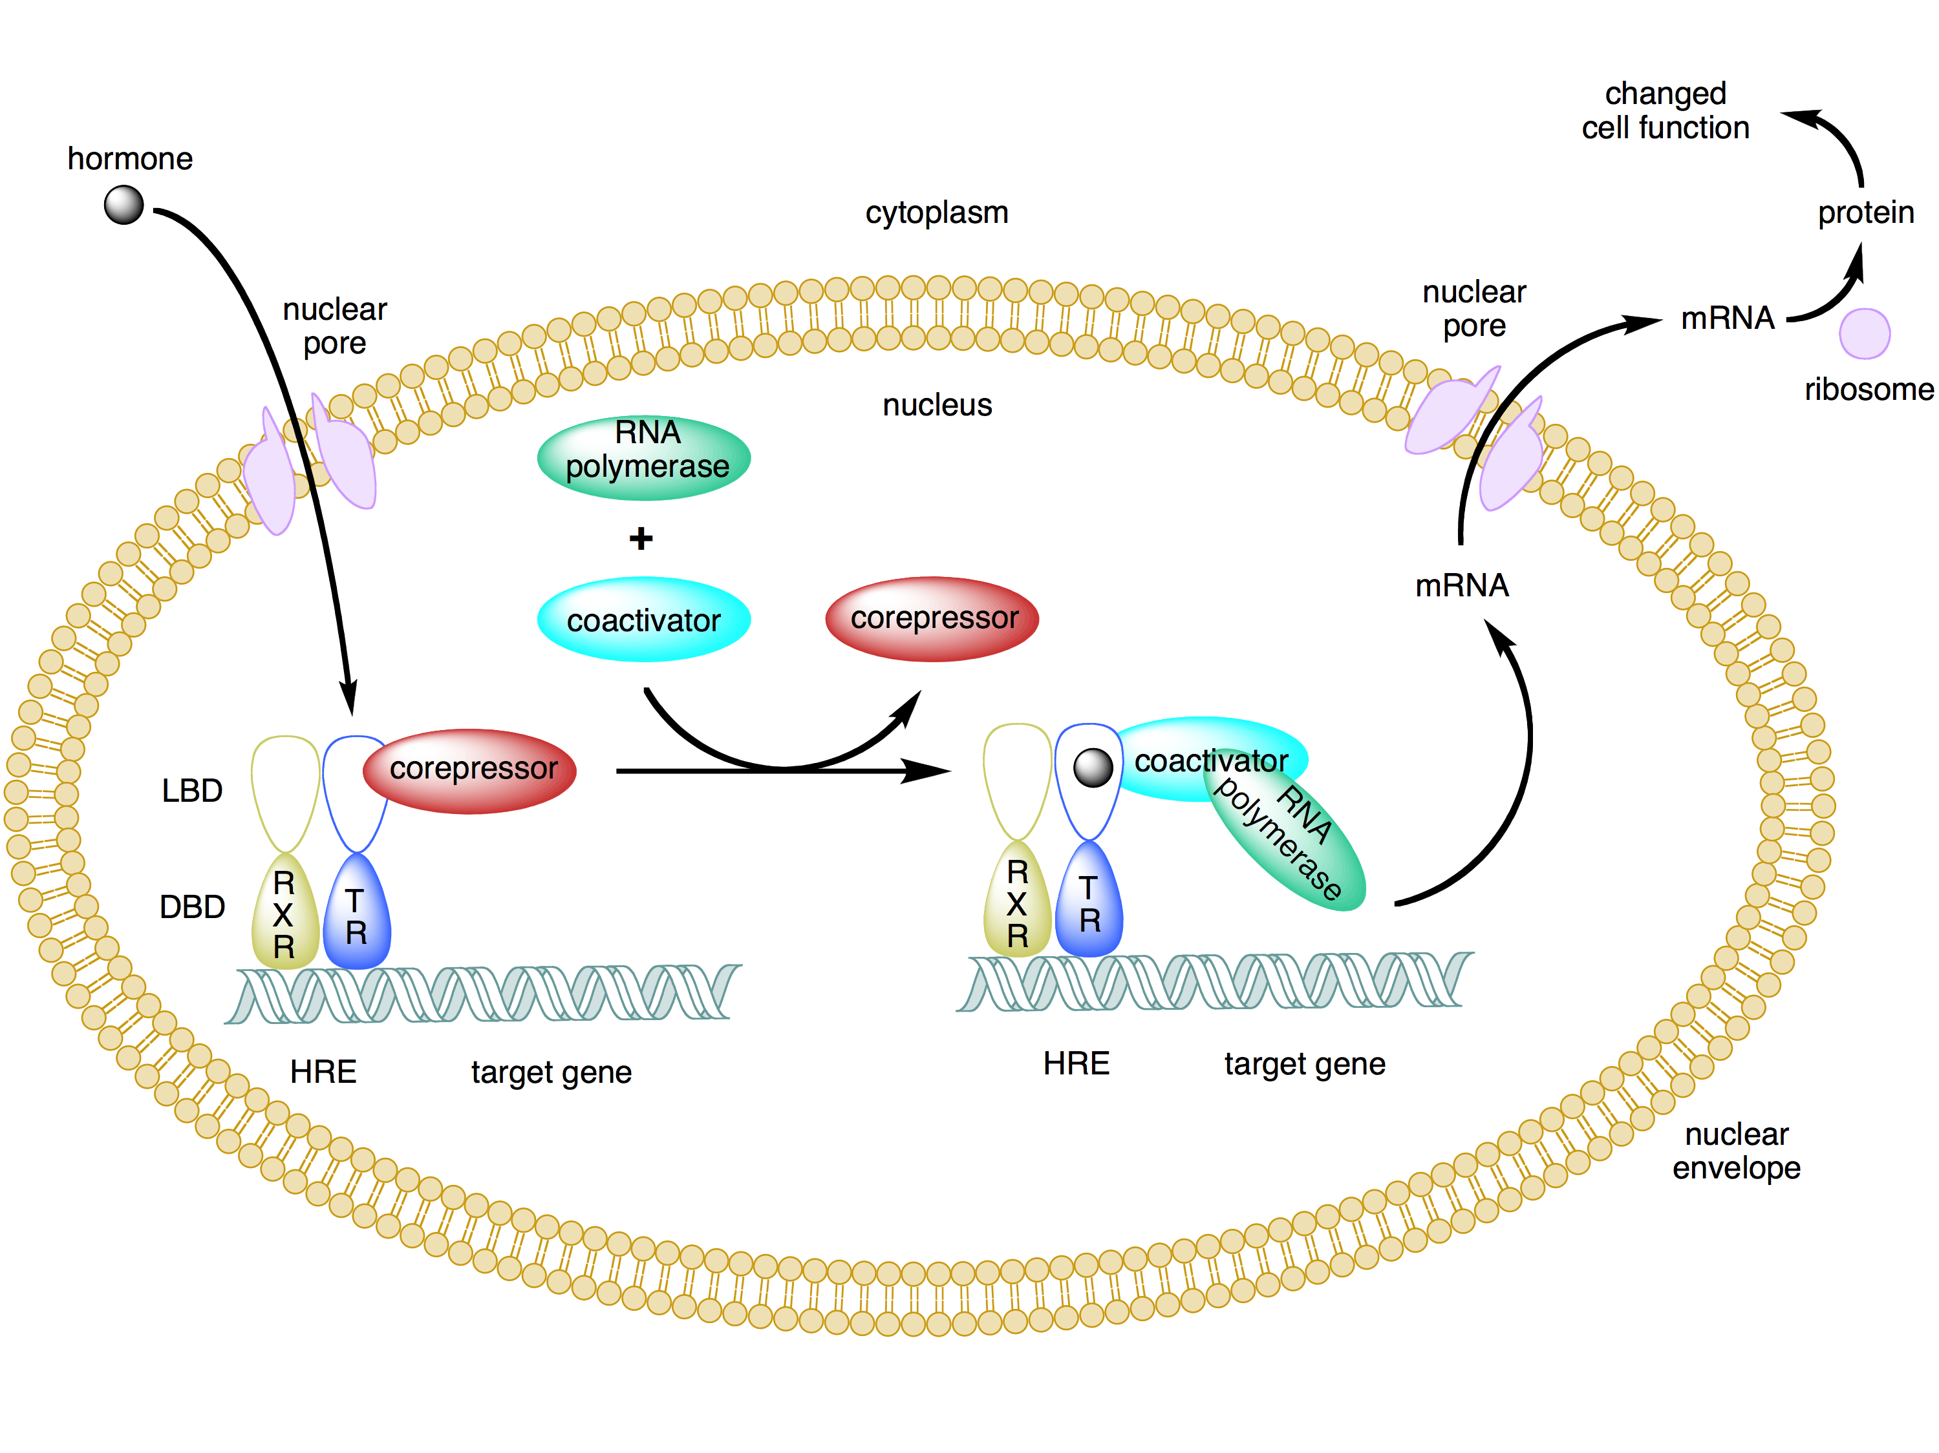
Thyroid hormone action
in the absence of TH, TR represses gene transcription through interaction with corepressor proteins
in the presence of TH, TR activates gene transcription through interaction with coactivator proteins
http://commons.wikimedia.org/wiki/File:Type_ii_nuclear_receptor_action.png

Slide 43
Thyroid hormone actions
Controls growth and development
Brain development (myelination, cerebellum)
Skeletal maturation
Controls metabolism
Stimulates Na+/K+ ATPase
Increases oxygen consumption
Increases heat production
Increases basal metabolic rate

Slide 44
Thyroid hormone actions
CV: inotropy and chronotropy
Sympathetic nervous system: beta-adrenergic receptors , sensitivity to catecholamines
GI: gut motility
Skeleton: bone resorption
Neuromuscular: muscle contraction/relaxation
Lipid/carbohydrate metabolism: glucose absorption, gluconeogenesis, cholesterol synthesis and degradation, lipolysis

Slide 45
Thyroid hormone metabolism
35%
45%
www.thyroidmanager.org

Slide 46
Thyroid hormone deiodinases
Type 1 5’- deiodinase
Most abundant; converts T4 to T3
Expression: liver, kidney, muscle, thyroid
Function: plasma T3 production
Type 2 5’-deiodinase
Converts T4 to T3
Expression: brain, pituitary gland, brown fat
Function: local T3 production; very important in the CNS
Type 3 5-deiodinase
Inactivates T4 to rT3 and T3 to T2
Expression: placenta and glial cells in the CNS
Function: protects fetus and brain from abnormal T4 levels

Slide 47
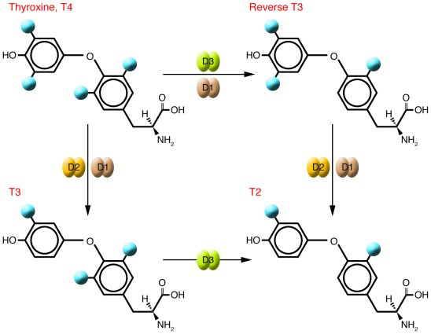
Thyroid hormone deiodinases
http://www.jci.org/articles/view/29812/figure/1

Slide 48
Thyroid in Disease
Disorders of function (commonly autoimmune)
Excess of thyroid hormone – Hyperthyroidism
Deficiency of thyroid hormone – Hypothyroidism
Disorders of structure
Thyroid nodules
Thyroid cancer

Slide 49
A “thyroid-focused” history and physical exam
History:
History of present illness
Past medical history
Medications
Family history
Environmental exposures

Slide 50
A “thyroid-focused” history and physical exam
Physical Exam:
Vital signs
General appearance
Eyes
Thyroid
Neck lymphadenopathy
Cardiac
Hand tremor
Reflexes
Skin

Slide 51
Laboratory tests of thyroid function
Best: TSH, Free T4
Others: Free T3, Total T4, Total T3, Thyroglobulin
Valuable antibodies:
Anti-TPO
Anti-Thyroglobulin (anti-Tg)
Thyroid Stimulating Immunoglobulins (TSI)

Slide 52
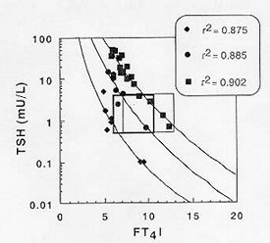
Laboratory tests of thyroid function
TSH: best single test of thyroid function
Inversely related to amount of Free T4 and Free T3
Very sensitive to small changes in thyroid hormone levels
www.thyroidmanager.org

Slide 53
Laboratory tests of thyroid function
TT4, TT3: highly dependent on amount of binding proteins and do not reflect the amount of “active” hormone
Can be used in cases when free thyroid hormone assays do not perform well (TBG extremes) or when cost is an issue
Free T3 levels useful in evaluation of hyperthyroidism
Thyroglobulin: tumor marker in thyroid cancer

Slide 54
Anti-thyroid antibodies
Anti-TPO
Autoimmune thyroid disease
Anti-Thyroglobulin
Autoimmune thyroid disease
Thyroid cancer follow-up
Thyroid Stimulating Immunoglobulins
Graves’ disease

Slide 55
Annual Rate of Development of Overt Hypothyroidism Whickham 20 yr F/U Study
Annual Rate of Development of Overt Hypothyroidism
Vanderpump et al., Clin. Endocrinol., 1995

Slide 56
Thyroid Stimulating Immunoglobulins
TSI
TSI are present in over 90% of cases of Graves’ disease
Are measured by testing the ability of serum or IgG from the patient to stimulate thyroid cells (or cells transfected with the TSHR) to generate cAMP; response compared to that of control serum
A greater than 30% increase compared with control is considered positive

Slide 57
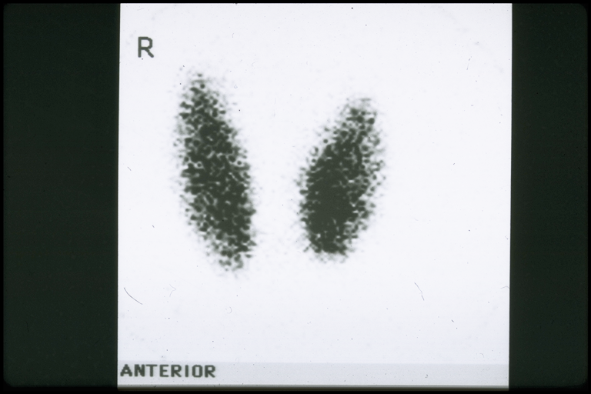
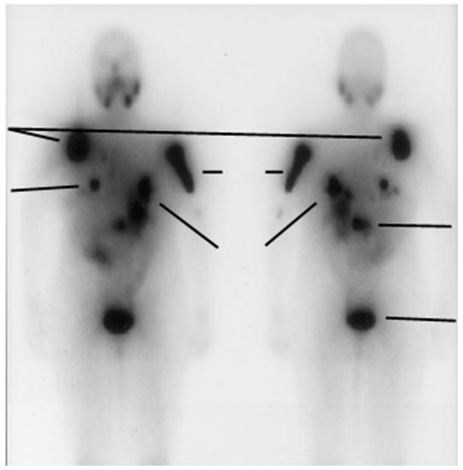
Imaging of the thyroid: I123 and I131 scans
Normal I123 scan
24 hr radioiodine uptake is 8-30%
Whole body scan of pt with metastatic follicular thyroid cancer
http://www.ncbi.nlm.nih.gov/bookshelf/br.fcgi?book=cmed&part=A18676

Slide 58
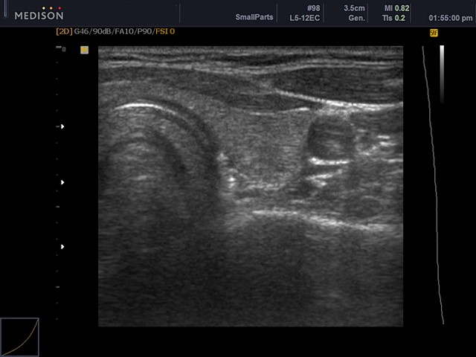
Imaging of the thyroid: Ultrasound
http://www.medison.ru/uzi/eho431.htm

Slide 59
Case 1
19 yro man with a 7 month h/o 25 lb weight loss, fatigue, N/V, diarrhea, palpitations, anxiety, and hand tremors.
PMH: neg. Meds: None.
Family Hx: + for thyroid disease
PE: 73.7 Kg, T 97.2, P 110, BP 142/71
HEENT + lid lag, + stare, + bilateral proptosis (25 mm on L, 26 mm on R), + periorbital edema, diffuse large goiter with no nodules, + thyroid bruits bilaterally
CV: tachycardic but regular rhythm, no m/g/r.
Lungs and Abd benign
Ext: warm, sweaty palms and mild BL hand tremor, no dermopathy, 3+ DTRs
Labs: TSH < 0.01 mIU/L (nl 0.4-4), FT4 4.2 (nl 0.6-1.6 ng/dl)

Slide 60
Hyperthyroidism: Symptoms
Anxiety/irritability, insomnia
Fatigue
Weight loss
Heat intolerance/sweating
Palpitations
Diarrhea
Hand tremor
Irregular menses

Slide 61
Hyperthyroidism
Prevalence: 1.3%
More common in women than in men (5:1 ratio)
Most common cause:
Graves’ disease: autoimmune disorder with TSH receptor-stimulating antibodies
Untreated leads to significant cardiac and bone morbidity
Significant effects on pregnant woman and fetus

Slide 62
DDx of Hyperthyroidism
Graves’ Disease (50-60%)
Toxic Multinodular Goiter (15-20%)
Toxic Adenoma (3-5%)
High HCG levels (pregnancy, trophoblastic disease, testicular tumors)
TSH producing pituitary adenoma
Subacute thyroiditis (granulomatous, medication-induced, lymphocytic, postpartum)
Exogenous thyroid hormone
Ectopic thyroid hormone production (struma ovarii, metastatic follicular thyroid cancer)
Iodine-mediated (IV contrast, amiodarone)

Slide 63
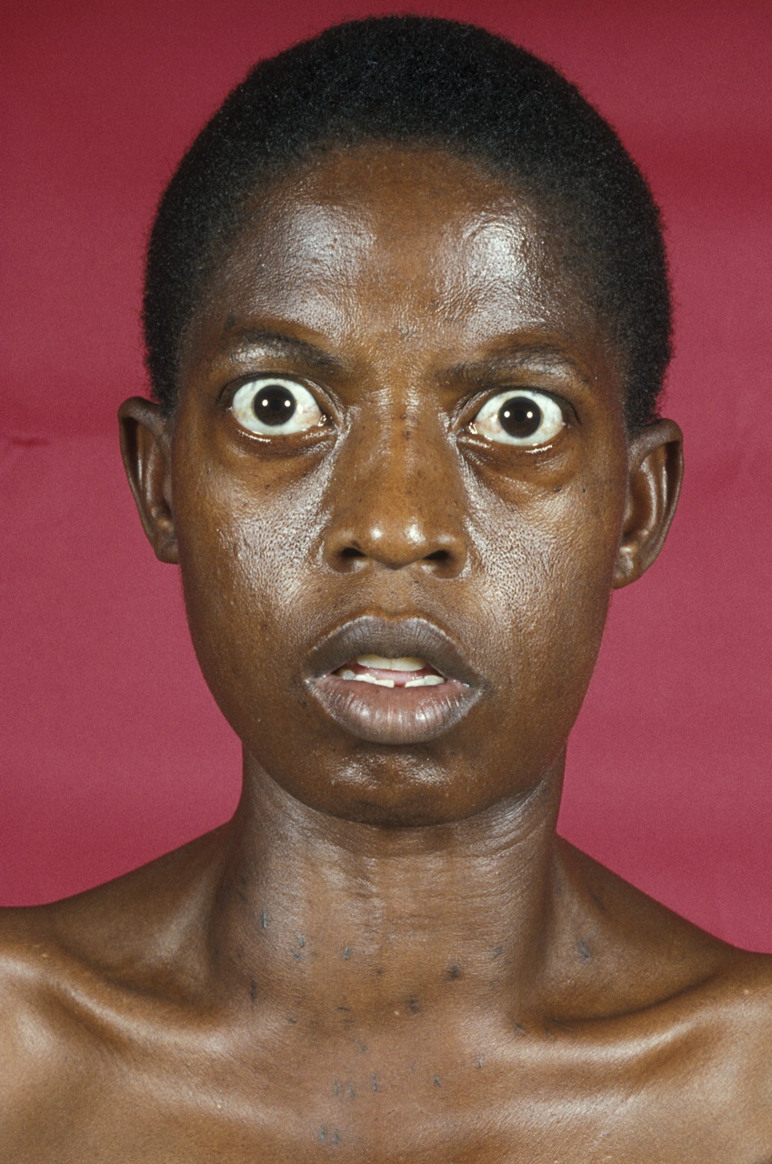
The typical appearance of severe thyrotoxicosis.
Mistry N et al. Pract Neurol 2009;9:145-156
©2009 by BMJ Publishing Group Ltd
Notes:
The typical appearance of severe thyrotoxicosis. Dr M A Ansary/Science Photo Library.

Slide 64
Graves’ Ophthalmopathy

Slide 65
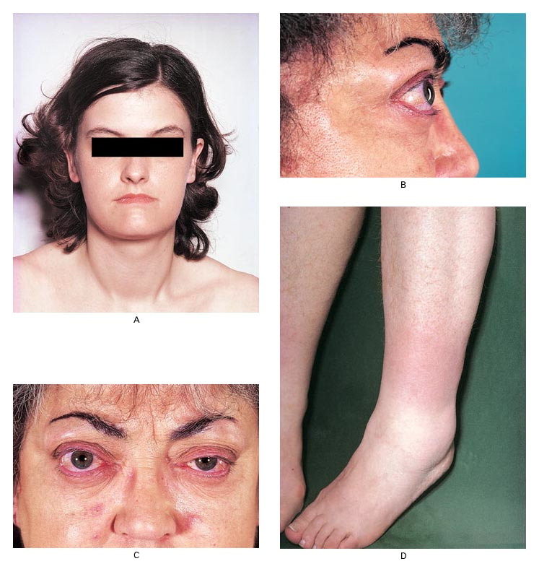
Clinical Manifestations of Graves' Disease
Weetman AP. N Engl J Med 2000;343:1236-1248.
Notes:
Figure 1. Clinical Manifestations of Graves' Disease. Panel A shows diffuse goiter in a 28-year-old woman with Graves' hyperthyroidism. Panels B and C show ophthalmopathy in a 55-year-old woman with Graves' disease, with periorbital edema, chemosis, scleral injection, and proptosis; the lid retraction in this patient is obscured by periorbital edema. Panel D shows localized dermopathy, occurring as an indurated, noninflamed plaque on the anterolateral aspect of the shin of a 47-year-old woman.

Slide 66
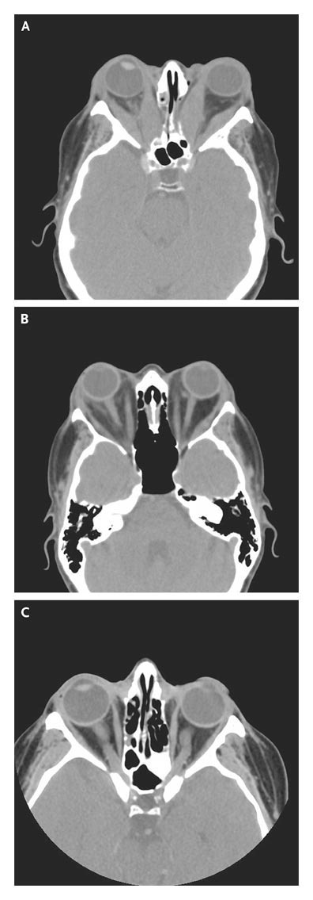
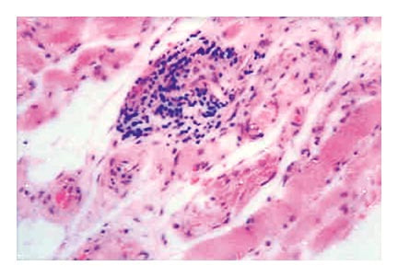
Computed Tomographic Scans of Patients with Graves' Ophthalmopathy and of a Normal Subject
Histologic Appearance of Extraocular Muscle in Graves' Ophthalmopathy (Hematoxylin and Eosin)
Bahn RS. N Engl J Med 2010;362:726-738.
Notes:
Figure 3. Histologic Appearance of Extraocular Muscle in Graves' Ophthalmopathy (Hematoxylin and Eosin). The focal and perivascular interstitial inflammatory mononuclear cell infiltrate is in close association with intact striated extraocular muscle fibers widely separated by amorphous granular material.

Slide 67
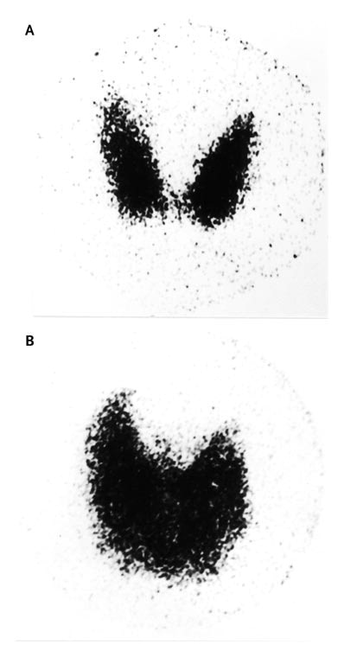
Radioiodine Scans of the Thyroid
Brent GA. N Engl J Med 2008;358:2594-2605.
Notes:
Figure 1. Radioiodine Scans of the Thyroid. Images were obtained 24 hours after ingestion of iodine-123 by a patient with a normal thyroid (Panel A) and a patient with Graves' disease (Panel B). The thyroid of the patient with Graves' disease is larger and concentrates a higher fraction of radioiodine. (Images courtesy of Dr. Jerome Hershman, David Geffen School of Medicine at UCLA, Los Angeles.)‏

Slide 68
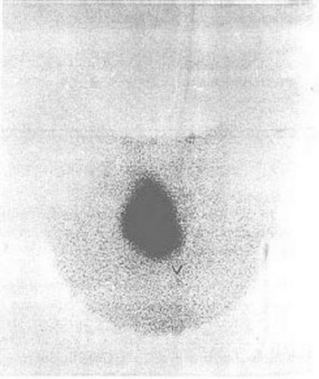
Hyperthyroidism – I 123 scan

Slide 69
Hyperthyroidism: Potential treatment targets
PTU, MTZ
Perchlorate
organification
Serum
I⁻, Li
I-
transport
Surgery, I131
secretion
T4 , T3
PTU, propranolol
Type 1 deiodinase
T4 T3
Peripheral tissues
Effects on target tissues
beta-blockers

Slide 70
Graves’ Disease Treatment
Medical Therapy
Methimazole (or PTU) along with beta blockers
Need to treat for 12-18 months for chance of cure (30%); the rest relapse
Risks: rash, hepatotoxicity, agranulocytosis
Radioactive iodine ablation
Treatment of choice in the US
Risk of permanent hypothyroidism in 80%
Risk of worsening ophthalmopathy
Thyroidectomy
Reserved for patients that cannot receive other tx
Risks: general anesthesia, recurrent laryngeal nerve injury, hypoparathyroidism

Slide 71
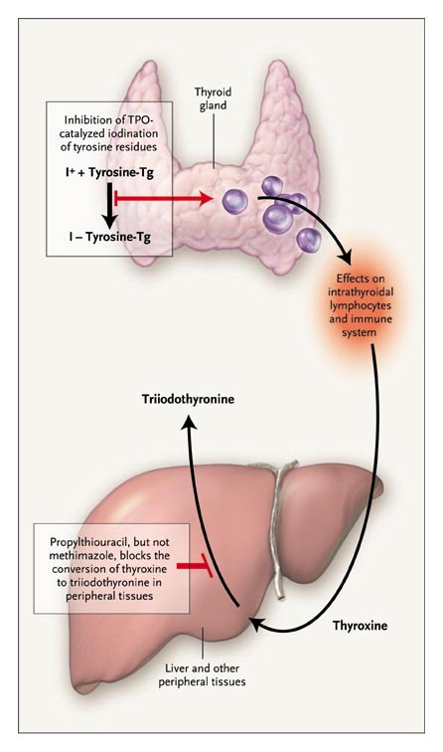
Effects of Antithyroid Drugs
Cooper DS. N Engl J Med 2005;352:905-917.
Notes:
Figure 3. Effects of Antithyroid Drugs. The multiple effects of antithyroid drugs include inhibition of thyroid hormone synthesis and a reduction in both intrathyroidal immune dysregulation and (in the case of propylthiouracil) the peripheral conversion of thyroxine to triiodothyronine. Tyrosine-Tg denotes tyrosine residues in thyroglobulin, I+ the iodinating intermediate, and TPO thyroid peroxidase.

Slide 72
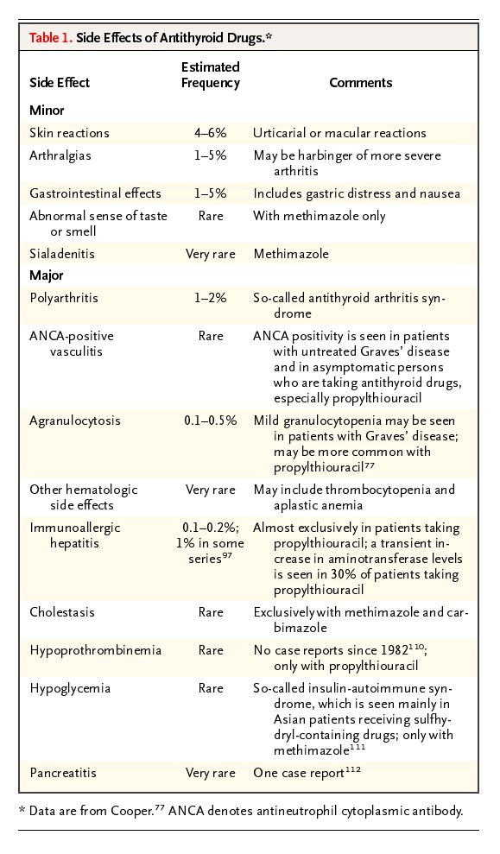
Side Effects of Antithyroid Drugs
Cooper DS. N Engl J Med 2005;352:905-917.

Slide 73
Antithyroid Drugs
Methimazole:
Once/day dosing
Better side effect profile overall
Rare association with congenital defects (methimazole embryopathy) if taken during 1st trimester of pregnancy
Drug of choice in all patients except in 1st trimester
PTU:
Three times/day dosing
Concern regarding hepatotoxicity
Considered safer in 1st trimester of pregnancy

Slide 74
Case 2
42 yro man referred for a low TSH
2 months ago had sore throat and painful swelling in the right neck. + 36 lb intentional weight loss in the past 2 months with diet/exercise. During the past month his symptoms have resolved.
PMH: None. Medications: None. Family history: unremarkable.
PE: 117 Kg, T 36.7, P 63, BP 110/66. HEENT: no lid lag, no stare, no ophthalmopathy. Neck: no thyromegaly or thyroid nodules. No hand tremors. Rest of exam unremarkable.

Slide 75
Case 2: Labs
 | 12/26/06 | 1/2/07 | 2/8/07 | 2/20/07
TSH (0.4-4.0) | 0.04 | 0.05 | 0.27 | 2.04
FT4 (0.6-1.6) | 2.1 | 1.9 | 0.5 | 0.9
TT3 (70-180) | 216 | 257 | 119 | 164

Slide 76
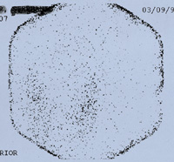
Hyperthyroidism – I 123 scan

Slide 77
Thyroiditis - Classification
Painful
Subacute granulomatous thyroiditis
Infectious thyroiditis
Radiation-induced thyroiditis
Trauma-induced thyroiditis
Painless
Subacute lymphocytic thyroiditis (postpartum, sporadic painless, drug-related)
Chronic lymphocytic thyroiditis (Hashimoto’s)
Amiodarone-associated thyroiditis
Fibrous thyroiditis
www.uptodate.com

Slide 78
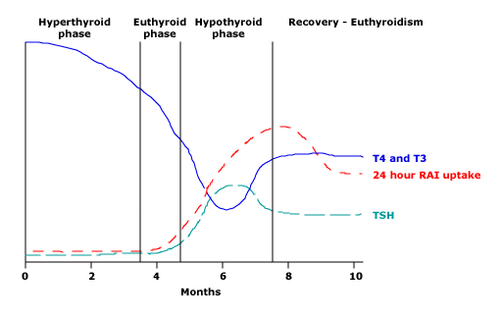
Subacute Thyroiditis – Natural History
* Less than 5% develop permanent hypothyroidism
www.uptodate.com

Slide 79
Thyroiditis - Treatment
Beta blockers may be needed to control sxs of thyrotoxicosis
Thionamides are of no benefit
If painful, use anti-inflammatories for pain
If symptomatic hypothyroidism develops, may benefit from a short course of LT4 replacement

Slide 80
Case 3
43 yro woman referred for a high TSH
Reports a 6 month h/o “strange neck sensation”, associated with dry throat and cough. Also has low energy level, + 10 lb weight gain, + constipation, + cold intolerance, + heavy menses.
FHX: + thyroid disease in mom and aunt.
PE: 83.5 kg, T 36.8, P 74, BP 132/90. Fatigued. + thinning of lateral eyebrows. + mild diffuse goiter. + delayed relaxation phase of Achilles’ DTRs.
Labs: TSH 48 mIU/L (normal 0.4-4), Free T4 0.4 ng/dl (normal 0.6-1.6)

Slide 81
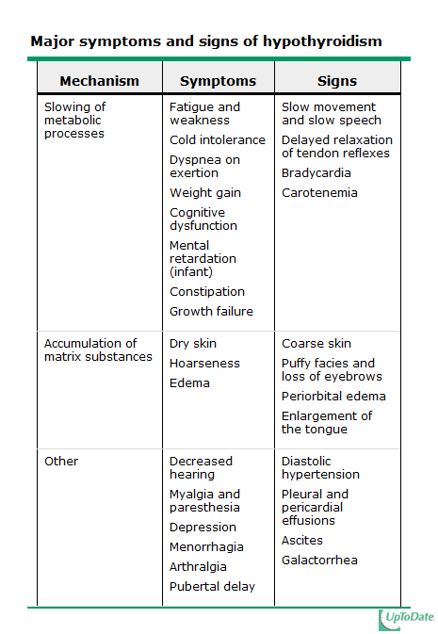
Hypothyroidism
Prevalence: about 4.6%
Most commonly autoimmune in etiology
Women affected more commonly than men (2:1-8:1 ratio)

Slide 82
Hypothyroidism - Causes
Primary (>95%)
autoimmune
iatrogenic
iodine deficiency or excess
medication-induced
infiltrative diseases
congenital
Central (<5%)
Pituitary disease (secondary)
Hypothalamic disease (tertiary)
Thyroid hormone resistance – Very rare
TSH High, Free T4 Low
TSH Low or Normal, Free T4/T3 Low

Slide 83
Facies of severe hypothyroidism
http://www.msdlatinamerica.com/ebooks/IrwinandRippesIntensiveCareMedicinel/sid1528701.html

Slide 84
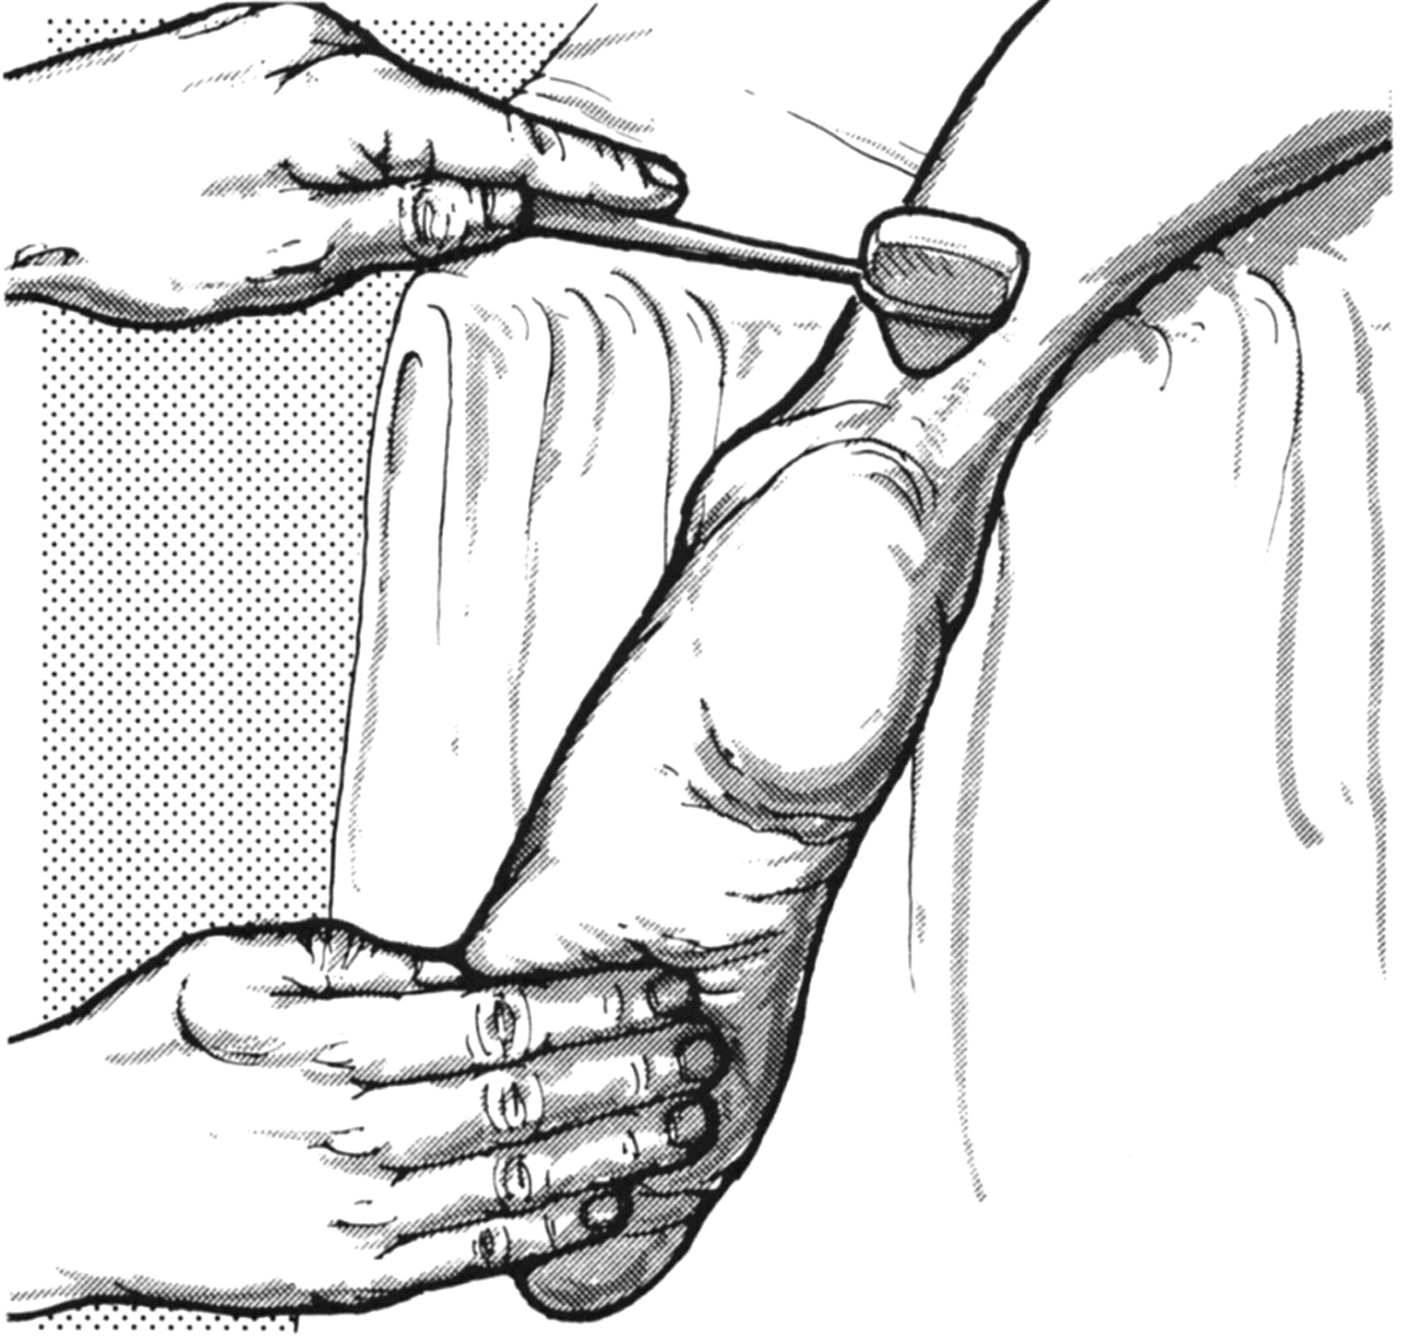
Method for obtaining the ankle-jerk reflex with the patient kneeling.
Mistry N et al. Pract Neurol 2009;9:145-156
©2009 by BMJ Publishing Group Ltd
Notes:
Method for obtaining the ankle-jerk reflex with the patient kneeling.49 Reproduced with permission from Lippincott Williams & Wilkins.

Slide 85
Hypothyroidism - Treatment
Thyroid hormone, usually in the form of T4 preparation
Daily replacement dose needed is about 1.6-1.7 mcg/kg
Can start full dose in young person with no heart disease
Adjust dose every 6 wks if needed
Separate LT4 from Ca, Fe, MVI, soy by at least 4 hrs
In older patients and in patients with known coronary artery disease, start with smaller doses

Slide 86
Hypothyroidism - Treatment
Consider testing glucocorticoid axis in all patients; definitely in all patients with secondary hypothyroidism. Initiating LT4 in the setting of undiagnosed adrenal insufficiency can precipitate adrenal crisis!
Be aware of increased risk for other autoimmune conditions (vitiligo, pernicious anemia).
In secondary hypothyroidism cannot follow TSH: need to follow FT4 and aim to keep FT4 in the middle to high end of normal range.

Slide 87
Sick Euthyroid Syndrome
Abnormal thyroid function tests in seriously ill patients NOT caused by primary thyroid or pituitary dysfunction
Found in up to 70% of hospitalized patients
Mild illness results in decreased 5’-monodeiodinase activity; severe illness can also cause transient central hypothyroidism
Characterized by:
Low T3 and high rT3
More serious illness: low TSH and low Free T4 as well
High TSH levels in the recovery phase

Slide 88
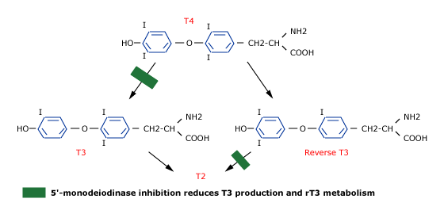
Thyroid hormone metabolism in illness
www.uptodate.com

Slide 89
Thyroid nodules
Prevalent: in 19-67% of the population by thyroid US -- higher frequencies in women and the elderly
Risk of malignancy: 5-10%
First step: check TSH; if low: radioactive iodine uptake and scan
“Hot nodules” are almost never malignant
If TSH NOT low: fine needle aspiration to rule out malignancy
Patients with compressive symptoms or continued nodule growth, even with benign FNA, treated with thyroidectomy

Slide 90
Thyroid cancer
Usually presents as a painless thyroid nodule with normal TSH
Evaluation: thyroid ultrasound and fine needle aspiration
Four types:
Papillary, Follicular: most common, well-differentiated, good prognosis, treated similarly, Tg as marker
Medullary: association with multiple endocrine neoplasia syndromes, calcitonin as marker
Anaplastic: dedifferentiated, aggressive, very poor prognosis
Treatment of well-differentiated thyroid cancer:
Thyroidectomy
Radioactive iodine ablation (I131) – can use recombinant TSH
TSH suppression with thyroid hormone

Slide 91
Summary – Key points
Clinical relevance of thyroid anatomy
Synthesis of thyroid hormone is a complex process highly regulated by the iodide supply and the HP axis
The thyroid hormone plays a very important role in metabolism and in development
Best laboratory tests to evaluate thyroid function are TSH and Free T4
Radioiodine uptake/scan and thyroid ultrasound are the most useful imaging modalities for the thyroid
Hypothyroidism and hyperthyroidism are prevalent, most frequently autoimmune conditions that affect all organ systems and should be readily treated
Thyroid tests can be significantly altered by illness and certain medications
Thyroid tests need to be interpreted in a clinical context; the same set of tests can represent different underlying diseases

