Slide 1
US Airport Public-Private Partnerships (P3s) 2017
A snapshot of the state of privatization efforts in the US
Paul Brown, Principal, Paul Brown Consulting, Inc. (pbrownconsulting.com)
Airport Revenue News Annual Conference and Exposition
March 14, 2017

Slide 2
P3s are a form of Privatization
Airport Privatization: the transfer of ownership or management (or both) of an airport to the private sector.
FAA Airport Privatization Pilot Program
Established in 1996 Reauthorization Act (RA)
Originally included 5 airports
Expanded in 2012 RA to 10 airports
Only 1 major hub (Chicago Midway) allowed to participate

Slide 3
All p3s are Privatizations; not all Privatizations are P3s!
P3s are Partial Privatizations which typically involve limited scope and some form of a lease
Full Privatization means Divestiture by the Government, creating a permanent Private Commercial enterprise, not a P3

Slide 4
Typical Differences Today in P3 Activities
USA P3s
International P3s
Non-aeronautical Commercial Operations (Concessions, Etc.)
Common Area Development and Maintenance
Non-aeronautical Commercial Operations (Concessions, Etc.)
Common Area Development and Maintenance
Terminal Building Construction
Parking
Airport Operations
Airport Security

Slide 5
P3 Financial Challenges
High Capital Investment is paid for by Non-aeronautical Revenues
High Rents to Concessionaires
US Airports typically want debts paid early in lease term

Slide 6
Questions on US P3 future
Will FAA ever broaden P3 scope (i.e., President Trump supports privatizing ATC)?
Will Airport community continue to find P3s appealing?
Will interest in the US Market from Foreign Investors continue to grow?
Will P3s eventually become more financially appealing?

Slide 7
Thank You!

Slide 8
Appendix
Sources of Information, Lists, Etc.

Slide 9
Upcoming US Privatizations
Milwaukee International Airport
San Antonio International Airport
Minneapolis-St. Paul International Airport

Slide 10
2015-2016 US P3 activity
Chicago Midway Airport (SSP/Hudson Group)
New York LaGuardia Airport Central Terminal; (LaGuardia Partners (Vantage, Skanska and others))
Denver International Airport Great Hall (Ferrovial)
Boston Logan International Airport (Pending)

Slide 11
Sources of Information
IATA Economics Briefing: AIRPORT PRIVATISATION by Brian Pearce Chief Economist, IATA 07/04/2005
FAA Airport Compliance Document on Airport Privatization Program, November, 2014
AirportImprovement.com article, “Denver Int’l Expands into Airport City, with Hotel, Conference Center, and Transit Link,” by Jennifer Bradley January-February, 2016.
Economics and Labour Relations Review, “Why Privatise Airports,” by Peter Kriesler,June, 1996 Source Volume: 7 Source Issue: 1
Southern Illinois University Carbondale, “Airport Privatization Movement in the 21st Century,” by Luis M. Camargo, May, 2013.
UK Essays, “The Pros and Cons of Airport Privatization Economics Essay,” March 23, 2015 (no author cited)
Donald Trump Supports Privatizing Air Traffic Control | Fortune.com fortune.com/2017/02/09/donald-trump-air-traffic-privatization/

Slide 12
Some Major International Airport Privatizations
Sales of Assets
Leases of Assets
BRITISH AIRPORTS AUTHORITY (BAA), UK
COPENHAGEN AIRPORT (CPH), DENMARK
VIENNA AIRPORT (VIE), AUSTRIA
ZURICH AIRPORT (ZRH), SWITZERLAND
BRUSSELS AIRPORT (BRU), BELGIUM
AUCKLAND INTERNATIONAL AIRPORT (AIA), NEW ZEALAND
SYDNEY INTERNATIONAL AIRPORT (SYD), AUSTRALIA
PERTH AIRPORT (PER), AUSTRALIA
EZEIZA INTERNATIONAL AIRPORT (EZE), ARGENTINA
JUAN SANTAMARIA INTERNATIONAL AIRPORT (SJO), COSTA RICA
JORGE CHAVEZ INTERNATIONAL AIRPORT (LIM), PERU
ATHENS INTERNATIONAL AIRPORT (AIA), GREECE

Slide 13
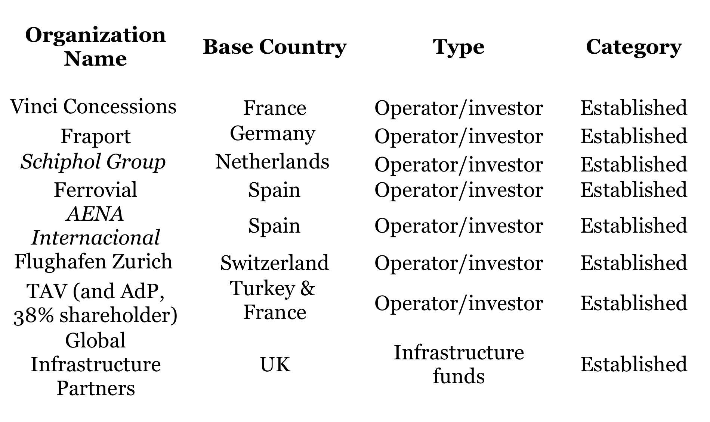
Europe has led the way…

Slide 14
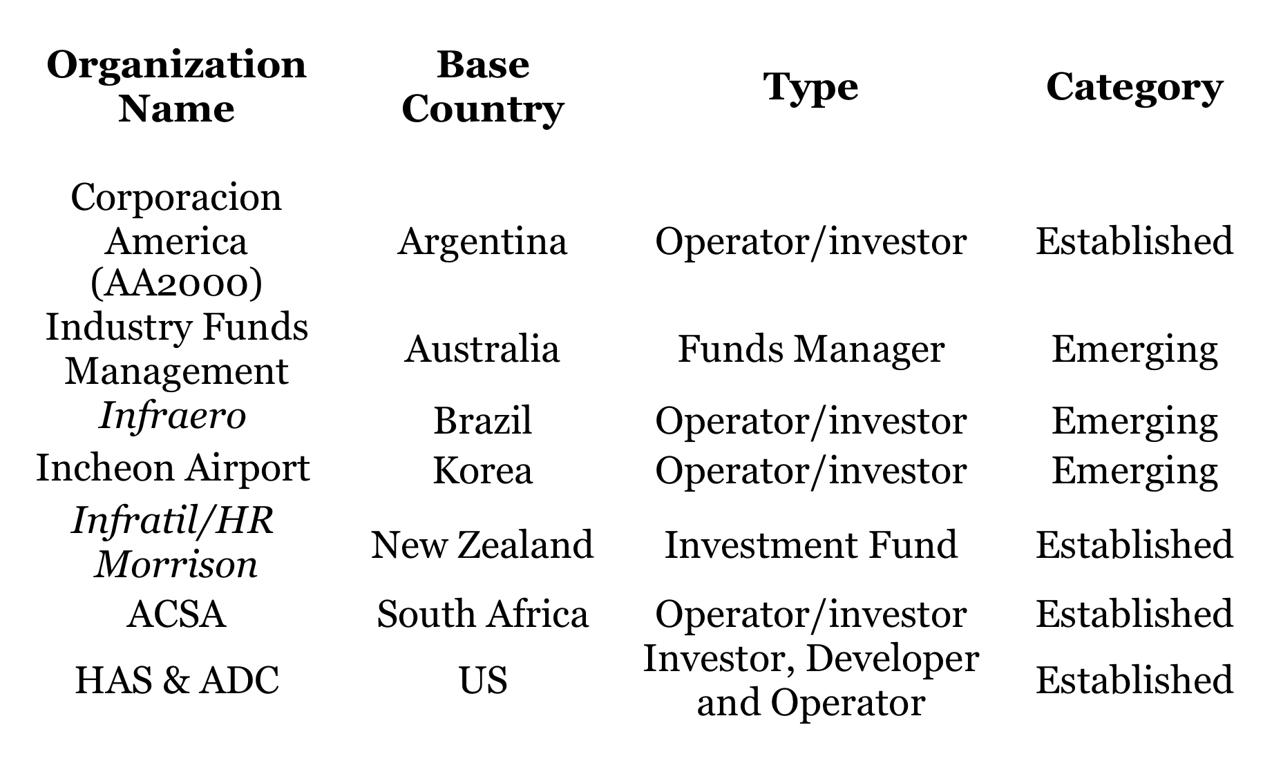
… but the Rest of the World is catchng on!

Slide 15
Not-so-Successful US Privatizations
Chicago Midway Airport (twice!)
New Orleans International Airport (Application withdrawn 2001)
Brown Field Municipal Airport , San Diego, CA (Application withdrawn 2001)
Niagara Falls International Airport, Niagara Falls, NY (Application withdrawn 2001)

