Slide 1
Block Ciphers and the Data Encryption Standard
Information and Network Security
Dr. Hadi AL Saadi

Slide 2
Modern Block Ciphers
The objective of this chapter is to illustrate the principles of modern symmetric ciphers.
The Data Encryption Standard (DES) is the most widely used symmetric cipher,
Although it is destined to be replaced by the Advanced Encryption Standard (AES), DES remains the most widely used algorithm.
It provides secrecy and/or authentication services.

Slide 3
Block vs Stream Ciphers
block ciphers process messages in blocks, each of which is then en/decrypted
like a substitution on very big characters
  64-bits or more
stream ciphers process messages a bit or byte at a time when en/decrypting
many current ciphers are block ciphers
  better analyzed
  broader range of applications

Slide 4
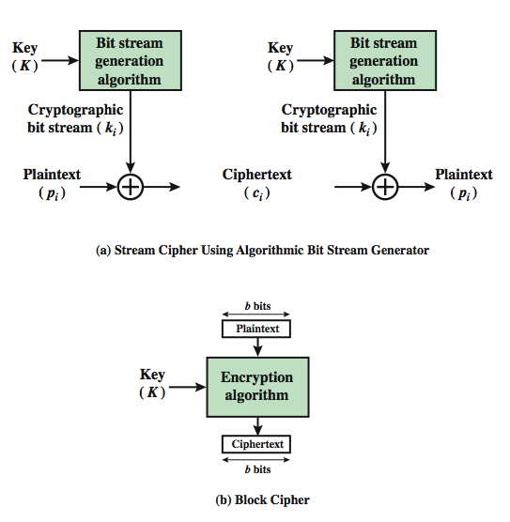
Block vs Stream Ciphers

Slide 5
Block Ciphers and the Data Encryption Standard
Simplified DES
Block Cipher Principles
The Data Encryption Standard
The Strength of DES
Differential and Linear Cryptanalysis
Block Cipher Design Principles
Block Cipher Modes of Operation

Slide 6

Simplified DES
S-DES

Slide 7
Simplified DES
Simplified DES (S-DES) was developed by Professor Edward Schaefer of Santa Clara University.
It is an educational rather than a secure encryption algorithm.
It has similar properties and structure to DES with much smaller parameters.

Slide 8
Simplified DES ( Overview )
The S-DES encryption algorithm takes an 8-bit block of plaintext and a 10-bit key as input and produces an 8-bit block of ciphertext as output.
The S-DES decryption algorithm takes an 8-bit block of ciphertext and the same 10-bit key used to produce the ciphertext as input and produces the original 8-bit block of plaintext as output.
8-bit plaintext
8-bit ciphertext
8-bit ciphertext
8-bit plaintext
Encryption Algorithm
Decryption Algorithm
10-bit key
10-bit key

Slide 9
Simplified DES ( Overview )
The DES encryption algorithm involves five functions:
  An initial permutation (IP);
  A complex function called f_{k}, which involves both permutation and substitution operations and depends on a key input;
  A simple permutation function that switches (SW) the two halves of the data;
  The function f_{k} again;
  A permutation function that is the inverse of the initial permutation (IP⁻¹).

Slide 10
Simplified DES Scheme
10-bit key
ENCRYPTION
P10
DECRYPTION
8-bit plaintext
8-bit plaintext
Shift
IP
IP⁻¹
P8
f_{K}
K₁
K₁
f_{K}
Shift
SW
SW
P8
f_{K}
K₂
K₂
f_{K}
IP⁻¹
IP
8-bit ciphertext
8-bit ciphertext

Slide 11
Simplified DES ( Overview )
The use of multiple stages of permutation and substitution results in a more complex algorithm, which increases the difficulty of cryptanalysis.
The function f_{k} takes as input the data and 8-bit key.
The algorithm can work with 16-bit key, consisting of two 8-bit subkeys, one used for each occurrence of f_{k}, or a single 8-bit key used twice in the algorithm.
A compromise is to use a 10-bit key from which two 8-bit subkeys are generated.

Slide 12
Simplified DES ( Overview )
The S-DES encryption algorithm can be expressed as a composition of functions:
IP⁻¹ ◦ f_{K2} ◦ SW ◦ f_{K1} ◦ IP
It can also be written as
ciphertext = IP⁻¹(f_{K2} (SW(f_{K1}(IP(plaintext)))))
K₁ = P8(Shift(P10(key)))
K₂ = P8(Shift(Shift(P10))))
The S-DES decryption algorithm is expressed as:
plaintext = IP⁻¹(f_{K1} (SW(f_{K2}(IP(ciphertext)))))

Slide 13
Simplified S-DES (S-DES Key Generation)
S-DED depends on the use of a 10-bit key shared between both sender and receiver.
From this key, two 8-bit subkeys are generated for use in stages of the encryption and decryption algorithms.
Steps for Key generation
  Initial permutation P10
  Divide in left and right parts
  Left shift and Merge
  An 8 bits permutation, resulting in a 8 bits K1
  Divide in left and right parts
  Double left shift and Merge
  An 8 bits permutation, resulting in a 8 bits K2

Slide 14
Simplified S-DES (S-DES Key Generation)
10
LS-1: Left-Shift 1-bit
LS-2: Left Shift 2-bit
P10
5
5
LS-1
LS-1
5
5
P8
K₁
8
LS-2
LS-2
5
5
P8
K₂
8
Key generation for simplified DES

Slide 15
Simplified S-DES
P-Boxes
  P10
  P8
  P4
3 | 5 | 2 | 7 | 4 | 10 | 1 | 9 | 8 | 6
6 | 3 | 7 | 4 | 8 | 5 | 10 | 9
2 | 4 | 3 | 1
1 | 2 | 3 | 4

Slide 16
Simplified S-DES (S-DES Key Generation)
Example of key generation:
  Key:
  P10:
  Split:
  Lshift:
  P8:
  2 Lshift:
  P8:
1 | 0 | 1 | 0 | 0 | 0 | 0 | 0 | 1 | 0
1 | 0 | 0 | 0 | 0 | 0 | 1 | 1 | 0 | 0
1 | 0 | 0 | 0 | 0 | 0 | 1 | 1 | 0 | 0
0 | 0 | 0 | 0 | 1
1 | 1 | 0 | 0 | 0
1 | 0 | 1 | 0 | 0 | 1 | 0 | 0
K1
0 | 0 | 1 | 0 | 0
0 | 0 | 0 | 1 | 1
0 | 1 | 0 | 0 | 0 | 0 | 1 | 1
K2

Slide 17

Simplified S-DES (S-DES Key Generation)
Worked Example for 10-bit input key (1010000010)
P10
3 | 5 | 2 | 7 | 4 | 10 | 1 | 9 | 8 | 6
K₁
10100100
P8
6 | 3 | 7 | 4 | 8 | 5 | 10 | 9
K₂
01000011

Slide 18
Simplified DES (S-DES Encryption)
S-DES encryption involves the sequential application of the five functions mentioned earlier.
Initial and Final Permutation
IP
2 | 6 | 3 | 1 | 4 | 8 | 5 | 7
IP⁻¹
4 | 1 | 3 | 5 | 7 | 2 | 8 | 6
IP⁻¹ ( IP (X) ) = X

Slide 19
Simplified DES (S-DES Encryption)
The Function f_{K}
The most complex component of S-DES encryption is the function f_{K}, which consists of permutation and substitution functions. The function is expressed as:
L and R are the leftmost 4 bits and rightmost 4 bits of the 8-bit input of f_{K}.
F is a mapping from 4-bit strings to 4-bit strings.
SK is a subkey.
⊕ is the bit-by-bit exclusive OR function.

Slide 20
Simplified DES (S-DES Encryption)
The Function F
The function F is taken from S0 and S1, such as:
  R is expanded by E
  The expansion is xored with the subkey
  The first 4 bits are the input for S0 the last are input to S1
  If the input to Si is I₁I₂I₃I₄, then I₁I₄ is the row to consider and I₂I₃ is the column
  The output goes then through P4

Slide 21
Simplified DES Scheme Encryption Detail
8-bit plaintext
8
IP
4
4
4
4
f_{K}
f_{K}
E/P
4
E/P
4
8
8
8
K₂
8
K₁
4
4
4
4
S0
S1
S0
S1
2
2
2
2
P4
P4
4
4
4
4
IP⁻¹
8
8-bit ciphertext

Slide 22
Plain text
1 | 1 | 1 | 1 | 0 | 0 | 1 | 1
Initial Permutation
IP
2 | 6 | 3 | 1 | 4 | 8 | 5 | 7
Output of IP
1 | 0 | 1 | 1 | 1 | 1 | 0 | 1
Compute F function
L
R
Divide the IP o/p into two half's (L & R)
1 | 0 | 1 | 1
1 | 1 | 0 | 1
Apply Expansion / Permutation E/ P to input 4 bits ( R)
E/P
4 | 1 | 2 | 3 | 2 | 3 | 4 | 1
1 | 1 | 1 | 0 | 1 | 0 | 1 | 1

Slide 23
Add the Output of E/P to sub key (k1) use ( XOR)
K1
1 | 0 | 1 | 0 | 0 | 1 | 0 | 0
⊕
Output of E/P
1 | 1 | 1 | 0 | 1 | 0 | 1 | 1
0 | 1 | 0 | 0 | 1 | 1 | 1 | 1
Pass the left 4 bits to S-Box S0
And the right 4 bits to S-Box S1
To S0
To S1

Slide 24
S- Box Operation
First and fourth bits give row number
Second and third give column number
Look-up number in specified row and column
Covert to Binary
For L which is the input to S0
0 | 1 | 0 | 0
Row=00 col=10 (2) → the output of S0=3 ( 11)
For R which is the input to S1
1 | 1 | 1 | 1
Row=11 (3) col=11 (3) → the output of S1=3 ( 11)
The output of S-Box is
1 | 1 | 1 | 1
Apply Permutation P4
P4
2 | 4 | 3 | 1
The output of F Function
1 | 1 | 1 | 1

Slide 25
The Function f_{K}
The output of F Function
1 | 1 | 1 | 1
L ( The leftmost 4-bits of IP
Output)
1 | 0 | 1 | 1
L Xor output of F
0 | 1 | 0 | 0
R ( The Rightmost 4-bits of IP
Output)
1 | 1 | 0 | 1
The 0utput of Function f_{K}
0 | 1 | 0 | 0
1 | 1 | 0 | 1

Slide 26
Simplified DES (S-DES Encryption)
The Switch Function
The function f_{K} only alters the leftmost 4 bits of the input.
The switch function (SW) interchanges the left and right 4 bits so that the second instance of f_{K} operates on a different 4 bits.
In the second instance, the E/P, S0, S1, and P4 functions are the same.
The key input is K₂.

Slide 27
Simplified DES (S-DES Encryption)
  f_{K1} (1011 1101) = (L⊕F(R, K₁), R)
  = (1011⊕1111,1101) = 0100 1101
  SW (0100 1101)= 1101 0100 = L || R
  F(R, K₂)
    E/P (0100) ⊕ K₂= 00101000 ⊕ 01000011 = 01101011
    S0 (0110) = 10
    S1 (1011) = 01
    P4 (1001) = 0101
  f_{K2}(1101 0100) = (L⊕F(R, K₂), R)
  = (1101⊕0101, 0100) = 1000 0100
  IP⁻¹ (10000100) = 01000001
Ciphertext C=01000001

Slide 28
Simplified DES (S-DES Decryption)
10-bit key
C = IP⁻¹ • f_{K2} • SW • f_{K1} • IP (P)
IP⁻¹ • f_{K1} • SW • f_{K2} • IP (C)
= IP⁻¹ • f_{K1} • SW • f_{K2} • IP • IP⁻¹ • f_{K2}
• SW • f_{K1} • IP (P)
= IP⁻¹ • f_{K1} • SW • f_{K2} • f_{K2}
• SW • f_{K1} • IP (P)
= IP⁻¹ • f_{K1} • SW • SW • f_{K1} • IP (P)
= IP⁻¹ • f_{K1} • f_{K1} • IP (P)
= IP⁻¹ • IP (P)
= P
ENCRYPTION
P10
DECRYPTION
8-bit plaintext
8-bit plaintext
Shift
IP
IP⁻¹
P8
f_{K}
K₁
K₁
f_{K}
Shift
SW
SW
P8
f_{K}
K₂
K₂
f_{K}
IP⁻¹
IP
8-bit ciphertext
8-bit ciphertext

Slide 29
Simplified DES (S-DES Decryption)
Only sub-keys are fed in reverse order
SW • SW = I (identity)
IP⁻¹ • IP = IP • IP⁻¹ = I (identity)
f_{K1} • f_{K1} (X,Y) = f_{K1}(X⊕F(Y, K₁), Y)
= (X⊕F(Y, K₁)⊕F(Y, K₁), Y)
= (X, Y)
f_{K2} • f_{K2} (X,Y) = f_{K2}(X⊕F(Y, K₂), Y)
= (X⊕F(Y, K₂)⊕F(Y, K₂), Y)
= (X, Y)

Slide 30
Simplified DES (S-DES Decryption)
Generate sub-keys in reverse order
P10(K)=k1 k2 … k10
Encryption
  LS-1(k1 k2 k3 k4 k5) = k2 k3 k4 k5 k1
  LS-2 (k2 k3 k4 k5 k1) = k4 k5 k1 k2 k3
Decryption
  RS-2 (k1 k2 k3 k4 k5) = k4 k5 k1 k2 k3
  RS-2 (k4 k5 k1 k2 k3) = k2 k3 k4 k5 k1

Slide 31
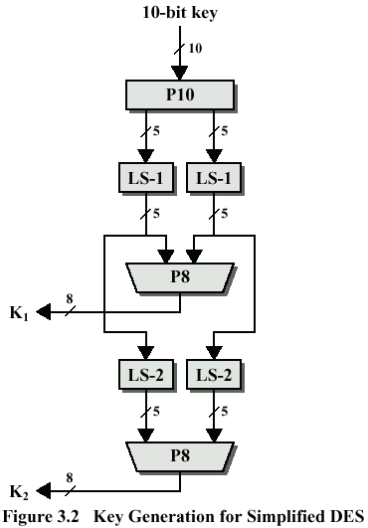
Generate sub-keys in reverse order
RS-2
RS-2
RS-2
RS-2

Slide 32
Simplified DES (Analysis of S-DES)
A brute-force attack on S-DES is certainly feasible, since for 10-bit key, there are only 1024 possibilities.
Given a ciphertext, an attacker can try each possibility and analyse the result to determine if it is a reasonable plaintext.
Notes:
Modern block ciphers are widely used to provide encryption of quantities of information, and/or a cryptographic checksum to ensure the contents have not been altered. We continue to use block ciphers because they are comparatively fast, and because we know a fair amount about how to design them.

Slide 33
Simplified DES (Analysis of S-DES)
Cryptanalysis attack can be performed in two different ways:
  Derive 8 nonlinear equations with 10 unknowns. There are a number of solutions, but each of these could be calculated and then analysed.
  Each of the permutations and additions in the algorithm is a linear mapping. The nonlinearity comes from the S-boxes. Alternating linear maps with the S-boxes nonlinear maps results in very complex polynomial expressions for the ciphertext bits, making cryptanalysis very difficult.
Notes:
Modern block ciphers are widely used to provide encryption of quantities of information, and/or a cryptographic checksum to ensure the contents have not been altered. We continue to use block ciphers because they are comparatively fast, and because we know a fair amount about how to design them.

Slide 34
Simplified DES (Relationship to DES)
DES operates on 64-bit blocks of input.
The encryption scheme can be defined as:
IP⁻¹ ◦ f_{K16} ◦ SW ◦ f_{K15} ◦ SW ◦ … ◦ SW ◦ f_{K1} ◦ IP
A 56-bit key is used, from which sixteen 48-bit subkeys are calculated.

Slide 35
Simplified DES (Relationship to DES)
The sequence of operations are as follows:
  Initial permutation of 56-bit followed by a sequence of shifts and permutations of 48 bits.
  Within the encryption algorithm, instead of F acting on 4 bits (n₁, n₂, n₃, n₄), it acts on 32 bits (n₁, …, n₃₂).
  After the initial E/P, the output of 48 bits can be diagrammed as:
n₃₂
n₄
•
•
•
n₂₈
n₁
n₅
•
•
•
n₂₉
n₂
n₆
•
•
•
n₃₀
n₃
n₇
•
•
•
n₃₁
n₄
n₈
•
•
•
n₃₂
n₅
n₉
•
•
•
n₁

Slide 36
Simplified DES (Relationship to DES)
  This matrix is added (XOR) to a 48-bit subkey.
  There are 8 rows corresponding to 8 S-boxes.
  Each S-box has 4 rows and 16 columns.
  The first and the last bit of a row of the preceding matrix picks out a row of an S-box, and the middle 4 bits pick out a column.

Slide 37
Block Cipher Principles
Most symmetric block ciphers are based on a Feistel Cipher Structure.
Needed since must be able to decrypt ciphertext to recover messages efficiently.
Block ciphers look like an extremely large substitution.
Would need table of 2⁶⁴ entries for a 64-bit block.
Instead create from smaller building blocks.
Using idea of a product cipher.

Slide 38
A block cipher operates on a plaintext block of n bits to produce a ciphertext of n bits.
There are 2^{n} possible different plaintext blocks, and, for the encryption to be reversible (i.e., for decryption to be possible), each plaintext must produce a unique ciphertext block (reversible or nonsingular transformation, also called reversible or nonsingular mapping).
For reversible mapping of n bits block, the number of different transformation is limited to 2^{n}!.

Slide 39
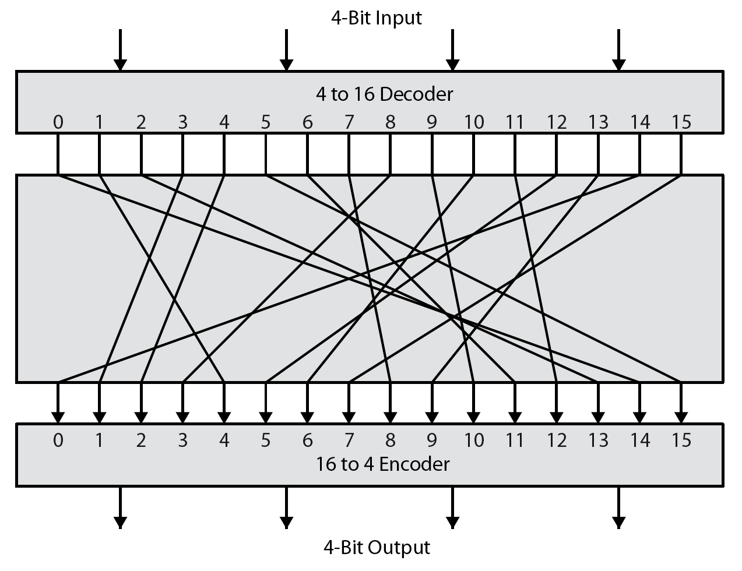
Ideal Block Cipher
Notes:
Feistel refers to an n-bit general substitution as an ideal block cipher, because it allows for the maximum number of possible encryption mappings from the plaintext to ciphertext block. A 4-bit input produces one of 16 possible input states, which is mapped by the substitution cipher into a unique one of 16 possible output states, each of which is represented by 4 ciphertext bits. The encryption and decryption mappings can be defined by a tabulation, as shown in Stallings Figure 3.2. It illustrates a tiny 4-bit substitution to show that each possible input can be arbitrarily mapped to any output - which is why its complexity grows so rapidly.

Slide 40
The Feistel Cipher
Horst Feistel proposed an approximation that can be used to simplify the ideal block substitution cipher for large n, by utilizing the concept of a product cipher.
Feistel suggested performing two or more basic cipher in sequence, in such a way that the final result or product is cryptographically stronger than any of the component ciphers.
Feistel proposed the use of a cipher that alternates substitutions and permutations.
In fact, this is a practical application of a proposal by Claude Shannon (1949) to develop a product cipher that alternates confusion and diffusion functions.

Slide 41
Confusion and Diffusion
Terms courtesy of Claude Shannon, father of Information Theory
“Confusion” = Substitution
  a -> b
  Caesar cipher
“Diffusion” = Transposition or Permutation
  abcd -> dacb
  DES

Slide 42
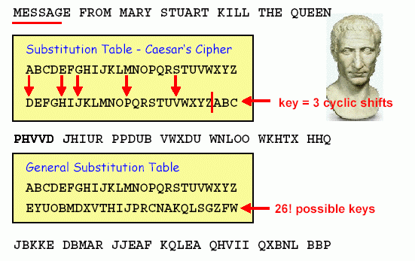
Confusion and Diffusion
“Confusion” : a classical Substitution Cipher
The idea of confusion is to hide the relationship between the ciphertext and the key.
Modern substitution ciphers take in N bits and substitute N bits using lookup table: called S-Boxes

Slide 43
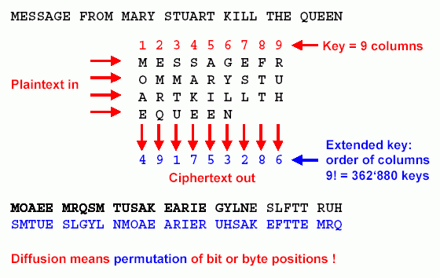
Confusion and Diffusion
“Diffusion” : a classical Transposition cipher
The idea of diffusion is to hide the relationship between the ciphertext and the plaintext.
modern Transposition ciphers take in N bits and permute using lookup table : called P-Boxes

Slide 44
Confusion and Diffusion
Shannon suggests to thwart “statistical analysis”
Confusion
  Blur the relation between the ciphertext and the encryption key
  Substitution
Diffusion
  Each ciphertext alphabet is affected by many plaintext alphabet
  Repeated permutations
Rounds
Diffusion and confusion can be achieved using iterated product ciphers where each iteration is a combination of S-boxes, P-boxes, and other components.

Slide 45
Product Ciphers
Shannon introduced the concept of a product cipher. A product cipher is a complex cipher combining substitution, permutation, and other components discussed in previous sections.

Slide 46
Feistel Cipher Structure
Feistel devised the Feistel cipher based on concept of invertible product cipher.
  Partitions input block into two halves.
  Process through multiple rounds which perform a substitution on left data half based on round function of right half and subkey.
  Permutation swapping halves.
Feistel implements Shannon’s substitution-permutation network concept.

Slide 47
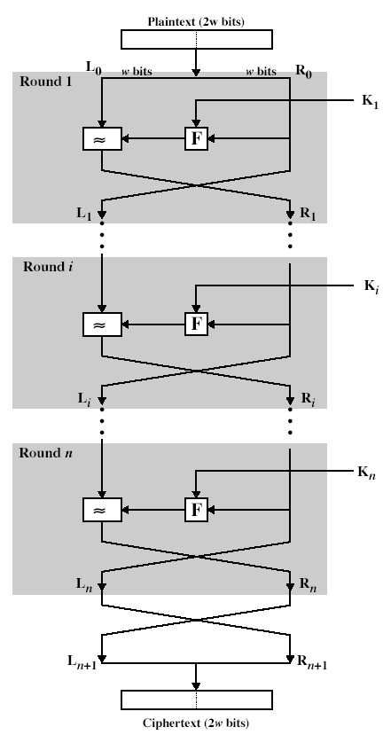
Classical Feistel Network

Slide 48
Feistel Cipher Design Principles
block size
  increasing size improves security, but slows cipher
key size
  increasing size improves security, makes exhaustive key searching harder, but may slow cipher
number of rounds
  increasing number improves security, but slows cipher
subkey generation
  greater complexity can make analysis harder, but slows cipher
round function
  greater complexity can make analysis harder, but slows cipher
fast software en/decryption & ease of analysis
  are more recent concerns for practical use and testing

Slide 49
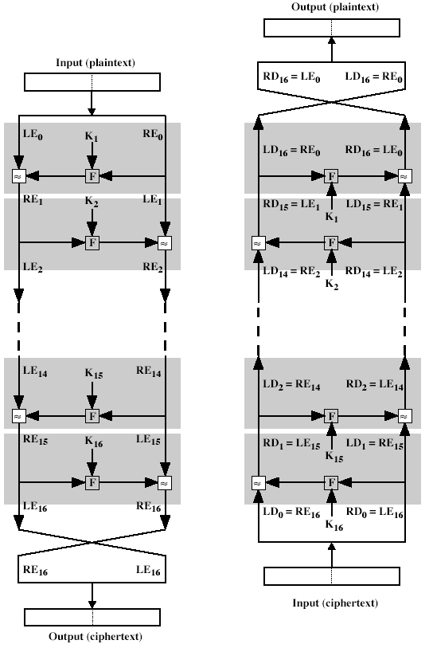
Feistel Encryption and Decryption

Slide 50
Feistel Cipher Structure
Feistel devised the Feistel cipher based on concept of invertible product cipher.
  Partitions input block into two halves.
  Process through multiple rounds which perform a substitution on left data half based on round function of right half and subkey.
  Permutation swapping halves.
Feistel implements Shannon’s substitution-permutation network concept.

Slide 51
Classical Feistel Network

Slide 52
Round i
L_{i-1} R_{i-1}
L₀ = left half of plaintext
R₀ = right half of plaintext
L_{i} = R_{i - 1}
R_{i} = L_{i - 1} ⊕ F (R_{i - 1}, K_{i} )
C = R_{n} || L_{n}
n is number of rounds
(undo last permutation)
k_{i}
+
f
L_{i} R_{i}

Slide 53
Decryption
Ciphertext
LD₀ = left half of ciphertext
RD₀ = right half of ciphertext
LD_{i} = RD_{i - 1}
RD_{i} = LD_{i - 1}
⊕ F (RD_{i - 1}, K_{n – i + 1})
P = RD_{n} || LDn
n is number of rounds
LD₀
RD₀
K_{n}
Substitution
+
f
Permutation
LD₁
RD₁

Slide 54
Feistel Encryption and Decryption
The Feistel encryption algorithm:
LE₁₆ = RE₁₅
RE₁₆ = LE₁₅ ⊕ F(RE₁₅, K₁₆)
On the decryption side:
LD₁ = RD₀ = LE₁₆ = RE₁₅
RD₁ = LD₀ ⊕ F(RD₀, K₁₆)
= RE₁₆ ⊕ F(RE₁₅, K₁₆)
= [LE₁₅ ⊕ F(RE₁₅, K₁₆)] ⊕ F(RE₁₅, K₁₆)

Slide 55
Feistel Encryption and Decryption
For the i^{th} iteration of the Feistel encryption algorithm:
LE_{i} = RE_{i-1}
RE_{i} = LE_{i-1} ⊕ F(RE_{i-1}, K_{i})
Rearranging terms:
RE_{i-1} = LE_{i}
LE_{i-1} = RE_{i} ⊕ F(RE_{i-1}, K_{i}) = RE_{i} ⊕ F(LE_{i}, K_{i})

Slide 56
The Data Encryption Standard (DES)
Most widely used block cipher in world.
Adopted in 1977 by the National Bureau of Standards (NBS) as a Federal Information Processing Standard 46 (FIPS PUB 46).
NBS is known as NIST.
The algorithm itself is referred to the Data Encryption Algorithm (DEA).
Encrypts 64-bit data using 56-bit key.

Slide 57
DES History
IBM developed LUCIFER cipher between 1960-1971
  By team led by Horst Feistel.
  Used 64-bit data blocks with 128-bit key.
Redeveloped as a commercial cipher by a team headed by Walter Tuchman and Carl Meyer from IBM and outside consultant and technical advice from NSA.
In 1973 NBS issued request for proposals (RFPs) for a national cipher standard.
IBM submitted their revised LUCIFER which was eventually accepted as the DES.

Slide 58
DES Design Controversy
Although DES standard is public. It was considerable controversy over design
  Choice of 56-bit key (LUCIFER 128-bit).
  Design criteria were classified.
Subsequent events and public analysis show in fact design was appropriate.
DES has become widely used, especially, in financial applications.

Slide 59
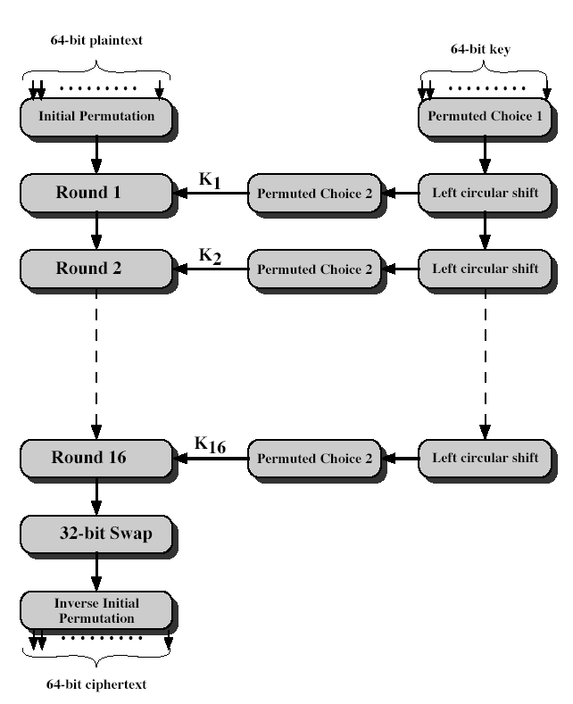
DES Encryption
General Depiction of DES Encryption Algorithm

Slide 60
Initial Permutation IP
First step of the data computation
IP reorders the input data bits.
Even bits to LH half, odd bits to RH half.
Quite regular in structure (easy in hardware)
See next text Table.
Example:
IP(675a6967 5e5a6b5a) = (ffb2194d 004df6fb)
01101110

Slide 61
DES Round Structure
Uses two 32-bit L and R halves.
As for any Feistel cipher can describe as:
  L_{i} = R_{i–1}
  R_{i} = L_{i–1} xor F(R_{i–1}, K_{i})
Takes 32-bit R half and 48-bit subkey and:
  Expands R to 48-bits using permutation E.
  Adds to subkey.
  Passes through 8 S-boxes to get 32-bit result.
  Finally permutes this using 32-bit permutation P.
Notes:
Note that the s-boxes provide the “confusion” of data and key values, whilst the permutation P then spreads this as widely as possible, so each S-box output affects as many S-box inputs in the next round as possible, giving “diffusion”.

Slide 62
Permutation Table of DES

Slide 63
Permutation Table of DES

Slide 64
DES Round Structure

Slide 65
Substitution Boxes S
Have eight S-boxes which map 6 to 4 bits.
Each S-box is actually 4 little 4 bit boxes.
  Outer bits 1 and 6 (row bits) select one rows.
  Inner bits 2 to 5 (col bits) are substituted.
  Result is 8 lots of 4 bits, or 32 bits.
Row selection depends on both data and key.
  Feature known as autoclaving (autokeying)
Example:
S(18 09 12 3d 11 17 38 39) = 5fd25e03

Slide 66
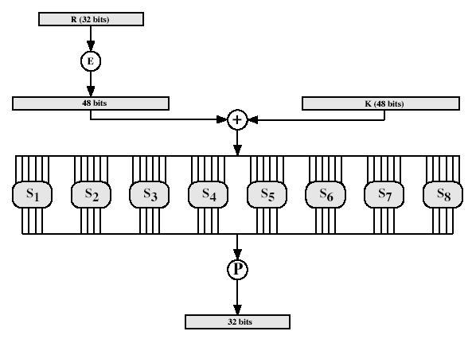
The Data Encryption Standard (DES)
Calculation of F(R, K)

Slide 67
Definition of DES Boxes

Slide 68
Definition of DES Boxes

Slide 69
DES Key Schedule
Forms subkeys used in each round.
Consists of:
  Initial permutation of the key (PC-1) which selects 56-bits in two 28-bit halves.
  16 stages consisting of:
    Selecting 24-bits from each half.
    Permuting them by PC-2 for use in function F.
    Rotating each half separately either 1 or 2 places depending on the key rotation schedule K.

Slide 70
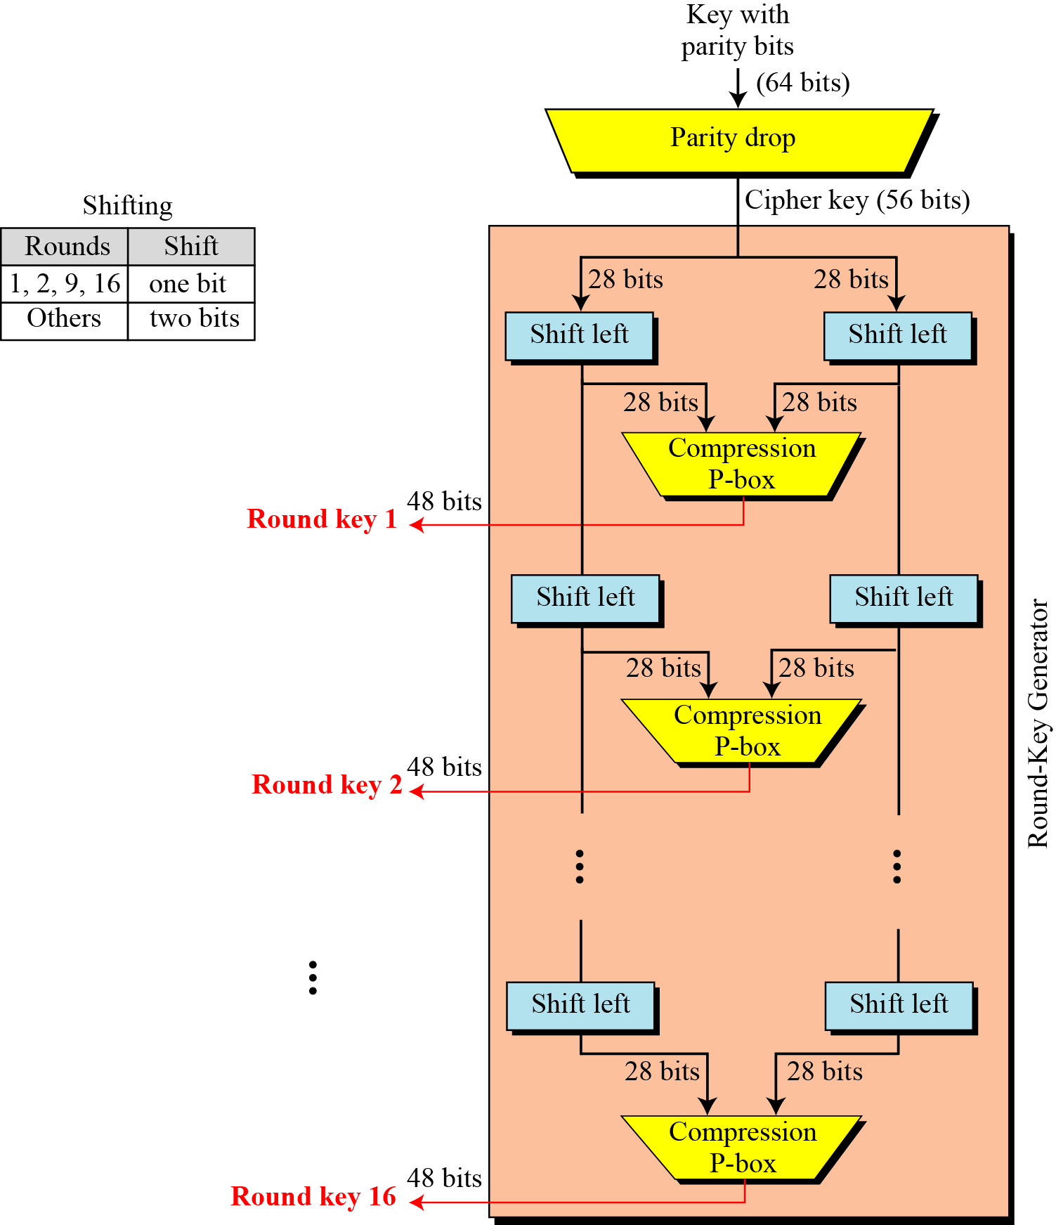

Slide 71
DES Key Schedule Calculation

Slide 72
DES Key Schedule Calculation

Slide 73
DES Decryption
As with Feistel cipher, decryption uses the same algorithm as encryption, except the application of subkeys is reversed.
With Feistel design, do encryption steps again using subkeys in reverse order (SK₁₆ … SK₁)
  IP undoes final FP step of encryption.
  1st round with SK₁₆ undoes 16th encrypt round.
  ….
  16th round with SK₁ undoes 1st encrypt round .
  Final FP undoes initial encryption IP.
Thus recovering original data value.

Slide 74
Avalanche Effect
A desirable property of any encryption algorithm is that a small change in either the plaintext or the key should produce a significant change in the ciphertext.
Where a change of one input or key bit results in changing approximately half of the output bits.
To make attempts to “home-in” by guessing keys impossible.
DES exhibits strong avalanche

Slide 75
Avalanche Effect
For example
  P1=0000 0000 ⋅⋅⋅ 0000
  P2=1000 0000 ⋅⋅⋅ 0000
  K=0000001 1001011 0100100 1100010 0011100 0011000 0011100 0110010]
  Then, 34 bits differ in C=R₁₆L₁₆
    Avalanche effect

Slide 76
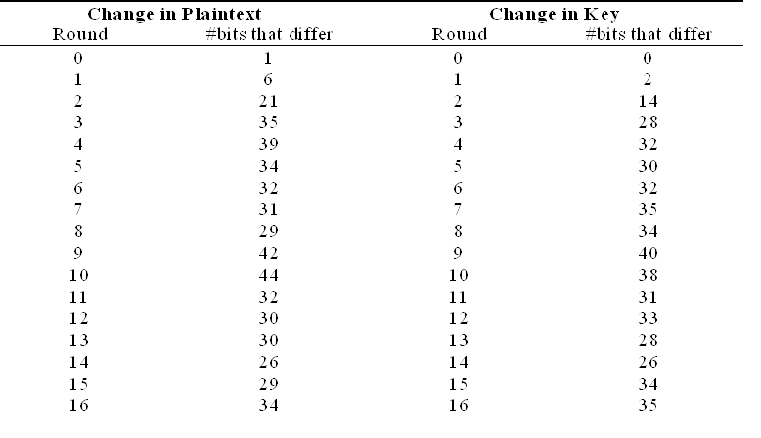
Fast avalanche effect

Slide 77
Strength of DES – Key Size
The concerns about the level of security provided by DES falls into three areas:
  Key size (use of 56-bit keys).
  The nature of the DES algorithm.
  Timing attack.

Slide 78
Strength of DES – Key Size
56-bit keys have 2⁵⁶ = 7.2 x 10¹⁶ values.
Brute force search looks hard.
Recent advances have shown is possible
  in 1997 on Internet in a few months.
  in 1998 on dedicated hardware (EFF) in a few days.
  in 1999 above combined in 22 hrs.
Still must be able to recognize plaintext.
Now considering alternatives to DES.
Notes:
DES finally and definitively proved insecure in July 1998, when the Electronic Frontier Foundation (EFF) announced that it had broken a DES encryption using a special-purpose "DES cracker" machine that was built for less than $250,000. The attack took less than three days. The
EFF has published a detailed description of the machine, enabling others to build their own cracker [EFF98].

Slide 79
Strength of DES – Timing Attacks
Attacks actual implementation of cipher.
Use knowledge of consequences of implementation to derive knowledge of some/all subkey bits.
Specifically use fact that calculations can take varying times depending on the value of the inputs.
Particularly problematic on smartcards.
Notes:
AES analysis process has highlighted this attack approach, and is a concern

Slide 80
Average time required for exhaustive key search
Key Size (bits) | Number of Alternative Keys | Time required at 10⁶ Decryption/µs
32 | 2³² = 4.3 x 10⁹ | 2.15 milliseconds
56 | 2⁵⁶ = 7.2 x 10¹⁶ | 10 hours
128 | 2¹²⁸ = 3.4 x 10³⁸ | 5.4 x 10¹⁸ years
168 | 2¹⁶⁸ = 3.7 x 10⁵⁰ | 5.9 x 10³⁰ years

Slide 81
Strength of DES – Analytic Attacks
Now have several analytic attacks on DES.
These utilise some deep structure of the cipher
  By gathering information about encryptions
  Can eventually recover some/all of the sub-key bits
  If necessary then exhaustively search for the rest
Generally these are statistical attacks. Include
  Differential cryptanalysis.
  Linear cryptanalysis.
  Related key attacks.

Slide 82
Differential Cryptanalysis
One of the most significant recent (public) advances in cryptanalysis.
Murphy (1990), Biham and Shamir.
Powerful method to analyse block ciphers.
Used to analyse most current block ciphers with varying degrees of success.
DES reasonably resistant to differential cryptanalysis.
Notes:
In [BIHA93] show Differential Cryptanalysis can successfully cryptanalyse DES with an effort on the order of 2⁴⁷, requiring 2⁴⁷ chosen plaintexts.
Differential cryptanalysis was known to the IBM DES design team as early as 1974, and influenced the design of the S-boxes and the permutation P. Compare with cryptanalysis of an eight-round LUCIFER algorithm requires only 256 chosen plaintexts, whereas an attack on an eight-round version of DES requires 2¹⁴ chosen plaintexts.

Slide 83
Differential Cryptanalysis
A statistical attack against Feistel ciphers.
Uses cipher structure not previously used.
Design of S-P networks has output of function F influenced by both input and key.
Hence cannot trace values back through cipher without knowing values of the key.
Differential Cryptanalysis compares two related pairs of encryptions.

Slide 84
Differential Cryptanalysis Attack
The differential cryptanalysis attack is complex.
Consider the original plaintext block m to consist of two halves m₀, m₁.
Each round of DES maps the RH input to the LH output and sets the RH output to be a function of the LH input and the subkey for this round.
So, at each round, one 32-bit block is created.
If each new block m_{i} (2 ≤ i ≤ 17), then the intermediate message halves are related as follows:
m_{i+1} = m_{i-1} ⊕ f(m_{i}, k_{i}) i = 1, 2, 3, …, 16
Notes:
Called Differential Cryptanalysis because the analysis compares differences between two related, encryptions - and looking for known difference in leading to a known difference out.

Slide 85
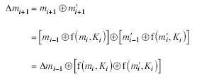
Differential Cryptanalysis Attack
With a known difference in the input.
Searching for a known difference in output when same subkeys are used

Slide 86
Differential Cryptanalysis
Have some input difference giving some output difference with probability p.
If find instances of some higher probability input/output difference pairs occurring, can infer subkey that was used in round
Then must iterate process over many rounds (with decreasing probabilities).

Slide 87
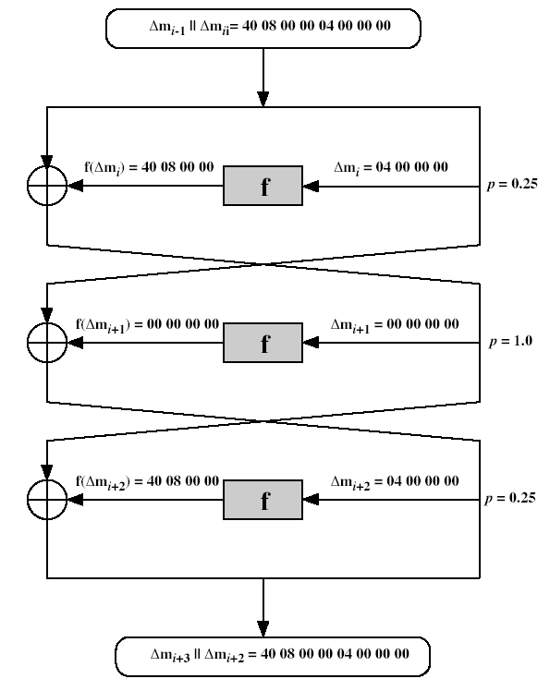
Differential Cryptanalysis
Notes:
Example of differential cryptanalysis on 3 rounds of DES (cf full 16 rounds). Overall, after three rounds the probability that the output difference is as shown is equal to 0.25 x 1 x 0.25 = 0.0625.

Slide 88
Differential Cryptanalysis
Perform attack by repeatedly encrypting plaintext pairs with known input XOR until obtain desired output XOR
when found
  if intermediate rounds match required XOR have a right pair.
  if not then have a wrong pair, relative ratio is S/N for attack.

Slide 89
Differential Cryptanalysis
Can then deduce keys values for the rounds
  right pairs suggest same key bits.
  wrong pairs give random values.
For large numbers of rounds, probability is so low that more pairs are required than exist with 64-bit inputs.
Biham and Shamir have shown how a 13-round iterated characteristic can break the full 16-round DES.

Slide 90
Linear Cryptanalysis
Another recent development.
Also a statistical method.
Must be iterated over rounds, with decreasing probabilities.
Developed by Matsui et al in early 90's.
Based on finding linear approximations.
Can attack DES with 2⁴⁷ known plaintexts, still in practise infeasible.

Slide 91
Block Cipher Design Principles
Basic principles still like Feistel in 1970’s.
  Number of rounds
    more is better, exhaustive search best attack
  Design of function F
    provides “confusion”, is nonlinear, avalanche
  Key schedule Algorithm
    complex subkey creation, key avalanche

Slide 92
Block Cipher Modes of Operation
Block ciphers encrypt fixed size blocks, e.g., DES encrypts 64-bit blocks, with 56-bit key.
They need ways to be used in practice, and usually they have an arbitrary amount of information to encrypt/decrypt.
Four ways were defined for DES in ANSI standard ANSI X3.106-1983 Modes of Use.
Subsequently now there are 5 ways for DES and AES.
They have block and stream modes.
Notes:
DES (or any block cipher) forms a basic building block, which en/decrypts a fixed sized block of data. However to use these in practise, we usually need to handle arbitrary amounts of data, which may be available in advance (in which case a block mode is appropriate), and may only be available a bit/byte at a time (in which case a stream mode is used).

Slide 93
Block Cipher Modes of Operation
The DES algorithm is a basic block for providing data security.
To apply DES in a variety of applications, four modes of operation have been defined (FIPS 81).
These four modes of operation are intended to cover all possible applications of encryption for which DES could be used.
NIST has expanded the list to five modes in special publication 800-38A. So that they can be use with any symmetric block cipher, including triple DES and AES.
Notes:
DES (or any block cipher) forms a basic building block, which en/decrypts a fixed sized block of data. However to use these in practise, we usually need to handle arbitrary amounts of data, which may be available in advance (in which case a block mode is appropriate), and may only be available a bit/byte at a time (in which case a stream mode is used).

Slide 94
Block Cipher Modes of Operation
The five modes of operation are:
  Electronic Codebook (ECB)
  Cipher Block Chaining (CBC)
  Cipher Feedback (CFB)
  Output Feedback (OFB)
  Counter (CTR)
Notes:
DES (or any block cipher) forms a basic building block, which en/decrypts a fixed sized block of data. However to use these in practise, we usually need to handle arbitrary amounts of data, which may be available in advance (in which case a block mode is appropriate), and may only be available a bit/byte at a time (in which case a stream mode is used).

Slide 95
Electronic Codebook Book (ECB)
Message is broken into independent blocks which are encrypted.
Each block is a value which is substituted, like a codebook.
Each block is encoded independently of the other blocks:
  C_{i} = DES_{K1} (P_{i})
Uses: Secure transmission of single values.
Notes:
ECB is the simplest of the modes, where each block is en/decrypted independently of all the other blocks, and is used when only a single block of info needs to be sent (eg. a session key encrypted using a master key).

Slide 96
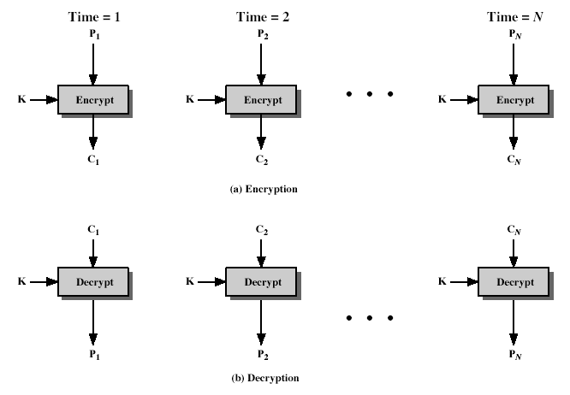
Electronic Codebook (ECB) Mode

Slide 97
Electronic Codebook (ECB) Mode
Encryption
  Key: K
  Plaintext: P=P₁P₂…P_{N-1}P_{N}
  Padded plaintext: P’=P₁P₂…P_{N-1}P_{N}’
    P₁, P₂,…, P_{N-1} are 64-bit blocks
    P_{N-1}’ is the last (padded) 64-bit block
    Padding pattern: 10…0
  Ciphertext C=C₁C₂…C_{N}
    C_{i} = E_{K}(P_{i}), 1≤i≤N

Slide 98
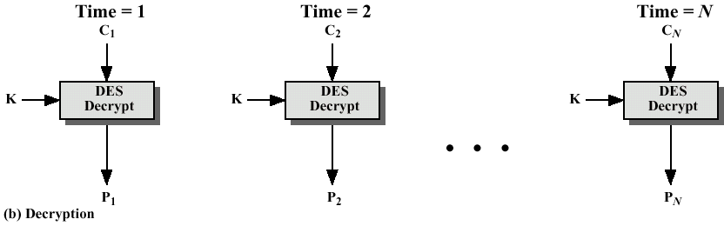
Electronic Codebook (ECB) Mode
Decryption
  Key: K
  Ciphertext: C=C₁C₂…C_{N}
  Padded plaintext: P’=P₁P₂…P_{N-1}P_{N}’
  Plaintext: P₁P₂…P_{N-1}P_{N}

Slide 99
Advantages and Limitations of ECB
Repetitions in message may show in ciphertext
  If aligned with message block.
  Particularly with data, such graphics.
  Or with messages that change very little, which become a codebook analysis problem.
Weakness due to encrypted message blocks being independent.
Main use is sending a few blocks of data.

Slide 100
Cipher Block Chaining (CBC) Mode
Message is broken into blocks, but these are linked together in the encryption operation.
Each previous cipher blocks is chained with current plaintext block.
Use Initial Vector (IV) to start process.
  C_{i} = DES_{K1}(P_{i} XOR C_{i-1})
  C₋₁ = IV
Uses: Bulk data encryption and authentication.
Notes:
To overcome the problems of repetitions and order independence in ECB, want some way of making the ciphertext dependent on all blocks before it. This is what CBC gives us, by combining the previous ciphertext block with the current message block before encrypting. To start the process, use an Initial Value (IV), which is usually well known (often all 0's), or otherwise is sent, ECB encrypted, just before starting CBC use. CBC mode is applicable whenever large amounts of data need to be sent securely, provided that its available in advance (eg email, FTP, web etc)

Slide 101
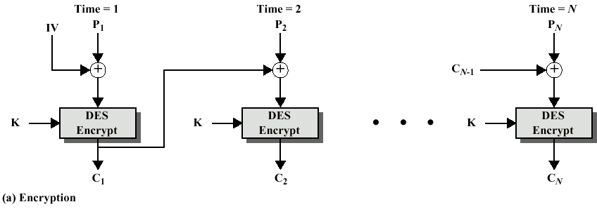
Cipher Block Chaining (CBC) Mode
Goal: the same plaintext block is encrypted into different ciphertext block
Initial vector (IV)
  64-bit long
  Fixed, or negotiated between sender and receiver
Padded plaintext: P’= P₁P₂…P_{N}
Ciphertext: C = C₁C₂…C_{N}
  C₁=E_{K}(IV ⊕ P₁)
  C_{i}=E_{K}(C_{i-1} ⊕ P_{i}), 2≤i≤N

Slide 102
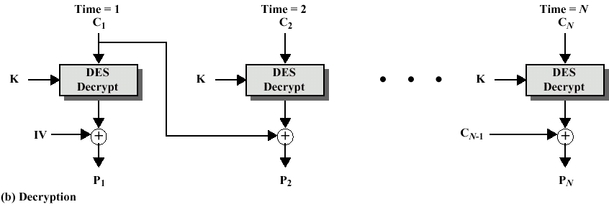
Cipher Block Chaining (CBC) Mode
Decryption
  Key: K
  Ciphertext: C=C₁C₂…C_{N}
  Padded plaintext: P=P₁P₂…P_{N}
    P₁=D_{K}(C₁) ⊕ IV
    P_{i}= D_{K}(C_{i}) ⊕ C_{i-1}= C_{i-1}⊕P_{i}⊕C_{i-1}

Slide 103
Advantages and Limitations of CBC
Each ciphertext block depends on all message blocks.
Thus a change in the message affects all ciphertext blocks after the change as well as the original block.
Need IV known to sender and receiver.
  If IV is sent in the clear, an attacker can change bits of the first block, and change IV to compensate.
  Hence either IV must be a fixed value (as in EFTPOS) or it must be sent encrypted in ECB mode before rest of message.
At end of message, handle possible last short block.
  Padding with known non-data value (e.g., nulls).
  Pading last block with count of pad size.
Notes:
CBC is the generally used block mode. The chaining provides an avalanche effect, which means the encrypted message
cannot be changed or rearranged without totally destroying the subsequent data.

Slide 104
Cipher Feedback (CFB) Mode
Message is treated as a stream of bits.
Added to the output of the block cipher.
Result is feedback for next stage.
Standard allows any number of bit (1, 8, 64, etc.) to be feedback.
  Denoted CFB-1, CFB-8, CFB-64, etc.
The most efficient is to use all 64 bits (CFB-64)
  C_{i} = P_{i} XOR DES_{K1}(C_{i-1})
  C₋₁ = IV
Uses: Stream data encryption and authentication.
Notes:
If the data is only available a bit/byte at a time (eg. terminal session, sensor value etc), then must use some other approach to encrypting it, so as not to delay the info. Idea here is to use the block cipher essentially as a pseudo-random number generator (see stream cipher lecture later) and to combine these "random" bits with the message. Note as mentioned before, XOR is an easily inverted operator (just XOR with same thing again to undo). Again start with an IV to get things going, then use the ciphertext as the next input. As originally defined, idea was to "consume" as much of the "random" output as needed for each message unit (bit/byte) before "bumping" bits out of the buffer and re-encrypting. This is wasteful though, and slows the encryption down as more encryptions are needed. An alternate way to think of it is to generate a block of "random" bits, consume them as message bits/bytes arrive, and when they're used up, only then feed a full block of ciphertext back. This is CFB-64 mode, the most efficient. This is the usual choice for quantities of stream oriented data, and for authentication use.

Slide 105
Cipher Feedback (CFB) Mode
Stream cipher mode
One-time pad
Block size: J bits, 1≤J≤ 64
Need no padding in most cases
  For example, between key board and computer, we set J=8
Encryption: J-bit CFB
  Plaintext: P = P₁P₂⋅⋅⋅P_{N}, P_{i}’s are J-bit blocks
  S_{J}(X): the leftmost J bits of X
  T_{64-J}(Y): the rightmost 64-J bits of Y
  Algorithm
    R=IV
    For i=1 to N
      C_{i}= P_{i} ⊕ S_{J}(E_{K}(R))
      R=T_{64-J}(R)||C_{i-1}

Slide 106
Cipher Feedback (CFB) Mode
Decryption: J-bit CFB
  Ciphertext: C= C₁C₂⋅⋅⋅C_{N}, C_{i}’s are J-bit blocks
  S_{J}(X): the leftmost J bits of X
  T_{64-J}(Y): the rightmost 64-J bits of Y
  Algorithm
    R=IV
    For i=1 to N
      P_{i}= C_{i} ⊕ S_{J}(E_{K}(R))
      R=T_{64-J}(R)||C_{i-1}

Slide 107
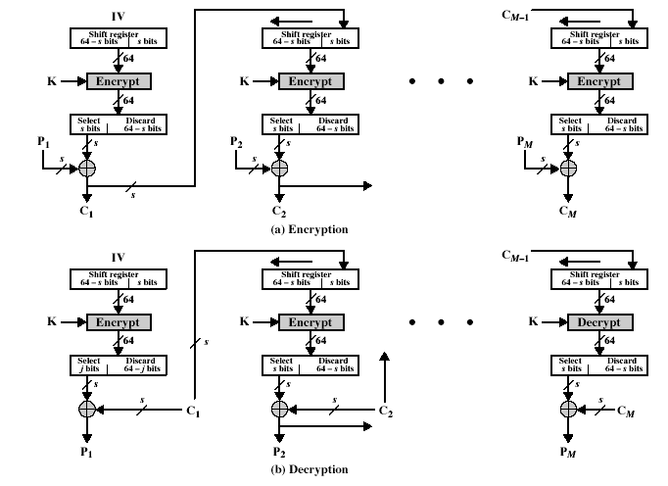
Cipher Feedback (CFB) Mode

Slide 108
Advantages and Limitations of CFB
Appropriate when data arrives in bits/bytes.
Most common stream mode.
Limitation is need to stall while do block encryption after every n-bits.
Note that the block cipher is used in encryption mode at both ends.
Errors propagate for several blocks after the error.
Notes:
CFB is the usual stream mode. As long as can keep up with the input, doing encryptions every 8 bytes. A possible problem is that if its used over a "noisy" link, then any corrupted bit will destroy values in the current and next blocks (since the current block feeds as input to create the random bits for the next). So either must use over a reliable network transport layer (pretty usual) or use OFB.

Slide 109
Output Feedback (OFB) Mode
Message is treated as a stream of bits.
Output of cipher is added to message.
Output is then feedback.
Feedback is independent of message.
Can be computed in advance
  C_{i} = P_{i} XOR O_{i}
  O_{i} = DES_{K1}(O_{i-1})
  O₋₁ = IV
Uses: Stream encryption over noisy channels.

Slide 110
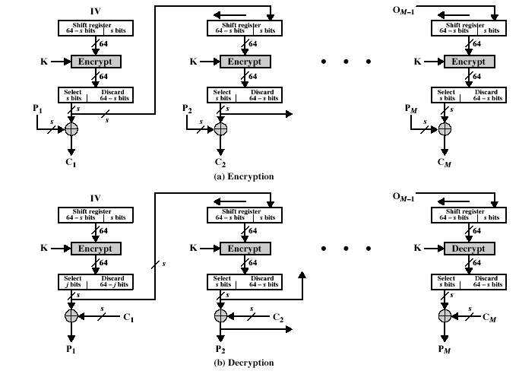
Output Feedback (OFB)

Slide 111
Advantages and Limitations of OFB
Used when error feedback a problem or where need to encryptions before message is available.
Superficially similar to CFB, but feedback is from the output of cipher and is independent of message.
A variation of a Vernam cipher, hence must never reuse the same sequence (Key+IV).
Sender and receiver must remain in sync, and some recovery method is needed to ensure this occurs.
Originally specified with m-bit feedback in the standards.
Subsequent research has shown that only OFB-64 should ever be used.
Notes:
Because the "random" bits are independent of the message, they must never ever be used more than once (otherwise the 2 ciphertexts can be combined, cancelling these bits, and leaving a "book" cipher to solve). Also, as noted, should only ever use a full block feedback ie OFB-64 mode.

Slide 112
Counter (CTR) Mode
A “new” mode, though proposed early on.
Similar to OFB but encrypts counter value rather than any feedback value.
Must have a different key and counter value for every plaintext block (never reused).
  C_{i} = P_{i} XOR O_{i}
  O_{i} = DES_{K1}(i)
Uses: High-speed network encryptions.

Slide 113
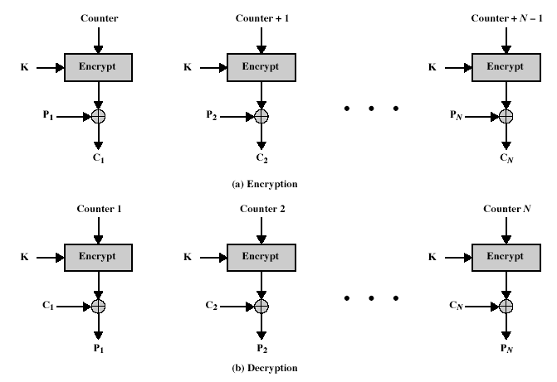
Counter (CTR) Mode

Slide 114
Advantages and Limitations of CTR
Efficiency
  can do parallel encryptions
  in advance of need
  good for bursty high speed links
Random access to encrypted data blocks.
Provable security (good as other modes).
Must ensure never reuse key/counter values, otherwise could break (OFB).

Slide 115
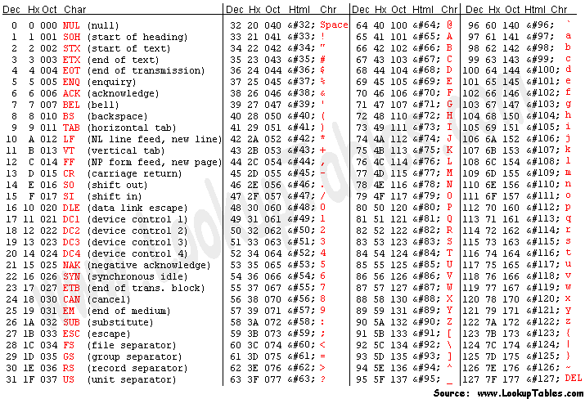
ASCII Code

Slide 116
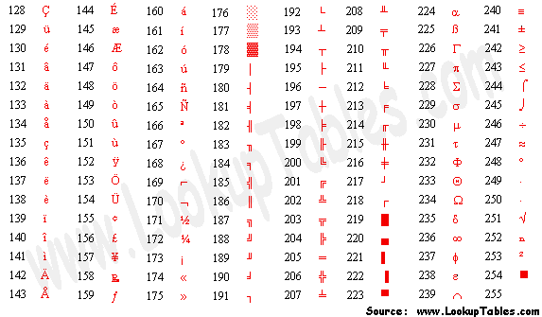
Extended ASCII

