Slide 1
Colon Cancer Screening
Seniors: Erum Iqbal, Julia Lee, Wendy Yang
Interns: Michelle Di Fiore, James Fry, Daniel Kim

Slide 2
Background
Colorectal cancer is the second most commonly diagnosed cancer world wide in women, third in men
Second leading cause of cancer deaths in the U.S.
The lifetime incidence for patients at average risk is 5 percent, with 90 percent of cases occurring after age 50.
Both the incidence of and mortality rates from CRC have been declining in the US
Screening may account for 53 percent of the observed reduction in CRC mortality (surveillance research program, NCI)
2012 in the United States, 65.1 percent of adults between ages 50 and 75 years were up-to-date with CRC screening and 27.7 percent had never been screened (CDC)

Slide 3
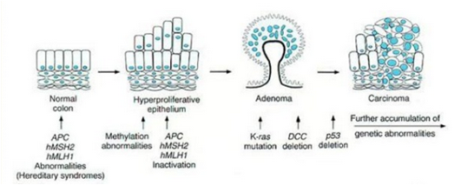
Pathogenesis
Inherited and acquired genetic defects (Adenomas to dysplasia and carcinoma )
Progression takes at least 10 years on average
Most colorectal polyps are either adenomatous (2/3) or hyperplastic. Biopsy is required for diagnosis
The risk of CRC increases with adenoma size, number, and histology (villous adenomas>tubular adenomas)
Removal of adenomatous polyps prevents cancer.
The National Polyp Study Work Group followed 1418 patients in whom colonoscopic examination led to the removal of one or more polyps. During a mean follow-up of 6 yrs, the incidence of colon cancer was 88 to 90 percent lower than in patients reported in other studies who had polyps that were not removed and 76 percent lower than in the general population.

Slide 4
Screening tests
Stool Based
FOBT : sensitivity using an older guaiac method, is only about 30 to 40%
Sensitive gFOBT — Hemoccult SENSA is more sensitive than Hemoccult II, 64 to 80% compared to 25 to 38% for nonrehydrated Hemoccult II
It is not a good test for the detection of polyps, which usually do not bleed.
3 consecutive stool specimens
Fecal immunochemical test (FIT):
Sensitivities of FIT were 2-3x’s higher than gFOBT for colorectal cancer, advanced adenoma, and all adenomas
more specific than guaiac tests because they respond only to human globin and do not detect upper GIB or foods with peroxidase activity.
fewer stool samples (1-2); automated analysis.
Stool DNA: gene amplification technique
detection of low frequency mutations with increased sensitivity for advanced adenomas, with testing for hemoglobin and for patterns of DNA methylation
More sensitive than FIT -not affected by cancer stage or location of the colonic lesion. More false positives (up to 10%)

Slide 5
Screening Tests
Imaging
Double contrast Barium Enema (DCBE): detects only 50% of adenomas larger than 1.0 cm and 39% of all polyps. Retrospective studies have found that DCBE may miss 15-22% of CRC
CT colonography (CTC)
Abnormal results need to be followed up by colonoscopy for excision and tissue diagnosis, or, for smaller lesions, surveillance with CTC
Flat adenomas may have greater malignant potential than polypoid lesions and are more likely to be missed on CTC than colonoscopy
Direct Visualization
Flexible sigmoidoscopy (60cm up to splenic flexure)
A meta-analysis of ten observational studies of screening sigmoidoscopy and six observational studies of colonoscopy suggests a 40 to 60 % lower risk of incident colorectal cancer and death from colorectal cancer for colonoscopy compared with sigmoidoscopy*
Colonoscopy
*Effect of flexible sigmoidoscopy-based screening on incidence and mortality of colorectal cancer: a systematic review and meta-analysis of randomized controlled trials.PLoS Med. 2012 Dec;9(12):e1001352. Epub 2012 Dec 4

Slide 6
Reducing Mortality from Colorectal Cancer by Screening for Fecal Occult Blood
N Engl J Med 1993; 328:1365-1371
46,551 participants 50-80 y/o. 13 year follow up
Mortality from colorectal cancer was 5.88 in the annual screened group, and 8.83 in the control group.
Rate in the annually screened group was significantly lower than the control group.
Improved survival and shift to detection at earlier stage.
33% reduction in mortality from colorectal cancer can be achieved by annual fecal occult-blood testing with rehydration
Fecal occult-blood testing can lead to a fourfold increase in the number of positive tests and diagnostic procedures involving colonoscopy.

Slide 7
Colonoscopy versus Fecal Immunochemical Testing in Colorectal-Cancer Screening
Quintero E, Castells A, Bujanda L, et al. N Engl J Med. 2012 Feb 23;366(8):697-706.
RCT of asymptomatic adults 50-69 years old comparing one-time colonoscopy with FIT every 2 years
26,703 pts versus 26,599, respectively
Primary outcome: rate of death from CRC at 10 years
Results:
CRC found in 30 pts (0.1%) in colonoscopy group and 33 pts (0.1%) in FIT group
Advanced adenomas found in 514 pts (1.9%) in colonoscopy group and 231 pts (0.9%) in FIT group
Non-advanced adenomas found in 1109 (4.2%) in colonoscopy group and 119 (0.4%) in FIT group
Conclusion:
FIT was able to identify a similar proportion of CRC in patients compared to colonoscopy; however, colonoscopy was greater at identifying non-advanced and advanced adenomas.
Subjects in the FIT group were however more likely to participate in screening than the colonoscopy group
Study is still ongoing to understand whether one or the other is better at preventing death from colorectal cancer.

Slide 8
Multitarget Stool DNA Testing for Colorectal-Cancer Screening
Imperiale T, Ransohoff D, Itzkowitz S, et al. N Engl J Med. 2014 Apr 3;370(14):1287-97.
Compared noninvasive, multitarget stool DNA test with fecal immunochemical test (FIT) in patients with average risk colorectal cancer
DNA test = quantitative molecular assays for KRAS mutations, aberrant NDRG4 and BMP3 methylation, and β, plus a hemoglobin immunoassay.
Analyzed 9,989 patients with colonoscopy and compared these results with DNA testing and FIT
65 had colorectal cancer (0.7%)
757 had advanced precancerous lesions (7.6%)
Compared to FIT, DNA testing had higher sensitivity, but lower specificity
Number needed to screen to detect one cancer:
Colonoscopy – 154
DNA testing – 166
FIT – 208
Conclusion:
In asymptomatic patients with average risk of CRC, multitarget stool DNA testing detected significantly more cancers than did FIT
But, also had more false positive results

Slide 9
Colorectal-Cancer Incidence and Mortality with Screening Flexible Sigmoidoscopy
N Engl J Med. 2012 Jun 21, 366(25):2345-57
Randomly assigned 154,900 men and women from ages 55- 74 yo to either:
A. Flex sig w/ repeat screening at 3 or 5 yrs
B. usual care
--> assessed number of colorectal cancers and deaths from CRC
77,445 were screened, 83.5% had baseline flex sig, 54% were screened at 3 or 5 yrs.
Incidence of CRC after median follow-up of 11.9 yrs:
-- 11.9 cases/10,000 person-years (flex sig)
-- 15.2 cases/10,000 person years (control)
-- 21% risk reduction (relative risk, 0.79; 95% confidence interval [CI], 0.72 to 0.85; P<0.001)
Significant reductions in the incidence of
-- distal CRC (479 cases vs. 669 in control group)
-- proximal CRC: (512 cases vs. 595 in control group)
Deaths from CRC
-- Flex sig: 2.9 deaths/10,000 person years
-- Control: 3.9 deaths/10,000 person years
-- 26% relative reduction
Mortality from Distal CRC: reduced by 50%
Mortality from Proximal CRC: UNAFFECTED!
So for proximal CRC, flex sig shows significant decrease in INCIDENCE,not MORTALITY

Slide 10
Guidelines-Average Risk: American Cancer Society 2008
Begin Screening at Age 50; discontinue when the individual's estimated life expectancy is less than 10 years.
Screening | Interval | Next Steps
Colonoscopy | 10 years
Flex Sigmoidoscopy | 5 years | Polyps->colonoscopy
CTC | 5 years | 1+ polyps >6 mm-> colonoscopy
DCBE | 5 years-if other options not available | 1+ polyps >6 mm-> colonoscopy
Sensitive gFOBT | Annual | positive->colonoscopy
FIT | Annual | positive->colonoscopy
Stool DNA | Uncertain | positive->colonoscopy

Slide 11
Guidelines-USPTF 2008
Three screening options for adults age 50 to 75 years : based systematic literature review and a simulation decision model
Annual sensitive gFOBT or FIT
Flexible sigmoidoscopy every five years, with sensitive FOBT every three years
Colonoscopy every 10 years
The task force found insufficient evidence of harms and benefit for DCBE, CTC or stool DNA testing.

Slide 12
Guidelines
American College of Gastroenterology 2008- guidelines recommend a "preferred" strategy, prioritizing options listed in the ACS-MSTF guidelines
colonoscopy as the preferred screening/prevention test
FIT as the preferred screening/detection test for patients who decline cancer prevention tests
Additionally, the ACG recommends initiating screening at age 45, rather than 50, for African Americans
National Comprehensive Cancer Network consensus guidelines 2013
colonoscopy every 10 years, when available, as the preferred screening strategy.
alternatives are annual stool testing with guaiac or immunochemical reagent or sigmoidoscopy every five years with or without annual stool testing.

Slide 13
Older adults
The decision whether to recommend screening for a patient over 70 years of age should depend upon the patient's health status, anticipated life expectancy, risk for colorectal cancer, and personal values
The USPSTF guidelines recommend that patients over age 85 not be screened, and recommend against screening in adults 76 to 85 years, unless there are individual considerations that favor screening
Patients with a life expectancy less than ten years would not be expected to benefit from colorectal screening, since studies indicate benefit from screening starts to accrue after about five years (ARR of one CRC related death)
One-time screening in older adults who have never been screened (23 % elderly individuals) appears to be cost-effective up to age 86 years

Slide 14
Who is at high risk?
Personal history of:
Colorectal cancer
Adenomatous polyps
Inflammatory bowel disease (UC or Crohn’s)
Family History of:
Colorectal cancer
Polyps
Hereditary Colorectal Cancer Syndromes:
Familial adenomatous polyposis (FAP)
Hereditary non-polyposis colon cancer (HNPCC)
Source: cancer.org/cancer/colonandrectum

Slide 15
Personal History: Surveillance after Initial Colonoscopy
Colonoscopy Findings: | Recommended Interval:
Colon cancer | 1 year after cancer resection
No polyp | 10 years
Hyperplastic , left- sided | 10 years
1-2 Tubular Adenomas < 1 cm | 5 – 10 years
Adenoma with low grade dysplasia | 5 – 10 years
3-10 Tubular adenomas > 1 cm | 3 years
Villous adenoma > 25% villous | 3 years
Adenoma with high grade dysplasia | 3 years
> 10 adenomas | 3 years (genetic testing should be considered- FAP/HNPCC)
Sessile adenomas with piecemeal resection | 2-6 months after resection

Slide 16
Personal/Genetic History:
Personal History/Genetic Diseases: | Surveillance recommendations:
Familial adenomatous polyposis (FAP) | At age 10 – 12 years; if genetic test positive then proceed with removal of colon (colectomy)
Hereditary non-polyposis colon cancer (HNPCC) | At age 20 – 25 years; or 10 years before youngest case in the immediate family; colonoscopy every 1-2 years
Inflammatory bowel disease: - Chronic ulcerative colitis - Crohn's Disease | Risk begins 8 years after onset of pancolitis (involvement of entire colon) OR 12-15 years after the onset of L-sided colitis Colonoscopy every 1-2 years with biopsies for dysplasia

Slide 17
Family History: Surveillance Guidelines
Colorectal cancer or polyps in first-degree relatives before age 60 OR 2 or more first-degree relatives at any age | Age 40, or 10 years before the youngest case in the family, whichever is earlier
Colorectal cancer or polyps in first degree relatives after age 60 or older OR 2 or more first-degree relatives at any age | Age 40

Slide 18
MKSAP Questions

Slide 19
Question #1
A 36 yo man is in clinic for a routine exam. He has no GI complaints and has not had any prior colorectal cancer screening. Family history is significant for his mother who was diagnosed with colon cancer at age 54.
Physical examination is normal.
Notes:
Question 40 (GI)

Slide 20
Which of the following is the most appropriate management?
Colonoscopy now
Colonoscopy at age 40 years
Colonoscopy at age 44 years
Fecal occult blood test at age 40 years

Slide 21
Which of the following is the most appropriate management?
Colonoscopy now
Colonoscopy at age 40 years
Colonoscopy at age 44 years
Fecal occult blood test at age 40 years

Slide 22
B: Colonoscopy at age 40 years
Family history contributes to 30% to 35% of all colorectal cancer cases.
Several hereditary cancer syndromes (eg. familial adenomatous polyposis, hereditary nonpolyposis colorectal cancer syndrome) are associated with significantly increased risks for colorectal neoplasia and other malignancies.
Nonsyndromic family histories are also associated with increased colorectal cancer risk.
The 2012 American College of Physicians Guidance Statement on colorectal cancer screening recommends initiation of screening in high-risk patients at age 40 years, OR 10 years younger than the earliest colon cancer diagnosis in the family, whichever is earlier.
In the absence of gastrointestinal symptoms, colonoscopy now is not indicated as colon cancer screening can be postponed until age 40 years.

Slide 23
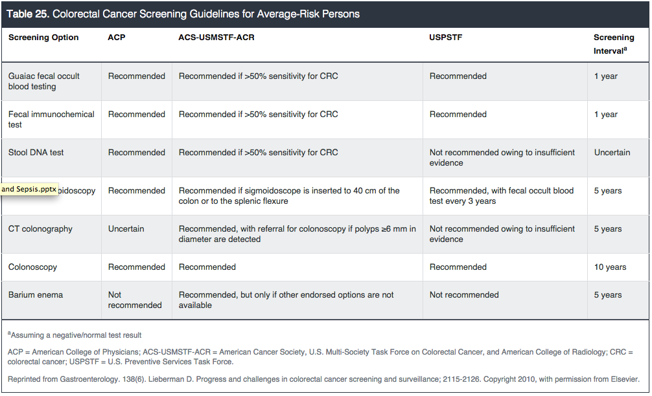
Colorectal Cancer Screening in Average-Risk Persons

Slide 24
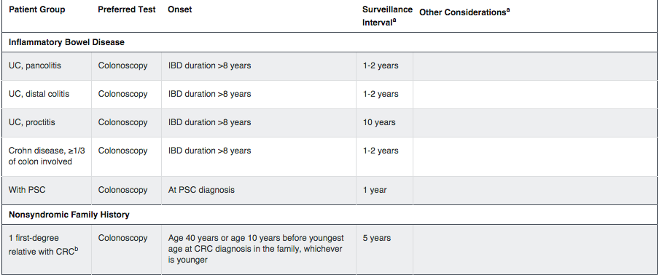
Colorectal Cancer Screening in Increased-Risk Persons

Slide 25
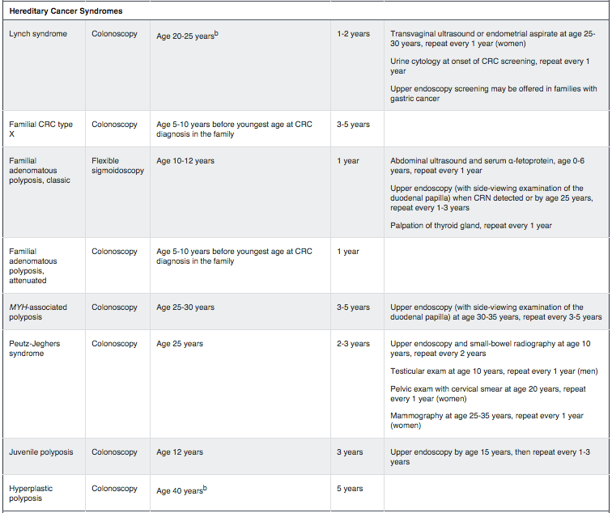

Slide 26
Question #2
A 57-year-old man is in clinic for 1-week follow up after his first screening colonoscopy. He has no history of colorectal neoplasia in first- or second-degree relatives.
Physical examination is normal.
A colonoscopy to the cecum was performed. The preparation was described as poor, with collections of semisolid debris that could not be effectively cleared from several colonic segments. According to the colonoscopy report, mass lesions 1 cm or larger are unlikely to have been obscured by the debris. Three diminutive (<3 mm) hyperplastic polyps were removed from the rectum.
Notes:
95 (GI)

Slide 27
Which of the following is the most appropriate management strategy
Repeat colonoscopy now following adequate preparation
Repeat colonoscopy in 3 years
Repeat colonoscopy in 5 years
Repeat colonoscopy in 10 years

Slide 28
Which of the following is the most appropriate management strategy
Repeat colonoscopy now following adequate preparation
Repeat colonoscopy in 3 years
Repeat colonoscopy in 5 years
Repeat colonoscopy in 10 years

Slide 29
A: Repeat colonoscopy now following adequate preparation
Colorectal cancer screening and surveillance guidelines are based on a high-quality baseline evaluation:
Cecal intubation
Well-visualized mucosa with minimal fecal debris
Withdrawal time greater than or equal to 6 minutes.
Adequate preparation allows confidence that mass lesions other than small (<5 mm) polyps were generally not obscured by residual debris.
If the bowel preparation is not adequate, the screening evaluation should be repeated before planning a long-term surveillance program.

Slide 30
After confirming a high-quality baseline evaluation, repeat colonoscopy in:
3 years for patients with 3 to 10 adenomas (not hyperplastic polyps).
5 years for patients with 1 or 2 small (<1 cm) tubular adenomas, with low-grade dysplasia as the most advanced histologic finding.
10 years for patients with no colorectal polyps or small rectal hyperplastic polyps only.

Slide 31
Colonoscopy
Colonoscopy permits endoscopic evaluation of the entire colorectum.
Dietary restrictions and full cathartic preparation are required prior to the procedure.
In contrast to other endorsed screening options, therapeutic polypectomy can be completed during the baseline procedure.
Colonoscopy “miss rates”: 5% for colorectal cancer, 2% to 12% for polyps 1 cm or larger, and more than 20% for polyps 6 mm or larger.

Slide 32
Question #3
A 50 yo woman is in clinic for a routine exam. She has no significant PMHx and denies any GI symptoms. She has no history of colorectal malignancy.
Physical examination is normal.
She is sent home with high-sensitivity guaiac fecal occult blood test (gFOBT) cards and is asked to collect two specimens each from three consecutive stools. One of the six samples is positive.
Notes:
31 (GI)

Slide 33
Which of the following is the most appropriate management for this patient?
Colonoscopy now
Fecal immunochemical test in 1 year
Flexible sigmoidoscopy now
gFOBT in 1 year
Repeat gFOBT now

Slide 34
Which of the following is the most appropriate management for this patient?
Colonoscopy now
Fecal immunochemical test in 1 year
Flexible sigmoidoscopy now
gFOBT in 1 year
Repeat gFOBT now

Slide 35
A: Colonoscopy now
When performed correctly, guaiac fecal occult blood testing (gFOBT) is an effective screening test for colorectal cancer and can detect bleeding anywhere in the colon. Occult blood is detected by either gFOBT or fecal immunochemical test (FIT).
This patient meets criteria for average-risk colorectal cancer screening, so high-sensitivity gFOBT is an acceptable choice for the initial assessment. Single-sample gFOBT of a stool specimen collected following digital rectal examination is NOT adequate for colorectal cancer screening. For any positive screening gFOBT result, colonoscopy is the indicated diagnostic test.
Immediate retesting with gFOBT does not provide useful diagnostic information, because a negative result is insufficient to exclude clinically relevant pathology. Repeat fecal occult blood testing in 1 year, by either gFOBT or FIT, is also insensitive for follow-up.
Flexible sigmoidoscopy permits structural evaluation of the distal colorectum, but would miss a bleeding source located proximal to the splenic flexure and is therefore not the most appropriate test for this patient.

Slide 36
Question #4
A 35-year-old woman is evaluated during a routine clinic follow-up. She has no medical history and is generally healthy, exercising regularly with a balanced diet. She has no GI symptoms, but would like to discuss whether she should undergo colorectal cancer screening. Physical examination is normal.
Her family history is as follows:
Father: Colorectal cancer, age 52 years
Mother: Healthy, no malignancies
Paternal aunt: Endometrial cancer, age 37 years
Paternal uncle: Large 2.5 cm colorectal adenoma, age 45 years
Brother: Colorectal cancer, age 46 years
Notes:
1 (GI)

Slide 37
Which of the following is the most appropriate management strategy
Colonoscopy now
Colonoscopy at age 40 years
Colonoscopy at age 50 years
CT Colonoscopy at age 40 years
Stool DNA test at age 40 years

Slide 38
Which of the following is the most appropriate management strategy
Colonoscopy now
Colonoscopy at age 40 years
Colonoscopy at age 50 years
CT Colonoscopy at age 40 years
Stool DNA test at age 40 years

Slide 39
A: Colonoscopy now
This patient's family history meets the Amsterdam criteria II, supporting a possible hereditary nonpolyposis colorectal cancer (HNPCC) kindred.
The Amsterdam criteria II: “3-2-1 rule” (3 affected members, 2 generations, 1 under age 50 years).
HNPCC (aka Lynch syndrome) is an autosomal dominant syndrome that carries an 80% lifetime risk for colon cancer. It is the most common of the hereditary colon cancer syndromes. Colorectal adenomas develop by 20 to 30 years and are thought to progress to colorectal cancer more quickly than sporadic adenomas.
HNPCC-associated extracolonic cancers include uterine and ovarian cancers. Colorectal evaluation should be initiated by age 20 to 25 years or 10 years prior to the earliest age of colorectal cancer diagnosis in the family, whichever comes first. Colonoscopy is the test of choice. In addition, gynecologic and genitourinary cancer screening should be performed.

Slide 40
Colonoscopy at age 40 years would be an acceptable option for a patient with a nonsyndromic family history of colorectal cancer in a first-degree relative but not in a patient with a possible hereditary nonpolyposis colorectal cancer syndrome.
Colonoscopy at age 50 years is an option for average-risk colorectal cancer screening, but it is not appropriate for this patient who is in a high-risk category.
Neither stool DNA testing nor CT colonography is currently endorsed for colorectal cancer screening/surveillance among patients at increased risk because of family history.

Slide 41
Question #5
A 38-year-old man with ulcerative colitis diagnosed 10 years ago is evaluated during a routine examination. He is tolerating his mesalamine and feeling well without any symptoms. His last colonoscopy was performed when he was diagnosed and showed mildly active extensive colitis extending to the hepatic flexure. He has no other family history of colon cancer, polyps or malignancy. There is no family history of colon cancer or colon polyps.
Physical exam and labs, including CBC, CMP and CRP, are all normal.
Notes:
9

Slide 42
Which of the following is the most appropriate colonoscopy interval for this patient?
Colonoscopy every 10 years starting at age 40
Colonoscopy every 5 years starting at age 40
Colonoscopy now and every 5 years
Colonoscopy now and every 1 to 2 years

Slide 43
Which of the following is the most appropriate colonoscopy interval for this patient?
Colonoscopy every 10 years starting at age 40
Colonoscopy every 5 years starting at age 40
Colonoscopy now and every 5 years
Colonoscopy now and every 1 to 2 years

Slide 44
D: Colonoscopy now and every 1 to 2 years
Patients with ulcerative colitis with disease extending beyond the rectum are at an increased risk of colorectal cancer.
Based on this increased cancer risk, routine surveillance colonoscopy with biopsies every 1 to 2 years is warranted beginning 8 to 10 years after diagnosis.
Because cancers associated with ulcerative colitis tend to arise from the mucosa as opposed to the usual adenoma-cancer sequence, biopsies are taken from flat mucosa throughout the colon and are evaluated for dysplastic changes. A finding of flat, high-grade dysplasia is grounds for recommending colectomy owing to the high rate of concomitant undetected cancer. A finding of flat, low-grade dysplasia warrants colectomy or continued surveillance colonoscopy at more frequent intervals.
Colonoscopy now for this patient is appropriate, but the interval should be every 1 to 2 years rather than every 5 years. For persons without ulcerative colitis but with a family history of colorectal cancer in a first-degree relative, screening is initiated either at age 40 years or beginning 10 years earlier than the diagnosis of the youngest affected family member. Colonoscopy every 10 years starting at age 40 is not appropriate for this patient.

Slide 45
