Slide 1
Global System for Mobile Communications (GSM)
Presented By :
Sayam Ganguly
Mayukh Basu
Shubham Roy Ghatak
Raktim Chowdhury
Md. Sahir Ahmed

Slide 2
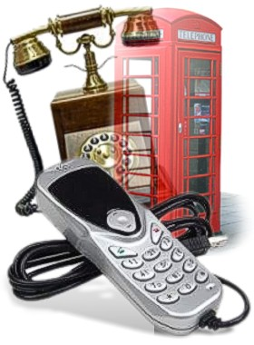
An introduction to GSM
Global System for Mobile Communications (GSM) is a second generation (2G) cellular standard developed to cater voice services and data delivery using digital modulation .
It was first launched in 1991 by European Standard Telecommunications Institute (ETSI).
It had been widely accepted by the world due to its significant technical advantages over analog telephone systems due to use of digital technology .

Slide 3
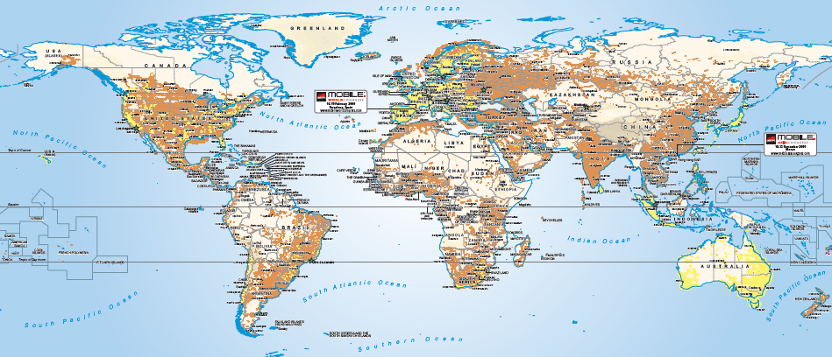
GSM across the world
1981 : Nordic Mobile Telephone (NMT) 450
1983 : American Mobile Phone System (AMPS)
1985 : Total Access Communication System (TACS)
1986 : Nordic Mobile Telephony (NMT) 900
1991 : American Digital Cellular (ADC)
1991 : Global System for Mobile Communication (GSM)
1992 : Digital Cellular System (DCS) 1800
1994 : Personal Digital Cellular (PDC)
1995 : PCS 1900—Canada
1996 : PCS—United States

Slide 4
GSM : The Basic Hierarchy
Mobile Switching Center (MSC)
Location Area (LA)
Base Station Controller (BSC)
Base Station Controller (BSC)
Location Area (LA)
Base Station Controller (BSC)
Cell
Cell
Cell
Base Station Controller (BSC) + Location Area (LA) (Overlap)

Slide 5
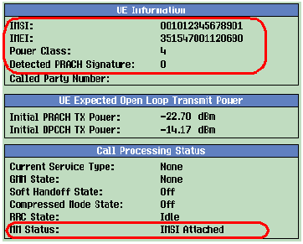
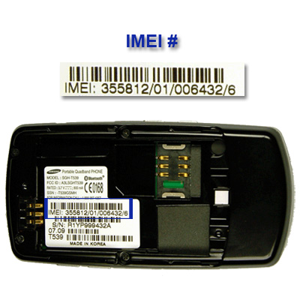
Salient Features of a GSM System
International Mobile Subscriber Identity (IMSI)
International Mobile Equipment Identity (IMEI)
Mobile Subscriber ISDN Number (MSIN)
Mobile Station Roaming Number (MSRN)
Location Area Identity (LAI)

Slide 6
GSM Services
Telecommunication Services (mobile
telephony , emergence calling etc.)
Bearer or Data Services (inter-
network information transfer ,
SMS , UMS etc .)
Supplementary Services (includes
all the call related services)

Slide 7
Call Routing in GSM
Call originating from MS
Call termination to MS

Slide 8
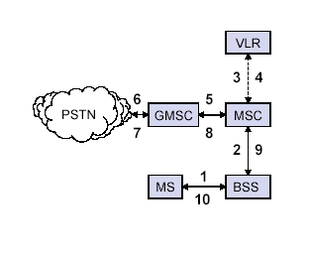
Outgoing Call
1 MS sends dialled number to BSS
2 BSS sends dialled number to
MSC
3,4 MSC checks VLR if MS has
allowed the requested service.If
so , MSC asks BSS to allocate
resources for call.
5 MSC routes the call to GMSC
GMSC routes the call to local
exchange of called user .
7, 8 ,9,10 Answer back(ring back)
tone is routed from called user to
MS via GMSC,MSC and BSS .

Slide 9
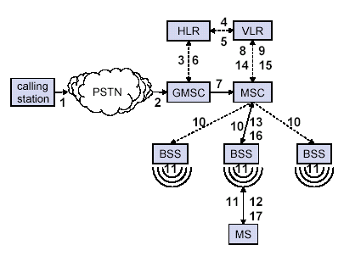
Incoming Call
1 Calling a GSM subscriber
2 Forwarding call to GSMC
3 Signal Setup to HLR by GMSC
4 , 5 Request MSRN by HLR from VLR
6 Forward responsible HLR to GMSC
7 Forward Call to current MSC
8 , 9 Get current status of MS
10 , 11 Paging of MS
12 ,13 MS answers
14 , 15 Security checks
16 , 17 Set up connection

Slide 10
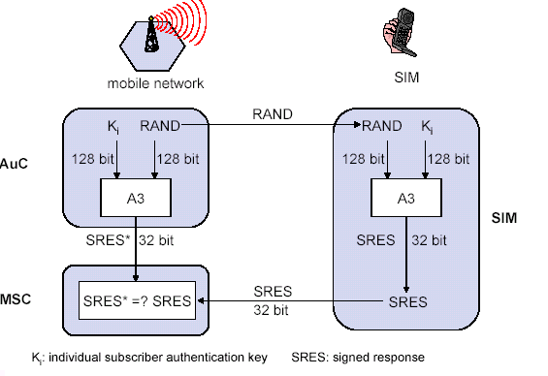
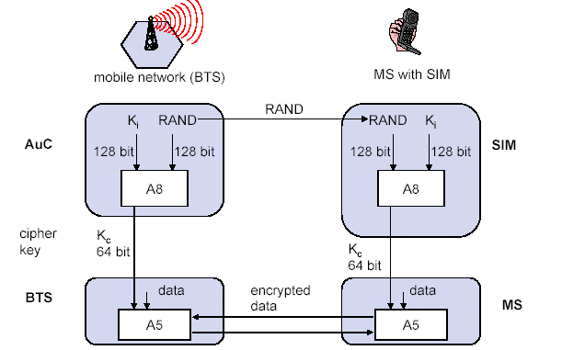
Security in GSM
On air interface, GSM uses
encryption and TMSI instead
of IMSI .
SIM is provided 4-8 digit PIN
to validate the ownership of
SIM .
3 main algorithms are specified
to ensure security:
A3 algorithm for authentication
A5 algorithm for encryption
A8 algorithm for key generation

Slide 11
Advantages of GSM over Analog system
Capacity increases .
Reduced RF transmission power and longer battery life .
International roaming capability.
Better security against fraud (through terminal validation and user
authentication).
Encryption capability for information security and privacy.
Compatibility with ISDN , leading to wider range of services.

Slide 12
Applications of GSM
Mobile telephony
GSM Radio
Telemetry System
Fleet management
Automatic meter reading
Toll Collection
Remote control and fault
reporting of DG sets
Value Added Services
Wireless Communication

Slide 13
Future of GSM
2nd Generation (2G)
GSM -9.6 Kbps (data rate)
2.5 Generation (2.5 G)
HSCSD (High Speed circuit switched data)
Data rate : 76.8 Kbps (9.6 x 8 kbps)
GPRS (General Packet Radio service)
Data rate: 14.4 - 115.2 Kbps
EDGE (Enhanced data rate for GSM Evolution)
Data rate: 547.2 Kbps (max)
3rd Generation (3G)
WCDMA (Wide band CDMA)
Data rate : 0.348 – 2.0 Mbps

Slide 14
Thank You

