Slide 1
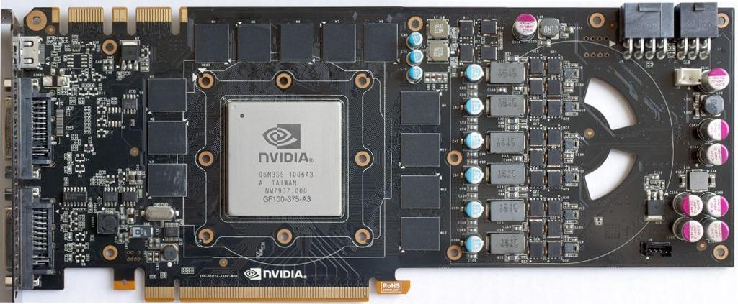
Graphics Processing Unit (GPU)
Architecture and Programming
TU/e 5kk73
/ʤɛnju:/ /jɛ/
Zhenyu Ye
Henk Corporaal
2011-11-15

Slide 2
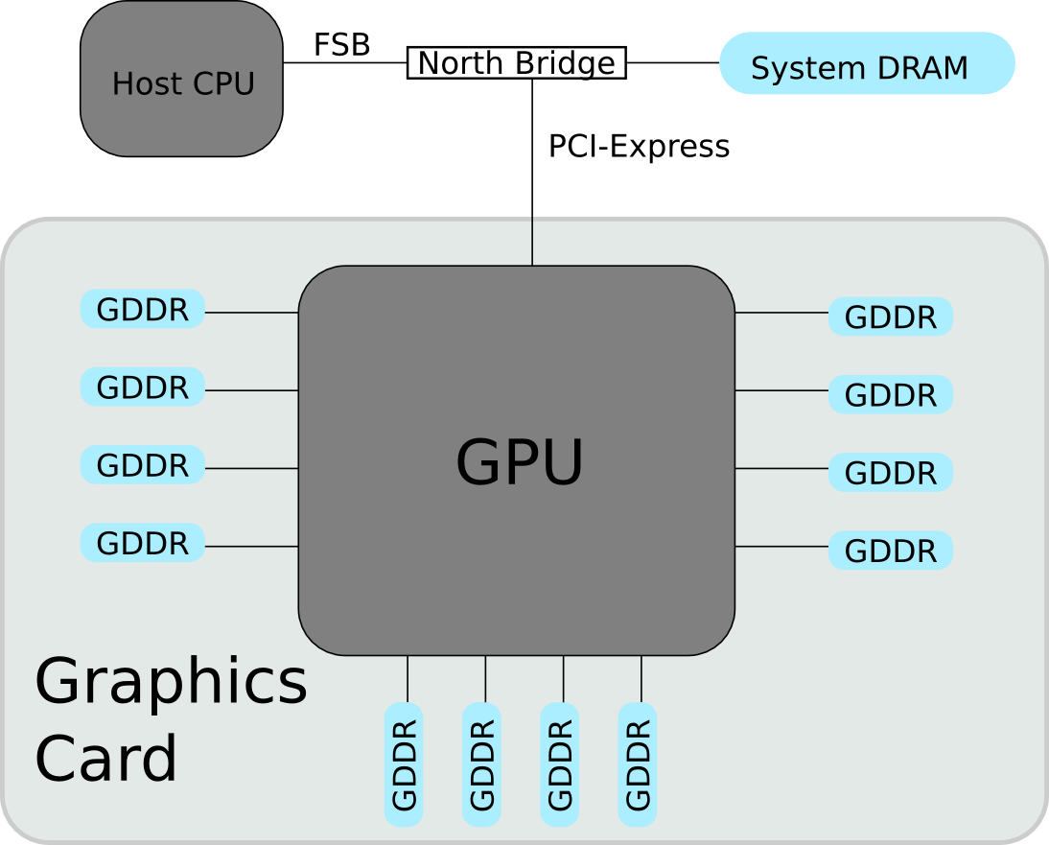
System Architecture

Slide 3
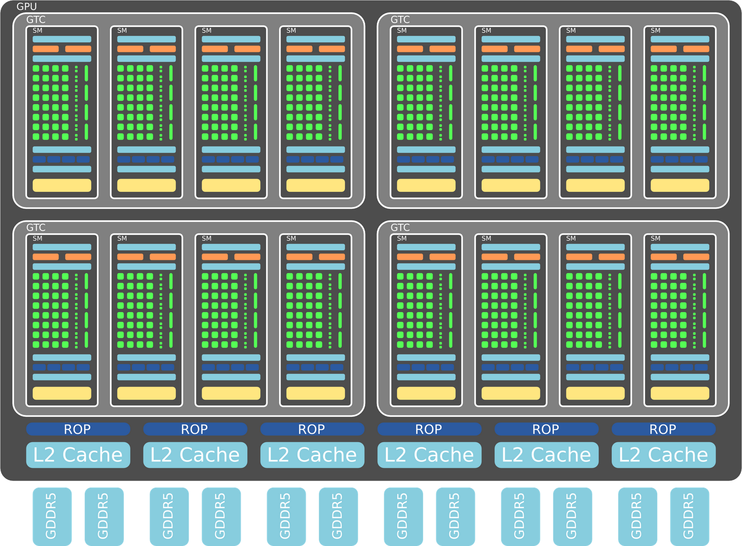
GPU Architecture
NVIDIA Fermi, 512 Processing Elements (PEs)
Notes:
NVIDIA planned to put 512 PEs into a single GPU, but the GTX480 turns out to have 480 PEs.

Slide 4
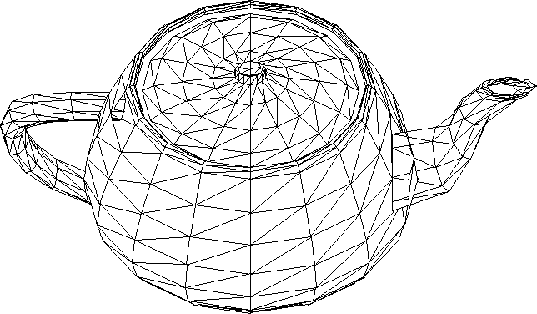

What Can It Do?
Render triangles.
NVIDIA GTX480 can render 1.6 billion triangles per second!
ref: "How GPUs Work", http://dx.doi.org/10.1109/MC.2007.59

Slide 5
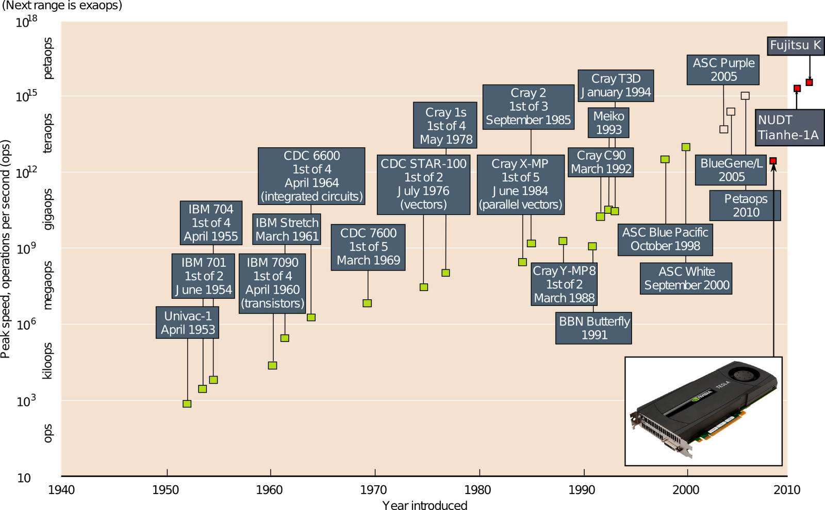
Single-Chip GPU v.s. Fastest Super Computers
ref: http://www.llnl.gov/str/JanFeb05/Seager.html

Slide 6
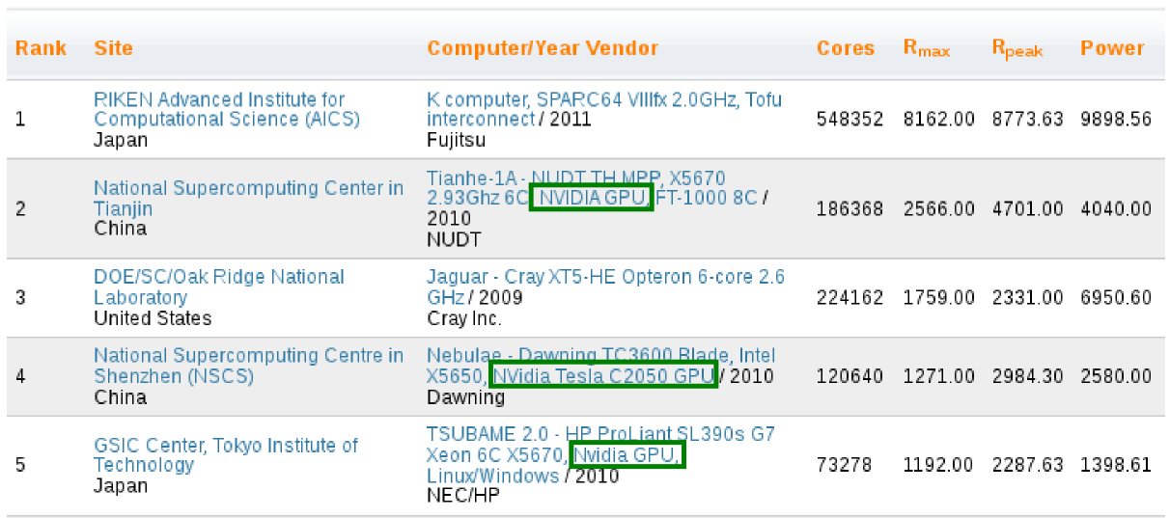
GPUs Are In Top Supercomputers
The Top500 supersomputer ranking in June 2011.
ref: http://top500.org

Slide 7
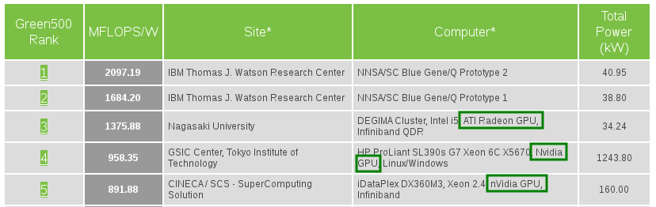
GPUs Are Also Green
The Green500 supersomputer ranking in June 2011.
ref: http://www.green500.org

Slide 8
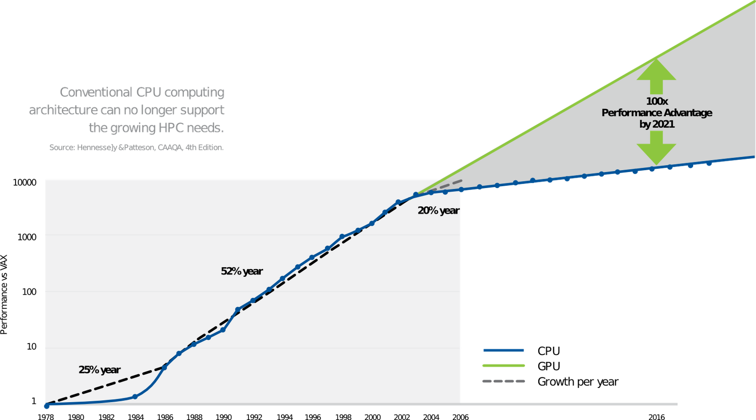
The Gap Between CPU and GPU
Note: This is from the perspective of NVIDIA.
ref: Tesla GPU Computing Brochure
Notes:
This gap is narrowed by multi-core CPUs.

Slide 9
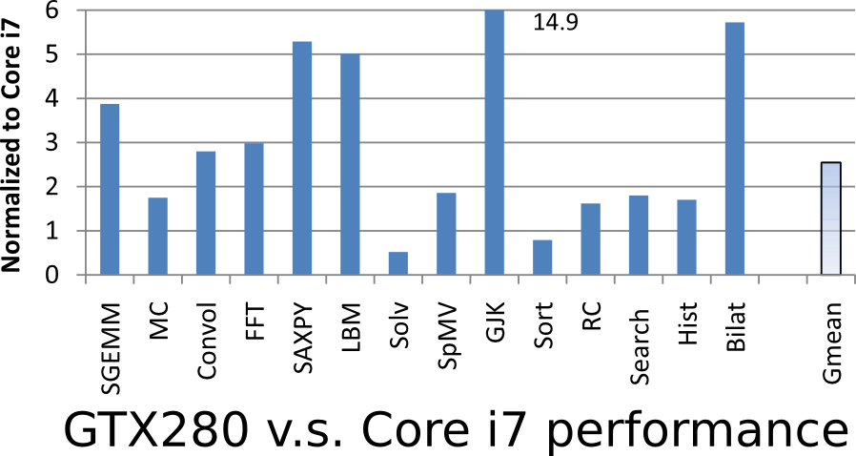
The Gap Between CPU and GPU
Application performance benchmarked by Intel.
ref: "Debunking the 100X GPU vs. CPU myth", http://dx.doi.org/10.1145/1815961.1816021

Slide 10
In This Lecture, We Will Find Out...
What is the archticture in GPUs?
How to program GPUs?

Slide 11
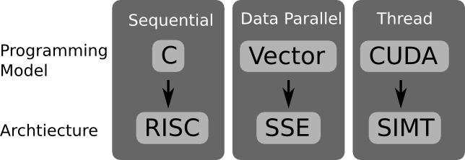
Let's Start with Examples
Don't worry, we will start from C and RISC!

Slide 12
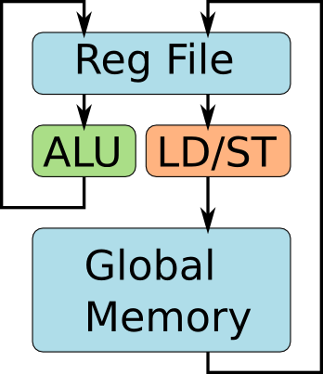
Let's Start with C and RISC
int A[2][4];
for(i=0;i<2;i++){
for(j=0;j<4;j++){
A[i][j]++;
}
}
Assembly
code of
inner-loop
lw r0, 4(r1)
addi r0, r0, 1
sw r0, 4(r1)
Programmer's view of RISC

Slide 13
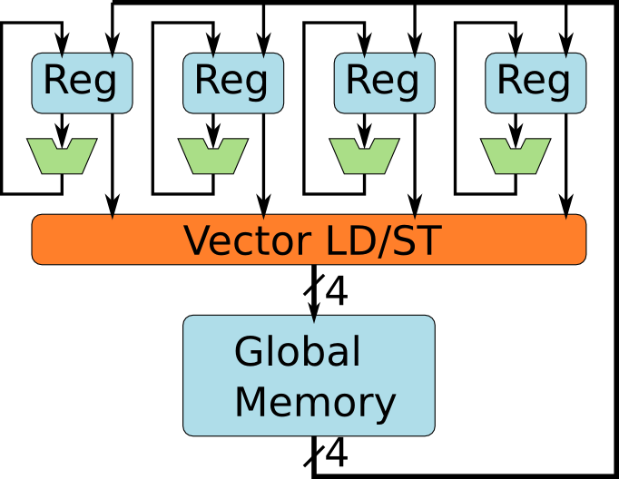
Most CPUs Have Vector SIMD Units
Programmer's view of a vector SIMD, e.g. SSE.

Slide 14
Let's Program the Vector SIMD
Unroll inner-loop to vector operation.
int A[2][4];
for(i=0;i<2;i++){
for(j=0;j<4;j++){
A[i][j]++;
}
}
int A[2][4];
for(i=0;i<2;i++){
movups xmm0, [ &A[i][0] ] // load
addps xmm0, xmm1 // add 1
movups [ &A[i][0] ], xmm0 // store
}
Looks like the previous example,
but SSE instructions execute on 4 ALUs.
int A[2][4];
for(i=0;i<2;i++){
for(j=0;j<4;j++){
A[i][j]++;
}
}
Assembly
code of
inner-loop
lw r0, 4(r1)
addi r0, r0, 1
sw r0, 4(r1)

Slide 15
How Do Vector Programs Run?
int A[2][4];
for(i=0;i<2;i++){
movups xmm0, [ &A[i][0] ] // load
addps xmm0, xmm1 // add 1
movups [ &A[i][0] ], xmm0 // store
}

Slide 16
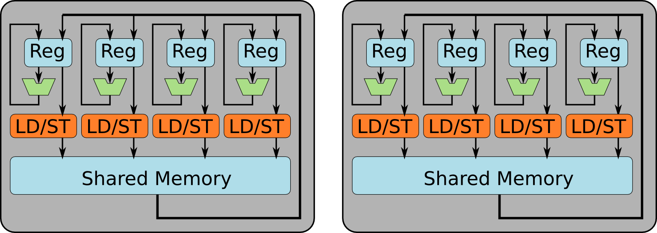
CUDA Programmer's View of GPUs
A GPU contains multiple SIMD Units.

Slide 17
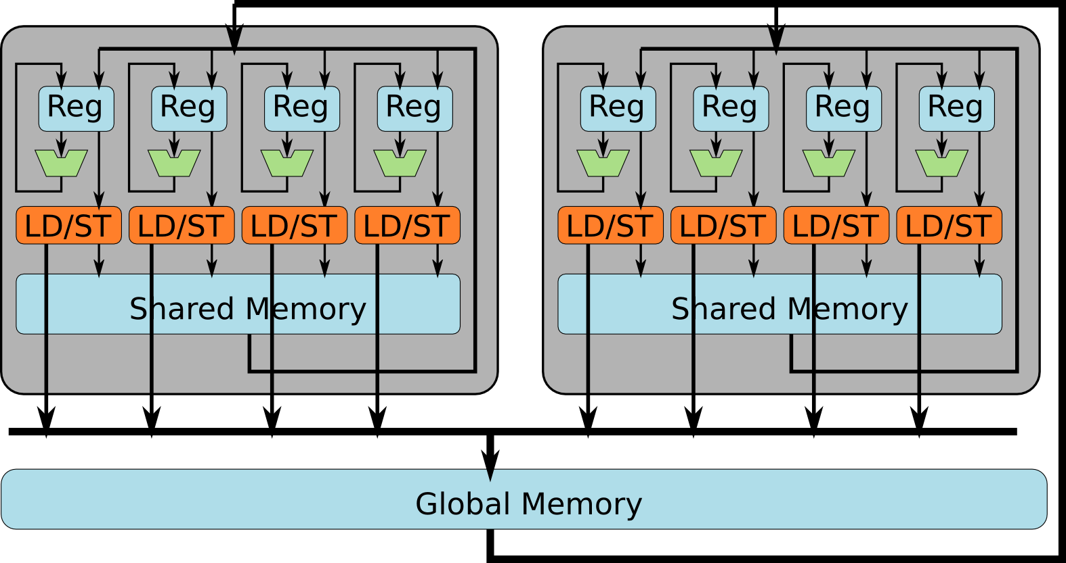
CUDA Programmer's View of GPUs
A GPU contains multiple SIMD Units. All of them can access global memory.

Slide 18
What Are the Differences?
SSE
GPU
Let's start with two important differences:
GPUs use threads instead of vectors
The "Shared Memory" spaces

Slide 19
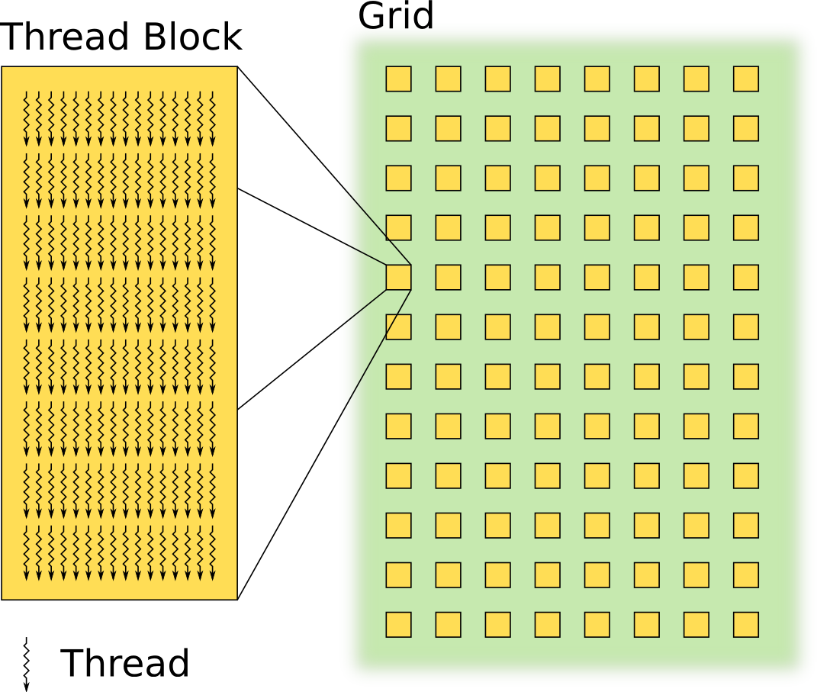
Thread Hierarchy in CUDA
Grid
contains
Thread Blocks
Thread Block
contains
Threads

Slide 20
Let's Start Again from C
int A[2][4];
for(i=0;i<2;i++){
for(j=0;j<4;j++){
A[i][j]++;
}
}
convert into CUDA
int A[2][4];
kernelF<<<(2,1),(4,1)>>>(A);
__device__ kernelF(A){
i = blockIdx.x;
j = threadIdx.x;
A[i][j]++;
}
// define threads
// all threads run same kernel
// each thread block has its id
// each thread has its id
// each thread has a different i and j

Slide 21
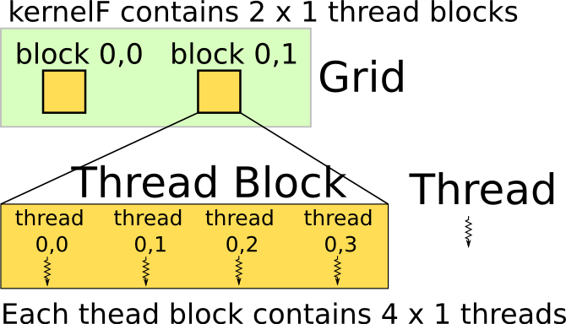
What Is the Thread Hierarchy?
thread 3 of block 1 operates
on element A[1][3]
int A[2][4];
kernelF<<<(2,1),(4,1)>>>(A);
__device__ kernelF(A){
i = blockIdx.x;
j = threadIdx.x;
A[i][j]++;
}
// define threads
// all threads run same kernel
// each thread block has its id
// each thread has its id
// each thread has a different i and j

Slide 22
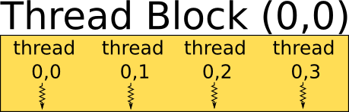
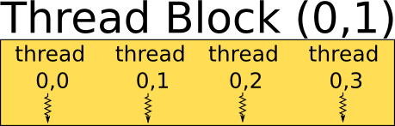

How Are Threads Scheduled?

Slide 23
How Are Threads Executed?
int A[2][4];
kernelF<<<(2,1),(4,1)>>>(A);
__device__ kernelF(A){
i = blockIdx.x;
j = threadIdx.x;
A[i][j]++;
}
mv.u32 %r0, %ctaid.x
mv.u32 %r1, %ntid.x
mv.u32 %r2, %tid.x
mad.u32 %r3, %r2, %r1, %r0
ld.global.s32 %r4, [%r3]
add.s32 %r4, %r4, 1
st.global.s32 [%r3], %r4
// r0 = i = blockIdx.x
// r1 = "threads-per-block"
// r2 = j = threadIdx.x
// r3 = i * "threads-per-block" + j
// r4 = A[i][j]
// r4 = r4 + 1
// A[i][j] = r4

Slide 24
Utilizing Memory Hierarchy

Slide 25
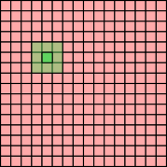
Example: Average Filters
Average over a
3x3 window for
a 16x16 array
kernelF<<<(1,1),(16,16)>>>(A);
__device__ kernelF(A){
i = threadIdx.y;
j = threadIdx.x;
tmp = (A[i-1][j-1]
+ A[i-1][j]
...
+ A[i+1][i+1] ) / 9;
A[i][j] = tmp;
}

Slide 26
Utilizing the Shared Memory
Average over a
3x3 window for
a 16x16 array
kernelF<<<(1,1),(16,16)>>>(A);
__device__ kernelF(A){
__shared__ smem[16][16];
i = threadIdx.y;
j = threadIdx.x;
smem[i][j] = A[i][j]; // load to smem
A[i][j] = ( smem[i-1][j-1]
+ smem[i-1][j]
...
+ smem[i+1][i+1] ) / 9;
}

Slide 27
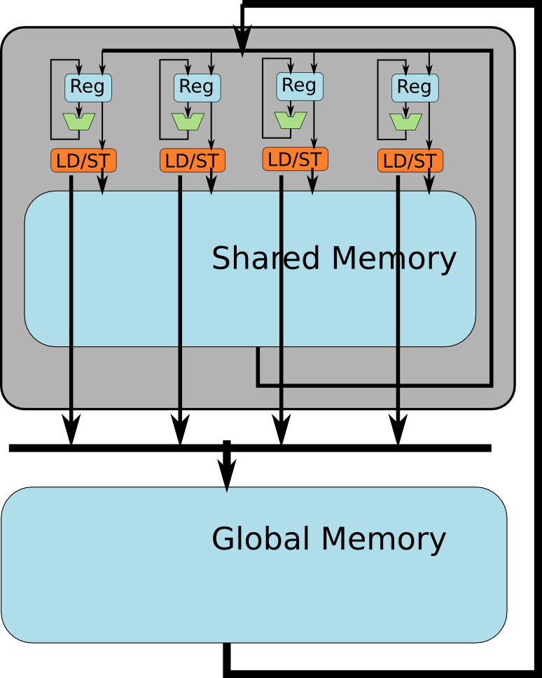

Utilizing the Shared Memory
kernelF<<<(1,1),(16,16)>>>(A);
__device__ kernelF(A){
__shared__ smem[16][16];
i = threadIdx.y;
j = threadIdx.x;
smem[i][j] = A[i][j]; // load to smem
A[i][j] = ( smem[i-1][j-1]
+ smem[i-1][j]
...
+ smem[i+1][i+1] ) / 9;
}
allocate shared mem

Slide 28
However, the Program Is Incorrect
kernelF<<<(1,1),(16,16)>>>(A);
__device__ kernelF(A){
__shared__ smem[16][16];
i = threadIdx.y;
j = threadIdx.x;
smem[i][j] = A[i][j]; // load to smem
A[i][j] = ( smem[i-1][j-1]
+ smem[i-1][j]
...
+ smem[i+1][i+1] ) / 9;
}

Slide 29
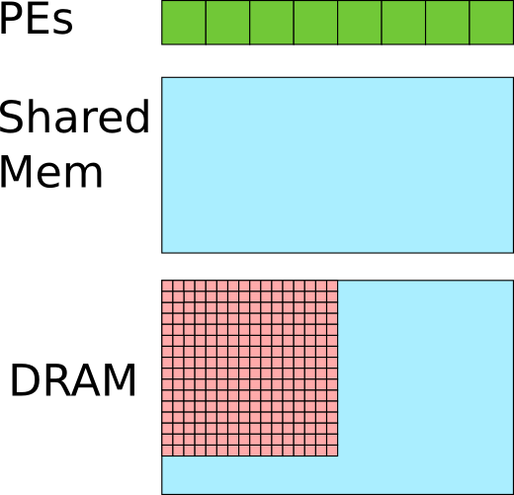
Let's See What's Wrong
Assume 256 threads are scheduled on 8 PEs.
kernelF<<<(1,1),(16,16)>>>(A);
__device__ kernelF(A){
__shared__ smem[16][16];
i = threadIdx.y;
j = threadIdx.x;
smem[i][j] = A[i][j]; // load to smem
A[i][j] = ( smem[i-1][j-1]
+ smem[i-1][j]
...
+ smem[i+1][i+1] ) / 9;
}
Before load instruction

Slide 30
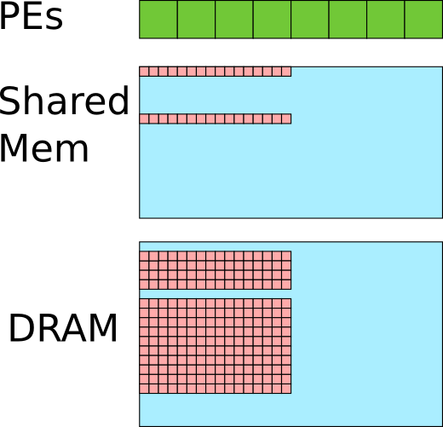
Let's See What's Wrong
Assume 256 threads are scheduled on 8 PEs.
kernelF<<<(1,1),(16,16)>>>(A);
__device__ kernelF(A){
__shared__ smem[16][16];
i = threadIdx.y;
j = threadIdx.x;
smem[i][j] = A[i][j]; // load to smem
A[i][j] = ( smem[i-1][j-1]
+ smem[i-1][j]
...
+ smem[i+1][i+1] ) / 9;
}
Some threads finish the load earlier than others.
Threads starts window operation as soon as it loads it own data element.

Slide 31
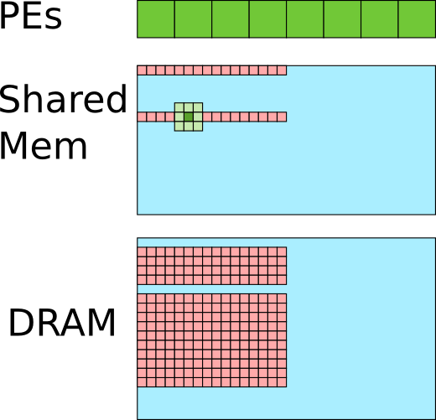
Let's See What's Wrong
Assume 256 threads are scheduled on 8 PEs.
kernelF<<<(1,1),(16,16)>>>(A);
__device__ kernelF(A){
__shared__ smem[16][16];
i = threadIdx.y;
j = threadIdx.x;
smem[i][j] = A[i][j]; // load to smem
A[i][j] = ( smem[i-1][j-1]
+ smem[i-1][j]
...
+ smem[i+1][i+1] ) / 9;
}
Some threads finish the load earlier than others.
Some elements in the window are not yet loaded by other threads. Error!
Threads starts window operation as soon as it loads it own data element.

Slide 32
How To Solve It?
Assume 256 threads are scheduled on 8 PEs.
kernelF<<<(1,1),(16,16)>>>(A);
__device__ kernelF(A){
__shared__ smem[16][16];
i = threadIdx.y;
j = threadIdx.x;
smem[i][j] = A[i][j]; // load to smem
A[i][j] = ( smem[i-1][j-1]
+ smem[i-1][j]
...
+ smem[i+1][i+1] ) / 9;
}
Some threads finish the load earlier than others.

Slide 33
Use a "SYNC" barrier!
Assume 256 threads are scheduled on 8 PEs.
kernelF<<<(1,1),(16,16)>>>(A);
__device__ kernelF(A){
__shared__ smem[16][16];
i = threadIdx.y;
j = threadIdx.x;
smem[i][j] = A[i][j]; // load to smem
__sync(); // threads wait at barrier
A[i][j] = ( smem[i-1][j-1]
+ smem[i-1][j]
...
+ smem[i+1][i+1] ) / 9;
}
Some threads finish the load earlier than others.

Slide 34
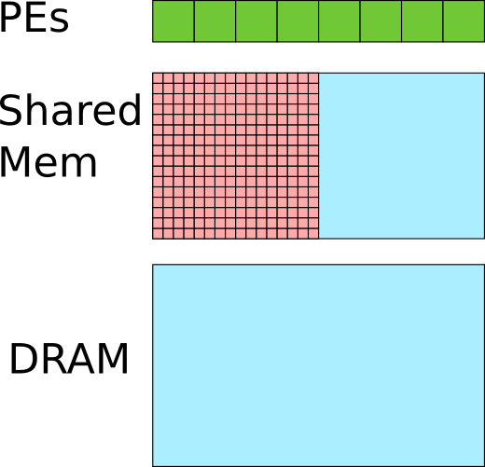
Use a "SYNC" barrier!
Assume 256 threads are scheduled on 8 PEs.
kernelF<<<(1,1),(16,16)>>>(A);
__device__ kernelF(A){
__shared__ smem[16][16];
i = threadIdx.y;
j = threadIdx.x;
smem[i][j] = A[i][j]; // load to smem
__sync(); // threads wait at barrier
A[i][j] = ( smem[i-1][j-1]
+ smem[i-1][j]
...
+ smem[i+1][i+1] ) / 9;
}
Some threads finish the load earlier than others.
Till all threads
hit barrier.

Slide 35
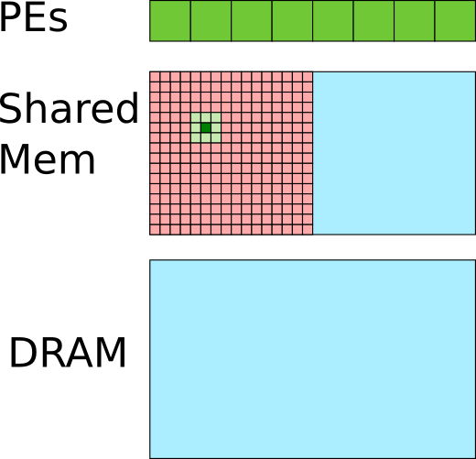
Use a "SYNC" barrier!
Assume 256 threads are scheduled on 8 PEs.
kernelF<<<(1,1),(16,16)>>>(A);
__device__ kernelF(A){
__shared__ smem[16][16];
i = threadIdx.y;
j = threadIdx.x;
smem[i][j] = A[i][j]; // load to smem
__sync(); // threads wait at barrier
A[i][j] = ( smem[i-1][j-1]
+ smem[i-1][j]
...
+ smem[i+1][i+1] ) / 9;
}
All elements in the window are loaded when each thread starts averaging.

Slide 36
Review What We Have Learned
1. Single Instruction Multiple Thread (SIMT)
2. Shared memory
Vector SIMD can also have shared memory.
For Example, the CELL architecture.
Q: What are the fundamental differences between the SIMT and vector SIMD programming models?

Slide 37
Take the Same Example Again
Average over a
3x3 window for
a 16x16 array
Assume vector SIMD and SIMT both have shared memory.
What is the difference?

Slide 38
Vector SIMD v.s. SIMT
int A[16][16]; // global memory
__shared__ int B[16][16]; // shared mem
for(i=0;i<16;i++){
for(j=0;i<4;j+=4){
movups xmm0, [ &A[i][j] ]
movups [ &B[i][j] ], xmm0 }}
for(i=0;i<16;i++){
for(j=0;i<4;j+=4){
addps xmm1, [ &B[i-1][j-1] ]
addps xmm1, [ &B[i-1][j] ]
...
divps xmm1, 9 }}
for(i=0;i<16;i++){
for(j=0;i<4;j+=4){
addps [ &A[i][j] ], xmm1 }}
kernelF<<<(1,1),(16,16)>>>(A);
__device__ kernelF(A){
__shared__ smem[16][16];
i = threadIdx.y;
j = threadIdx.x;
smem[i][j] = A[i][j]; // load to smem
__sync(); // threads wait at barrier
A[i][j] = ( smem[i-1][j-1]
+ smem[i-1][j]
...
+ smem[i+1][i+1] ) / 9;
}

Slide 39
Vector SIMD v.s. SIMT
int A[16][16];
__shared__ int B[16][16];
for(i=0;i<16;i++){
for(j=0;i<4;j+=4){
movups xmm0, [ &A[i][j] ]
movups [ &B[i][j] ], xmm0 }}
for(i=0;i<16;i++){
for(j=0;i<4;j+=4){
addps xmm1, [ &B[i-1][j-1] ]
addps xmm1, [ &B[i-1][j] ]
...
divps xmm1, 9 }}
for(i=0;i<16;i++){
for(j=0;i<4;j+=4){
addps [ &A[i][j] ], xmm1 }}
kernelF<<<(1,1),(16,16)>>>(A);
__device__ kernelF(A){
__shared__ smem[16][16];
i = threadIdx.y;
j = threadIdx.x;
smem[i][j] = A[i][j];
__sync(); // threads wait at barrier
A[i][j] = ( smem[i-1][j-1]
+ smem[i-1][j]
...
+ smem[i+1][i+1] ) / 9;
}
Programmers schedule operations on PEs.
# of PEs in HW is transparent to programmers.
You need to know how many PEs are in HW.
Programmers give up exec. ordering to HW.
Each inst. is executed by all PEs in locked step.
CUDA programmers let the SIMT hardware schedule operations on PEs.

Slide 40
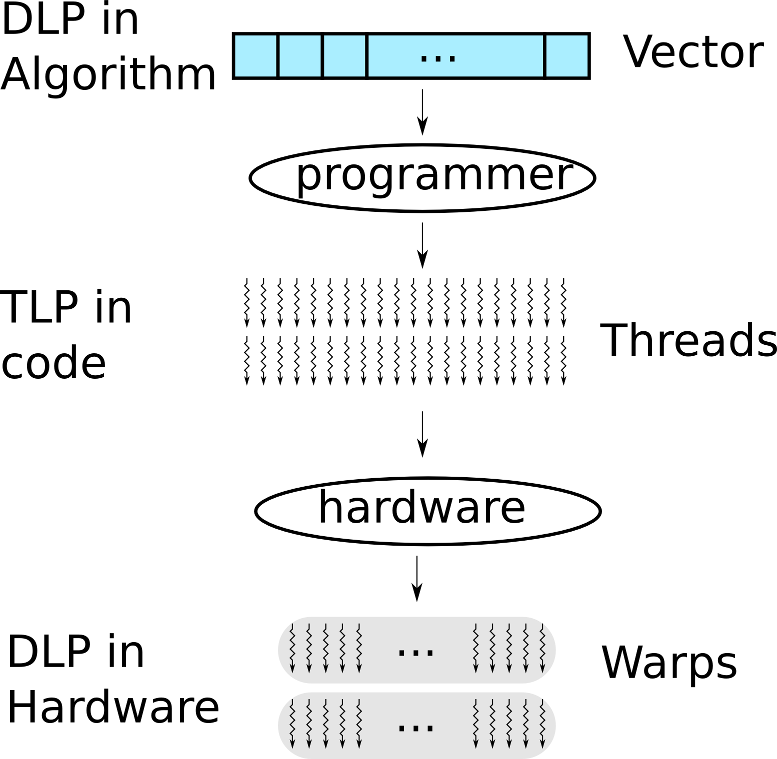
Review What We Have Learned
Programmers convert data level parallelism (DLP) into thread level parallelism (TLP).

Slide 41
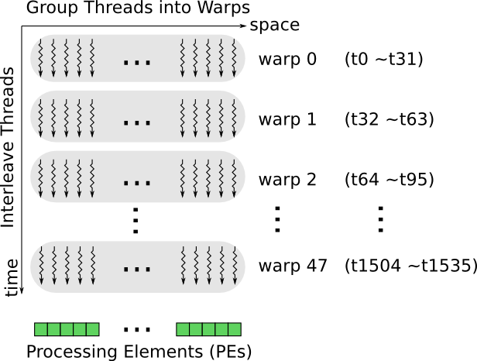
HW Groups Threads Into Warps
Example: 32 threads per warp

Slide 42
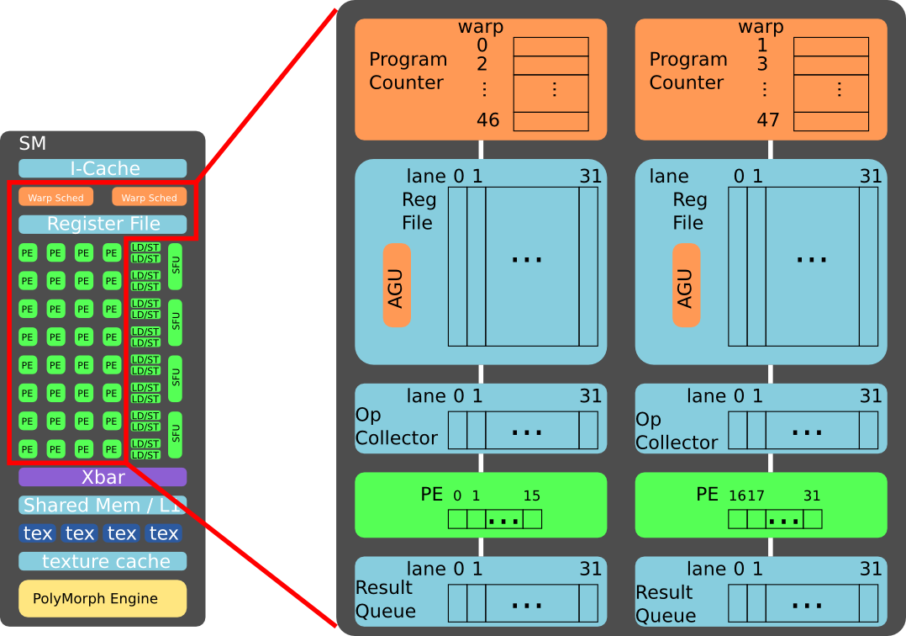
Example of Implementation
Note: NVIDIA may use a more complicated implementation.
Notes:
This example assumes the two warp schedulers are decoupled. It is possible that they are coupled together, at the cost of hardware complexity.

Slide 43
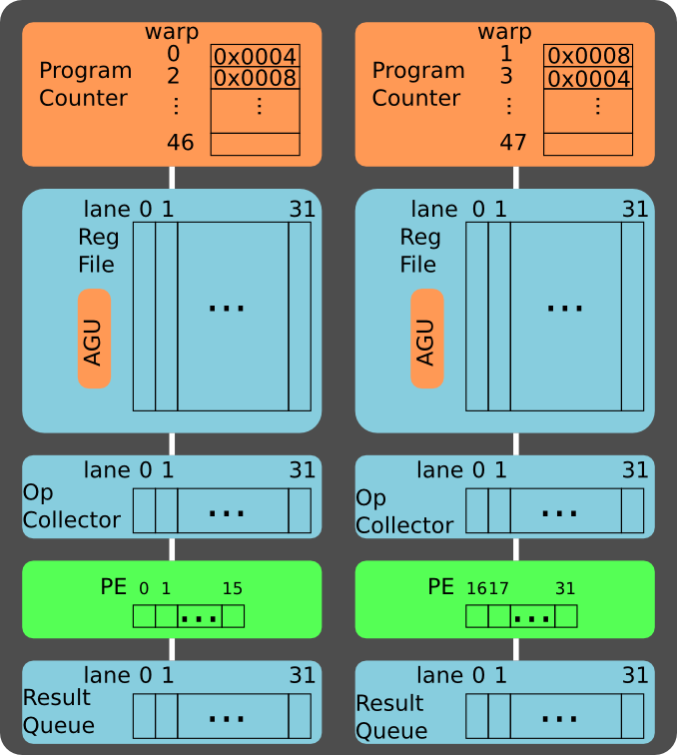
Example
Program Address: Inst
0x0004: add r0, r1, r2
0x0008: sub r3, r4, r5
Assume warp 0 and warp 1 are scheduled for execution.

Slide 44
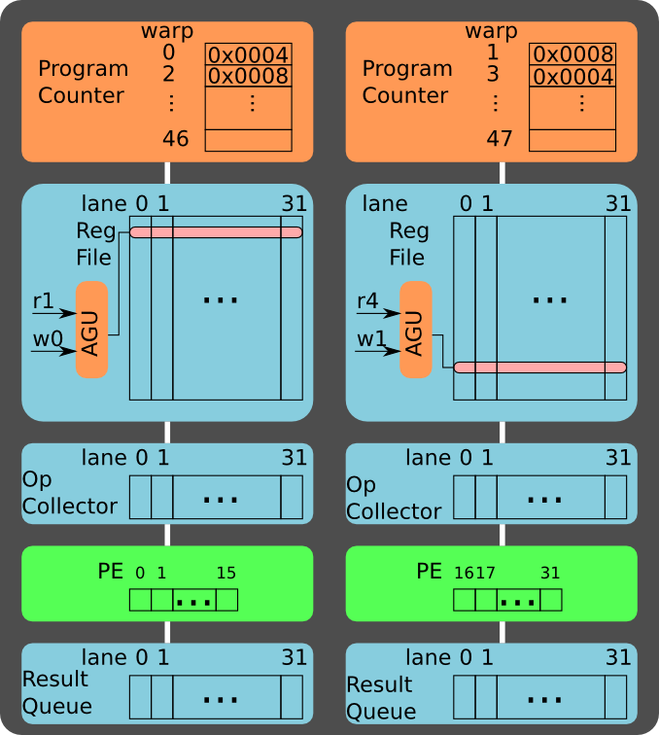
Read Src Op
Program Address: Inst
0x0004: add r0, r1, r2
0x0008: sub r3, r4, r5
Read source operands:
r1 for warp 0
r4 for warp 1
Notes:
Assume the register file has one read port.
The register file may need two read port to support instructions with 3 source operands, e.g. the Fused Multiply Add (FMA).

Slide 45
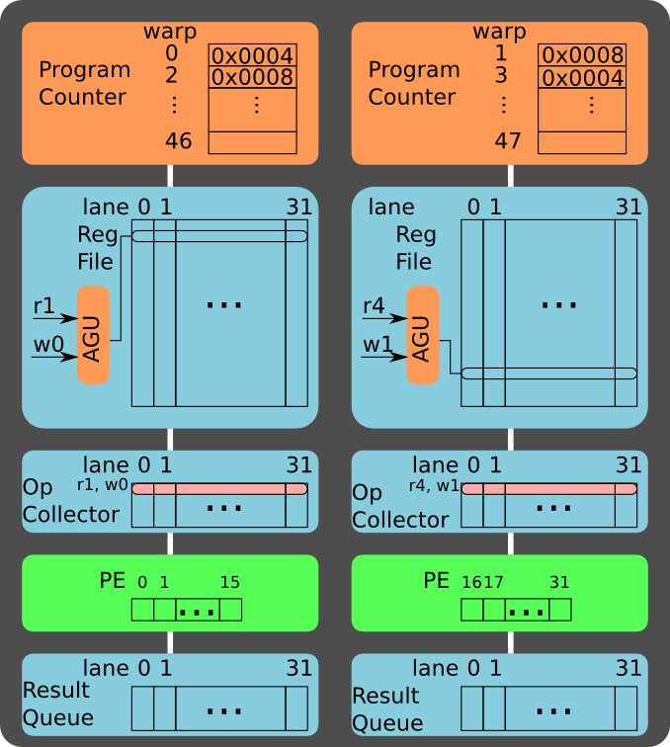
Buffer Src Op
Program Address: Inst
0x0004: add r0, r1, r2
0x0008: sub r3, r4, r5
Push ops to op collector:
r1 for warp 0
r4 for warp 1

Slide 46

Read Src Op
Program Address: Inst
0x0004: add r0, r1, r2
0x0008: sub r3, r4, r5
Read source operands:
r2 for warp 0
r5 for warp 1

Slide 47
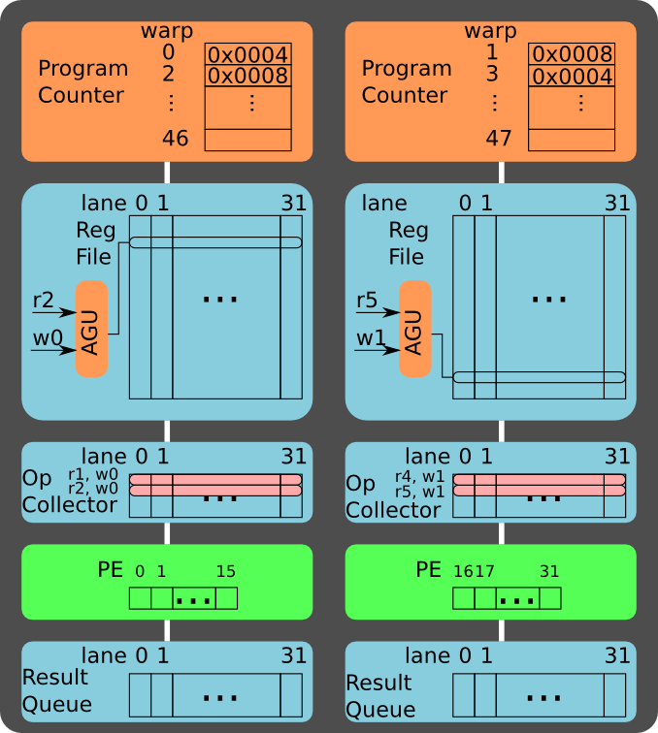
Buffer Src Op
Program Address: Inst
0x0004: add r0, r1, r2
0x0008: sub r3, r4, r5
Push ops to op collector:
r2 for warp 0
r5 for warp 1

Slide 48
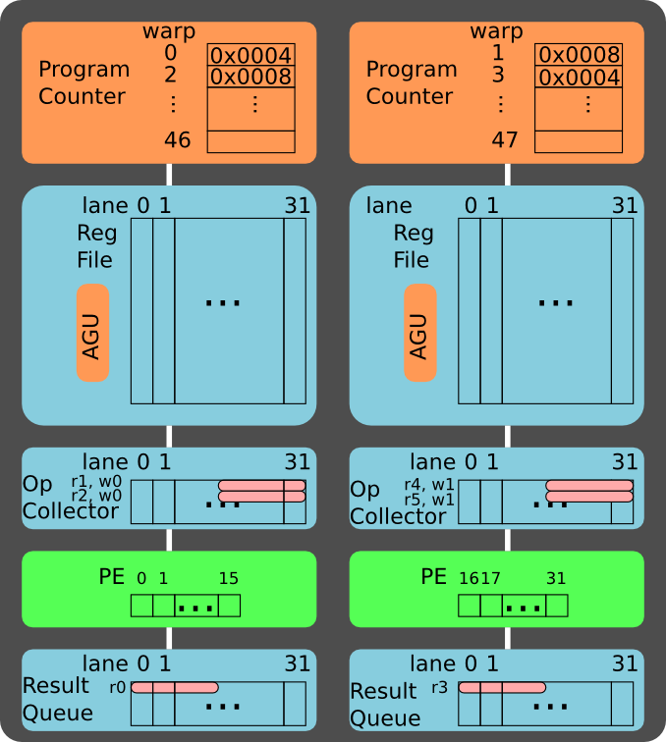
Execute
Program Address: Inst
0x0004: add r0, r1, r2
0x0008: sub r3, r4, r5
Compute the first 16 threads in the warp.

Slide 49
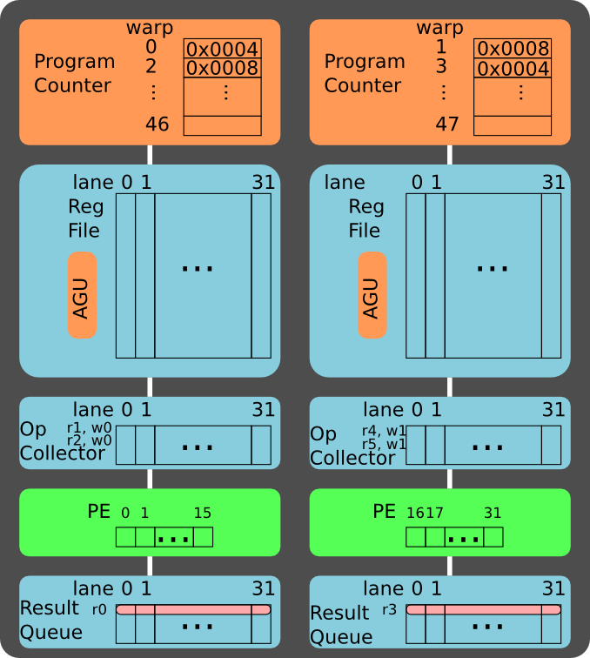
Execute
Program Address: Inst
0x0004: add r0, r1, r2
0x0008: sub r3, r4, r5
Compute the last 16 threads in the warp.

Slide 50
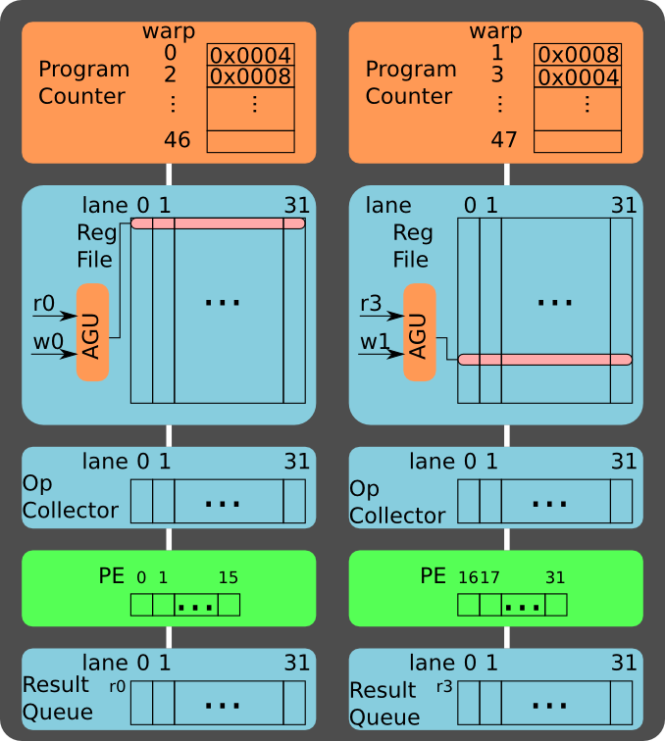
Write back
Program Address: Inst
0x0004: add r0, r1, r2
0x0008: sub r3, r4, r5
Write back:
r0 for warp 0
r3 for warp 1

Slide 51
A Brief Recap of SIMT Architecture
Threads in the same warp are scheduled together to execute the same instruction.
A warp of 32 threads can be executed on 16 (8) PEs in 2 (4) cycles by time-multiplexing.

Slide 52
Summary
The CUDA programming model.
The SIMT architecture.

Slide 53
Reference
NVIDIA Tesla: A Unified Graphics and Computing Architecture, IEEE Micro 2008, link: http://dx.doi.org/10.1109/MM.2008.31
Understanding throughput-oriented architectures, Communications of the ACM 2010, link: http://dx.doi.org/10.1145/1839676.1839694
GPUs and the Future of Parallel Computing, IEEE Micro 2011, link: http://dx.doi.org/10.1109/MM.2011.89
An extended list of learning materials in the assignment website: http://sites.google.com/site/5kk73gpu2011/materials

