Slide 1
Preparing Calibration Service Procedures and Validation Methods in Support of CMCs
Marina Gertsvolf
Jan 28, 2014
2015 SIM TFWG Workshop

Slide 2
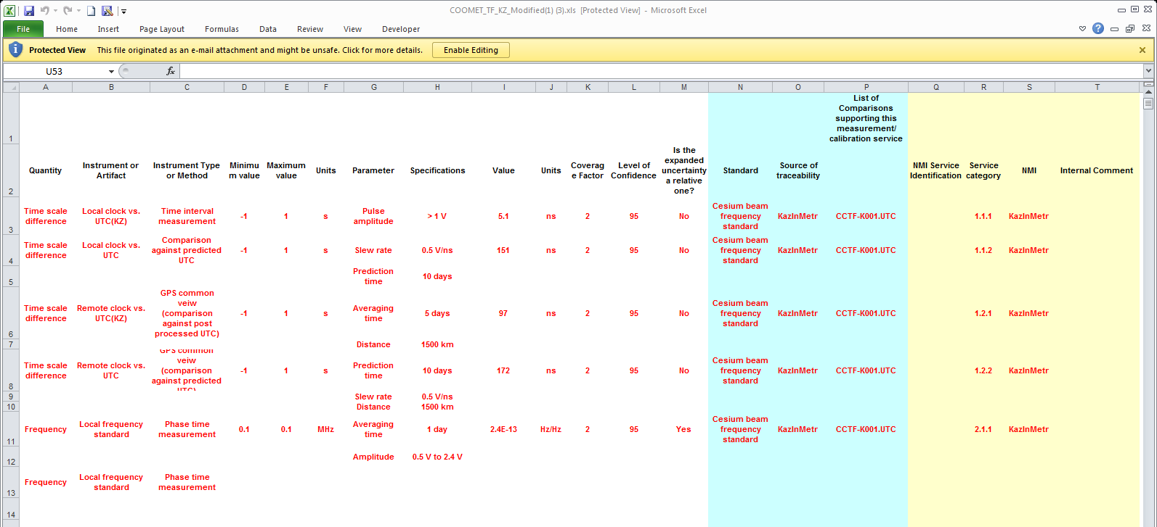
CMC review example
Recent CMS from COOMET_TF_KZ

Slide 3
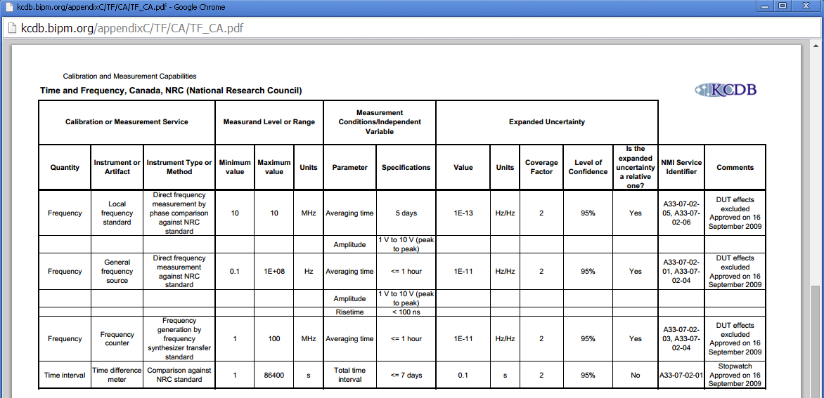
NRC CMC in Time and Frequency
General Frequency Source Calibration – Procedure Missing (external audit finding)

Slide 4
Calibration Approach
Method
  Frequency source → frequency counter or time interval counter
    Procedure FTS_FREQMEAS
  frequency counter: calibration procedure missing
    Procedure FTS-FREQ_CNTR_CAL
  time interval counter : verified for the use at 1PPS only via CCTF-K001.UTC

Slide 5
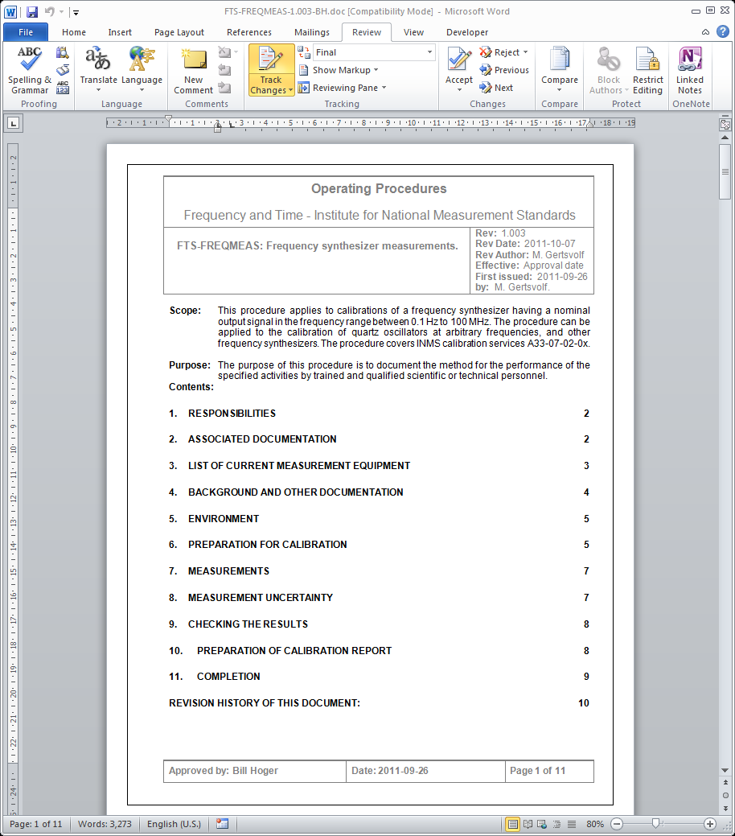
Calibration Procedure: FTS-FREQMEAS

Slide 6
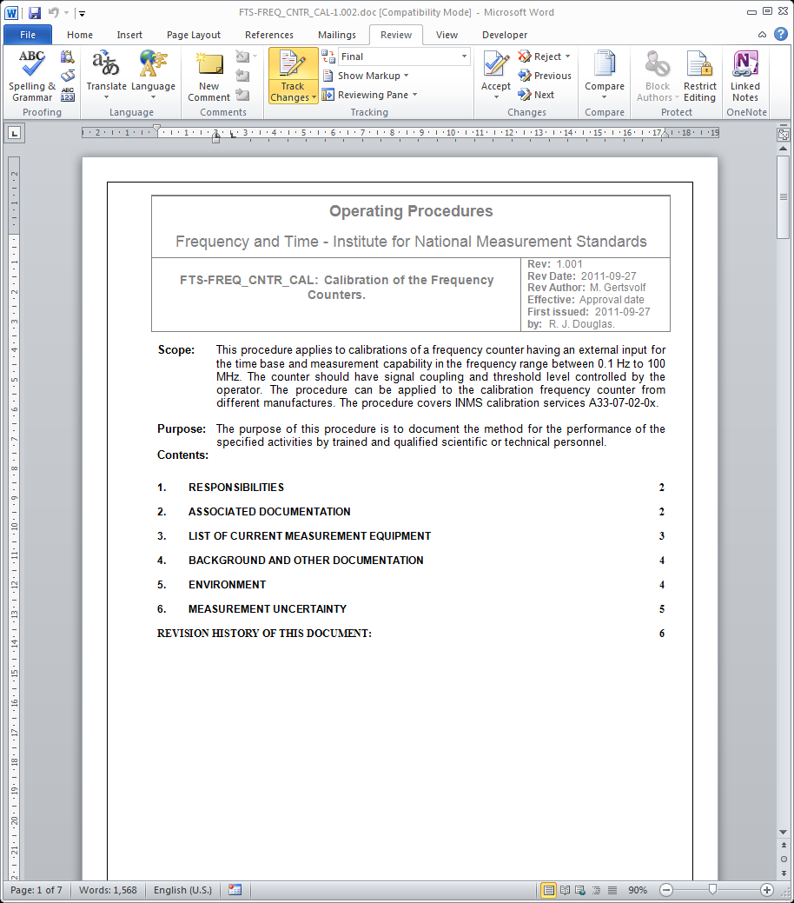
Calibration Procedure: FTS-FREQ_CNTR_CAL

Slide 7
Calibration Validation
Procedure:
    Frequency source → frequency counter or time interval counter
Validation:
  Known frequency source → Calibrated frequency counter or time interval counter
  Over all frequency ranges and with the worst case slope
    100 ns rise time
    1 Vpp
    0.1 Hz
    1 hr averaging

Slide 8
Calibration Validation: Setup
Start with the system used in the Key Comparison CCTF-K001.UTC
H maser or Cs clock
5MHz
sine
time base
Time Interval Counter
HP 5370B
Measurement Automation Switch Box
NRC R.P.
1PPS
TTL
UTC(NRC)

Slide 9
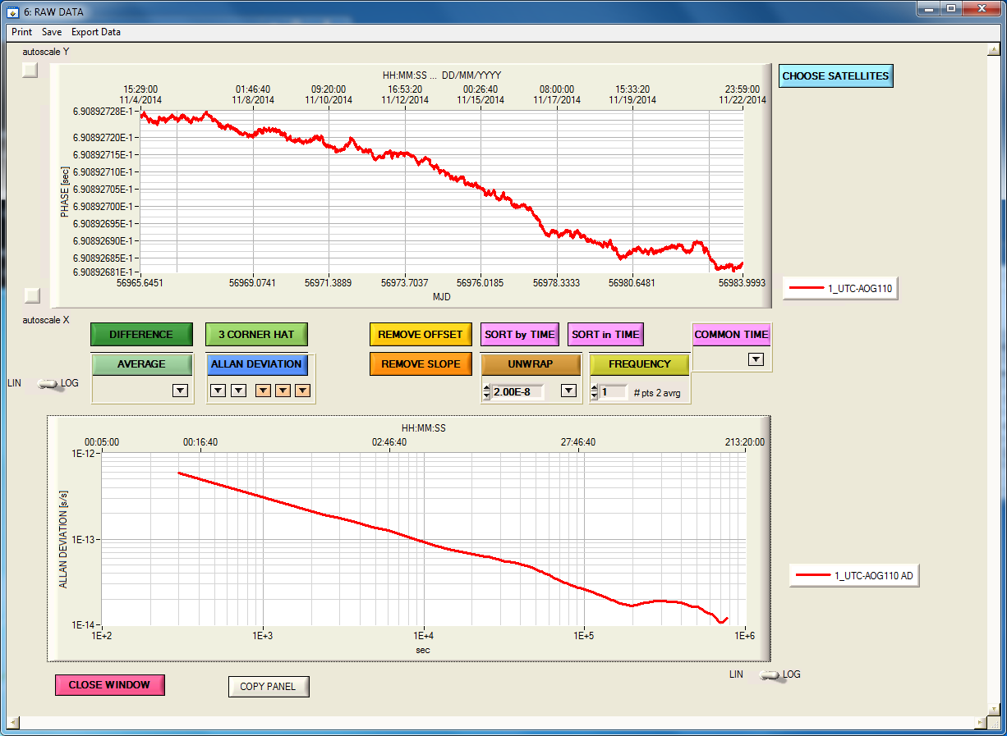

Results
HP-5370B measurement results example
$$σ_{y}\left(τ=1hr\right)<2∙{10}^{−13}$$

Slide 10
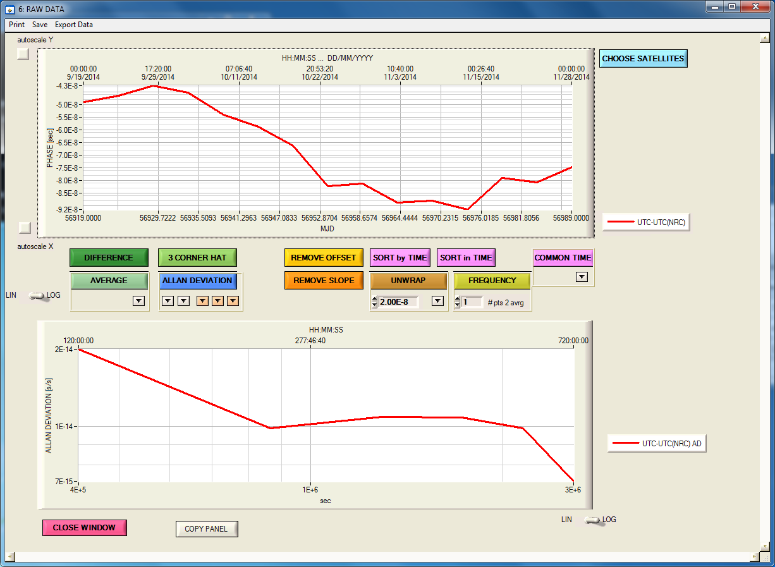
Results
UTC - UTC(NRC) from Circular T

Slide 11
Calibration Validation: Setup
Generate custom signals with CMC specifications
H maser or Cs clock
5MHz
sine
Frequency Synthesizer
Anritsu MG 3641A
Stanford Research DS245
time base
5 - 100MHz
sine
Frequency Divider
NRC CAL DIV W.P.
nPPS
TTL
2.32Vpp @50Ω

Slide 12
Calibration Validation: Setup
Use K001.UTC system for custom signals calibration
H maser or Cs clock
5MHz
sine
Frequency Synthesizer
Anritsu MG 3641A
Stanford Research DS245
5MHz
sine
5 - 100MHz
sine
Frequency Divider
NRC CAL DIV W.P.
Time Interval Counter
HP 5370B
nPPS
TTL
Measurement Automation Switch Box
NRC R.P.
1PPS
TTL
UTC(NRC)

Slide 13
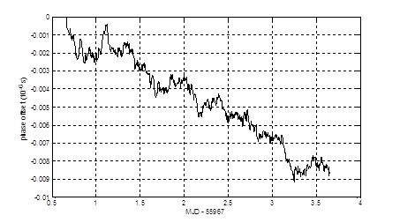
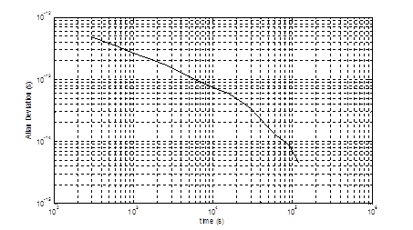
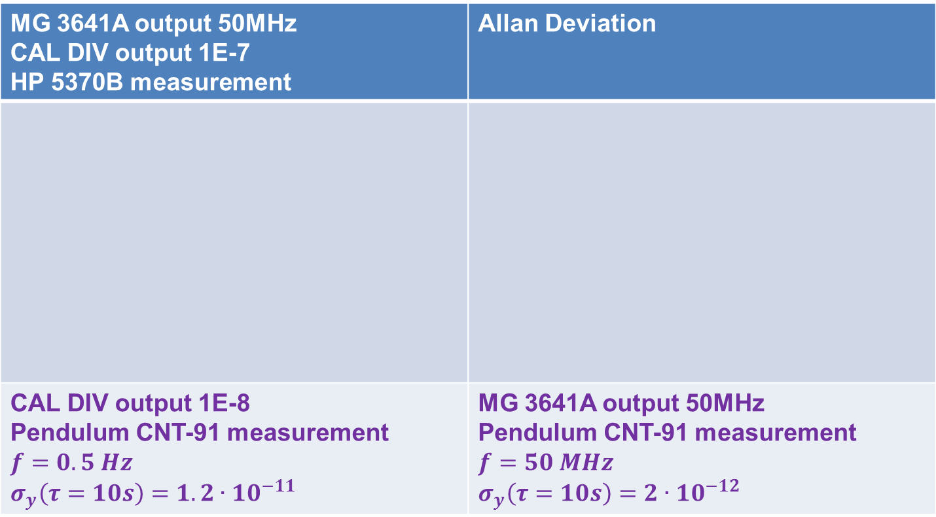

Frequency Measurements with HP system
MG 3641A output 50MHz CAL DIV output 1E-7 HP 5370B measurement | Allan Deviation
CAL DIV output 1E-8 Pendulum CNT-91 measurement $$f=0.5 Hz$$ $$σ_{y}\left(τ=10s\right)=1.2∙{10}^{−11}$$ | MG 3641A output 50MHz Pendulum CNT-91 measurement $$f=50 MHz$$ $$σ_{y}\left(τ=10s\right)=2∙{10}^{−12}$$
$$σ_{y}\left(τ=1hr\right)<2∙{10}^{−13}$$

Slide 14
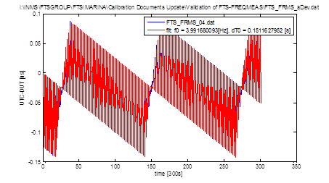
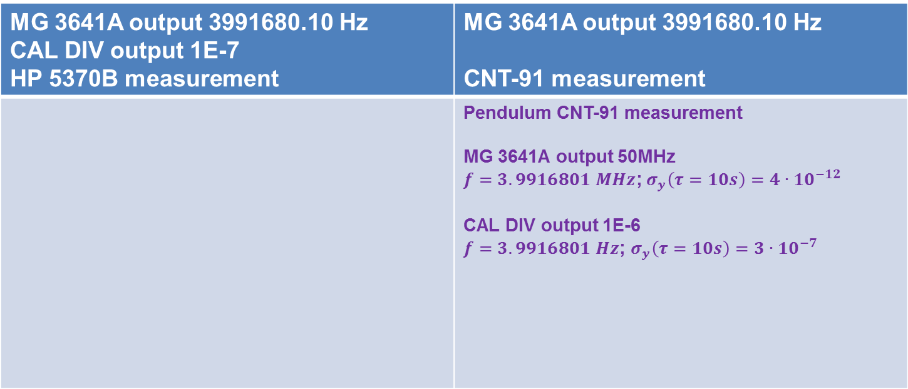
Frequency Measurements with HP system part 2
MG 3641A output 3991680.10 Hz CAL DIV output 1E-7 HP 5370B measurement | MG 3641A output 3991680.10 Hz CNT-91 measurement
 | Pendulum CNT-91 measurement MG 3641A output 50MHz $f=3.9916801 MHz$;${ σ}_{y}\left(τ=10s\right)=4∙{10}^{−12}$ CAL DIV output 1E-6 $f=3.9916801 Hz$; $σ_{y}\left(τ=10s\right)=3∙{10}^{−7}$

Slide 15
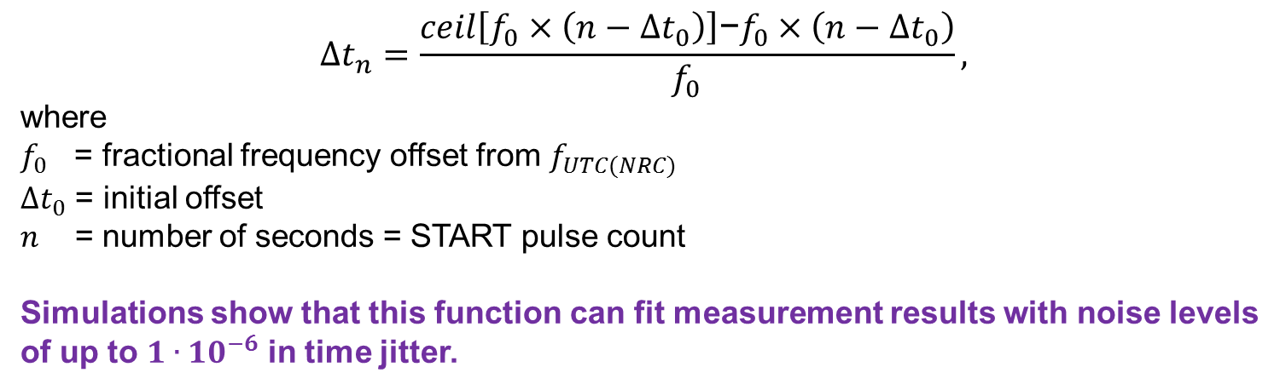

Time Interval counter readings at non-integer frequencies
${1/f}_{UTC(NRC)}$= 1s = T_{UTC(NRC)}
START
Δt_{n}
Δt₀
1/f₀ = T₀
STOP
$$∆t_{n}=\frac{ceil\left[f_{0}×\left(n−∆t_{0}\right)\right]\text{−}f_{0}×\left(n−∆t_{0}\right)}{f_{0}},$$
where
$f_{0}$ = fractional frequency offset from $f_{UTC(NRC)}$
$∆t_{0}$ = initial offset
$n$ = number of seconds = START pulse count
Simulations show that this function can fit measurement results with noise levels of up to $1∙{10}^{−6}$ in time jitter.

Slide 16
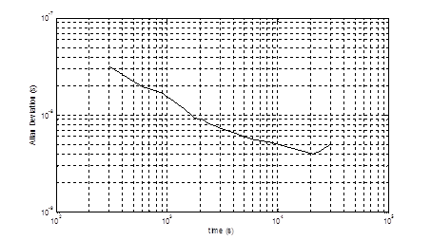

Frequency Measurements with HP system part 3
MG 3641A output 3991680.10 Hz CAL DIV output 1E-7 HP 5370B measurements UNWRAPPED | Allan Deviation
$$σ_{y}\left(τ=1hr\right)<7∙{10}^{−9}$$
PROBLEM: The HP 5370B data acquisition software generates one output value calculated from an average of 11 points around the nominal time stamp. The accuracy of the timestamp value becomes critical when the DUT frequency is not a multiple of Hz and over 11 measurements the time interval varies over ns or more. As a result, when the DUT frequency, after being divided and delivered to the HP 5370B is not an integer number of Hz (± 1.0e-9), the averaging over 11 measurements leads to very high modulation in the reported readings.

Slide 17
Calibration Validation: Setup
Use Calibrated Frequency / Time Interval Counter system for custom signals calibration
H maser or Cs clock
5MHz
sine
Frequency Synthesizer
Anritsu MG 3641A
Stanford Research DS245
5MHz
sine
5 - 100MHz
sine
Frequency Divider
NRC CAL DIV W.P.
nPPS
TTL
Frequency / Time Interval Counter
Pendulum CNT-91
1PPS
TTL
UTC(NRC)

Slide 18
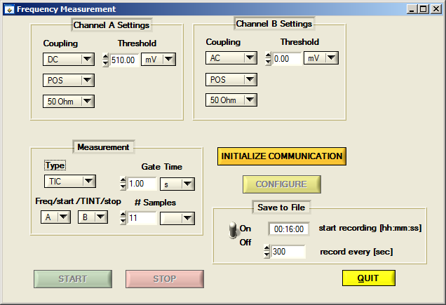
Calibration Validation
New software for data acquisition with CNT-91

Slide 19
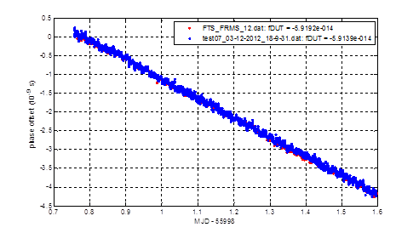
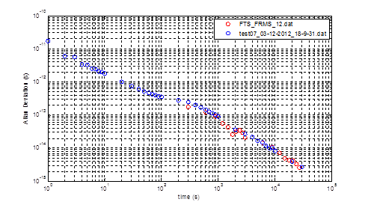

Frequency Measurements with CNT system,
CNT measurements validation against HP system (traceable to UTC via CCTF-K001.UTC
MG 3641A output 100MHz CAL DIV output 1E-7 → HP 5370B (blue) CAL DIV output 1E-8 → CNT-91(red) | Allan Deviation
$$σ_{y}\left(τ=1hr\right)<2∙{10}^{−13}$$

Slide 20
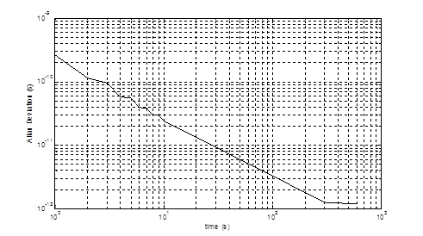
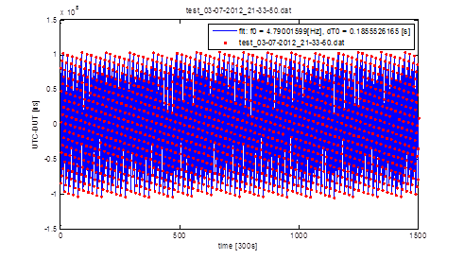
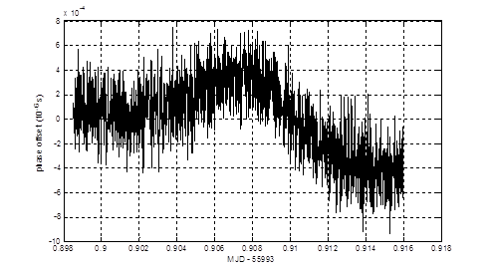

Frequency Measurements with CNT system,
Measurements of non-integer frequency values
MG 3641A output 47.9001599 MHz CAL DIV output 1E-7 CNT-91 measurement | Allan Deviation
$$σ_{y}\left(τ=100s\right)<4∙{10}^{−12}$$

Slide 21
Calibration Validation
Low Pass filter for simulating 100ns rise time
  Connected between the Frequency Divider and the Counter
Attenuator for simulating 1Vpp
  Connected after the filter
R = 3 Ω
c = 2.2 pF
V in
V out
TTL
rise time 120 ns
measured with 500MHz BW TDS 3054B oscilloscope

Slide 22
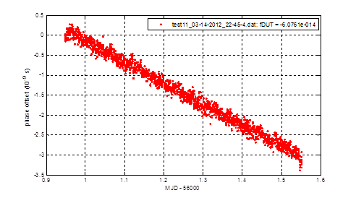

Frequency Measurements with 1Vpp, 120ns rise time
MG 3641A output 100MHz CAL DIV output 1E-8 CNT-91 measurement | Allan Deviation
$$σ_{y}\left(τ=1hr\right)<4∙{10}^{−14}$$

Slide 23
Calibration Validation: Frequency Counter Calibration using Known Frequencies
Validate Frequency Counter readings using known frequencies
H maser or Cs clock
Frequency multiplier
Spectra Dynamics FS100-RM
5MHz
sine
5MHz
sine
10,40,90 MHz
sine
2.32Vpp @50Ω
Frequency / Time Interval Counter
Pendulum CNT-91

Slide 24
Frequency Counter Calibration using Known Frequencies
The CNT-91 was used in a frequency counter mode
FS100-RM Frequency Output 2.32Vpp @ 50Ω [MHz] | CNT-91 Reading A: AC, _|¯, 50Ω, 1x, Man, 0V MeasTime 1s, # samples 100 [MHz]; | CNT-91 Reading A: AC, _|¯, 50Ω, 1x, Man, 0V MeasTime 10s, # samples 100 [MHz];
10 | 10; σ_{y} = 3.5e-11 | 10; σ_{y} = 2.5e-12
40 | 40; σ_{y} = 0.75e-11 | 40; σ_{y} = 1.5e-12
90 | 90; σ_{y} = 0.75e-11 | 90; σ_{y} = 1.5e-12

Slide 25
Summary
The validation had verified the measurement capability and the traceability to the levels exceeding CMC specifications
The frequency counter calibration procedure was developed and the counter was calibrated

Slide 26


Thank you
Dr. Marina Gertsvolf
Tel: 613-998-1311
marina.gertsvolf@nrc-cnrc.gc.ca
www.nrc-cnrc.gc.ca
26

