Slide 1



MODIFICATION OF CELLULOSE BY ANIONIC POLYSACCHARIDES
UTTAM C. PAUL , A. P. Manian, B. Široká, T. Bechtold
Research Institute of Textile Chemistry and Textile Physics
University of Innsbruck, Austria
STEP-ITN Mid-year meeting, Dornbirn, Austria, 13-14 March 2012

Slide 2
Outline of the Presentation
Introduction
Part 1: Ca²⁺ Modulated Interactions of Polysaccharides with Cellulose
Part 2: Sorption of Iron (III) and Alginate to cellulose from Iron (III)-Alginate Complexes
Part 3: Modification of Cellulose Fabric by Iron (III)-Polysaccharide Complexes
Potential Applications and Future Aspect of Work

Slide 3
Introduction
Incorporation of polysaccharide to cellulose is an important field of research
-In textiles polysaccharides like alginate use as a sizing agent, print past and thickener. Deleterious effect!
Extensive chemical modifications!
Cellulose
Alginate
Polysaccharides for cellulose modification
But,
cellulose is anionic and,
it is poorly compatible with another anionic polysaccharide matrix.
-Challenges of the research – incorporation of anionic polysaccharide, bring
novel functionalities, without deteriorating its strength properties

Slide 4
PART 1
Ca²⁺ Modulated Interactions of Polysaccharides with Cellulose

Slide 5
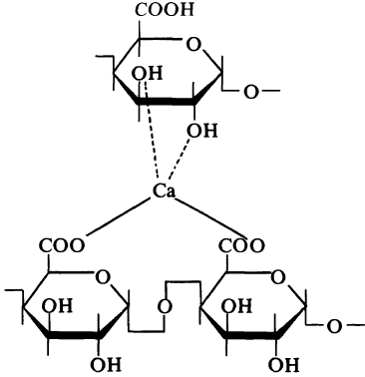
DM Cellulose Fibers
Immerse in Ca²⁺
R. Kohn/PAC/1975, V.42, Issue 3, P 371-397
Ca²⁺ Adsorbed Cellulose fibres
Immerse in PS
Ca2+
Ca²⁺- PS Adsorbed Cellulose Fibres
Pectin Molecules
Scheme : Sorption of polysaccharide into Ca²⁺ containing cellulose fibres
Ca²⁺ ions

Slide 6
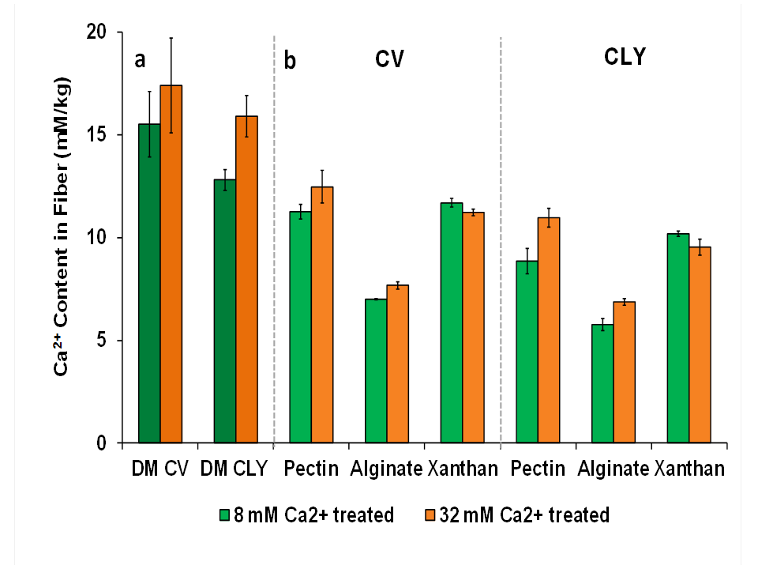
Paul, U.C., et al., Carbohydrate Polymers. 2012. 87. p. 695-700
Introduction Part 1

Slide 7
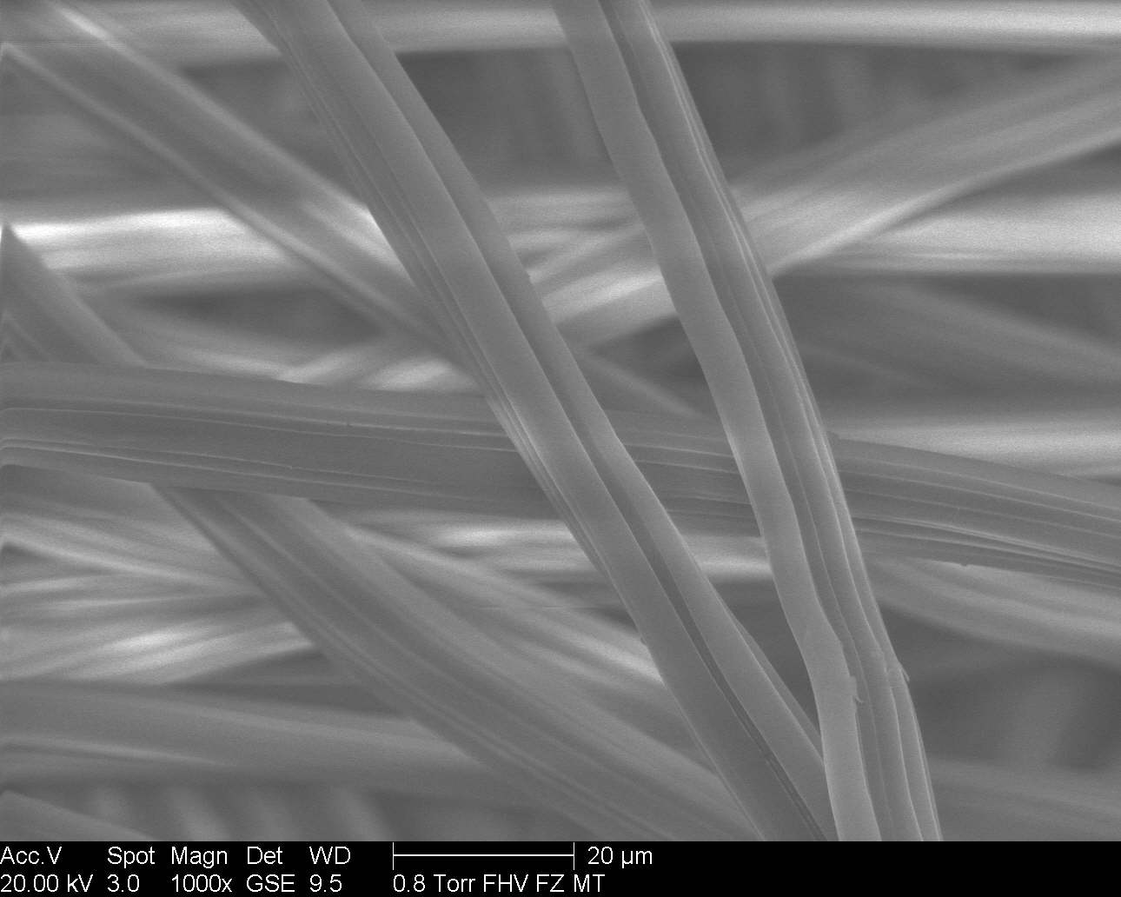
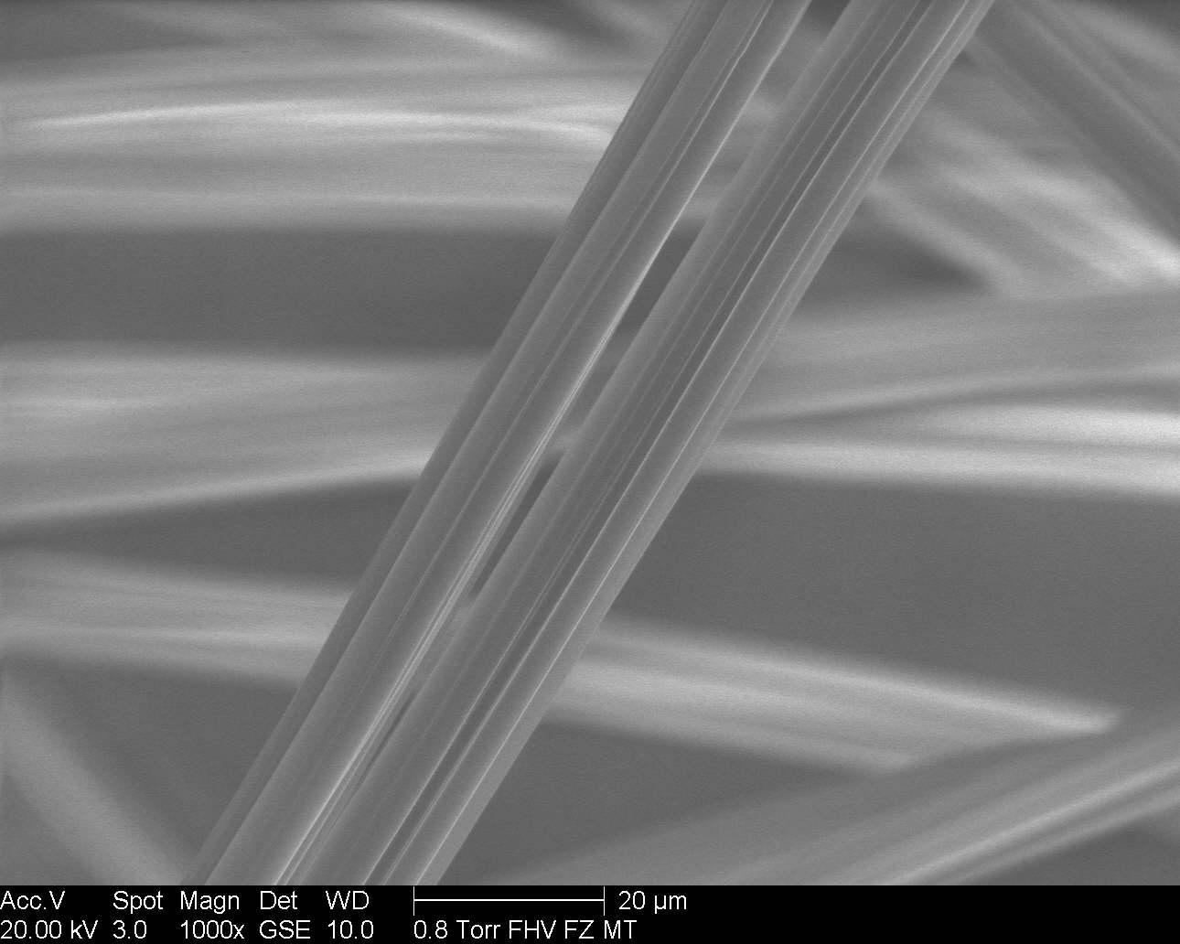
ESEM analysis of polysaccharides adsorbed fibres
calculated thickness layer 7 nm
Untreated Viscose (CV)
8mM Ca²⁺ -Pectin Treated CV

Slide 8
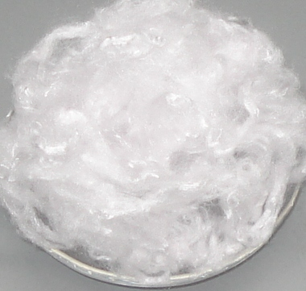
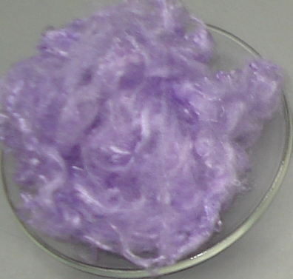
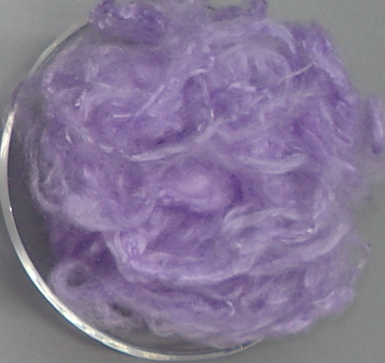
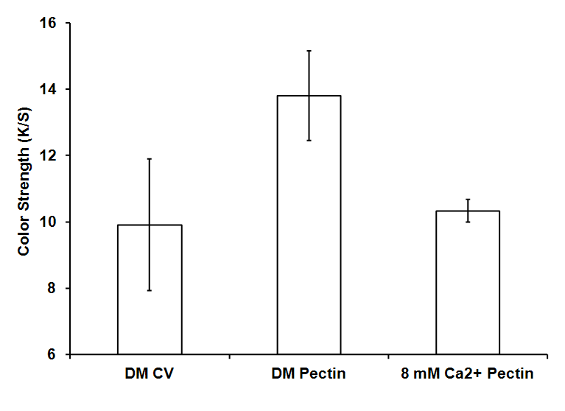
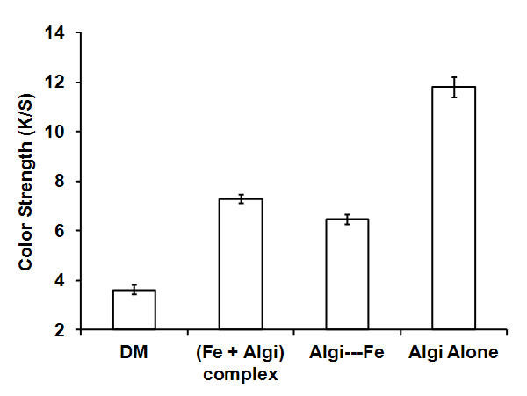
Staining of Ca²⁺ by Alizarin Dye
Pectin CV
DM CV
8 mM Ca²⁺ CV
8 mM Ca²⁺, Pectin CV
Staining of Polysaccharides by Ruthenium Red Dye
Introduction Part 1 Part 2 Part 3 Applications

Slide 9
PART 2
Sorption of Iron (III) and Alginate to Cellulose from Iron (III)- Alginate Complexes
Introduction Part 1 Part 2 Part 3 Applications

Slide 10
Experimental Procedure
Preparation of Fe (III) – Alginate
Complex Solution
0.5:1 M and 0.05:1 M, pH 3, 7, 9, 11, 13
Alginate and Fe (III) in blank solution
Cellulose Fiber
(CLY)
Residual Alginate in exhausted solution
Immerse in
Fe (III) – Alginate Solution,
24 h, 30⁰C and 60⁰C
Residual [Fe³⁺] in exhausted solution
Fe (III) content in fiber
Fe (III) - Alginate -
Cellulose Fiber
Alginate content in fiber
FTIR
ESEM, K/S
Fiber Tenacity, Elongation and Abrasion resistance

Slide 11
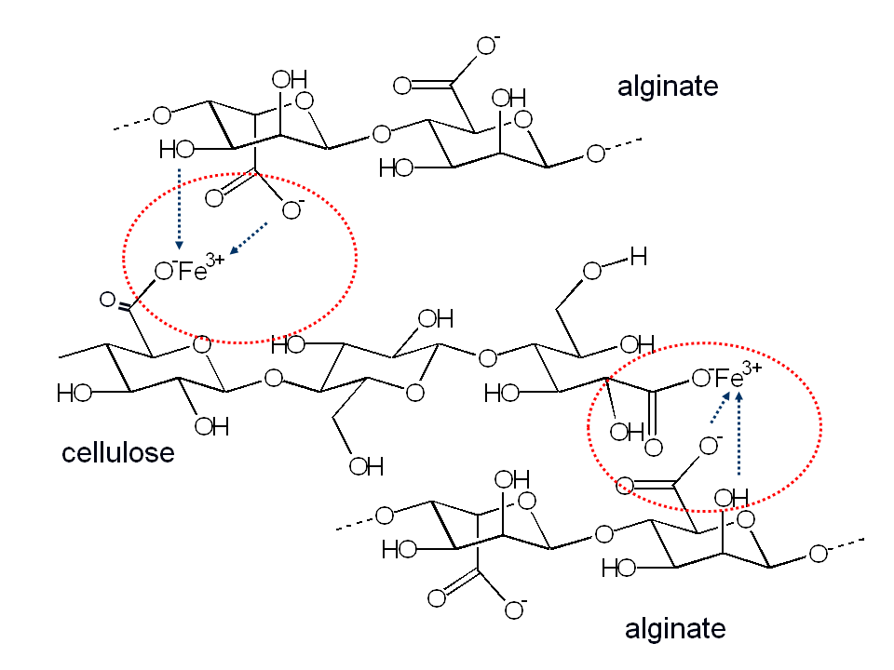
Bechtold, T., et al., Carbohydrate Polymers. doi. 10.1016/j.carbpol.2012.01.064
Sorption mechanism of Fe³⁺, alginate and cellulose

Slide 13
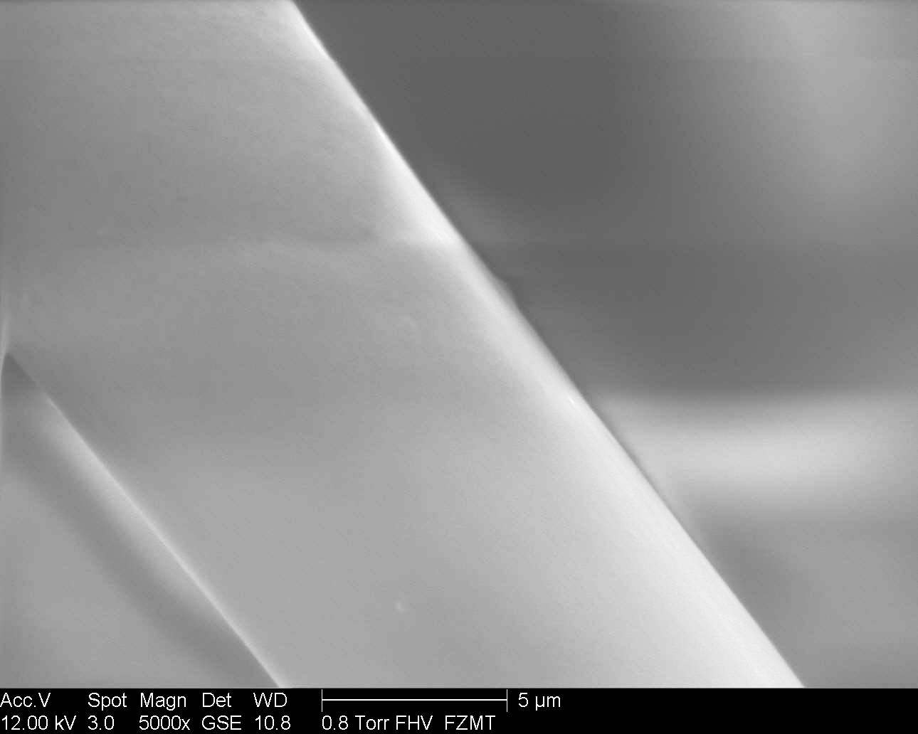
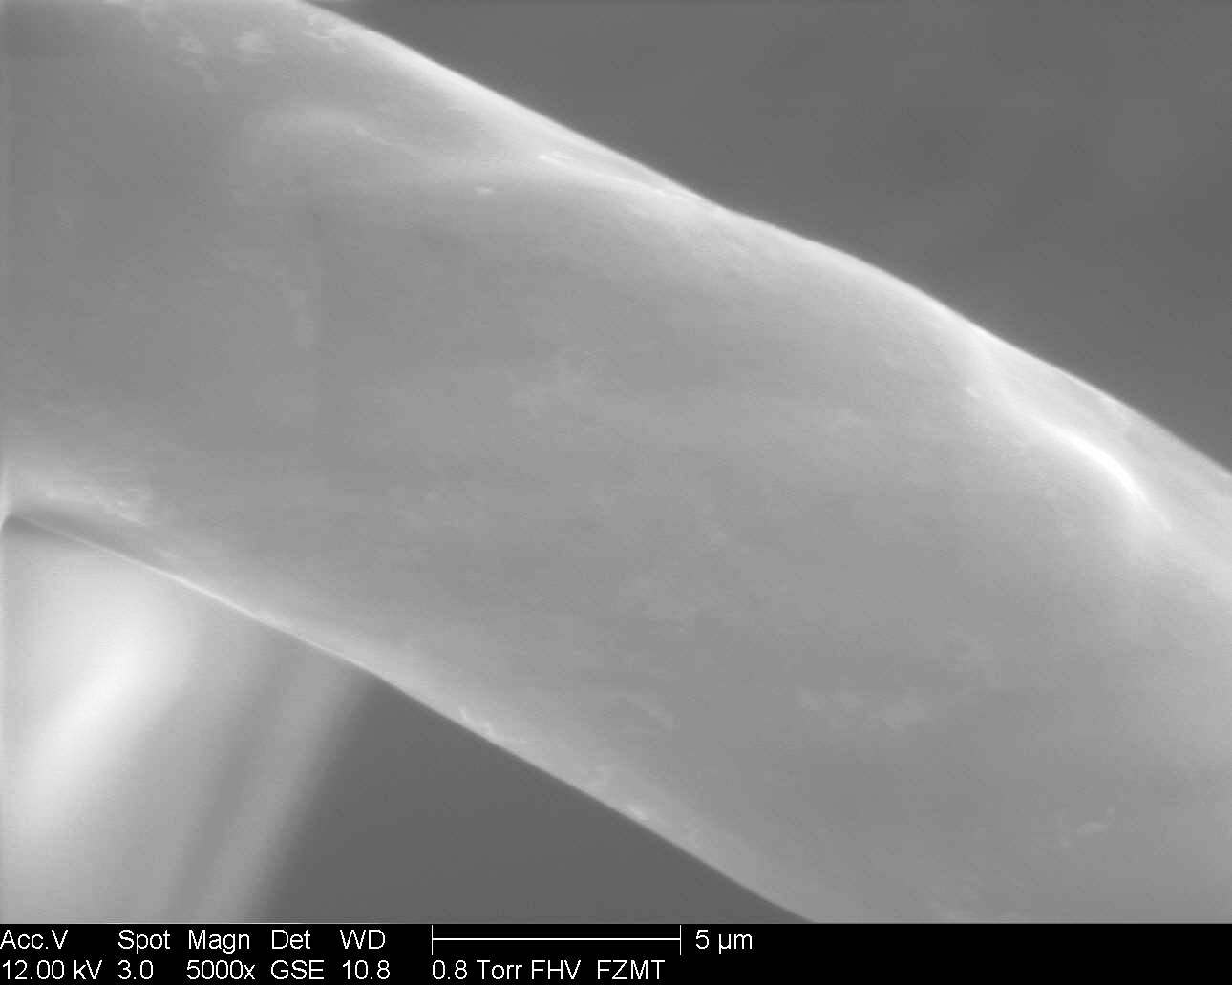
ESEM analysis of alginate adsorbed fibres
Untreated Lyocell (CLY)
Calculated max. thickness layer of alginate is 22 nm
0.5: 1 M Fe³⁺-alginate Treated CLY

Slide 14
PART 3
Modification of Cellulose Fabric by Iron (III)- Polysaccharide Complexes
Introduction Part 1 Part 2 Part 3 Applications

Slide 15
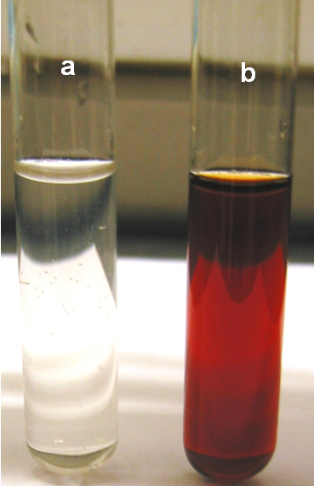
Fabric (viscose, woven)
Demineralized with EDTA at RT for 1 h – wash with DI water
(to remove Ca²⁺)
Fe + Alginate complex
Add Fe(NO₃)₃ to sodium alginate
Add NaOH dropwise to Fe-Alginate mixture
All the above under stirring of ca. 1200 rpm –
continue stirring until homogeneous
solution formed
Final composition of complex:
    Fe: 0.02 mol/l
    Alginate: 0.04 mol/l
    NaOH: 0. 1 mol/l
Complex pH ≈ 12.7 Treatment Process: Pad batch Process
(a) Alginate , (b) (Fe + alginate) complex solution

Slide 17
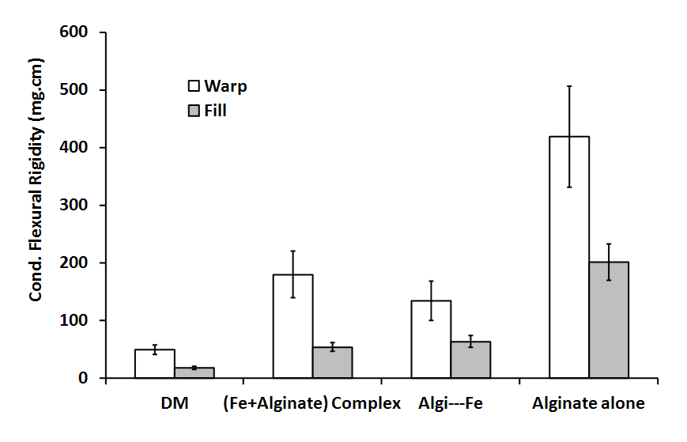

Slide 18
Introduction Part 1 Part 2 Part 3 Applications

Slide 19
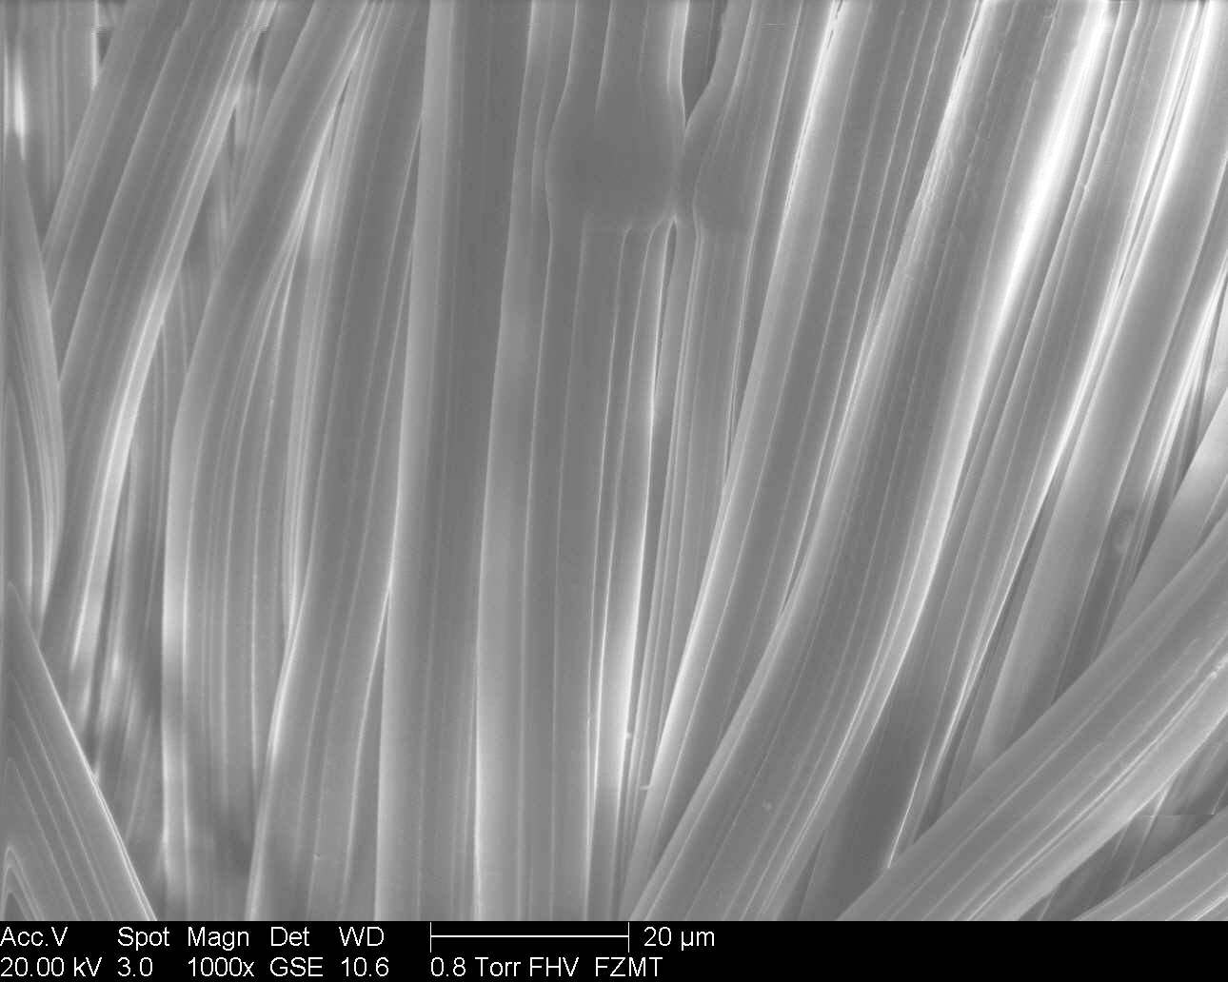
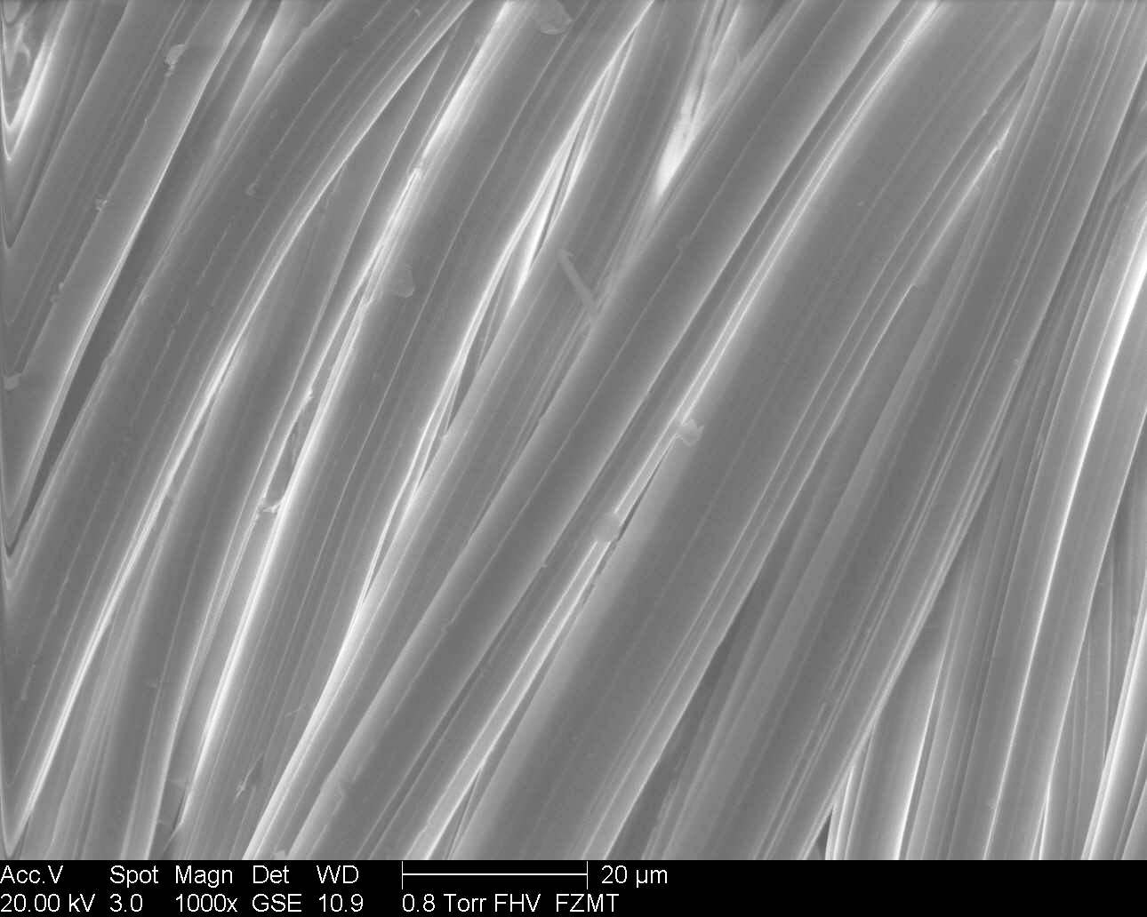
ESEM analysis of (Fe + alginate) adsorbed fabric
Untreated CV fabric
(Fe + alginate) complex treated CV fabric

Slide 20
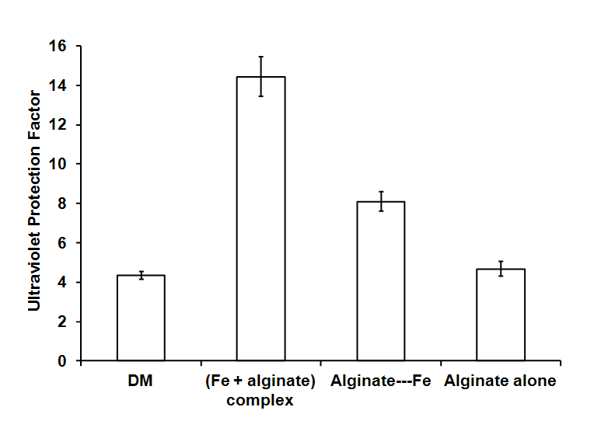
AS/NZS 4399 Australian/New Zealand Standard®
Sun protective clothing—Evaluation and classification
Ultraviolet Protection Factor (UPF)
UPF Rating | Protection Category | % UV Radiation Blocked
UPF 15 - 24 | Good | 93.3 - 95.9
UPF 25 - 39 | Very Good | 96.0 - 97.4
UPF 40 – 49, 50+ | Excellent | 97.5 or more

Slide 21
Applications and Future Potential
There is a growing interest for sustainable PS modified
fibers in different fields: textiles, pharmacuticals, and
reinforcement materials industry.
Applications:
Smart fabric
Sanitary goods
Smart dressing and wound healing
Color textiles (exellent color fastness properties)
UV protective textiles
The process is environmental friendly, so,
It is believe that this modification procedure can be used for
practical applications
Introduction Part 1 Part 2 Part 3 Applications

Slide 22



Thank you for your attention
The research leading to these results has received funding from the European Community’s Seventh Framework Programme [FP7/2007-2013] under Grant Agreement No. 214015.

Slide 23
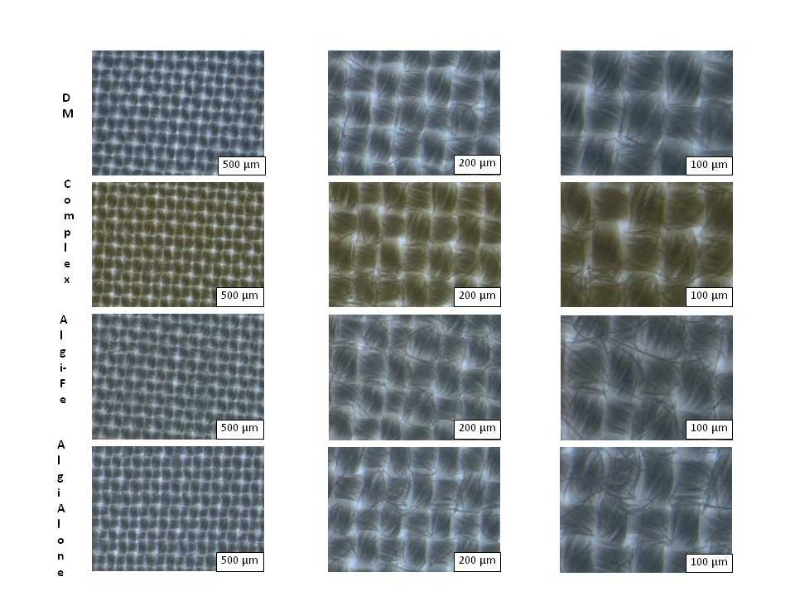
Light micrographs of
(Fe + alginate) complex
treated CV
Untreated CV
(Fe + alginate) complex treated CV

Slide 24

T = thickness of polysaccharide layer (nm),
d = fiber linear density (1.3 dtex = 1.3 g/10,000 m),
r = fiber radius (m), P = average polysaccharide content on fiber (g/g),
σ = polysaccharide density (approximated at 1 g/cm³).

Slide 25
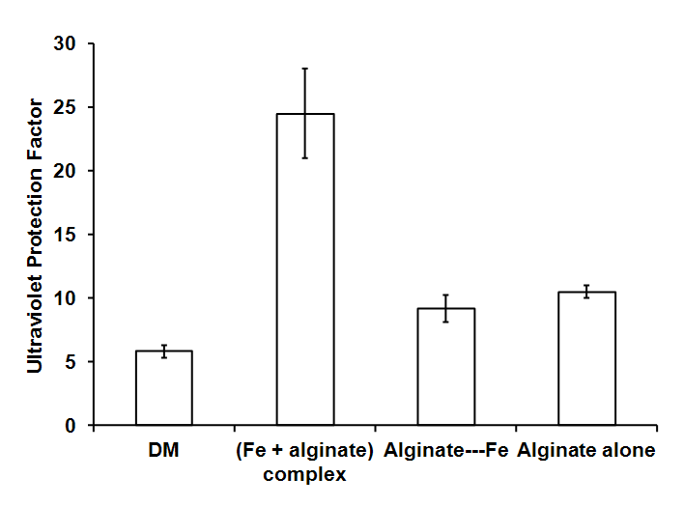
UPF after Ruthenium Red Dye

