Slide 1
Patent Law and Other Intellectual Property Issues
February 16, IEEE IAS Meeting
Jason M. Perilla

Slide 2
What Is a Patent?
Patents protect the exclusive rights of inventors to their respective inventions for a limited time
Encourages innovation via reward of limited monopoly
Facilitate sharing of knowledge via public disclosure
Bargain Theory – Monopoly granted in exchange for public disclosure
Constitutional Basis – Article I, Section 8, Clause 8

Slide 3
Why Patents Instead of Trade Secrets?
Patents are by definition public, and inventions are released to the public domain after 20 years
Trade secrets can persist indefinitely
However, a patent is recommended for any invention that is publicly released and susceptible to reverse engineering
Note: reverse engineering is generally legal

Slide 4
Why Patents Instead of Copyrights?
Copyrights protect an expression of an idea, not the underlying idea itself
For example, a copyright of computer software protects direct copying of the software
Copyright does not protect against competitors developing software that offers the same functionality

Slide 5
The Right to Exclude
A patent grants the inventor a right to exclude others from practicing (making/using/selling/importing) an invention
A patent does not automatically entitle an inventor to practice his or her invention
Secrecy orders
Blocking patents

Slide 6
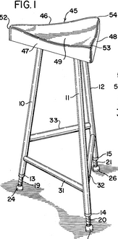
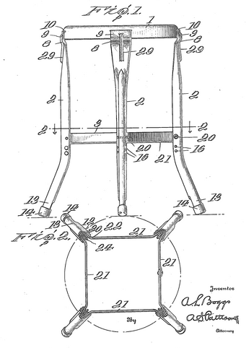
Blocking Patent Hypothetical
Patent A (filed first)
Patent B (filed second)
A stool comprising three legs and a seat.
A stool comprising four legs and a seat.

Slide 7
Blocking Patent Example
Patent A: A stool comprising three legs and a seat.
Patent B: A stool comprising four legs and a seat.
The inventor of Patent B cannot sell four-legged stools without a license of Patent A because four-legged stools fall under the scope of both patents
Although Patent A would be earlier filed in this example, Patent A may be granted before Patent B or even after Patent B due to delays at the patent office

Slide 8
Enforceability, Publication, and Expiration
Patents are enforceable only after being granted (2+ years after filing)
Damages may be payable on infringement calculated starting from the time of application publication
Publication is at 18 months or can be requested earlier
Publication is mandatory for foreign filing, voluntary otherwise
Thus, for a purely domestic filing, the patent application may be kept secret until a patent is granted
A patent expires 20 years from date of filing and may be extended in days or years due to delays at the patent office
A patent can expire for failure to pay maintenance fees, although revival is possible

Slide 9
Misconceptions about what Patents Cover
“Software” patents
“Outrageous” patents frequently discussed by media and blogs
Misplaced emphasis on reading first page of patent (title & abstract), which are intentionally broad
Scope of protection defined by claims at the end of the patent
Even claims are difficult to interpret without detailed study of entire specification and prosecution file history

Slide 10
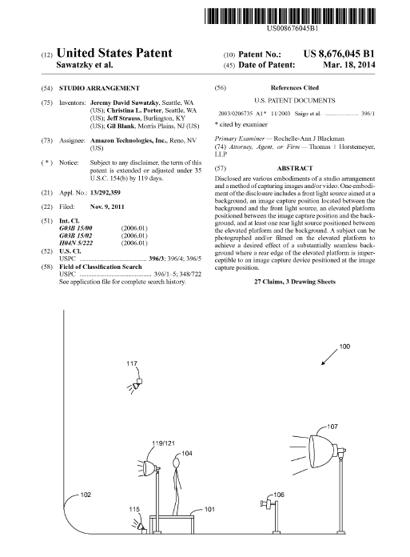
Studio Arrangement US 8,676,045

Slide 11
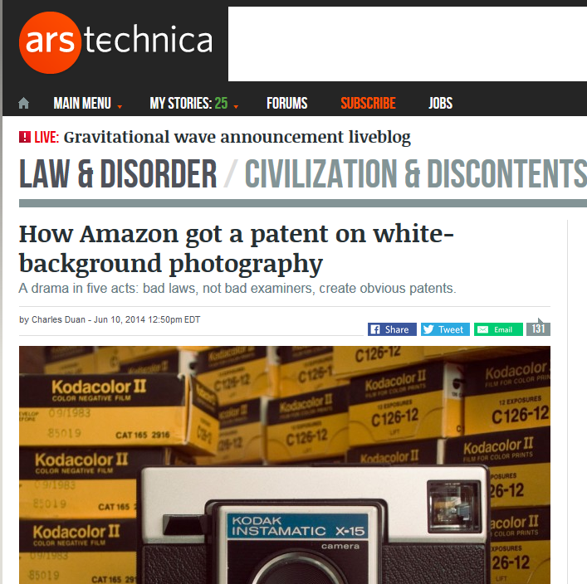
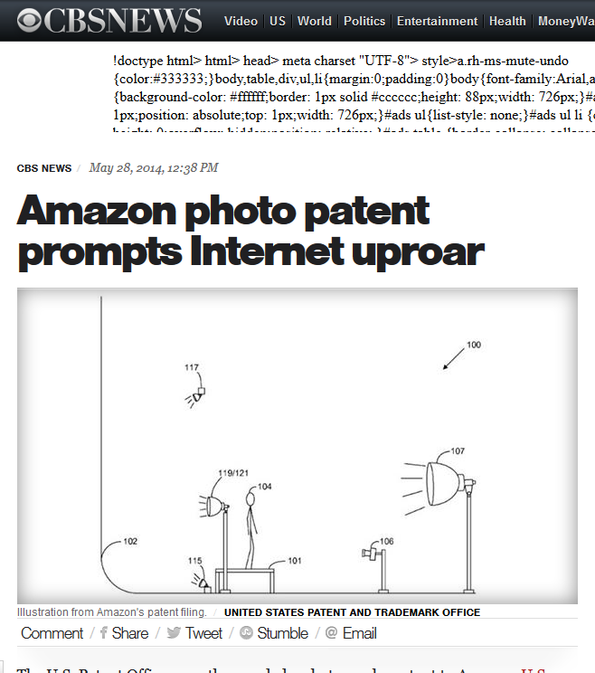
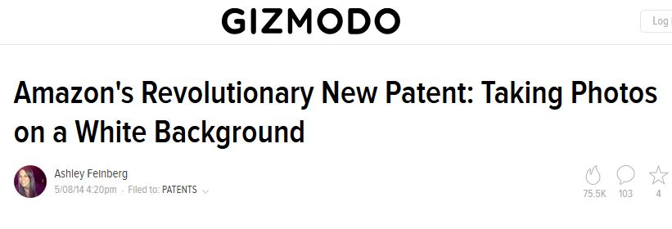
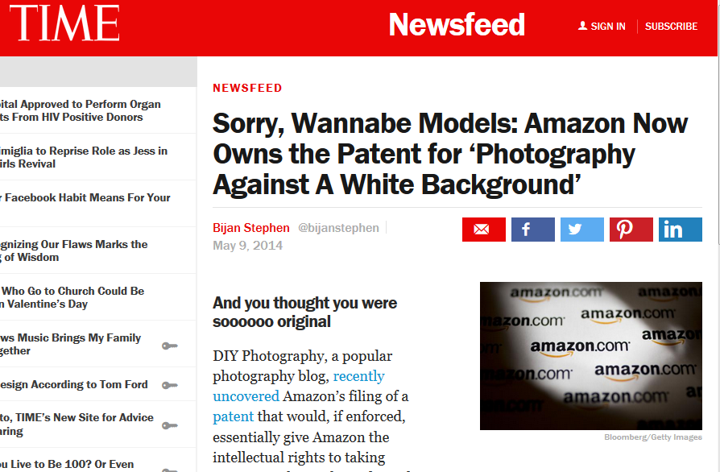
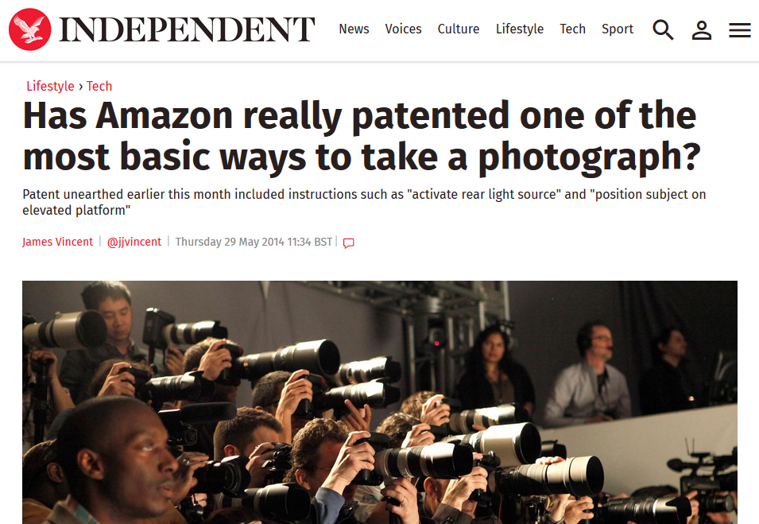
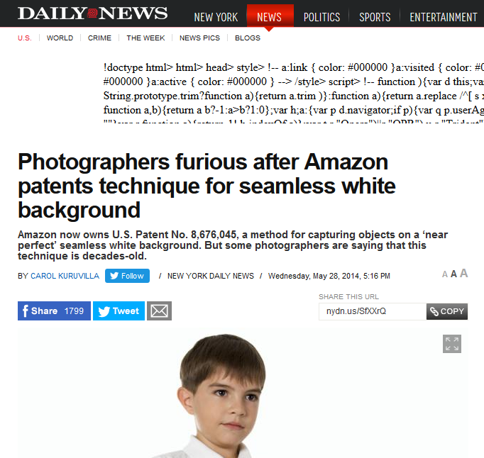
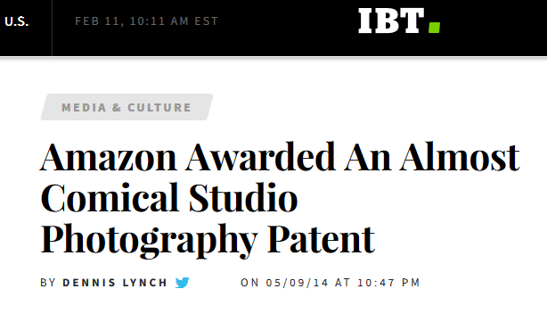

Slide 12
Patentability Requirements
Fall within one of the four statutory categories in 35 U.S.C. §101:
Process, machine, article of manufacture, composition of matter
Judicial exceptions: laws of nature, natural phenomena, abstract ideas
Novelty under §102 – No one has done exactly this before
Non-Obvious under §103 – Even if no one has done exactly this, a skilled artisan would not modify one or more teachings of the prior art to arrive at the claimed invention

Slide 13
Does the “Poor Man’s Patent” Still Exist?
Concept: An inventor writes a description of his or her invention and mails it to himself. The postmark proves the date of invention.
Not really a patent in any respect, but it helped to prove conception, which could be relevant under the pre-AIA first to invent system
No longer useful under AIA first-inventor-to-file system in place since 2013

Slide 14
Provisional Patent Applications
File as early as possible!
Low cost approach to get idea on paper with patent office quickly
Can be narrative based; no claims or drawings required
No working prototype needed
Must be followed by non-provisional application within one year

Slide 15
Non-Provisional Patent Applications
Strict formal requirements as to black-and-white line art drawings, specification, claims, and abstract
Continuing applications – follow-on applications to obtain broader scope or cover different inventions/embodiments
Cannot extend patent term beyond 20 years
Design applications – Simple drawing-focused applications to cover ornamental designs
Plant applications

Slide 16
Filing Deadlines
Under first-inventor-to-file, it is possible that a later inventor but earlier applicant will obtain the patent for an invention
By waiting to file, additional art may be published that can preclude a patent
It is crucial that a patent application be filed before one year after any public disclosure, public use, or offers to sell the invention by the inventor
Many clients file before any public disclosure to preserve foreign rights

Slide 17
Patent Costs
Typically, more than $10,000 – not a vanity exercise
Large corporations can pay nearly $20,000 in patent office fees alone!
AIA introduced a 75% discount for some small inventors
Costs and fees continue at certain intervals across the lifetime of the patent: before and at filing, during prosecution, at issuance, and for maintenance fees

Slide 18
Patentability Searches
A search is not required to file a patent application
If you perform a search, anything material to patentability must be disclosed to the patent office
From a cost perspective, it may be better to file a provisional application without a search
Google Patents is a good self-directed search option for independent inventors

Slide 19
Filing & Examination of Patent Applications
All interactions with USPTO must be done by the applicant pro se or by a registered practitioner
Practitioners must have an approved undergraduate degree in science or engineering or meet coursework requirements
Practitioners are not required to have a law degree, but many do
Registration not required for representation related to patent litigation

Slide 20
Filing & Examination of Patent Applications
Examination performed by 8000 examiners in Alexandria, satellite offices, or anywhere – including Georgia
Examiners conduct a search of the prior art (patents & publications) and typically send a rejection
Applicants respond to the rejections with arguments or amendments to claims
During prosecution, claims are given a broadest reasonable interpretation, while in litigation, they are given their plain and ordinary meaning in view of the specification and prosecution history

Slide 21
Foreign Patent Protection
US patents effective only in US; can prevent import of infringing products
Paris Convention & Patent Cooperation Treaty facilitate claims of priority to a U.S. application
Foreign filing process must be initiated no more than one year after earliest priority date
PCT streamlines the process and allows delay of national filings for 30 months
Foreign filing is extremely expensive!

Slide 22
Assignments
Patent assignments should be recorded with the USPTO
Absent assignment of ownership, inventors are presumed to have an equal and undivided interest in the patent, regardless of the relative contribution of each inventor

Slide 23
Inventorship
Important issue; can render patent invalid
Defined relative to claimed subject matter, not unclaimed subject matter
Merely assisting implementation, being on a team, or supervising a team does not automatically make a person an inventor
Avoid inventorship entanglements!
File a provisional application or establish a clear contractual obligation to assign before brainstorming with others, or the other person could wind up owning an equal interest in the patent!

