Slide 1
How to Carry Out
Patent Surveys.
NGB Corporation
IP Research Institute
Masahiko SAWADA

Slide 2
Outline
Kinds of Searches
Process of Patent Search
Method for Validity Search
Effective Utilization of Japanese Patents
Method for an Infringement Search
Difficult aspects of Chinese Patent Search

Slide 3
Kinds of Searches
R & D
Product
Design
Production
Commercialization
Sales
(Purpose of patent searches in R&D stage)
Promotion/Retreat of Research Activities,
Information for Making Decision,
Technological Forecasting
(Prerequisites)
Collection Search, Patent analysis

Slide 4
Kinds of Searches
R & D
Product
Design
Production
Commercialization
Sales
(Purpose of patent searches in Product Design stage)
To reduce wasteful applications,
To get a strong patent
(Prerequisites)
Patentability Search

Slide 5
Kinds of Searches
R & D
Product
Design
Production
Commercialization
Sales
(Purpose of searches in Production stage)
To avoid being attacked for infringement by someone
(Prerequisites)
Infringement Search / Clearance Search
If any patent which could be an obstacle in the future is
found, a validity Search should be conducted.

Slide 6
Search Process - Phase 1
Step 1):
Ensure the purpose of the search is clear
Step 2):
Select the appropriate database according to its features:
Fulltext or Abstract ,
Domestic or World wide,
Language, the coverage of its collection
Step 3):
Set the search logic using keywords, classes and the unique codes depend on each DB.
Purpose
Subject Matter
Time(Expenses)
1) To clarify the Search Strategy
2) To select database
Keywords
Classes
3) To set Search Logic
Relevant data list
KW
code
CL

Slide 7
Search Process - Phase 2
Step 4:
Perform a manual page-by-page search, with attention paid to search criteria to clarify the difference between relevant and irrelevant results.
Relevant data list
Irrelevant
Relevant
4) Manual Search &
To determine the search criteria
5) Supplementary Search
Step 5:
Supplementary search for improving the search quality by the other point view:
+ Applicant Names
+ Citations
+ Equivalents
Search Results

Slide 8
Validity Search
Purpose
To find prior art for invalidation
Period
Prior to Application Date
Materials
Patents and/or Non-patent literature (World wide)
Subject Claims ⇔ Full text
Comparison

Slide 9
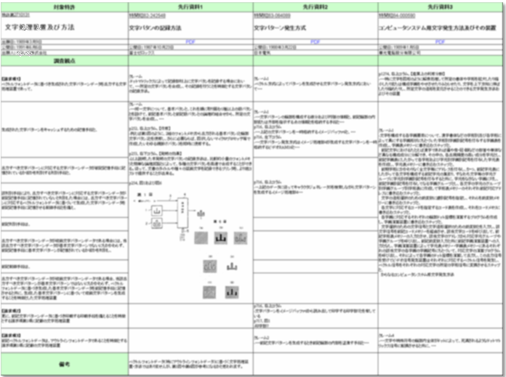
Validity Search – Report Form
Subject Patent
Reference 1
Reference 2
Reference 3
Claims

Slide 10
Validity Search – Report Form
Subject Patent |  | Reference 1 | Reference 2 | Reference 3
Claim 1
Elements | A:preamble | X | X | X
 | B | X | Y | Y
 | C | Y | X | Y
 | D | X | Y | A
Claim 2 |  | Y | A | A
Combination of Prior Art References

Slide 11
Effective Utilization of Japanese Patents
US
EP
CN
KR
JP
US
EP
JP
The number of Japanese patent is decreasing in the recent years.

Slide 12
Effective Utilization of Japanese Patents
The total number of patents between 1991 and 2009
The total number of JP patent is the largest among other countries.

Slide 13

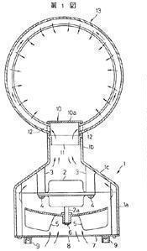
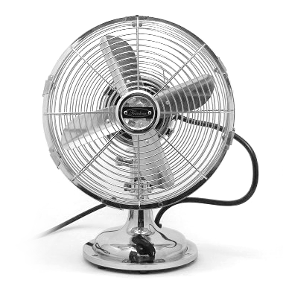
Effective Utilization of Japanese Patents
One of Example
New Product with innovative design launched in 2010
Prior Art in JP Patent published in 1981
Conventional

Slide 14
IPC
FI
F-Term
Unique code system by JPO
Structure
Purpose
Material
Principle
.
.
.
2C057AF01
and 2C057AG15 50
and 2C057BA14
B41J 3/
Hit Count: 79,000
B41J 3/04,103A
Hit Count: 20,000

Slide 15
Infringement Search
Purpose
To find any patent which might be infringed by product/method
Period
Duration of the patent right
Materials
Patents and UMs in force
Product’s features ⇔ All claims
Comparison

Slide 16
Infringement Search – Report Form
Technical Features
Hyperlink to PDF

Slide 17
Comparison between Validity Search and Infringement Search
Validity Search
Infringement Search
Time
Field
Broad Search Field
Narrow Search Field
Retrospective from Application Date
Duration of the patent right

Slide 18
Difficult aspects of Chinese Patent Search
Difficult aspects from abroad
Period:
20 years must be covered
Volume:
Huge number of PATs & UMs
Language:
Chinese
The main purpose of Japanese companies for searching in Chinese patents is infringement search . However, it is hard to conduct a perfect search from other countries.

Slide 19
Conclusion
Is China trending from “Quantity” to “Quality”? If so, Patentability search become a cornerstone to IP strategy.
Patentability Search
Japanese companies want to avoid patent infringement in China, but it is not easy to conduct infringement searches from other countries.
Infringement Search
Japanese patent databases are a treasure trove of prior art. Validity searches should cover Japanese publications.
Validity Search

Slide 20
Thank you
CONTACT
Masahiko Sawada
NGB IP Research Institute
E-mail: IP-Gateway@ngb.co.jp

