Slide 1
Misbehavior in Organizations: relations with organizational distributive justice, organizational climate, occupational status, and leader-member exchange
Lily Chernyak-Hai & Aharon Tziner
Netanya Academic College, School of Behavioral Sciences

Slide 2
Misbehavior in organizations – definitions and research
Workplace deviance or Counterproductive Work Behavior (theft, sabotage, withdrawal, harassment, and drug use) Violate important organizational norms and mainly harm organizations in ways relevant to goals, employees, procedures, productivity and profitability
employees’ personal traits and abilities
job experiences
work stressors
interaction between personal factors and organizational stressors

Slide 3
Misbehavior in organizations – the present research
Perceived leader-member exchange
Perceived organizational climate: - general - ethical
Misbehavior
Perceived distributive justice
Employee occupational level

Slide 4
Perceptions of organizational justice
Appropriate, fair and respectful treatment, adequate and accurate information, resources and rewards.
Distributive justice (fairness in resources and products allocation), Procedural justice (fairness of organizational procedures and ways in which decisions are reached), Interactional justice (fairness of organizational inter-personal relations and accessibility of equal opportunities)
Hypothesis 1
Notes:
Hypothesis 1: Employees’ perceptions of organizational distributive justice will be negatively associated with organizational misbehavior – the higher the perceived justice, the lower the reported counterproductive workplace behaviors.

Slide 5
Perceptions of organizational climate
Part of an active psychological process resulting in perceptions of social climate or atmosphere in a workplace relevant to policies, practices and procedures in organizations.
Organizational ethical climate - employees’ aware­ness of moral obligation, their beliefs of what is ethically correct behavior and how the organization’s ethical issues should be handled (“instrumental”, “caring”, “independence”, “rules”, “law and code”).
Hypotheses 2-3
Notes:
Hypothesis 2: Employees’ perceptions of overall organizational climate are negatively associated with organizational misbehavior - the better the perceived overall organizational climate, the lower the reported counterproductive workplace behaviors.
Hypothesis 3: Employees’ perceptions of organizational ethical climate are negatively associated with organizational misbehavior - the better the perceived organizational ethical climate, the lower the reported counterproductive workplace behaviors.

Slide 6
Leader-member exchange (LMX)
The quality of the relations between leaders and group members or superiors and subordinates.
Levels of information exchange, interaction, trust, respect, support, mutual influence and rewards.
Affects employees’ motivation, increasing or decreasing opportunities, sense of empowerment, emotional support, and cooperative interactions, as well as loyalty, respect and obligation.

Slide 7
Leader-member exchange (LMX) past research
Distributive and Procedural fairness
Procedural and Interpersonal justice perceptions
LMX
Organizational citizenship behaviors (OCBs)
Employees obligation to the organization
Hypothesis 4
Notes:
Hypothesis 4: Employees’ perceptions of leader-member exchange will moderate the influences of perceived organizational justice or climate on reported counterproductive workplace behaviors – the negative associations between perceived organizational justice or climate and misbehavior, will be amplified under perceived low quality LMX.

Slide 8
Employee’s occupational level
Relevant to different aspects of employees’ performance and ability to cope. Past research:
occupational level
belief in organizational goals and values
organizational commitment
readiness to contribute to the organization
maintaining organizational membership
Hypothesis 5
Notes:
Hypothesis 5: Employees’ occupational level will moderate the influences of perceived organizational ethical climate on reported organizational misbehavior – the negative association between perceived ethical climate and misbehavior will be reduced among high occupational level employees.

Slide 9
The present research Study 1
Perceived distributive justice
Misbehavior
Perceived overall climate
LMX

Slide 10
Study 1
Participants & Measures
Participants: 120 employees in a large governmental electric company (66 men, 54 women; mean age=42.20, SD=7.82).
Perceptions of organizational distributive justice: a 5-item instrument (Tang & Sarsfield-Baldwin, 1996). For example: “The organization is fair in rewarding me, if I consider the amount of effort that I have put forth”; “The organization is fair in rewarding me, if I consider the stresses and strains of my job” (Cronbach's alpha= .96; M=2.95; SD=0.50).

Slide 11
Study 1
Perceptions of organizational climate: a 50-item Organizational Climate Questionnaire assessing 9 dimensions of organizational climate (Litwin & Stringer, 1968). For example: “One of the problems in this organization is that the employees do not take responsibility” (Responsibility dimension); “Decisions in management meetings are taken quickly and without any difficulty” (Conflict dimension). (Cronbach's alpha= .88; M= 3.0; SD=.37).
Perceptions of leader-member exchange: a 7-item instrument (Graen & Uhl-Bien, 1995). For example: “The leader understands my job problems and needs”; “The leader recognizes my potential”. (Cronbach's alpha= .78; M= 3.0; SD=.76).
Organizational misbehavior: a 24-item measure of workplace deviance - WDB (Bennett & Robinson, 2000), implicit form - questions as addressing other employees’ behavior in order to avoid social desirability bias. For example: “Worked on a personal matter instead of work for the employer”; “Called in sick when she/he was not”. (Cronbach's alpha= .94; M= 2.64; SD=.74).

Slide 13
Variables | 1 | 2 | 3 | 4 | 5 | 6 | 7 | 8 | 9 | 10 | 11 | 12
1. Perceived distributive justice
2. Perceived organizational climate | .56**
3. LMX | .18 | .39**
4. Organizational misbehavior | -.19* | -.43** | -.26**
5. Perceived organizational climate “structure” | .35** | .78** | .35** | -.32**
6. Perceived organizational climate “responsibility” | .90** | .68** | .24** | -.29** | .45**
7. Perceived organizational climate “reward” | .31** | .67** | .29** | -.37** | .47** | .38**
8. Perceived organizational climate “risk” | .22* | .69** | .28** | -.29** | .51** | .33** | .44**
9. Perceived organizational climate “warmth” | .13 | .44** | .09 | -.22* | .28** | .23** | .20* | .40**
10. Perceived organizational climate “support” | .20* | .54** | .30** | -.19* | .43** | .27** | .43** | .39** | .18*
11. Perceived organizational climate “standards” | .49** | .70** | .31** | -.38** | .52** | .52** | .45** | .35** | .13 | .21*
12. Perceived organizational climate “conflict” | .48** | .69** | .29** | -.26** | .50** | .55** | .39** | .38** | .28** | .20* | .59**
13. Perceived organizational climate “identity” | .39** | .64** | .15 | -.31** | .46** | .42** | .38** | .44** | .25** | .33** | .42** | .38**
Notes:
The regression analysis indicated that perceived organizational climate was a significant predictor of organizational misbehavior (β=-.42, t(116) = -3.51; p< .001), but not the perceptions of organizational distributive justice (β=-.10, t(116) = -.96; n.s.). Next, in order to examine the influence of perceptions of organizational distributive justice and climate beyond the LMX, we performed additional analysis whereby LMX was entered as step 1 and perceptions of organizational distributive justice and climate were entered at step 2. This time the perceptions of organizational distributive justice appeared as a significant predictor of organizational misbehavior (β=-.23, t(117) = -2.87; p< .05).
Also, the hierarchical regression for examining the moderating effect of LMX, showed that for participants high in LMX, the relationship between perceived organizational distributive justice and organizational misbehavior was not significant β = -.11, t(118) = -1.07, n.s. (M = 2.03, SD = .78 for low perceived justice, and M = 1.97, SD = .76 for high perceived justice).Conversely, when LMX was low, the two variables were significantly related (β = -.48, t(118) = -4.5, p< .001), indicating that the reported misbehavior was high when perceived organizational distributive justice was low, in contrast to high levels of perceived distributive justice (M = 3.89, SD = .68 and M = 2.95, SD = .66, respectively).

Slide 14
Study 2
Employee’s occupational level
Misbehavior
Perceived ethical climate

Slide 15
Study 2
Participants & Measures
Participants: 114 employees in a private company specializing in electronic device commerce (61 men, 39 women; mean age= 36.57, SD= 12.59).
Occupational levels: 44% - manufacture laborers (low); 36% - supervisory positions/inspectors (medium); 20% - managerial appointment/managers (high).

Slide 16
Study 2
Perceptions of organizational ethical climate: 26-item ethical climate questionnaire – ECQ, assessing 5 types of moral climate (Victor & Cullen, 1988; Cullen, Victor, & Bronson, 1993). For example: “What is best for everyone in the company is the major consideration here” (caring); “In this company, the first consideration is whether a decision violates any law” (law and code); “Everyone is expected to stick by company rules and procedures” (rules). (Cronbach's alpha of overall ECQ measure= .61; M=4.15; SD=0.53).
Organizational misbehavior: a 24-item measure of workplace deviance - WDB (Bennett & Robinson, 2000), implicit form. For example: “Dragged out work in order to get overtime”; “Publicly embarrassed someone at work”. (Cronbach's alpha= .94; M= 2.0; SD=0.73).

Slide 17
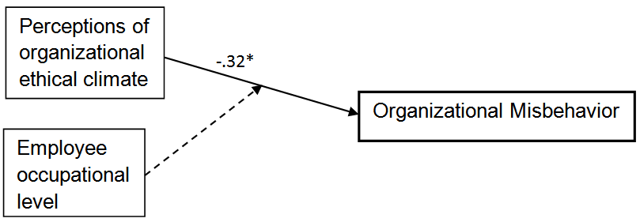
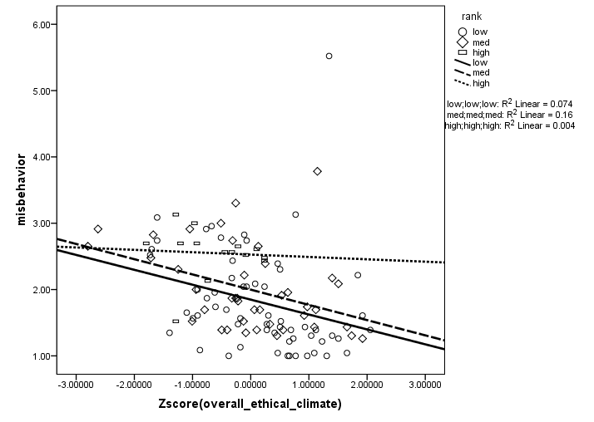
Study 2 - Results
The “employee occupational level” variable was dummy-coded and the perceived organizational ethical climate variable was centered (Z-scores).

Slide 18
Variables | 1 | 2 | 3 | 4 | 5 | 6
1. Overall ethical climate
2. Organizational misbehavior | -.47**
3. Ethical climate “instrumental” | .37** | .01
4. Ethical climate “caring” | .68** | -.46** | -.03
5. Ethical climate “independence” | .65** | -.18* | .32** | .22*
6. Ethical climate “rules” | .70** | -.43** | -.11 | .61** | .20*
7. Ethical climate “law and code” | .62** | -.41** | .06 | .36** | .13 | .58**
Notes:
The regression analysis indicated that perceived organizational ethical climate was a significant predictor of organizational misbehavior (β= -.32, t(104) = -3.45; p< .05). Further, significant organizational ethical climate X employee occupational level interaction was found for participants having medium and low employee occupational levels (β = -.21, t(104) = -2.23, p< .05 and β = -.23, t(104) = -2.41, p< .05, respectively). The interpretation of this interaction is that for medium and low employees’ occupational levels, where organizational ethical climate was perceived positively (i.e. higher scores were obtained), organizational misbehavior was lower. In contrast, there was no significant relation between organizational ethical climate and organizational misbehavior when employee’s occupational level was high.
.

Slide 19
Summary & conclusions
Focus on perceptions of organizational distributive justice and organizational climate as important antecedents of misbehavior. Explanatory contributions of LMX and employees’ occupational level.
The quality of the relations between leaders and employees may function as a buffer in the impact of perceived organizational distributive justice on misbehavior.
Perceived organizational ethical climate negatively associates with organizational misbehavior at medium and low occupational levels.
Limitations: correlative nature; specific organizational contexts; *the mean levels of perceived distributive justice, organizational climate, and misbehavior.
Thank you !
Notes:
* Limits - the mean levels: the overall mean of perceived distributive justice obtained in Study 1 was relatively low (scale range 1-6, mean = 2.95, SD = 0.50), indicating that, in general, employees tended to perceive the organization as relatively unjust. Nevertheless, the overall
perceptions of organizational climate were positive (scale range 1-5, mean = 3.00, SD = 0.37) and the reported misbehavior
was relatively low (scale range 1-6, mean = 2.64, SD = 0.74). In addition, Study 2 indicated relatively high average values of
perceived ethical dimensions (scale range 1-6, means between 3.31 and 5.09, SD’s between 1.09 and 0.75) and also a relatively low mean
of reported misbehavior (scale range 1-6, mean = 2.00, SD = 0.73). A possible explanation of these findings is the delicate nature of the assessed
variables. Even though the participants were assured anonymity and answered the misbehavior measure as addressing other employees’ behavior
rather than their own, it may be that they preferred to describe organizational climate in a relatively favorable manner and underrate
the prevalence of deviant behaviors. In contrast, when asked about organizational distributive justice, there was less of psychological
barrier to report dissatisfaction.

