Slide 1
Impact of Organizational Justice on Job Performance in Libraries: Mediating Role of Leader-Member Exchange Relationship
Sidra Shan
International Islamic University Islamabad
&
Maqsood Ahmed Shaheen
Public Affair Section, U.S. Embassy Islamabad

Slide 2
Abstract
The study primarily focused on the perception of university libraries personnel regarding organizational justice practices and the quality of their relationship with their supervisors. This study tested a sample of fifteen university libraries of Islamabad, Pakistan. Data were accumulated through questionnaire and analyzed on SPSS (v.20).
The result revealed that all three kinds of organizational justices predict the job performance but interactional justice along with leader-member exchange impacts more strongly on job performance. The result of this study will help the library leadership to foster a greater sense of employee worth and teamwork among staff members by implementing organizational justice practices.

Slide 3
Conceptual Framework
Distributive Justice
LMX
Procedural justice
Job Performance
Interactional Justice

Slide 4
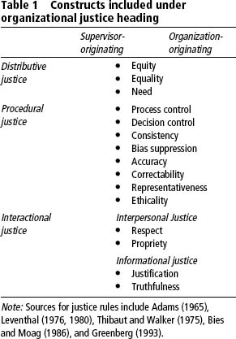

Slide 5
LMX
Leader-Member Exchange (LMX) concerns with quality of the leader subordinate relationship and include the factors such as respect, affect, contribution and loyalty (Liden & Maslyn, 1998).

Slide 6
Theorization of the Study
Equity Theory (Adams, 1965) argues that individuals compare their outcome/input ratio to that of some relevant comparison other. Any imbalance in ratios creates a sense of distress.
Social Exchange Theory (Blau, 1964) suggests, employees consider their workplace as social market-place where they are interested to obtain favorable return on their investment.

Slide 7
Literature Review
Ameen (2006) discussed the interactional justice and internal equity in the context of Pakistani library professionals. She stated that library professionals are not getting as much respect, power and authority as other professionals are getting on the same hierarchical level within the same organization. She also suggested employers to improve rewards (distributive justice) and respect (interactional justice) for innovative librarians.

Slide 8
Literature Review Continued
Kont and Jantson (2013) discuss the study of Estonian university libraries are facing the problem of lower distributional rewards (money) as compare to their knowledge, skills and responsibility. Library staff members showed great concern in the study that if they are paid more justifiably their inclination toward working will be high.
Masterson et. al. (2000) stated that organizational justice works as an organizational input in the process of exchange relationship.

Slide 9
Literature Review Continued….
American library Association (ALA) efforts toward joining the National Committee of Pay Equity (NCPE) in 1974 and celebration of Pay Equity Day (April 16) also showed the potential significance of equal rewards for library professionals (Farley 2000)
Cohen-Charash and Spectro (2001) stated in their meta-analysis of organizational justice and job performance that procedural justice is the best predictor of performance as compare to distributive justice

Slide 10
Hypotheses
H1. Distributive justice has positive relation with job performance.
H2. Procedural justice has positive relation with job performance.
H3. Interactional justice has positive relation with job performance.
H4. LMX mediate the relationship between distributive justice and job performance.
H5. LMX mediate the relationship between procedural justice and job performance.
H6. LMX mediate the relationship between interactional justice and job performance.

Slide 11
Measures
20 item scale developed by Niehoff and Moorman (1993) is used to measure three construct of organizational justice (5 DJ, 6 PJ, 9 IJ). Internal consistency and validity with the Cronbach alpha scores are .83, .88, .92.
7 item scale developed by Scandura and Graen (1984) is used to measure LXM. Cronbach alpha score .86
5 item scale developed by Elding, D.J.(1989) is used to measure to job performance. Cronbach alpha score .83

Slide 12
Analysis Demographic
Notes:
. Professional employees are defined as the librarians working on basic pay scale (BPS) 16 and higher grades and those employed after attaining their master’s degree in Library and Information Science (MLIS). Paraprofessional library staff member are those who are working below BPS 16 and have at least bachelors in Library and Information Science (BLIS).

Slide 13
Demographic Analysis Continued………
Notes:
The lower numbers of female staff in academic libraries showed that female librarians are not being proportionally hired or may be early quitting the job due to family responsibilities (Rubin; 1989). Mostly upper positions in academic libraries of Pakistan are occupied by male librarians that give the signal of glass ceiling effect as well.

Slide 14
Demographic Analysis Continued………

Slide 15
Control Variables
One-way ANOVA analysis was conducted to check the impact of control variable (gender, age, job level & qualification) on other variables but result found was insignificant.

Slide 16
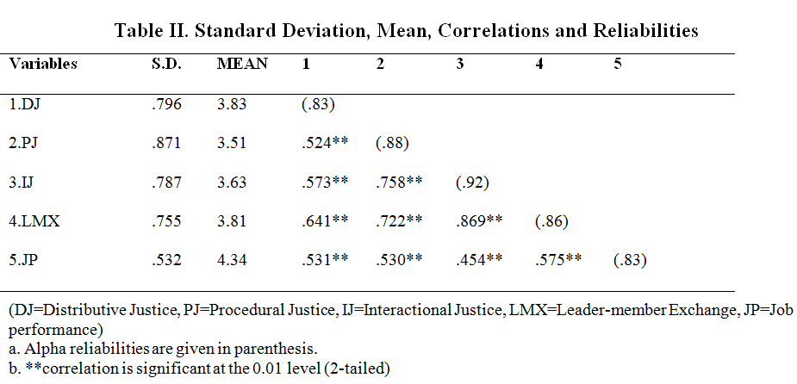

Slide 17
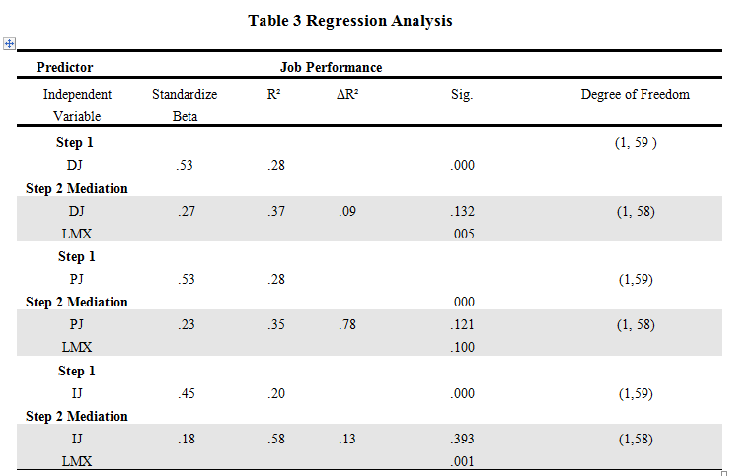

Slide 18
Regression Analysis
Predictor | Job Performance
Independent Variable | Beta | R² | ΔR² | Sig.
Step 1
Distributive Justice (DJ) | .53 | .28 |  | .000
Step 2 Mediation
DJ | .27 | .37 | .09 | .132
LMX |  |  |  | .005
Step 1
Procedural Justice (PJ) | .53 | .28 |  | .000
Step 2 Mediation
PJ | .23 | .35 | .78 | .121
LMX |  |  |  | .100
Step 1
Interactional Justice (IJ) | .45 | .20 |  | .000
Step 2 Mediation
IJ | .18 | .58 | .13 | .393
LMX |  |  |  | .001

Slide 19
Results
In first step demographic variables were incorporated as control variable but the results were not significant.
In second step job performance were regressed on distributive justice, procedural justice and interactional justice separately and results shows highly significance (p ˂ .001).
In third step job performance were regressed on all three kind of justice and LMX together. Results shows the decrease in beta value and insignificance of independent variable in the presence of mediating variable, i-e (DJ β=.53 p ˂ .001 to β=.27 p ˂ .132).

Slide 20
Discussion on Results
The library staff members that score high at job performance scale, also perceived fairness in the process of reward distribution. The majority of library personnel believed that their concerns are heard by their supervisors. The values of coefficient of determination (28%) showed that both distribution and procedural justice equally impact the job performance.
Procedural justice also showed significant relationship with job performance in the presence of LMX. When employees assume that all decisions made by their supervisors are applied consistently and fairly, their level of performance increases.

Slide 21
Discussion on Results Continued..
Mostly respondents believed that their supervisors treated them with respect, dignity, kindness and truthfully. The result proved that combing LMX with distributive justice, procedural justice and interactional justice explained 37 %, 35% and 58% of total variation, in the job performance.
Regression analysis depicted that interactional justice combined with LMX is the most power full predictor of high job performance (Burton, Sablynski & Sekiguci, 2008) as compared to distributive and procedural justice (Wang et al., 2010). Rubin (1989) also discussed the need of interpersonal skills and competencies of library supervisors to perform well in libraries.

Slide 22
Conclusion
To ensure the justice in libraries, leadership should hold the moral code of conduct by involving all concerned stakeholders in the process of decision making.
In addition to considering fairness in decision making of employee recruitment, selection, training and development and performance appraisal, it is equally important to maintain fairness in interpersonal relationship between the library leadership and employees.
It is believed that when library personnel consider their leadership having the qualities of respect, propriety, truthfulness and justification, they feel more secure and trusted.

Slide 23
Limitation
Generalization
Convenient Sampling
Cross-Sectional Design
Future Research
Public and Special Libraries
Organizational justice relationship with Organizational Citizenship behavior, Employee Commitment and Psychological Contracts of Librarians

