Slide 1
Gene Expression and Regulation and Mutations

Slide 2
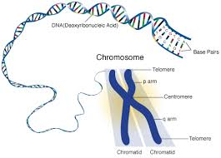
Gene Expression
There are thousands of genes on each chromosome
Each gene codes for one type of protein
Gene expression = DNA → RNA → Proteins

Slide 3
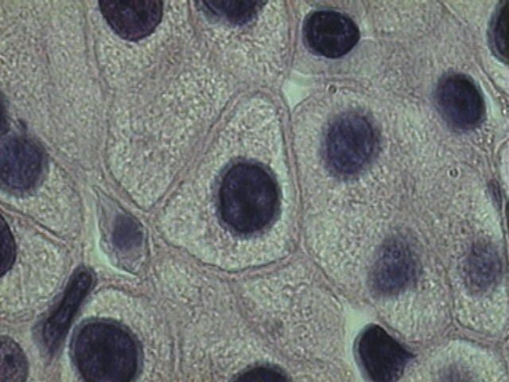
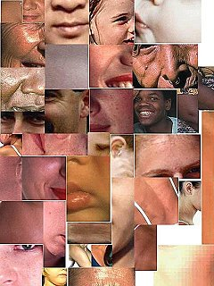
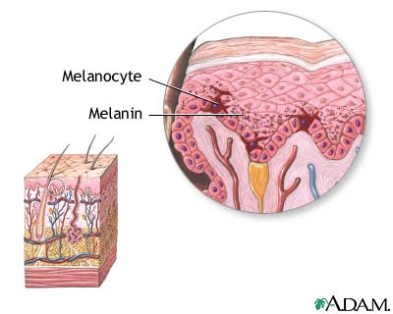
Gene Expression Regulation
DNA is the same in most cells
DNA can be turned “on and off”
Ex. Gene that codes for melanin is expressed (turned on) in skin cells but not for liver cells

Slide 4
Eukaryotic Gene Regulation
5 Main Steps
Chromatin Modification
Transcription Regulation
mRNA Processing
mRNA Degradation
Protein Degradation

Slide 5
1. Chromatin Modification
Occurs in Nucleus
Some DNA is tightly coiled where genes cannot be expressed
Some DNA is loosely coiled allowing for wrapping around Histone Proteins in chromosomes
Gene Expression!

Slide 6
2. Transcription Regulation
Occurs in Nucleus
Certain Genes are transcribed into mRNA
Allows for certain proteins to be made

Slide 7
3. mRNA Processing
Occurs in Nucleus
Newly formed “immature” mRNA is process to make “mature” mRNA
2 segments of mRNA
Introns and exons
Introns = “junk” genes and are spliced out
Exons = “expressed” genes

Slide 8
4. mRNA Degradation
Occurs in Cytoplasm
Occurs after gene translation into proteins
mRNA is used up and destroyed
mRNA not destroyed = mutations!

Slide 9
5. Protein Degradation
Occurs in Cytoplasm
Occurs after Protein has been made and used
Protein is no longer functional and protein is destroyed
Protein not destroyed = mutations!

Slide 10
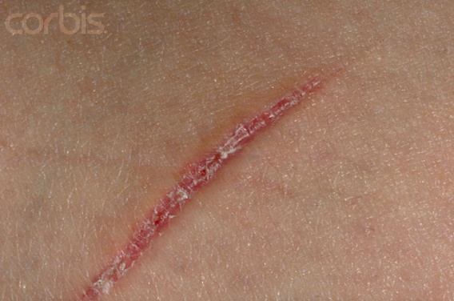
Example of Gene Regulation
Injury of skin (cut) = overproduction of certain proteins to allow healing

Slide 11
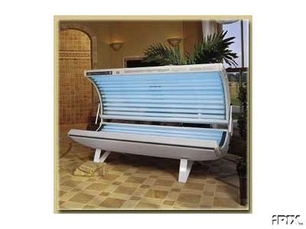
Environmental Factors!
Cells’ environment controls gene expression
Causing cell to produce only certain proteins
Ex. Exposure to UV light can cause skin cells to produce more melanin
Results in darker skin (tan)

Slide 12
Regulation Goes Wrong!!!
Overproduction of proteins can cause cell to have uncontrolled cell division
Cancer!
Underproduction of proteins can cause cell to not make enough
Insulin → diabetes
Caused by DNA mutations!!!

Slide 13
What if this DNA
CACGTGGACTGAGGACTCCTC
…was changed to this DNA?
CACGTGGACTGAGGACACCTC
A
What does it matter?

Slide 14
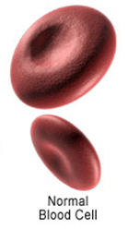
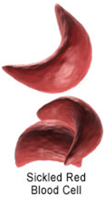
CACGTGGACTGAGGACTCCTC
Codon for CTC =
glutamate
CACGTGGACTGAGGACACCTC
Codon for CAC =
valine
What does it matter???

Slide 15
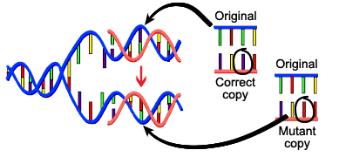
Mutations
Mutation = any change in DNA sequence
Usually occurs during DNA replication
In sex cells = affects individual’s offspring
In body cells = affects the individual

Slide 16
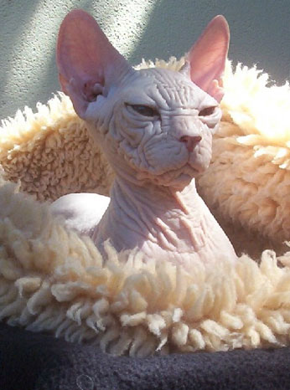
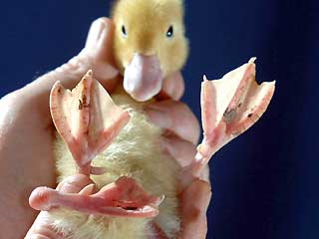
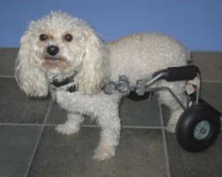
Mutations can be bad…
Lead to cancer, aging, birth defects, self-aborted embryos

Slide 17
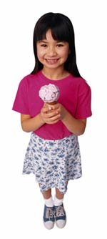
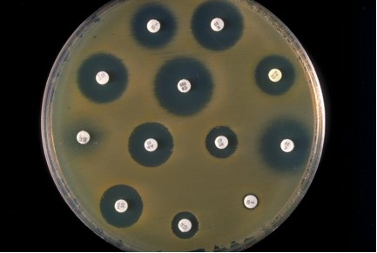
Mutations can be good…
Make organism survive in its environment
Ex. Bacterial becomes antibiotic-resistant
Ex. Ability to drink milk as an adult

Slide 18
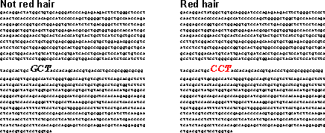
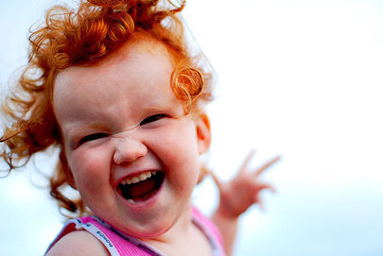

Slide 19
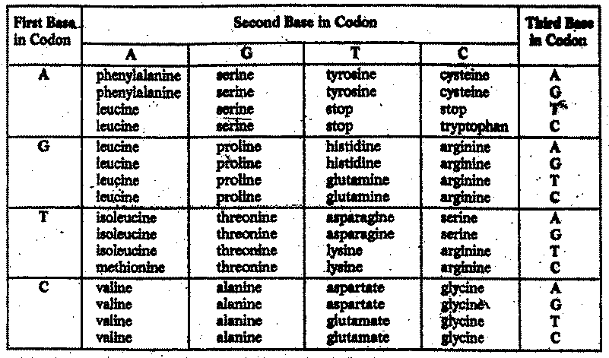
Some mutations have no effect
Valine
CAC = amino acid (_______________)
CAT = amino acid (________________)
Valine

Slide 20
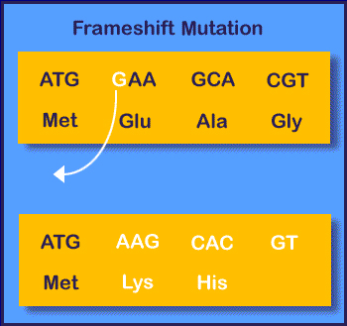
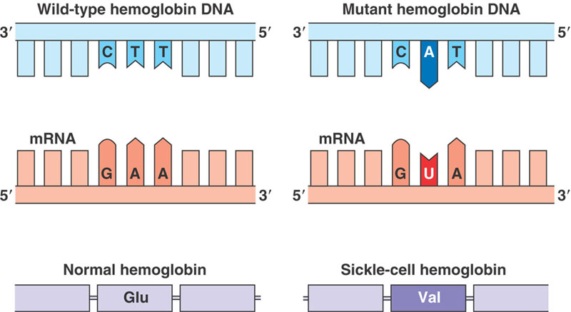
2 Types of Mutations
Gene Mutation – only affect one gene
Point mutation = substitution of single base pair
Changes only one amino acid (if any!)
Frameshift mutation = single base is added/deleted
A.K.A. nonsense mutation

Slide 21
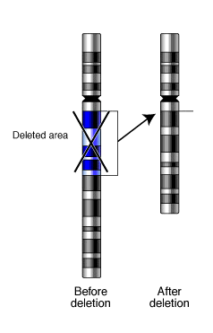
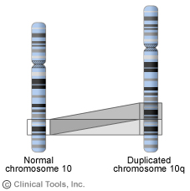
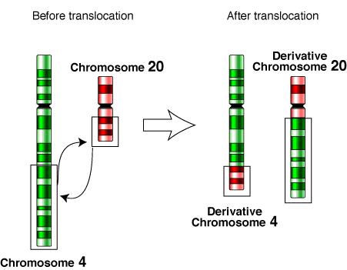
2 Types of Mutations
Chromosomal mutation – may affect more than one gene
Examples: nondisjunction, deletion, insertion, inversion, and translocation

Slide 22
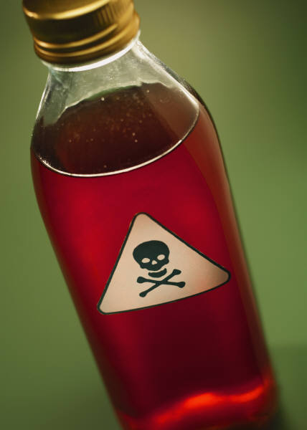
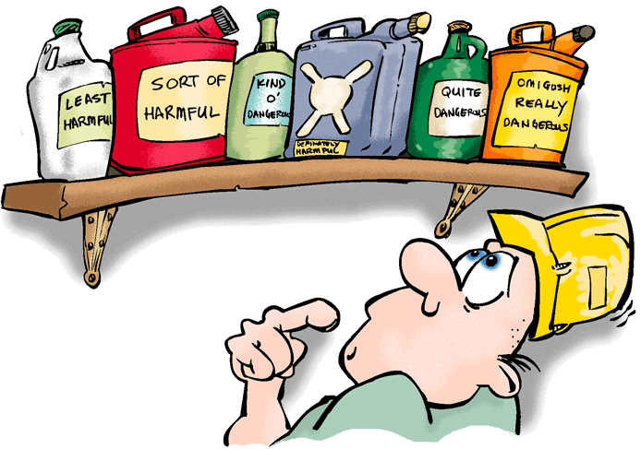
What can cause a mutation?
Can be inherited, caused by environmental agents, or happen spontaneously
Mutagen = anything environmental that can cause change in DNA

Slide 23
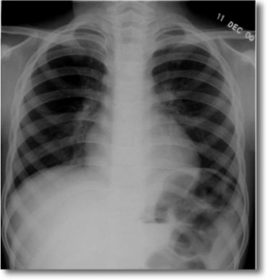
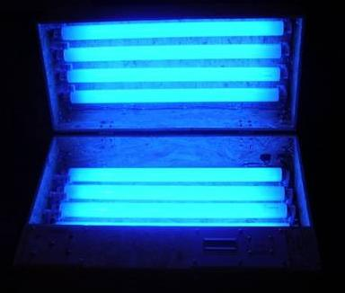
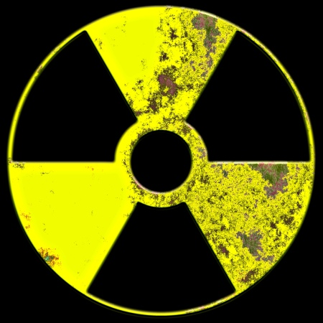
Mutagens
Radiation = UV, X-rays, nuclar

Slide 24
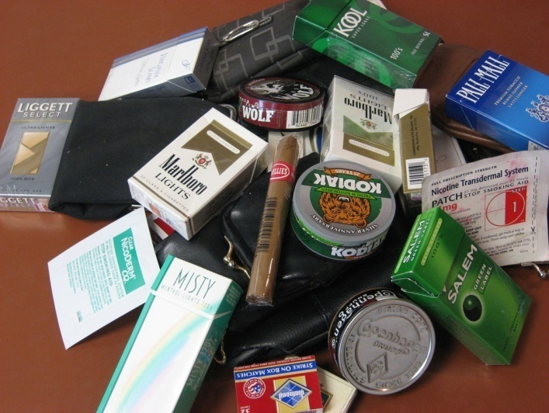
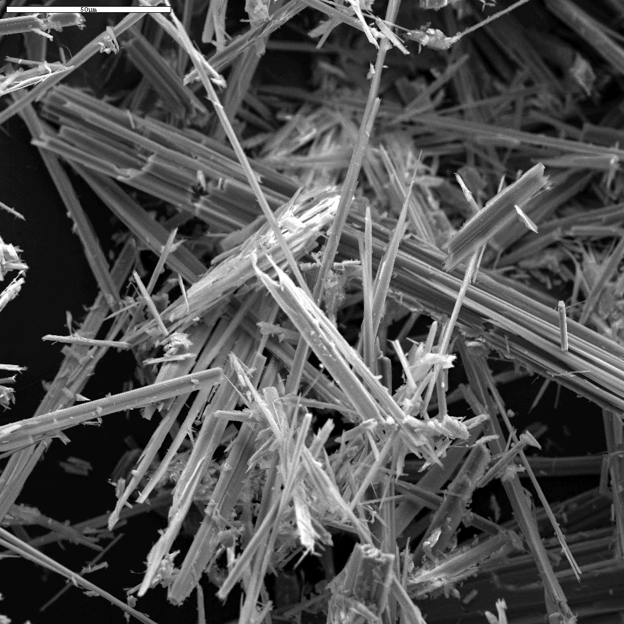
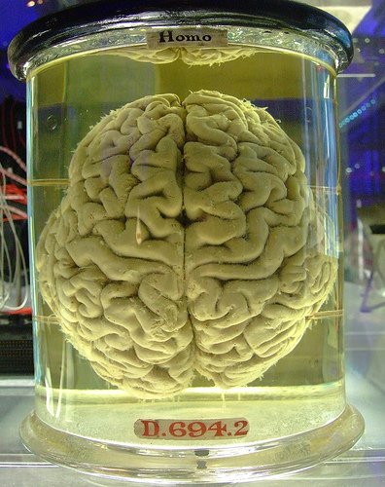
Mutagens
Chemicals = asbestos, formaldehyde, chemicals in tobacco products
Many mutagens are also carcinogens – cause cancer

Slide 25
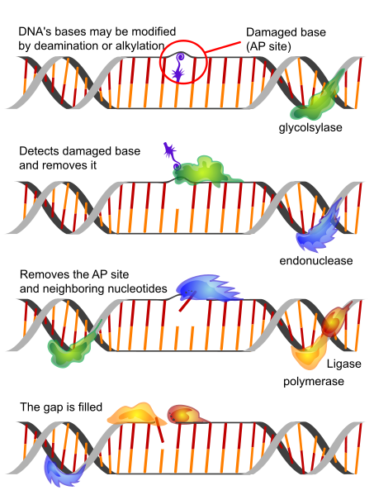
Repair!
DNA mutates constantly but our cells have repair mechanisms
Overexposure to mutagen is what causes worst problems since cell cannot repair all mutations in time
Mutation repair reduces effectiveness with age

