Slide 1
Gene Correlation Networks
Jin Chen
CSE891-001
Fall 2012

Slide 2
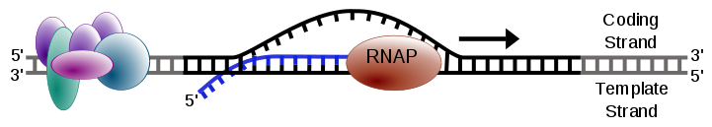
Gene expression
Gene expression is the process by which information from a gene is used in the synthesis of a functional gene product
It is used by all known life
The process of transcription is carried out by RNA polymerase (RNAP), uses DNA (black) as a template and produces RNA (blue)
http://en.wikipedia.org/wiki/Gene_expression
Notes:
Several steps in the gene expression process may be modulated
transcription, RNA splicing, translation, and post-translational modification of a protein
Gene regulation gives the cell control over structure and function, and is the basis for cellular differentiation, morphogenesis and the versatility and adaptability of any organism

Slide 3
Gene expression detection
Single gene expression detection
  Northern blots & RT-qPCR
Genome-wide gene expression detection
  DNA microarray
  Next generation of sequencing, esp., RNA-seq
Notes:
Recent advances in microarray technology allow for the quantification, on a single array, of transcript levels for every known gene in several organism's genomes, including humans.

Slide 4
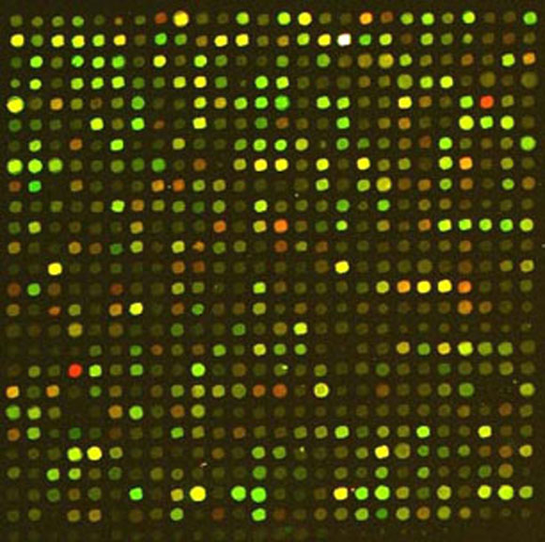
DNA microarray
Microarray consists of an arrayed series of thousands of probes
Probe-target hybridization is usually detected and quantified to determine relative abundance of nucleic acid sequences in the target
One cDNA sample was labelled with red fluorophore, the other cDNAs with green fluorophore
Selective hybridization of cDNA from either sample to a DNA spot produces red or green signal
Hybridization of cDNA from both RNA samples produces yellow signal
Valerie Reinke, WormBook. http://www.wormbook.org/chapters/www_germlinegenomics/germlinegenomics.html
Notes:
Since an array can contain tens of thousands of probes, a microarray experiment can accomplish many genetic tests in parallel. Therefore arrays have dramatically accelerated many types of investigation.

Slide 5
Normalization
A microarray experiment is performed under the assumption that gene intensities reflect actual mRNA levels
But raw gene expression intensities are highly influenced by a number of non-biological sources of variation
Normalization and quantification of differential expression in gene expression microarrays
C. Steinhoff et al, BRIEFINGS IN BIOINFORMATICS (2006). VOL 7. NO 2. 166-177
Notes:
Thus, for achieving biologically meaningful data, computational preprocessing including normalization steps is essential

Slide 6
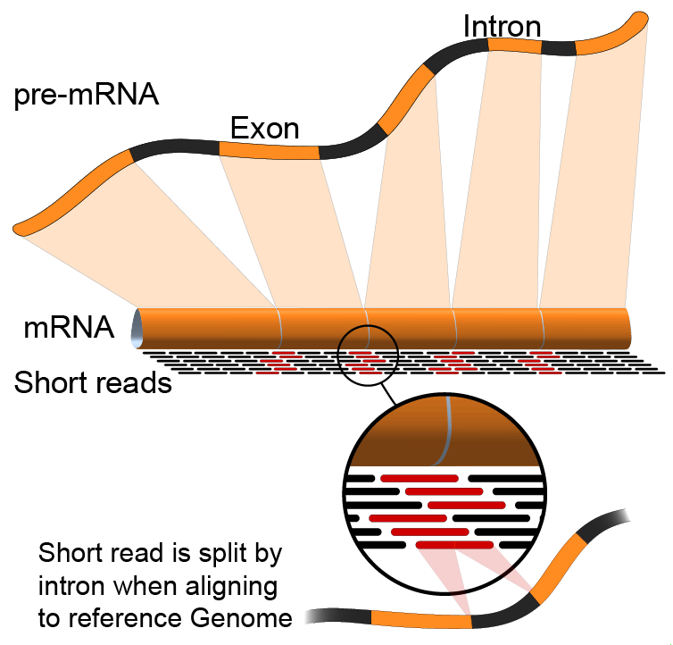
RNA-seq
To use the next generation of sequencing (NGS) technologies to sequence cDNA in order to get information about a sample's RNA content
NGS technologies generate millions of short reads from a library of nucleotide sequences
Notes:
NGS technologies generate millions of short reads from a library of nucleotide sequences, whether they come from DNA, RNA, or a mixture

Slide 7
Gene co-expression network
Construction of co-expression networks from gene expression datasets has become a popular alternative to the conventional analytic approaches
Large-scale gene co-expression networks have been used, e.g. to demonstrate that functionally related genes are frequently co-expressed across multiple datasets and across different organisms
By constructing separate co-expression networks for different conditions, such as normal and cancerous states, it is possible to identify disease-mediated changes in the network connectivity patterns
L. Elo et al. Bioinformatics (2007) Vol 23, Iss. 16 Pp. 2096-2103

Slide 8




http://www.functionalnet.org/

Slide 9
Gene co-expression network
Definition: a gene co-expression network is a graph, where each node corresponds to a gene and a pair of nodes is connected with an undirected edge if their pair-wise expression similarity is above a particular threshold
“standard” methods for network construction
  Computation of co-expression: Pearson correlation
  Edge threshold: pre-defined cutoff value
  Statistical significance test: Student's t-test

Slide 10

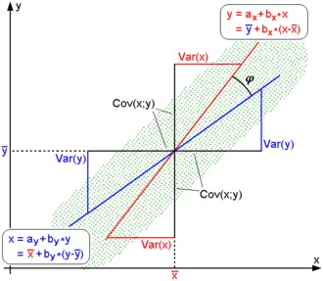
Pearson correlation
Pearson correlation is a measure of the correlation (linear dependence) between two variables X and Y, giving a value between +1 and −1 inclusive
For uncentered data, the Pearson correlation coefficient corresponds with the the cosine of the angle φ between both possible regression lines y=g_{x}(x) and x=g_{y}(y).

Slide 11
Unweighted gene co-expression network
Measure concordance of gene expression with a Pearson correlation
Pearson correlation matrix is dichotomized to arrive at an adjacency matrix
Binary values in the adjacency matrix correspond to an unweighted network
Bin Zhang and Steve Horvath (2005) Statistical Applications in Genetics and Molecular Biology: Vol. 4: No. 1

Slide 12
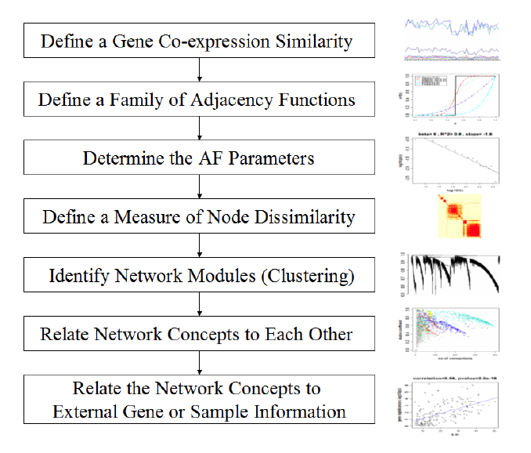
Weighted gene co-expression network
Bin Zhang and Steve Horvath (2005) Statistical Applications in Genetics and Molecular Biology: Vol. 4: No. 1

Slide 13
Weighted vs. unweighted
Weighted Network View Unweighted View
All genes are connected A subset of genes are connected
Connection widths=connection strengths All connections are equal
Hard threshold may lead to an information loss. If 2 genes are correlated with score 0.79, then they are disconnected with regard to a threshold of 0.8

Slide 14
Adjacency matrix
A network can be represented by an adjacency matrix, A=[a_{ij}], that encodes whether/how a pair of nodes is connected
  A is a symmetric matrix with entries in [0,1]
  For unweighted network, entries are 1 or 0 depending on whether or not 2 nodes are adjacent (connected)
  For weighted networks, the adjacency matrix reports the connection strength between gene pairs

Slide 15
Generalized connectivity
Gene connectivity = row sum of the adjacency matrix
  For unweighted networks, it is the number of direct neighbors
  For weighted networks, it is the sum of connection strengths to other nodes:

Slide 16
Adjacency matrix
Measure co-expression with Pearson correlation s(i,j) for gene i & j
Define an adjacency matrix A(i,j) with adjacency function AF(s(i,j)).
2 classes of AF
  Step function AF(s)=I(s>tau) with parameter tau (unweighted network)
  Power function AF(s)=s^{b} with parameter b
  The choice of the AF parameters (tau, b) determines the properties of the network
Notes:
AF is a monotonic function

Slide 17
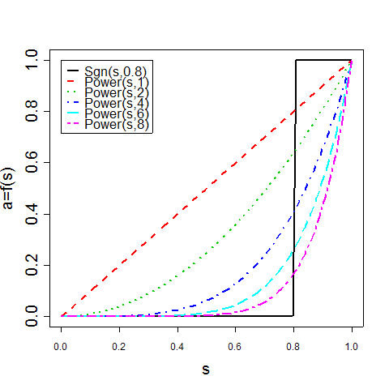
Compare power adjacency functions with step function
Adjacency
=connection strength
AF(s)=s^{b}
Gene Co-expression Similarity

Slide 18
Choosing parameters for adjacency function AF
A) Consider only those parameter values that result in approximate scale-free topology
B) Select the parameters that result in the highest mean number of connections
Motivated by the finding that most biological networks have been found to exhibit a scale free topology
Leads to high power for detecting modules (clusters of genes) and hub genes

Slide 19
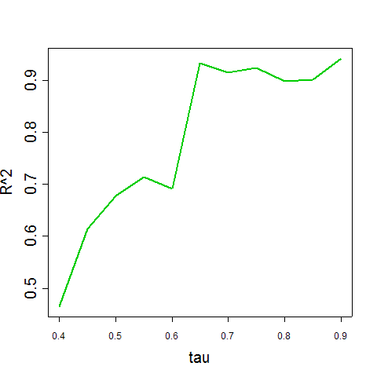
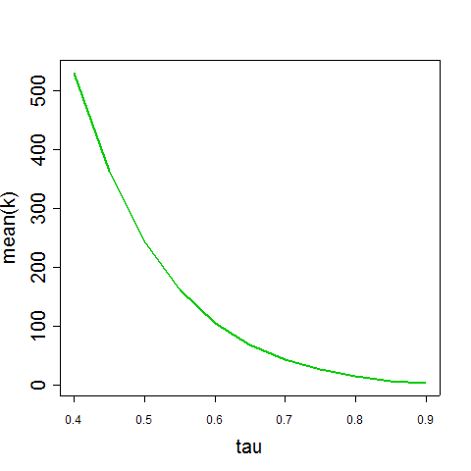
Trade-off between criterion A and B when varying tau
Step Function: I(s>tau)
criterion A: fit R^2 criterion B: mean connectivity

Slide 20
Module identification in gene correlation networks
One important aim of network analysis is to detect subsets of nodes (modules) that are tightly connected to each other
Modules are groups of nodes that have high topological overlap
Ravasz E, Somera AL, Mongru DA, Oltvai ZN, Barabasi AL (2002) “Hierarchical organization of modularity in metabologic networks”. Science Vol 297 pp1551-1555
Notes:
based on the notion of topological overlap

Slide 21
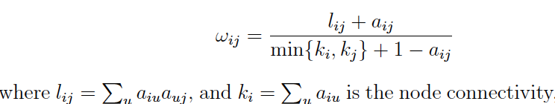
Topological Overlap Matrix (TOM)
The topological overlap matrix (TOM) Ω= [w_{ij}] is a similarity measure for biological networks:
Note that w_{ij} = 1 if the node with fewer connections satisfies two conditions: (a) all of its neighbors are also neighbors of the other node and (b) it is connected to the other node.
In contrast, w_{ij} = 0 if i and j are un-connected and the two nodes do not share any neighbors.
Ravasz E, Somera AL, Mongru DA, Oltvai ZN, Barabasi AL (2002) “Hierarchical organization of modularity in metabologic networks”. Science Vol 297 pp1551-1555

Slide 22
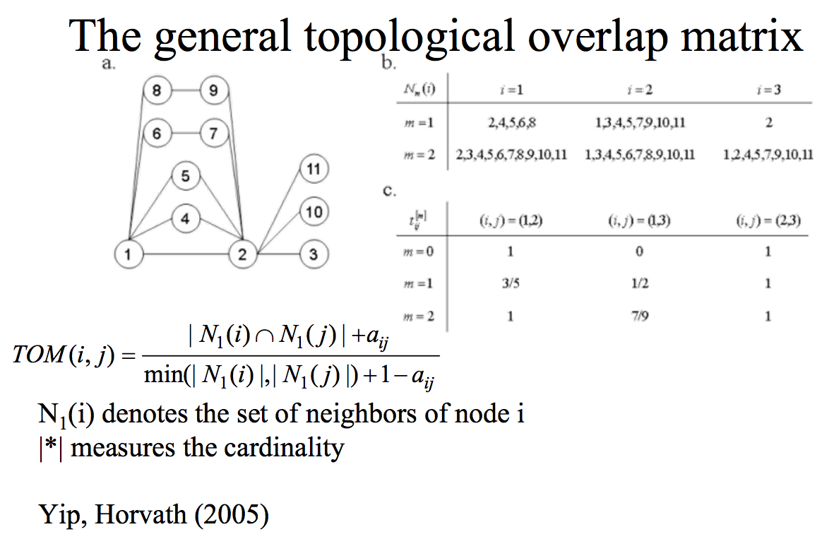

Slide 23
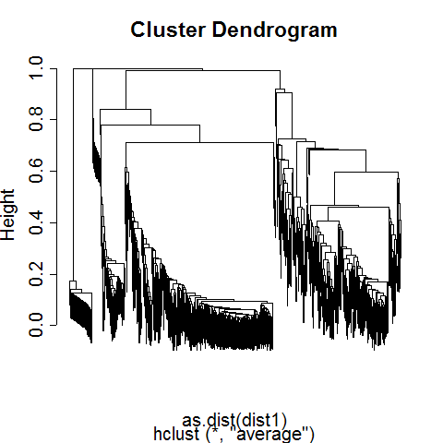
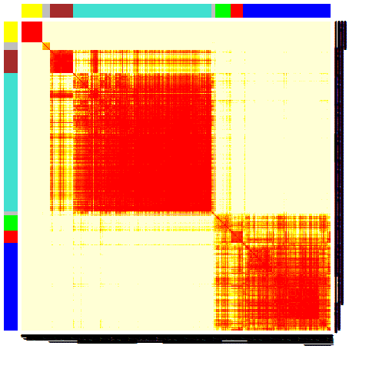
Steps for defining gene modules
Define a dissimilarity measure between 2 genes
  dissim(i,j)=1-abs(correlation)
  network community=1-Topological Overlap Matrix (TOM)
Use the dissimilarity in hierarchical clustering
Define modules as branches of the hierarchical clustering tree
Visualize the modules and the clustering results in a heatmap plot
Heatmap

Slide 24
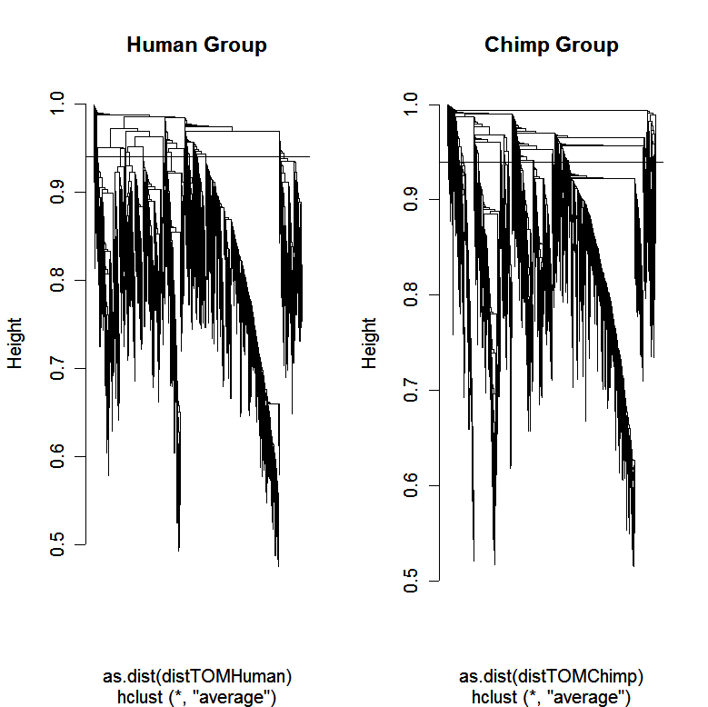
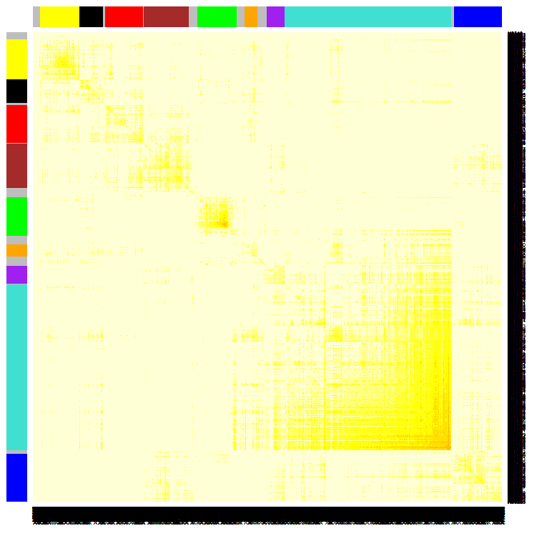

Using the TOM matrix to cluster genes
To group nodes with high topological overlap into modules, use average linkage hierarchical clustering coupled with the TOM distance measure
Once a dendrogram is obtained from a hierarchical clustering method, choose a height cutoff to arrive at a clustering
Modules correspond to branches of the dendrogram
TOM plot
Genes correspond to rows and columns
TOM matrix
Hierarchical clustering
dendrogram
Module:
Correspond
to branches

Slide 25
Module-centric view (intramodular connectivity) v.s. whole network view (whole network connectivity)
Traditional view based on whole network connectivity
Module view based on within module connectivity
In many applications, intramodular connectivity is biologically and mathematically more meaningful than whole network connectivity
Mathematical Facts in gene co-expression networks
Hub genes are always module genes in co-expression networks.
Most module genes have high connectivity

Slide 26
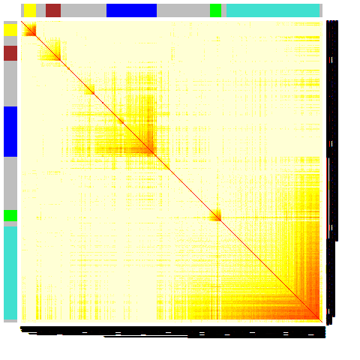
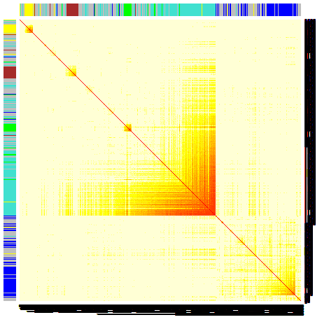
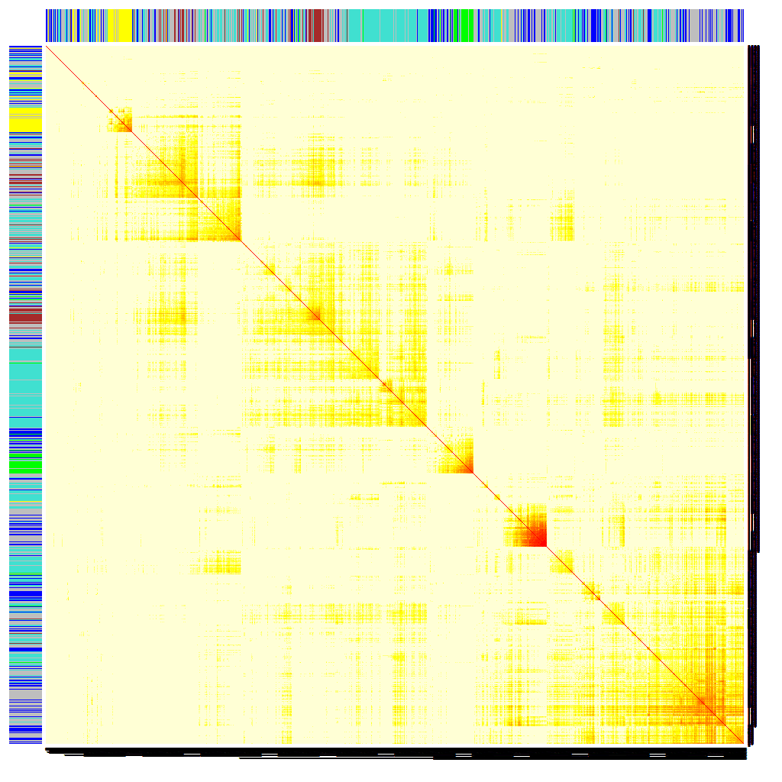
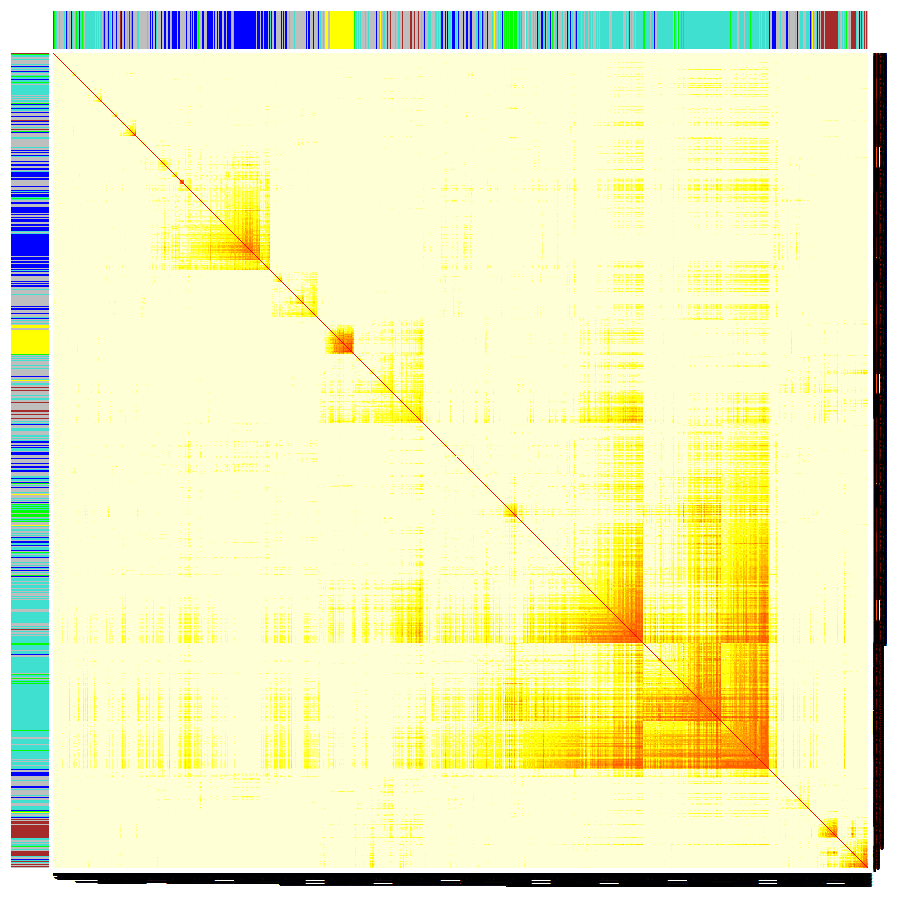
Module structure is highly preserved across data sets
55 Brain Tumors
VALIDATION DATA: 65 Brain Tumors
Messages:
1) Cancer modules can be independently validated
2) Modules in brain cancer tissue can also be found in normal, non-brain tissue
--> Insights into the biology of cancer
Normal brain (adult + fetal)
Normal non-CNS tissues
Horvath et al PNAS 2006 vol. 103 no. 46 17402-17407

Slide 27
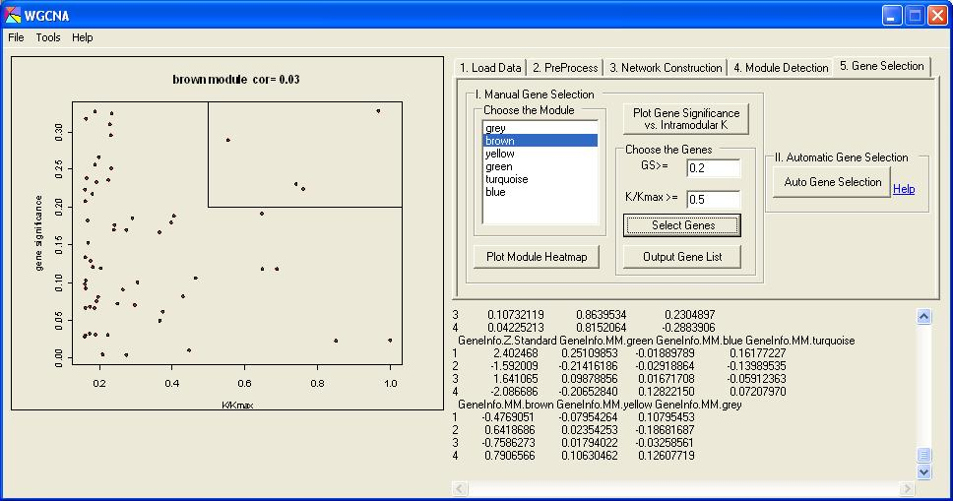
http://www.genetics.ucla.edu/labs/horvath/CoexpressionNetwork/Softwares/WGCNA/

Slide 28
Conclusion
Gene co-expression network analysis can be interpreted as the study of the Pearson correlation matrix
Connectivity can be used to single out important genes
Weak relationship with principal or independent component analysis
  Network methods focus on “local” properties
Open questions
  What is the mathematical meaning of the scale free topology criterion?
  Alternative connectivity measures, network distance measures
  Which and how many genes to target to disrupt a disease module?

