Slide 1
Neural Network based Handwriting Recognition
Presented By
Lingzhou Lu & Ziliang Jiao

Slide 2
Domain
Optical Character Recogntion (OCR)
Upper-case letters only

Slide 3
Motivation
Build our own handwriting recognition system that can recognition a simple sentence or phrase

Slide 4
Problems
Each person has an unique writing style
Written characters varies in sizes, stroke, thickness, style
Generalization of the recognition system largely depends on the size of training set
Notes:
Traditional algorithmic approach follows a set of instructions to solve problems.

Slide 5
Approach
Image Acquisition
Pre-processing
Segmentation
Feature Extraction
Classification & Recognition
Notes:
There are 4 major stages for handwriting recognition

Slide 6
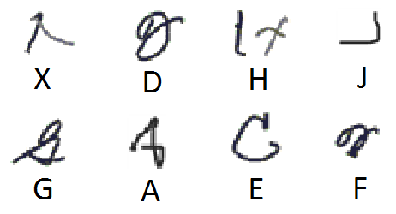
Unipen datasets
Contains 16414 samples of isolated upper case letters
Around 600 full sets of 26 alphabetic letters
Only 300 are used
70% training set
10% validating set
20% testing set
Problems
Missed labeled
Mixed with Cursive data
Unreadable data
Problematic cases in Unipen

Slide 7
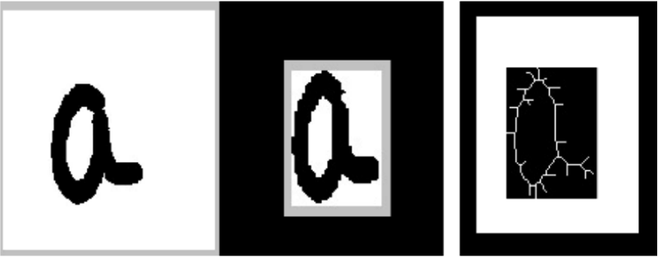
Pre-processing
Using Aforge library
Minimize the variability of handwritten character with different stroke thickness, color, and size
Convert to binary image
Cropped Image
Skeletonization

Slide 8
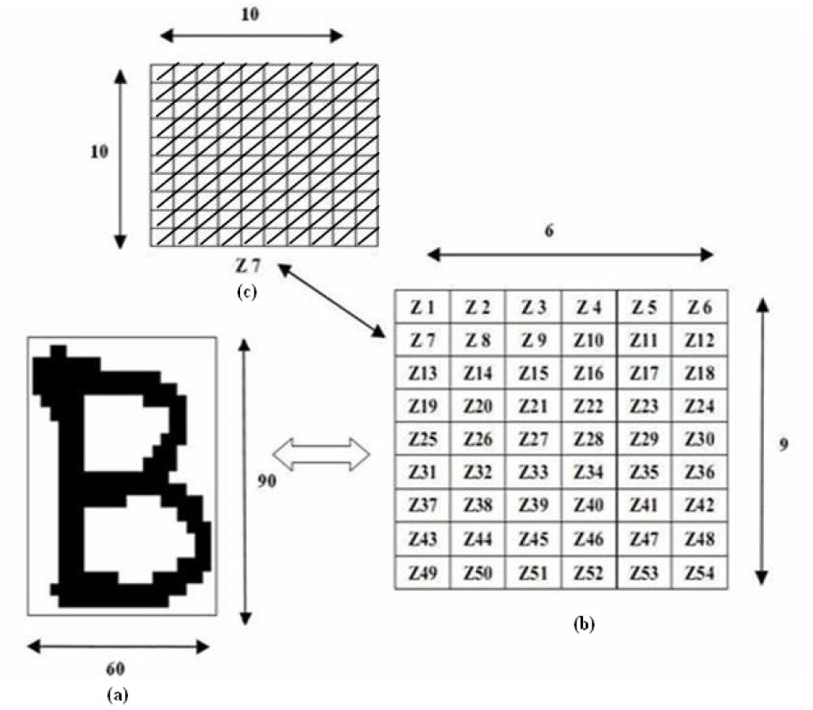
Feature Extraction
Extracting from the raw data the information which is most relevant for classification purposes.
Every character image of size 90x60 is divided into 54 equal zones, each of size 10x10 pixels

Slide 9
Experiement
Neural Network using back propagation
Network parameters
ANN representation: 69-100-26
Activation function: Hyperbolic tangent/Sigmoid
Training epochs: 10000
Learning Rate: 0.0005
Momentum Rate: 0.90
Terminated condition: validation set MSE
Notes:
n=√ input units * output units

Slide 10
Experiement
Distortion
Similar to mutation in GA
0.01 possibility at every epoch
Every image has 50% chance to be distorted
Example of distortion

Slide 11
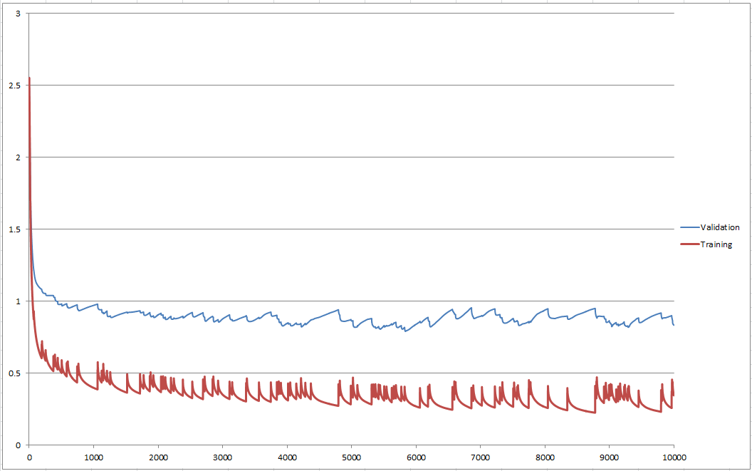
Result
Distortion | Training Set | Testing set
YES | 92% | 83%
NO | 97% | 75%
Notes:
No distortion => converge faster

Slide 12
Conclusion
Distortion helps generalize recognition system
Better result can be yield with larger training
Validation set can be use to avoid overfitting and find the best generalized result

Slide 13
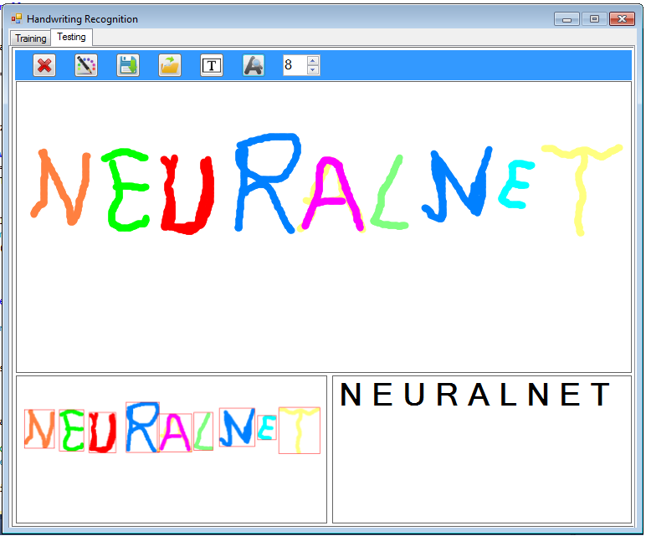
Application
Notes:
Implement an additional spellchecker module at the output to prevent misrecognize from similar characters

Slide 14
Future Work
Expand dataset
Look for better segmentation and feature extraction method
Apply GA to feature input to find out the possible better solution

