Slide 1
Organizational Structure
Empower your team
Carolyn Warkentin, B.A., C.A.E.
Executive Director
South Essex Community Council

Slide 2
“An empowered organization is one in which individuals have the knowledge, skills, desire and opportunity to personally succeed in a way that leads to collective organizational success.”
Stephen Covey

Slide 3
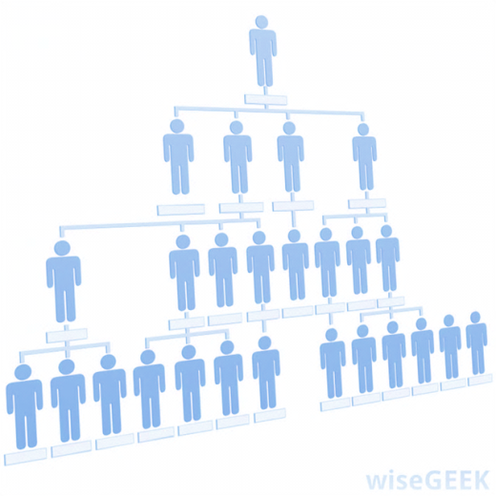
Objectives
What is structure?
Why is it important?
How does structure & accountability empower staff?
How does that benefit you as a supervisor or leader?

Slide 4
What is Structure?

Slide 5
What is structure?
A framework around which the organization is organized
Operating manual
Describes how leadership is chosen & decisions are made
The way an organization arranges people and jobs so that its work can be performed and its goals can be met
www.referenceforbusiness.com

Slide 6
When examining structure…
Responsibility
Tasks
Authority
Workflow
Understand the relationships between tasks, workflows, responsibility & authority.

Slide 7
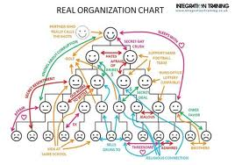
When was the last time you really looked at your org chart?

Slide 8
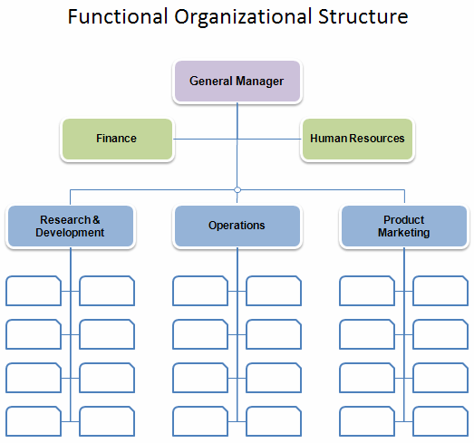
FUNCTIONAL
Organized into teams
According to purpose or function of a specific job

Slide 9
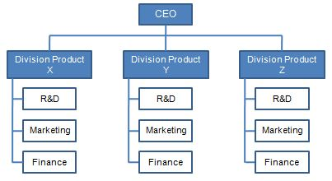
DIVISIONAL
Larger companies
Based on geography, products or services
Each division is equipped with it’s own resources in order to function independently

Slide 10
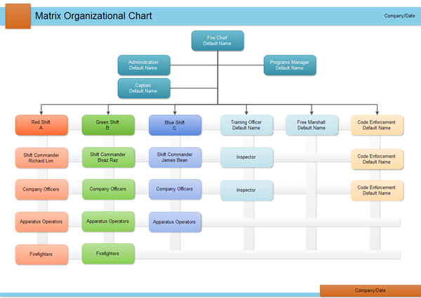
MATRIX
Based on a combination of functional and divisional
Teams of employees accomplish the work
Form teams according to functions and services/products, strengths & competencies

Slide 11
If done properly:
Right people in the right positions
Better utilize organization’s inventory of skills
Helps leaders prioritize
Staff make decisions
In the end, it’s about
BALANCE
Your organizational design should take into consideration:
Strategy
Organizational size
Environment
Controls
Incentives

Slide 12
http://www.youtube.com/watch?v=q0vvdjxfsF8

Slide 13
What is the purpose of your organizational structure?
Does it align with your organization’s mission, vision and values? Why is that important?
Does your structure allow for leadership development & creative thinking?

Slide 14
Why is Structure Important?

Slide 15
Quiz
1. Do you ever see people blaming others for what goes wrong in your organization?
2. Do you feel that people do not accept responsibility for what they do or how they do it?
3. Do you see people failing to take the initiative to report on their activities and their progress towards results?
4. Do people fail to “dive for the ball” when it gets dropped?
5. Do people “wait and see” if things will ever get better when serious problems engulf your organization?

Slide 16
Quiz
Do you hear people saying they feel a situation is out of control and that they can do nothing to resolve it?
Do people spend their time “covering their tails” just in case things go wrong?
Do people seem to feel more responsible for their activity and effort than they do for their results?
Do you hear people say, “It’s not my job or my department” and act as if they expect someone else to solve the problem?
Do you feel that people display a low level of personal ownership and involvement when problems arise?
Organizational Accountability Assessment, The Oz Principle, by Roger Connors, Tom Smith & Craig Hickman

Slide 17
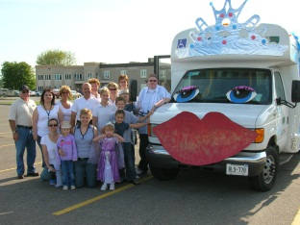
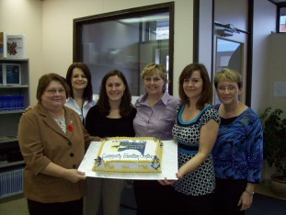
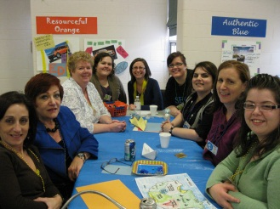
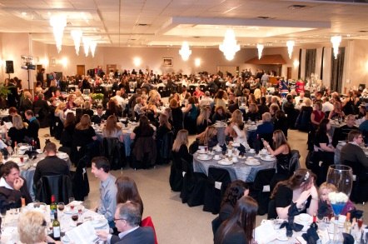
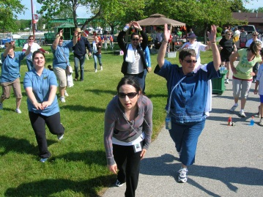
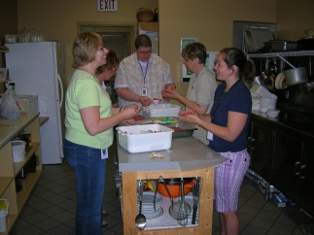
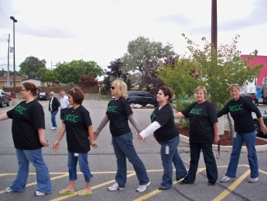
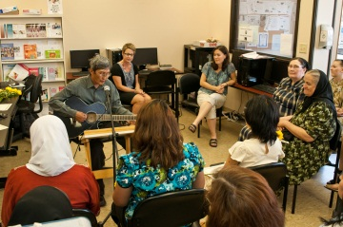
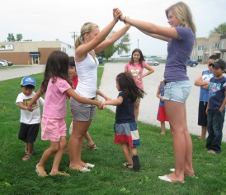
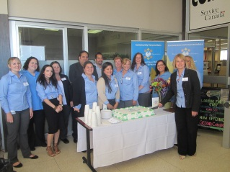
SECC’s Story

Slide 18
Making the Connection
Mission
Vision
Values
Strategic Plan

Slide 19
Executive Director
Manager of Finance
Department Coordinator Job Connect
Department Coordinator CHSS
Department Coordinator Comm Ed
Manager of Human Resources
Department Coordinator Imm Services
Department Coordinator Employment Edge
Front Line Staff
Program Leader MOW
Program Leader Foot Care
Program Leader Transit
Program Leader Adult Day Program
Program Leader HM, FV, SC
Program Leader Literacy
Program Leader Child Care
Front Line Staff
Front Line Staff
Front Line Staff
Front Line Staff
Front Line Staff
Front Line Staff
Front Line Staff
LINC Front Line Staff
Program Leader*
Front Line Staff
Front Line Staff
Volunteer Services Program Leader
Administrative Assistant
Former Structure

Slide 20
Organizational alignment is linking strategy, culture, processes, people, leadership and systems to best accomplish the needs of a company. An aligned organization is one whose performance influences are mutually supportive and are focused on effective and efficient delivery of results.

Slide 21
Why is structure important?
Strategic Plan
Mission
Vision
Values
Flow of Communication
Clear Reporting Relationships
Decision Making
Rapid Response
Achieving Goals
Effective Use of Human Resources
Evaluation of Performance—individual, organizational

Slide 22
How does structure & accountability empower staff?

Slide 23
Barriers to Empowerment
Formal structures make it difficult to act.
Leadership discourages actions aimed at implementing the new vision.
Employees understand the vision & want to make it a reality, but are boxed in.
A lack of needed skills undermines action.
Personnel & information systems make it difficult to act.
Leading Change, by John P. Kotter

Slide 24
Executive Director
Manager of Finance
Department Coordinator Employment & Training
Department Coordinator CHSS
Department Coordinator Language & Settlement
Manager of Human Resources
Front Line Staff
Program Leader MOW
Program Leader Foot Care
Program Leader Transit
Program Leader Adult Day Program
Program Leader HM, FV, SC
Program Leader Settlement & CC
Program Leader Child Care
Front Line Staff
Front Line Staff
Front Line Staff
Front Line Staff
Front Line Staff
Front Line Staff
Front Line Staff
Program Leader LINC
Volunteer Services Program Leader
Program Leader Employment Connections
Program Leader Employment Edge
Front Line Staff
Program Leader Literacy
Front Line Staff
Front Line Staff
Administrative Assistant
New Structure—Phase 2

Slide 25
SECC Annual Staff Staff Survey
I can make decisions in my day-to-day work activities about the decisions I make.
36%→44%
The strengths and talents of staff are valued.
21%→30%
Leadership is open to suggestions & values input from staff.
16%→45%
Mission
Vision
Values
Strategic Plan—How are we doing? Did we get the priorities right?
Staff Satisfaction—self improvement, happiness, personal performance, leadership opportunities, organizational culture, support at work

Slide 26
How does structure benefit you as a leader?

Slide 27
Benefits
Build trust
Open communication
Enhance listening skills
Engaged staff=more productivity
Innovation
Have time to think and manage strategically
Take your strategic plan from paper on the shelf to real results
Be proactive
Succession planning

Slide 28
https://www.ted.com/talks/stanley_mcchrystal.html?source=email#.UkNjBfMYtfB.email

Slide 29
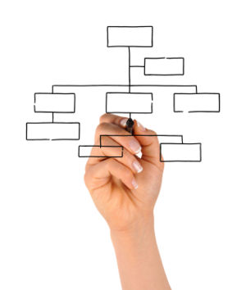
Questions?

Slide 30
Resources
Functional, Divisional and Matrix Organizational Structures
http://voices.yahoo.com/functional-divisional-matrix-organizational-structures-165219.html
Leading Change, John P. Kotter
“Organizational Alignment”, Donald T. Tosti and Stephanie F. Jackson http://pdf.aminer.org/000/246/967/it_and_organizational_alignment_impact_and_value.pdf
The Oz Principle, Roger Connors, Tom Smith and Craig Hickman
“The Secrets to Successful Strategy Execution”, Gary L. Neilson, Karla L. Martin and Elizabeth Powers. HBR’s 10 Must Reads On Strategy, 2011.
TutorialsPoint--Organizational Structures
http://www.tutorialspoint.com/management_concepts/organizational_structures.htm

