Slide 1
Business-to-Business Marketing
By Suwattana Sawatasuk

Slide 2
What is Business-to-Business (B2B) marketing?
It refers to the process of buying & selling goods/services
to be used in the production of other goods/services,
for consumption by the buying organization, and/or
for resale by wholesalers and retailers

Slide 3
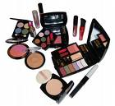
B2B and B2C
B2B
Business-to-Business
B2C
Business-to-Consumer
Ultimate user: Business
Ultimate user: individual household consumer

Slide 4
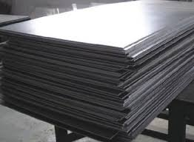
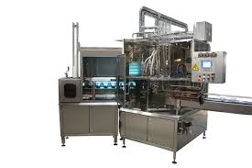
Type of Business Products
Major equipment: capital goods such as large or expensive machines, airplanes, and buildings
Accessory equipment: goods, such as portable tools and office equipment, that are less expensive and shorter-lived than major equipment
Raw materials: unprocessed extractive or agricultural products, such as mineral ore, timber, corn, fruits, vegetables, and fish
Component parts: either finished items ready for assembly or products that need very little processing before becoming part of some other product i.e. diesel engines for trucks, tires and electric motors for automobiles
Processed materials: product used directly in manufacturing other products i.e. sheet metal, chemicals, specialty steel, corn syrup, and plastics
Supplies: consumable items that do not become part of the final product i.e. lubricants, detergents, paper towels, pencils, and paper

Slide 5
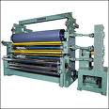
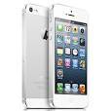
Derived demand
The demand of B2B sales is often derived from the B2C sales in the same supply chain

Slide 6
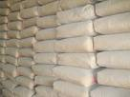
B2B Organizations
Manufacturers or Producers
Resellers: are marketing intermediaries that resell manufactured products without significantly altering their form
Institutions
Government

Slide 7
B2B Buying Process
Need Recognition
Product Specification
RFP Process
Proposal Analysis & Supplier Selection
Order Specification
Vendor/ Performance Assessment

Slide 8
B2B Buying Process (con’t)
Need Recognition: the buying organization recognizes, through, either internal & external sources, that it has an unfilled need
Product Specifications: the organization considers alternative solutions and come up with potential specifications that suppliers might use to develop their proposals to supply the product

Slide 9
B2B Buying Process (con’t)
RFP Process: RFP (Request for Proposals) is a common process through which buying organizations invite alternative suppliers to bid on supplying their required components
Proposal Analysis, Vendor Negotiation, and Selection: the buying organization evaluates all the proposals it receives in response to its RFP

Slide 10
B2B Buying Process (con’t)
Order Specification: the firm places its order with its preferred supplier(s). The order includes detailed prescription of the goods, prices, delivery dates, and penalties if the order is not filled on time (for some firms). Then, the supplier will send an acknowledgement that it has received the order and fill it by specified date.
Vendor Analysis: firms analyze their vendor’s performance so they can make decisions about their next purchases. Analysis for B2B is typically more formal and objective than B2C.

Slide 11
Factors Affecting the Buying Process
The buying center: all the individuals and units that involved in the purchase decision
Role | The one who… | Sample of Computer Purchase
Initiator | First suggests making a purchase | Division general manager proposes to replace company’s computer
Influencers/ evaluators | Influence the buying decision and often help define specifications and provide info. for evaluating options | Corporate controller’s office and vice president of data processing have an important say in which system & vendor the company will deal with
Gatekeepers | Regulate the flow of info. | Corporate department for purchasing & data processing analyze company’s needs and recommend likely matches with potential vendors
Decider | Has the formal/informal power to choose or approve the selection of supplier or brand | Vice president of administration, with advice from others, selects vendor the company will deal with and system it will buy
Users | Actually use the product | All division employees use the computers

Slide 12
Factors Affecting the Buying Process (con’t)
Organizational culture:
Buying situations
New buy: a situation requiring the purchase of a product for the first time
Modified rebuy: a situation where the purchaser wants some change in the original good or service i.e. new color
Straight rebuy: a situation in which the purchaser reorders the same goods/services without looking for new info. or investigating other suppliers

Slide 13
Factors Affecting the Buying Process (con’t)
Organizational culture
Autocratic buying center: 1 person make decision alone
Democratic buying center: based on majority rule
Consultative buying center: 1 person make decision based on consultative idea
Consensus buying center: all members of the team must reach a collective agreement that they can support a particular purchase

Slide 14
In-class Assignment (Group)
Searching information of KKUIC buying center and who responsible for each role on “computers purchasing for the student common room”
Submit: in paper

